Slide 1
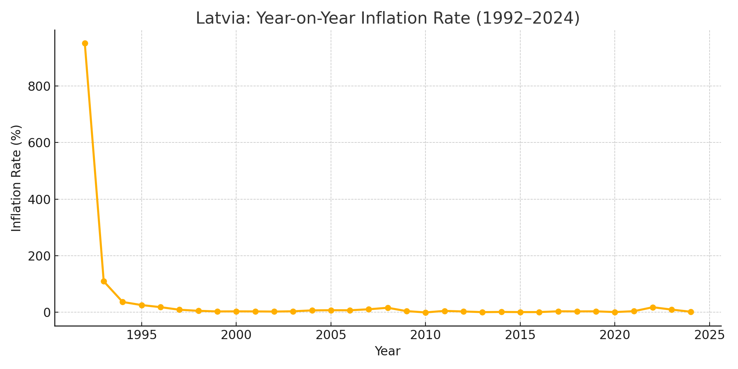
Descriptive Analysis: Overview & Historical Context
Latvia’s Year-on-Year Inflation (1992–2024)
- Target variable: “infl”, based on CPI
- Dataset: Annual macroeconomic data (33 years)
- Key explanatory variables:
• Real GDP (rGDP), Consumption (cons), Investment (inv)
• Exports & Imports (nominal + % of GDP)
• Unemployment (unemp), Monetary aggregates (M0, M1, M2)
Historical Phases of Inflation:
1. Post-Soviet Hyperinflation (1992–1995):
• 1992 inflation rate: 951.69%
• Driven by price liberalization, weak institutions
2. Stabilization & EU Integration (1996–2013):
• Inflation declined with reforms and EU accession (2004)
3. Eurozone & Global Shocks (2014–2024):
• Stability followed by spike in 2022 (17.93%)
• Caused by energy and supply chain shocks
Key Insight: Inflation reflects Latvia’s transition to a stable market economy.

Slide 2
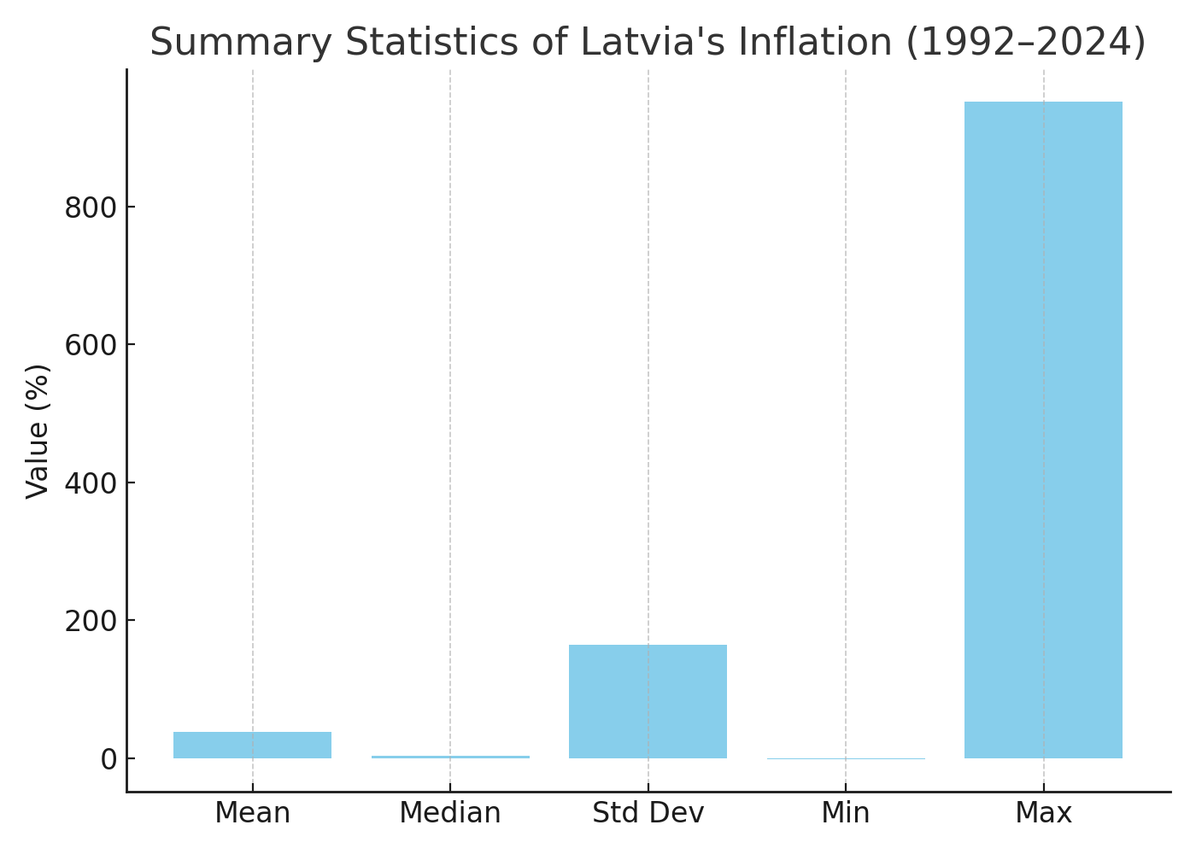
Descriptive Statistics & Modeling Implications
Inflation Summary Statistics (1992–2024):
- Mean: 38.15%
- Median: 3.28%
- Std Dev: 165.16%
- Min: –1.08% (2010)
- Max: 951.69% (1992)
Observations:
- Strong right-skew due to early hyperinflation
- High volatility in early years
Modeling Implications:
- Likely non-stationary: ADF/KPSS tests needed
- Structural breaks: 2004 (EU), 2014 (Euro) Use dummies/tests
- Missing early data (unemp, money): impute or exclude
Trending variables (GDP, M2, trade): consider differencing
Conclusion: Must account for volatility, breaks, and long-run dynamics.

Slide 3
Baseline Models: AR, ARIMA & Phillips Curve
- Latvia’s inflation is autocorrelated and likely non-stationary.
- AR or ARIMA models capture time dynamics using past values.
- AR(2) model (assignment benchmark) useful for short-run forecasting.
Limitations of ARIMA:
- Purely data-driven; ignores macroeconomic structure.
- Misses variables like unemployment or money supply.
Theory-Based: Phillips Curve
- Model: inflₜ = β₀ + β₁ · unempₜ + β₂ · inflₜ₋₁ + εₜ
- Captures inflation-unemployment-expectations link.
- Relevant in Latvia’s post-EU period as inflation expectations stabilized.
Key Insight: Use ARIMA as a benchmark, but theory-based models reveal causal structure.

Slide 4
Structural & Multivariate Models: VAR, ECM
VAR (Vector Autoregression):
- Treats inflation, rGDP, unemployment, M2 as jointly endogenous.
- Captures interactions, shocks, and feedback across variables.
- Useful for impulse response analysis.
- Risk: 33 obs, therefore overfitting if model is too large.
ECM (Error Correction Model):
- Combines long-run equilibrium with short-run adjustments.
- Relevant if inflation is cointegrated with GDP, M2, etc.
- Reflects Latvia’s EU/Euro convergence path.
Key Insight: Use ECM/VAR to build structure, but be cautious with complexity.

Slide 5
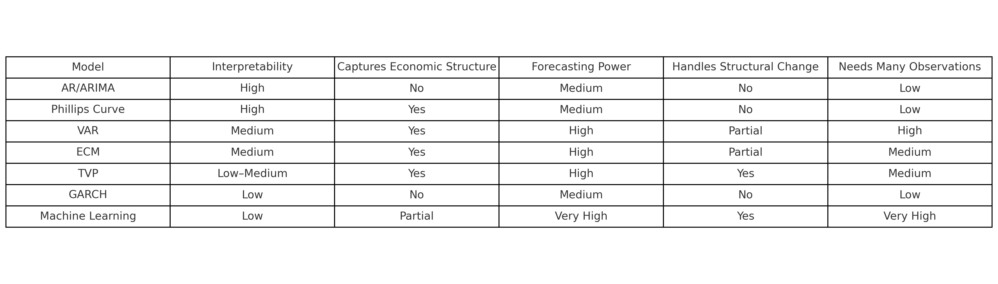
Advanced Models: TVP, GARCH & Machine Learning
TVP (Time-Varying Parameter Models):
- Parameters evolve over time to reflect policy shifts.
- Ideal for Latvia’s transition economy (1990s vs. post-Euro).
GARCH (Volatility Modeling):
- Models changing variance, not just mean.
- Suitable if residuals show volatility clustering (e.g., 2008, 2022).
Machine Learning:
- RF, SVR capture nonlinearities and complex interactions.
- High predictive power, but low interpretability.
- Best used as complementary forecasting tools.
Key Insight: Advanced tools boost robustness, especially under uncertainty.

