Slide 1
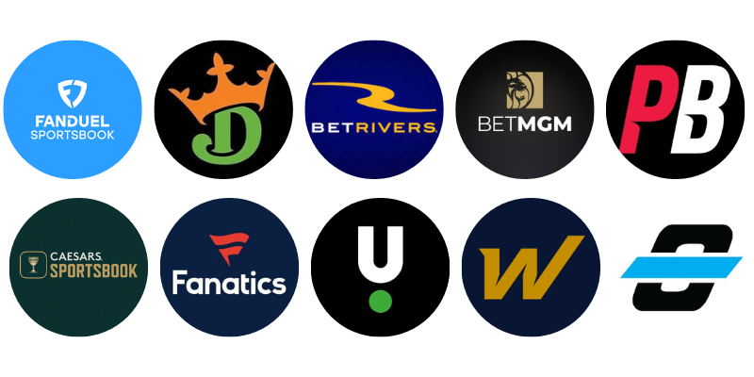
Playing the Player: Ethical Implications of Data-Driven Personalization in Sports Betting
Skylar Furey DATA 740: Governance, Bias, Ethics, and Fairness in Data Science and AI UNC Chapel Hill – July 28, 2025

Slide 2
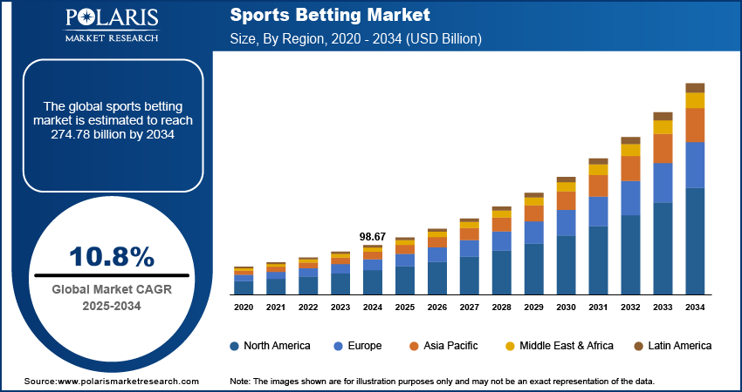
Context & Role
Who am I?
Chief Data Officer at a sports betting tech startup
Responsible for data governance, personalization, and compliance
Industry Snapshot:
Sports betting = ~$100B market
Heavy use of behavioral data + AI models for personalization

Slide 3
The Ethical Problem
Core Question: How can platforms use personalization responsibly without exploiting vulnerable users?
Challenges:
Data-driven personalization → boosts engagement but risks harm
Algorithmic bias + manipulation for profit
Vulnerable groups: compulsive gamblers

Slide 4
Ethical Matrix
Stakeholder | Autonomy | Harm Prevention | Fairness | Accountability
Users | Right to opt-in/opt-out | Protection from addiction | Equal access, no targeting of vulnerable users | Clear terms
Data Scientists | Model transparency | Minimize unintended harms | Unbiased feature engineering | Explainable ML, documentation
Investors | Informed about ethical risks | Avoid investing in harmful practices | Expect fairness in market operations | Demanding ethical compliance
Regulators | Enforce consent laws | Monitor social harm | Ensure compliance across user segments | Oversight, penalties
Mental Health Advocates | Advocate for vulnerable users | Promote addiction safeguards | Push for equal treatment of at-risk users | Public campaigns, lobbying for audits

Slide 5
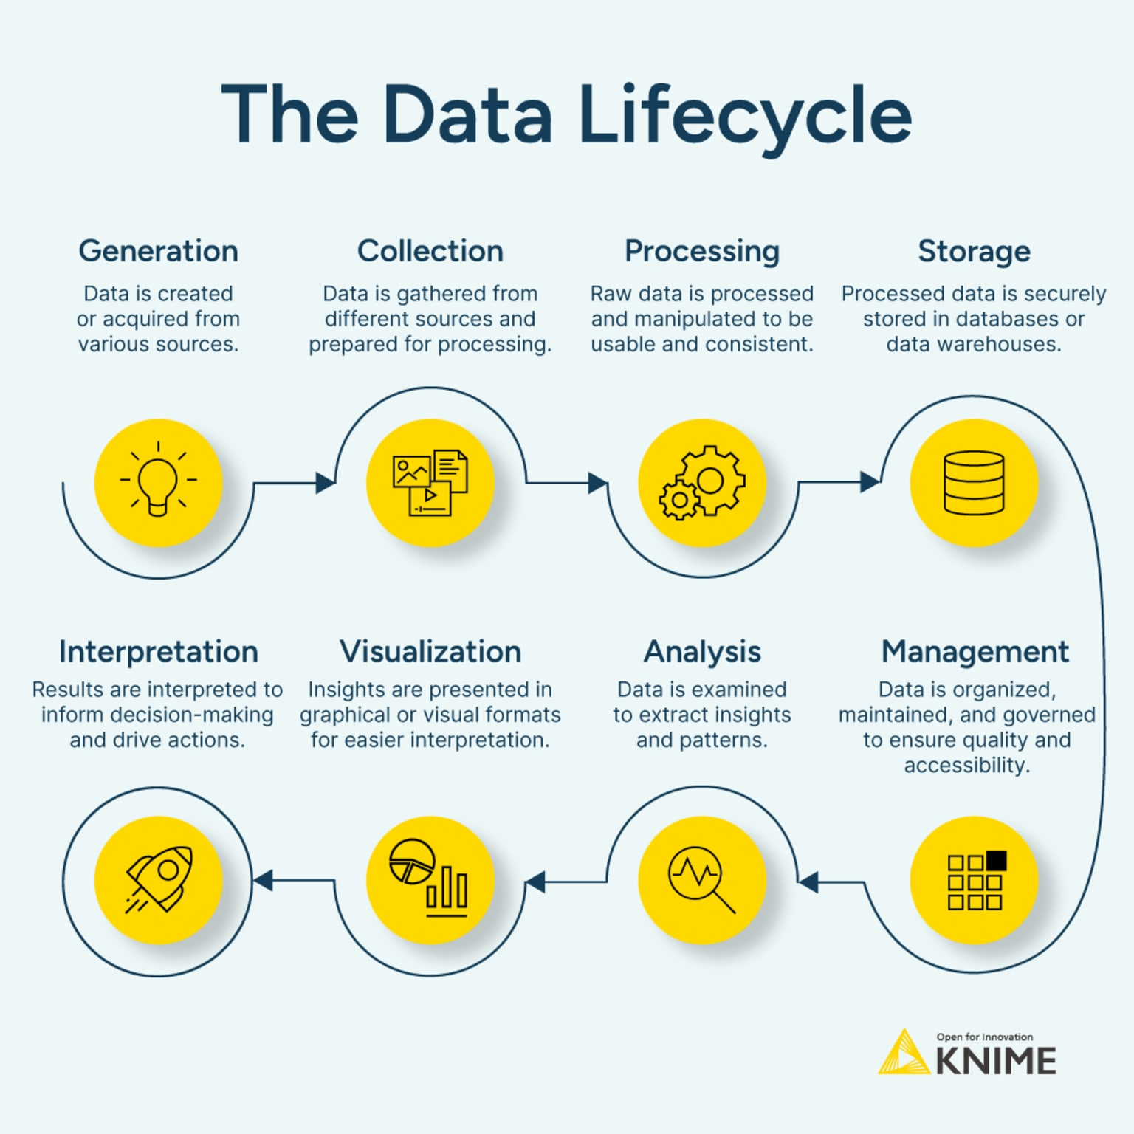
Mitigation Strategies
Data Lifecycle Safeguards:
Collection: Explicit consent, no dark patterns
Access: Role-based controls, anonymization
Modeling: Fairness-aware ML, A/B testing
Privacy: User control, opt-out standards
Governance:
Internal Ethics Board
Third-party audits
Regulatory compliance

Slide 6
Conclusion
Bottom Line:
Personalization ≠ Exploitation
Ethical foresight + strong governance → trust & sustainability
Data-driven success should be measured by responsibility, not just engagement.

