Slide 1

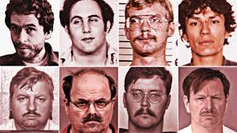
Reel to Real: Predicting Crime Rates Through Movie Ratings
Skylar Furey, Jimmy Kruse, Sivani Pillutla

Slide 2

Data
IMDb
Revenue, Budget, Genre, Runtime,
Age Rating, Critic Ratings
Posters
FBI Crime Data Explorer
2020 Census Population Data

Slide 3

Methodology
Extract features from movie posters using ResNet.
Predict state-level crime rates with a Feedforward Neural Network.
Process numerical movie data through a dense layer.
Combine the dense layer output with ResNet features.
Pass combined outputs through two additional dense layers.
Generate a regression-based estimate of monthly violent crimes for each state based on the movie's release date.

Slide 4
Results
Based on Counts:
Best Model Mean Absolute Error (MAE) = 3,921
Baseline MAE from Mean = 4,540
Range of Actual Crime Rates= 37,464
Based on Proportion of Population:
Best Model Mean Absolute Error (MAE) = 0.0328
Baseline MAE from Mean = 0.0337
Based on the data we used we could not find a good predictor for crime rates based on movie data
Notes:
Only slightly better than guessing the mean of the train dataset each time

