Slide 1
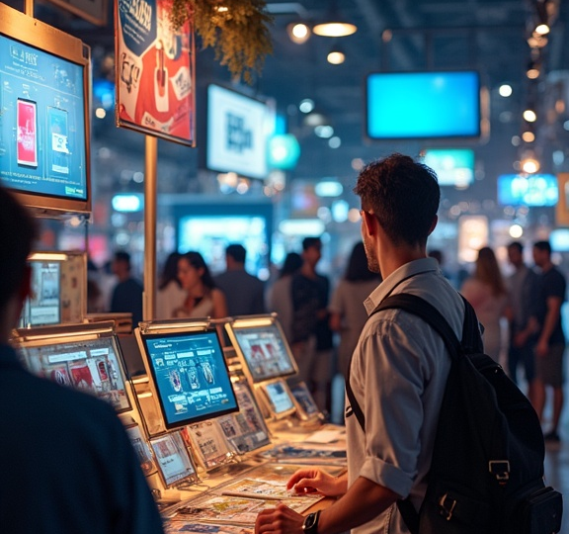
Digital Marketplace
A platform connecting honest suppliers with buyers for digital goods.

Slide 2
Introduction
The Digital Marketplace is a hybrid decentralized platform built to connect honest suppliers with digital product buyers in a secure and transparent way. It enables suppliers to upload and sell digital goods, while allowing buyers to browse, purchase, and decrypt these goods with minimal trust assumptions and cryptographic protections.
Without relying on centralized supplier verification or manual vetting, the platform uses on-chain identity, signed product data, and a reputation system to build trust between parties , the platform leverages decentralized components to enforce fairness and transparency across the transaction lifecycle:

Slide 3
Core Features & Architecture

Slide 4
Core Features & Architecture

Slide 5
1
Registration Process

Slide 6
1
Registration Process

Slide 7
Buyer Registration Steps

Slide 8
Buyer Registration Steps
The buyer registration process begins when a user connects their wallet to the platform. The system checks if the user is already registered. If not, they are prompted to enter a passphrase which will be used to generate their public/private keys. The public key is then securely stored on the blockchain, while the private key remains with the buyer. Buyers have the option to regenerate their private key using the same passphrase, ensuring security and control over their digital assets.

Slide 9
Supplier Registration Steps
Suppliers undergo a similar registration process as buyers. After connecting their wallet, they fill in necessary information that includes their digital goods details. This data is sent to the backend with a digital signature for verification. Once verified, the supplier's information is registered on the blockchain, establishing their identity and credibility as a supplier on the marketplace.

Slide 10
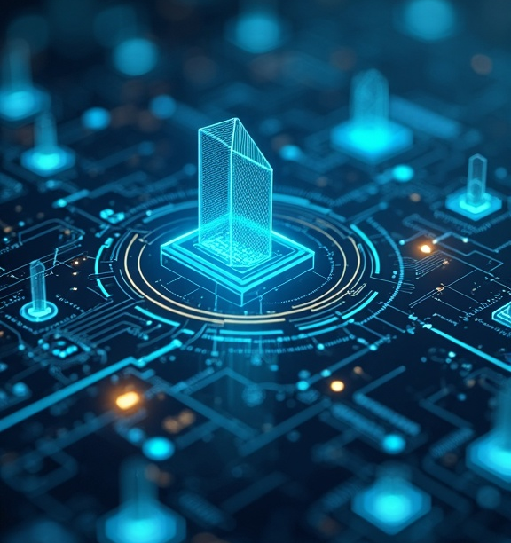
Data Validation Measures
Data validation is crucial to ensure the integrity and trustworthiness of the marketplace. After suppliers submit their registration information, the backend system conducts a thorough verification process. This includes signature validation to confirm the authenticity of the submitted data, as well as checks against existing blockchain records to prevent fraudulent activities. Any discrepancies during validation may lead to rejection of registration, ensuring that only legitimate suppliers gain access to the marketplace.

Slide 11

02
Marketplace Features

Slide 12

Product Upload Process
Once verified, suppliers gain access to their dashboard where they can upload digital goods to the marketplace. The product upload process is user-friendly; suppliers are guided through each step, including providing product descriptions, uploading files, and setting pricing. Each product is linked to the supplier's profile, enhancing visibility for potential buyers. The system also incorporates encryption and secure storage solutions to protect the digital goods until purchased.

Slide 13
Transaction Mechanism
The transaction mechanism ensures a secure and efficient payment process. When a buyer selects a product and initiates a purchase, the supplier must first confirm the transaction by specifying the product ID and completing a CAPTCHA for security purposes. Once the supplier approves, the transaction structure is initiated on the blockchain. The buyer then makes payment to a Secure Delivery smart contract, which safeguards funds until the transaction concludes successfully.

Slide 14
User Ratings and Reputation Management
To foster trust within the marketplace, a user rating system allows buyers to leave feedback on their purchased products. This optional feature enables buyers to rate their experience and interactions with suppliers. The ratings contribute to a supplier's reputation score, influencing their credibility on the platform. New suppliers must demonstrate a satisfactory number of completed transactions and maintain a positive reputation score to qualify for immediate payment processing, ensuring high standards within the marketplace.

Slide 15
Conclusions

Slide 16
Thank you!
Do you have any questions?
+00 000 000 000

