Slide 1




Project
Presentation

Slide 2
404_FOUND
▪︎ Prranav Babbar
▪︎ Pratham Bansal
▪︎ Sarthak Maheshwari
▪︎ Shreyansh
▪︎ Vasuman Garg

Slide 3
INTRODUCTION
In modern cloud environments, monitoring and observability are crucial for keeping applications running smoothly. In this hackathon, your challenge is to create a basic cloud monitoring tool. It will collect, process, and display logs and metrics from a Kubernetes cluster (control plane as well as pods).

Slide 4
Background
In modern cloud environments, monitoring and observability are crucial for keeping applications running smoothly. In this hackathon, your challenge is to create a basic cloud monitoring tool. It will collect, process, and display logs and metrics from a Kubernetes cluster (control plane as well as pods).

Slide 5

Problem statement
The goal is to develop a comprehensive monitoring solution for a Minikube Kubernetes cluster that hosts applications using PostgreSQL and MySQL databases. This solution needs to efficiently collect and authenticate logs from the applications and databases, process them through a backend service, and store the data in a time series database. Furthermore, it should provide a custom dashboard for visualization, featuring capabilities such as search and filtering of logs, as well as real-time monitoring of database performance metrics. The solution aims to enhance observability and facilitate proactive management of the cluster's resources and application performance.

Slide 6
Goals
Implement a system to efficiently collect and process logs from Kubernetes pods and databases in real-time, ensuring seamless data ingestion and reliable message handling for scalability and fault tolerance.
Build a custom dashboard to visualize logs and metrics, offering features like filtering by hostname and timestamp, along with comprehensive visual insights into system performance, error rates, and traffic.

Slide 7
Proposed solution
Use Logstash to gather logs from the Kubernetes pods running in Minikube, and push them into a RabbitMQ queue for reliable message handling. Consumers will retrieve logs from RabbitMQ, process them, and store them in Elasticsearch, allowing for efficient indexing, search, and analytics of the logs.
Develop a backend service to fetch logs from Elasticsearch, with filtering capabilities based on hostname and timestamp. Build a custom dashboard to visualize logs and key metrics, providing search and filtering features.

Slide 8
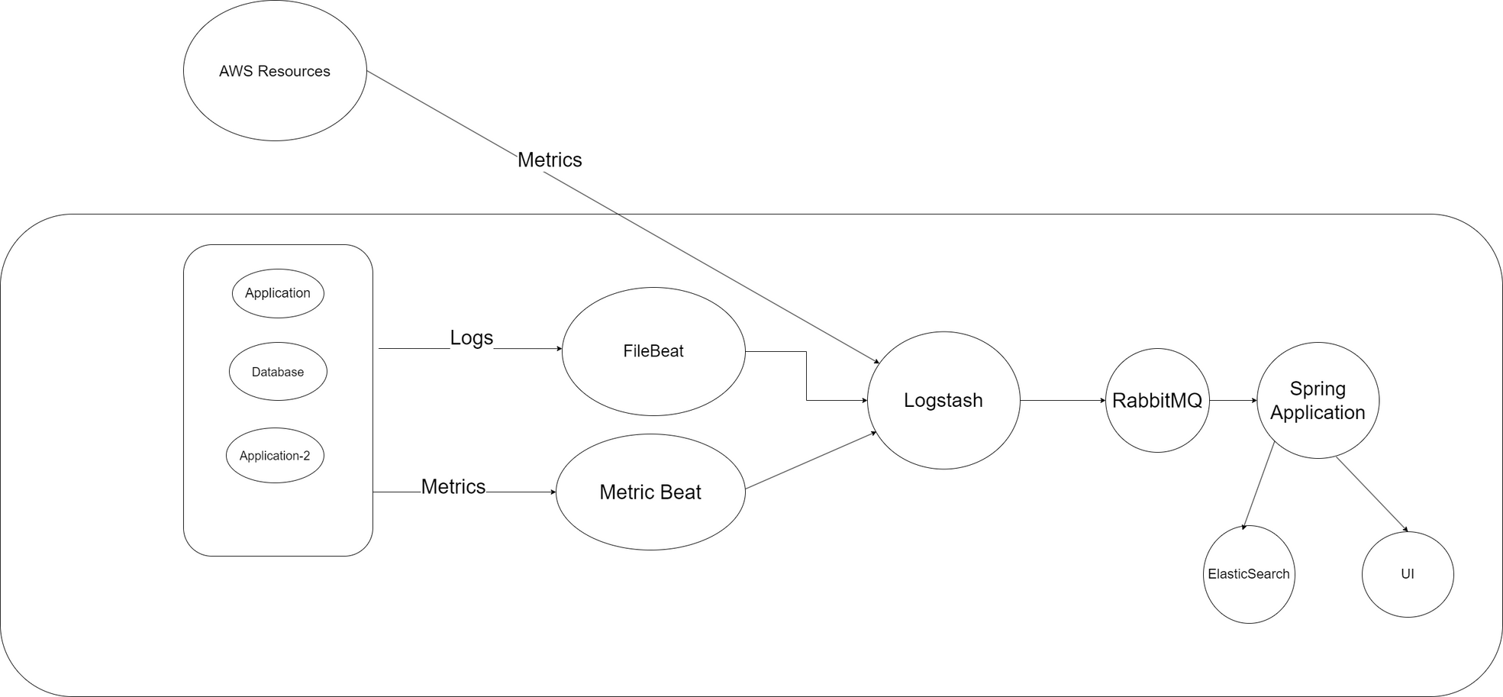
architecture

Slide 9
Discussion
The solution leverages Logstash for flexible log collection and real-time data processing, while RabbitMQ ensures reliable, scalable message queuing between producers and consumers. Elasticsearch is ideal for log storage and fast querying due to its full-text search and analytics capabilities. A custom dashboard offers tailored log visualization with filtering by hostname and timestamp

Slide 10


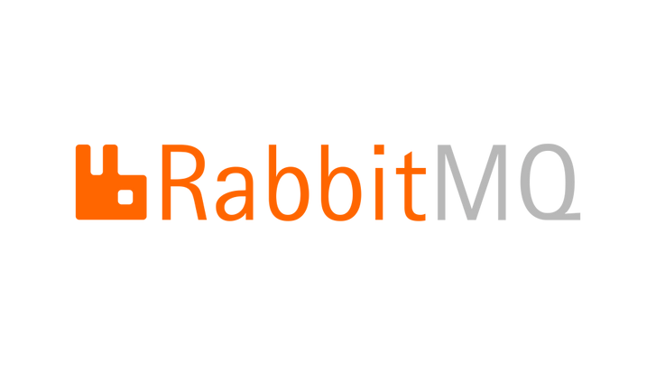


Technologies used

Slide 11
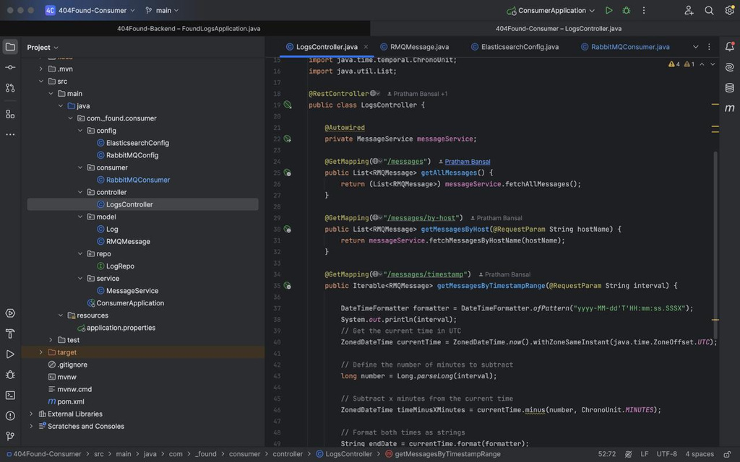
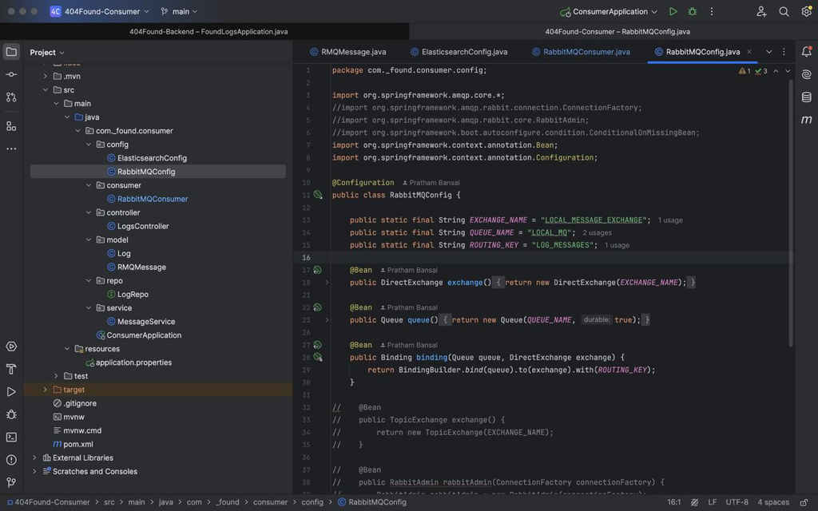

Slide 12
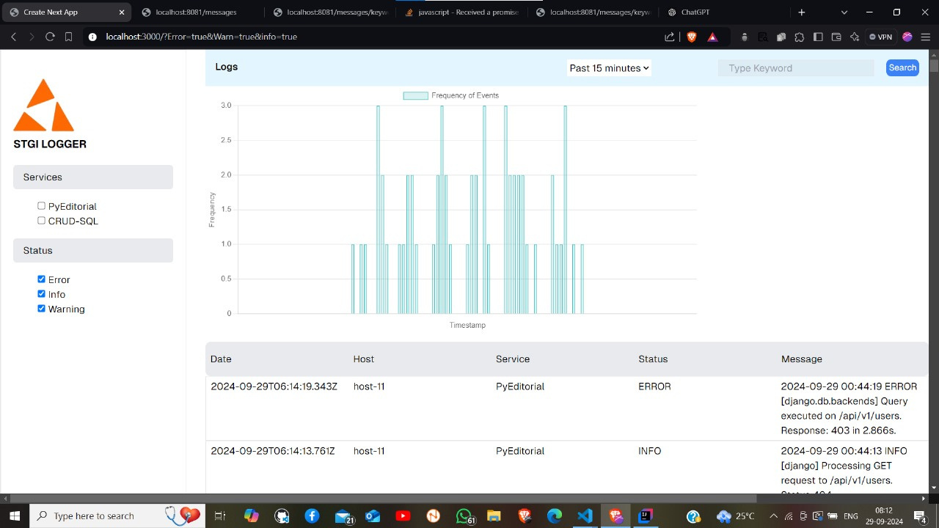

Slide 13
Pros
1. Real-time Log and Metrics Collection: Using Filebeat and Metricbeat ensures timely collection of logs and metrics, allowing real-time monitoring and issue detection.
2. Scalable Architecture: RabbitMQ provides reliable message queuing and asynchronous communication, making the solution scalable and capable of handling large log volumes.
3. Flexible Log Processing: Logstash offers flexibility in parsing and transforming logs, allowing customization of log pipelines to meet specific requirements.
4. Centralized Data Storage: Elasticsearch enables efficient log and metrics storage with powerful full-text search, making querying fast and simple.

Slide 14
Pros
5. Customizable Filtering and Visualization: The Spring Boot application provides customizable APIs for filtering logs by hostname, timestamp, and other parameters, while the React frontend offers a tailored and user-friendly interface for visualization.
6. Enhanced Observability with Metrics: Extending the solution with Metricbeat and AWS integration offers comprehensive monitoring by combining logs and performance metrics, providing deeper insights into system health and performance.
7. Cloud Integration: AWS resource metrics and logs can be seamlessly integrated into the system, ensuring unified observability across cloud and on-premise environments.
8. Routing Flexibility: RabbitMQ’s routing keys allow fine-grained control over how logs and metrics are processed, enabling separate processing pipelines for different types of data.

Slide 15
Conclusion
This solution aims to address the challenge of monitoring logs and metrics for applications running in a Kubernetes cluster with PostgreSQL and MySQL databases. By leveraging Logstash for real-time log collection, RabbitMQ for reliable message queuing, and Elasticsearch for fast log storage and querying, the system ensures efficient log handling. The custom-built dashboard provides powerful filtering and visualization, allowing users to track critical metrics and performance insights.

Slide 16
Thank You

