Slide 1




STGI H CKATHON
TEAM: PEACEMAKERS
Ankit Sharma
Aaersh Kumar
Saurabh Pandey
Vaibhav

Slide 2
PROBLEM STATEMENT
INFRA MONITORING
FOR CLOUD

Slide 3




PROPOSED SOLUTION
PODS ACCESS
1
ACCESS LOGS
Creating pods on Kubernetes cluster through docker
2
FILTER LOGS
Acessing logs in node.Js through API,
from the derived cluster.
3
Compressing the logs using G-zip

Slide 4


PROPOSED SOLUTION
STORING LOGS IN DATABASE
4
FRONTEND DASHBOARD
Storing compressed logs in InfluxDB using Node.js server
5
Used React for frontend to visualize and display logs in form of tables and charts

Slide 5
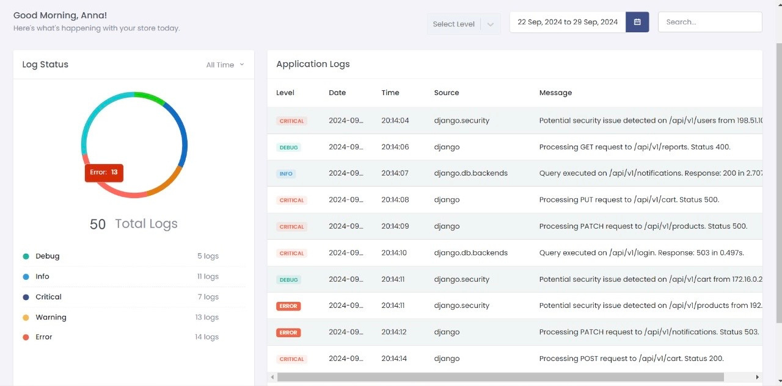
DASHBOARD

Slide 6
PROVIDED FILTER BASED ON DATE AND LEVEL AS A FUNCTIONALITY

Slide 7
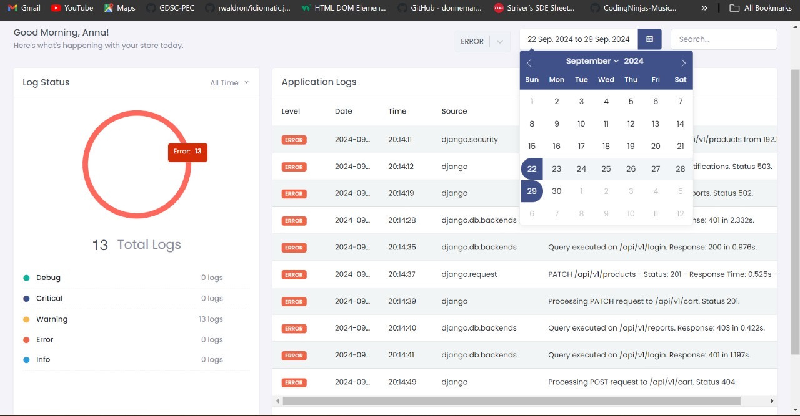

Slide 8
FUTURE IMPLICATION
Scalability and Performance
1
Implementing data sharding or partitioning in InfluxDB to manage larger datasets efficiently
Machine Learning Integration
2
Using ML Algorithms to analyze log patterns and identify anomalies or predict potential issues

Slide 9
Thanks!!

