Slide 1
Automated Refactoring for Asynchronous Applications
Bachelor thesis
Author:
Grebiel José Ifill Brito
Supervisor:
Prof. Dr. Guido Salvaneschi
Reactive Programming Technology
Notes:
7/10/16
|
| <number>

Slide 2
Motivation
1) Motivation 2) Contribution 3) Refactoring Approach
4) Evaluation 5) Conclusions
Functional & Reactive Programming →
                facilitates writing and comprehension
Asynchronous applications (Callback based) → not trivial
What about existing applications ? → Refactoring!
Refactoring is tedious → Automated ☺
Notes:
7/10/16
|
| <number>

Slide 3
Contribution
1) Motivation 2) Contribution 3) Refactoring Approach
4) Evaluation 5) Conclusions
Refactoring approach to convert SwingWorkers into RxJava
  SwingWorker async construct for Swing applications
System to host refactoring tools (2Rx)
Client of 2Rx: SwingWorker2Rx
Client of 2Rx: AsyncTask2Rx (based on RxFactor)
Notes:
7/10/16
|
| <number>

Slide 4
SwingWorker
1) Motivation 2) Contribution 3) Refactoring Approach
4) Evaluation 5) Conclusions
Notes:
- 3 main methods
doInBackground
process
done
- explain diagram
7/10/16
|
| <number>

Slide 5
Juneiform (before refactoring)
1) Motivation 2) Contribution 3) Refactoring Approach
4) Evaluation 5) Conclusions
Notes:
7/10/16
|
| <number>

Slide 6
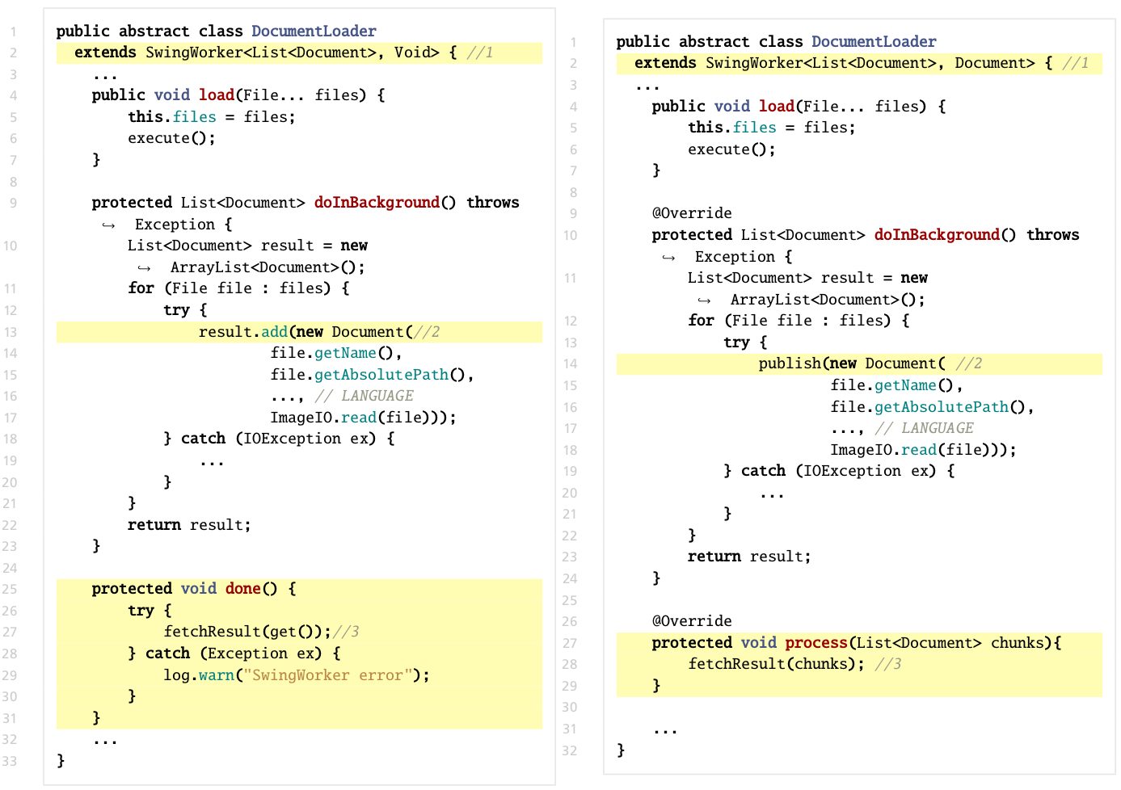
DocumentLoader - Pre-Processing
1) Motivation 2) Contribution 3) Refactoring Approach
4) Evaluation 5) Conclusions
Notes:
7/10/16
|
| <number>

Slide 7
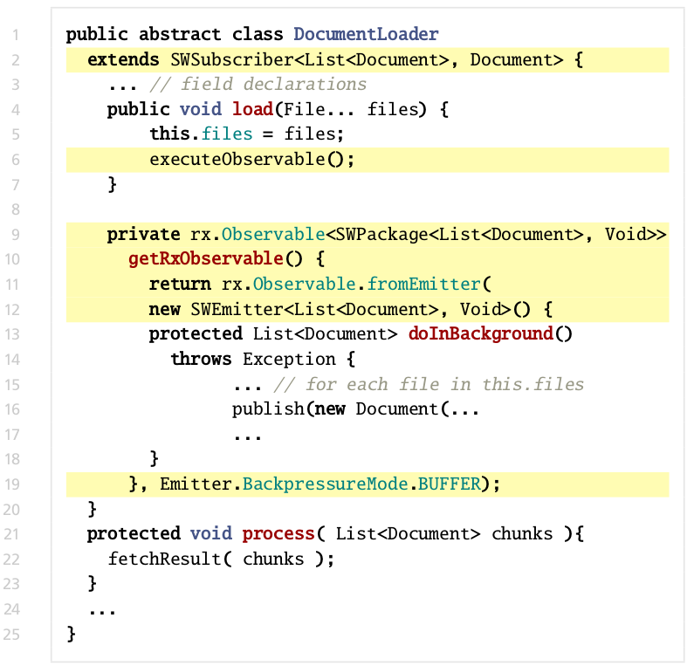
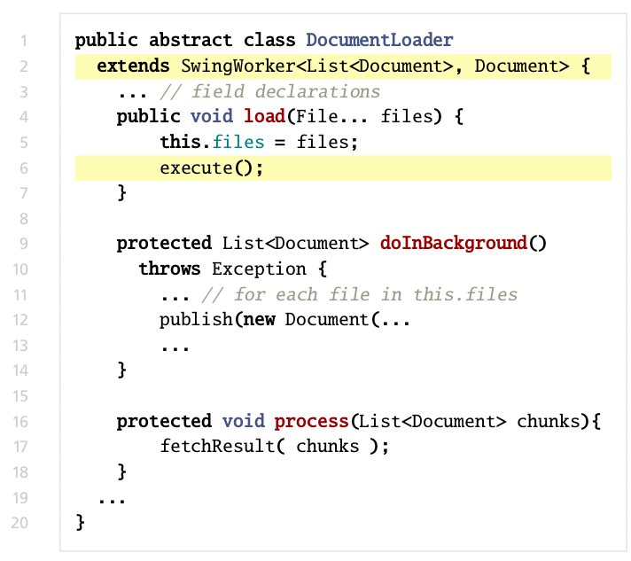
DocumentLoader – Automated Refactoring
1) Motivation 2) Contribution 3) Refactoring Approach
4) Evaluation 5) Conclusions
Observer
(Subscriber)
Same Semantic
Subject (Observable)
Notes:
7/10/16
|
| <number>

Slide 8
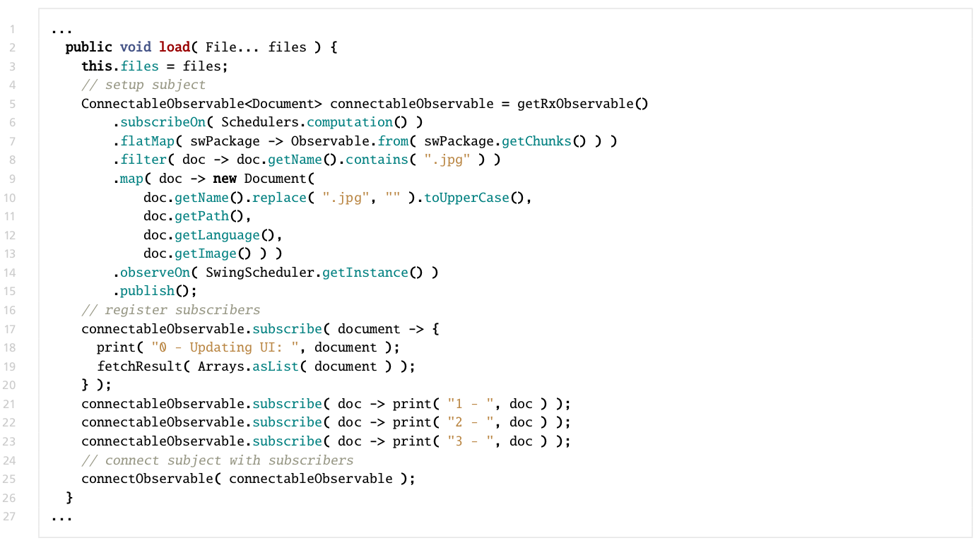
DocumentLoader – Functional & Reactive Programming
1) Motivation 2) Contribution 3) Refactoring Approach
4) Evaluation 5) Conclusions
Notes:
7/10/16
|
| <number>

Slide 9
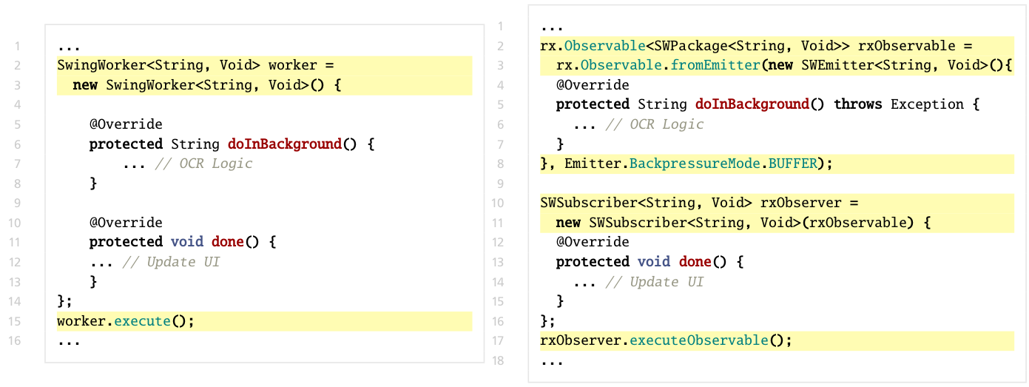
Editor – Automated Refactoring
1) Motivation 2) Contribution 3) Refactoring Approach
4) Evaluation 5) Conclusions
Same Semantic
Subject (Observable)
Observer
(Subscriber)
Notes:
7/10/16
|
| <number>

Slide 10
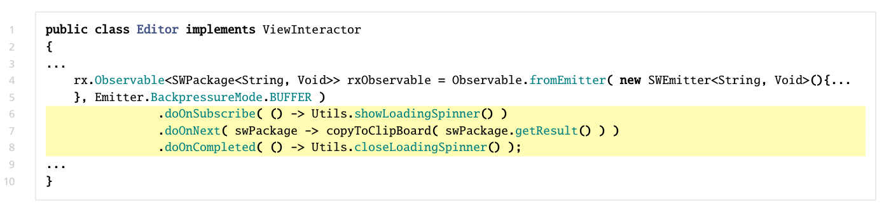
Editor – Functional Programming
1) Motivation 2) Contribution 3) Refactoring Approach
4) Evaluation 5) Conclusions
Notes:
7/10/16
|
| <number>

Slide 11
Juneiform (after refactoring and adding features)
1) Motivation 2) Contribution 3) Refactoring Approach
4) Evaluation 5) Conclusions
Application
Console
Text Editor
Notes:
7/10/16
|
| <number>

Slide 12
SwingWorker
1) Motivation 2) Contribution 3) Refactoring Approach
4) Evaluation 5) Conclusions
Observer
(Subscriber)
Observable
Notes:
7/10/16
|
| <number>

Slide 13
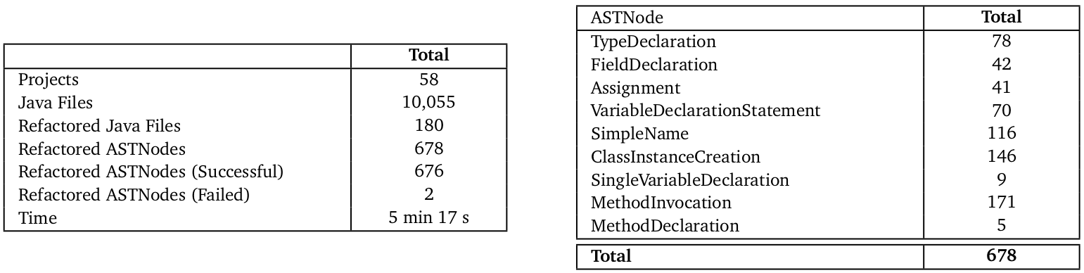
Evaluation - Accuracy
1) Motivation 2) Contribution 3) Refactoring Approach
4) Evaluation 5) Conclusions
Unit tests: 1 project
Runtime tests: 10 projects
Code inspections: 47 projects
Approximately 99,7% accuracy
Notes:
7/10/16
|
| <number>

Slide 14
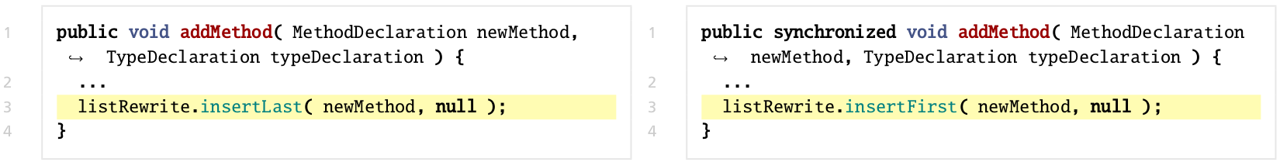
Evaluation - Extensibility
1) Motivation 2) Contribution 3) Refactoring Approach
4) Evaluation 5) Conclusions
RxFactor → AsyncTask2Rx
34 Projects, 24 ASTNodes
diff -r RxFactor/ AsyncTask2Rx/ -x *.classpath -x *.project -x *.jar -x *.class -x *.cache -x gen
  1 file differs
RxFactor
AsyncTask2Rx
Notes:
7/10/16
|
| <number>

Slide 15
Conclusions
1) Motivation 2) Contribution 3) Refactoring Approach
4) Evaluation 5) Conclusions
Functional and Reactive programming facilitates code writing and code comprehension.
Refactoring SwingWorkers to RxJava manually takes time.
SwingWorker2Rx can refactor SwingWorkers automatically.
The evaluation shows that …
  SwingWorker2Rx is accurate
  2Rx is extensible
Notes:
7/10/16
|
| <number>

Slide 16
Questions
Refactoring Approach ? ( 6 slides )
  Structure (UML Class Diagram)
  Dynamic (Sequence Diagram)
2Rx & SwingWorker2Rx ? ( 3 slides )
  Dynamic (Sequence Diagram)
Future Work ? ( 7 slides )
  Further constructs
  2Rx: New Features
  SwingWorker2Rx: Improvements
Limitations ? ( 2 slides )
Other questions are also welcome…
( but no slides☺)
Notes:
7/10/16
|
| <number>

Slide 17
← Questions
Refactoring Approach
Notes:
7/10/16
|
| <number>

Slide 18
RxJava and Extension Classes
← Questions
UML Class Diagram
(next slide)
Notes:
7/10/16
|
| <number>

Slide 19
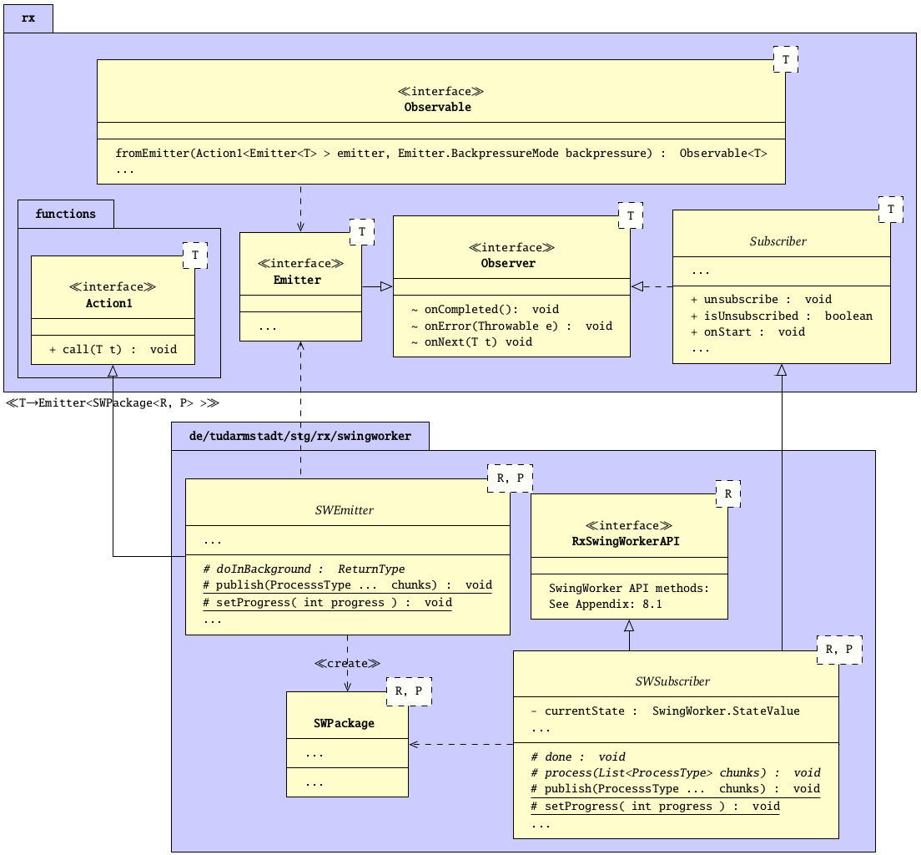
← Questions
1) Motivation 2) Contribution 3) Refactoring Approach 4) 2Rx & SwingWorker2Rx
5) Evaluation 6) Future Work 7) Conclusions
Notes:
7/10/16
|
| <number>

Slide 20
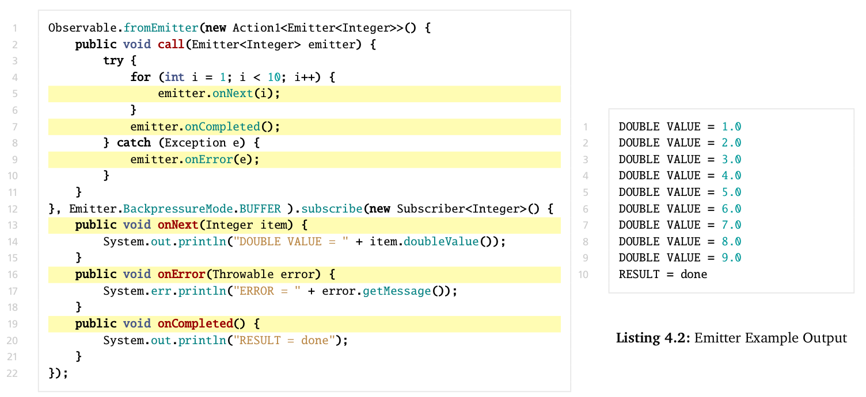
Observable & Subscriber Example
← Questions
Subject (Observable)
Observer (Subscriber)
Notes:
7/10/16
|
| <number>

Slide 21
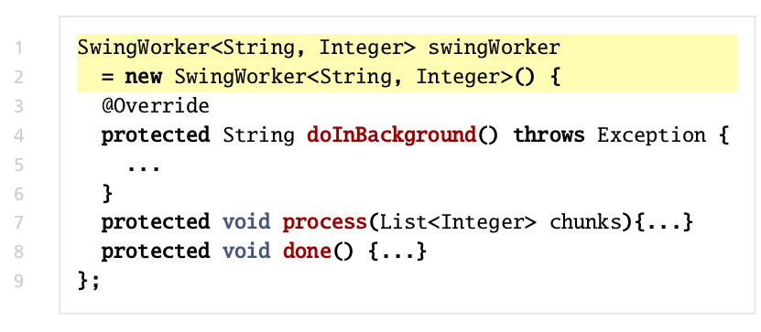
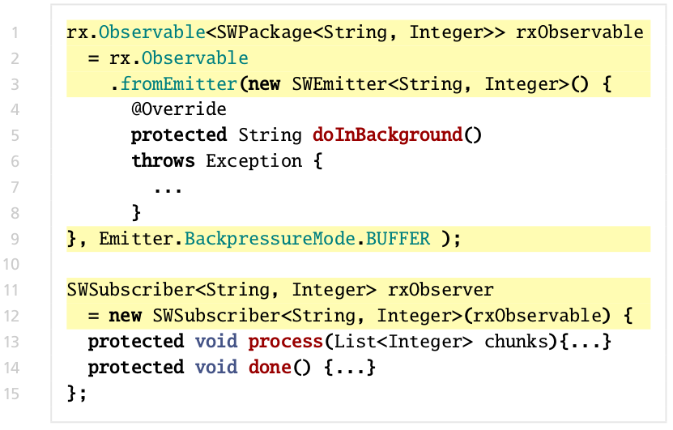
Source Code: Before vs. After Refactoring
← Questions
Class Instance Creation
Subject (Observable)
Observer
(Subscriber)
Notes:
7/10/16
|
| <number>

Slide 22
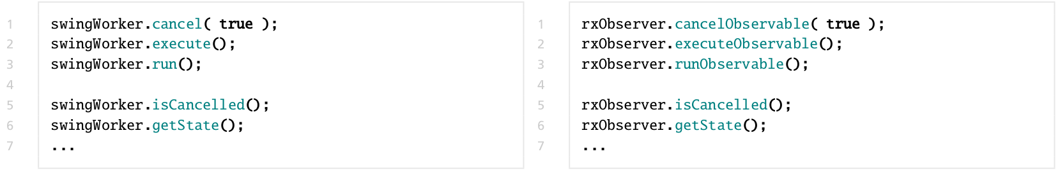
Source Code: Before vs. After Refactoring
← Questions
Method Invocations
Notes:
7/10/16
|
| <number>

Slide 23
RxJava Extension for SwingWorkers (I)
← Questions
Observable
Observer
?
unlock
Notes:
7/10/16
|
| <number>

Slide 24
RxJava Extension for SwingWorkers (II)
← Questions
Observer
Observable
Notes:
7/10/16
|
| <number>

Slide 25
← Questions
2Rx & SwingWorker2Rx
Notes:
7/10/16
|
| <number>

Slide 26
ASTNodes - ASTView
← Questions
Notes:
7/10/16
|
| <number>

Slide 27
2Rx & SwingWorker2Rx
← Questions
Notes:
7/10/16
|
| <number>

Slide 28
2Rx & SwingWorker2Rx
← Questions
Notes:
7/10/16
|
| <number>

Slide 29
← Questions
Future Work
Notes:
7/10/16
|
| <number>

Slide 30
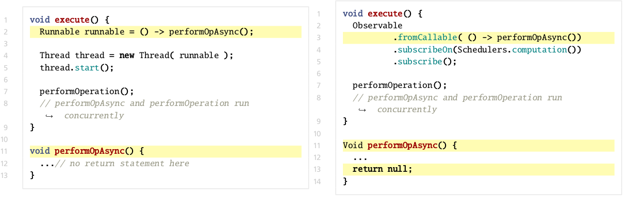
Future Work
← Questions
Further async constructs
Notes:
7/10/16
|
| <number>

Slide 31
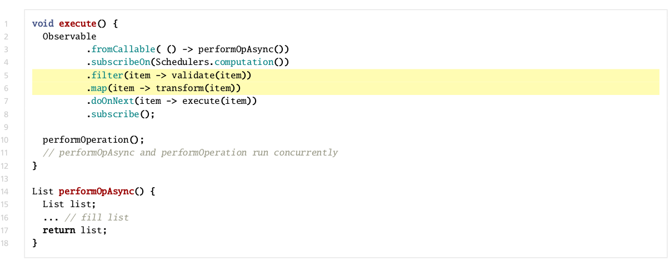
Future Work
← Questions
Further async constructs
Notes:
7/10/16
|
| <number>

Slide 32
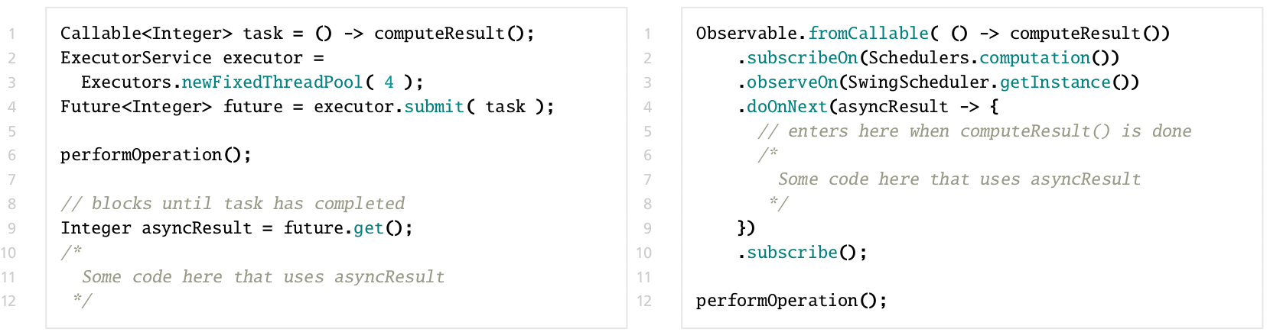
Future Work
← Questions
Further async constructs
Notes:
7/10/16
|
| <number>

Slide 33
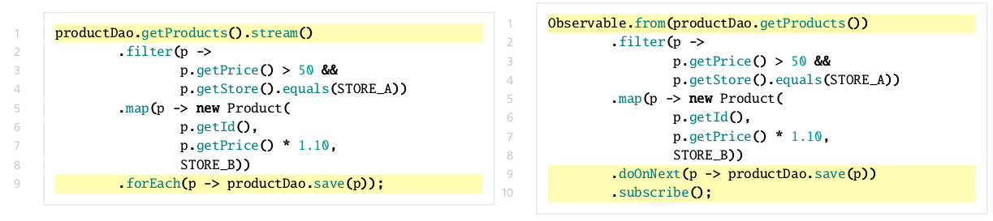
Future Work
← Questions
Java 8 and Functional Programming
Notes:
7/10/16
|
| <number>

Slide 34
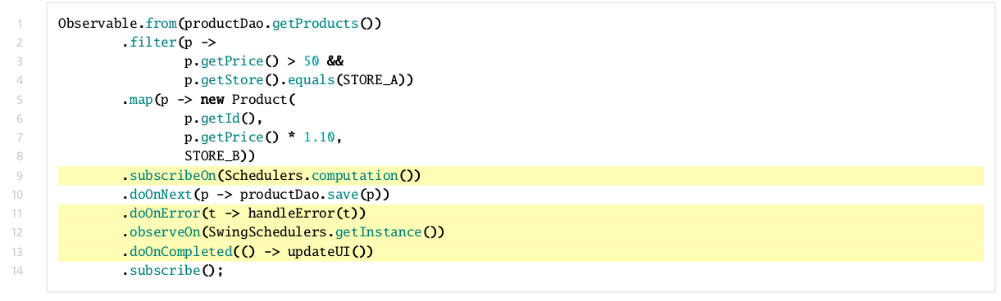
Future Work
← Questions
Java 8 and Functional Programming
Notes:
7/10/16
|
| <number>

Slide 35
Future Work
← Questions
2Rx
UNDO feature
Cancel or Stop button
Settings
...
Notes:
7/10/16
|
| <number>

Slide 36
Future Work
← Questions
RxJava Extension for SwingWorkers
Implement buffer to avoid blocking the Observable on each publish invocation.
?
unlock
Notes:
7/10/16
|
| <number>

Slide 37
← Questions
Limitations
Notes:
7/10/16
|
| <number>

Slide 38
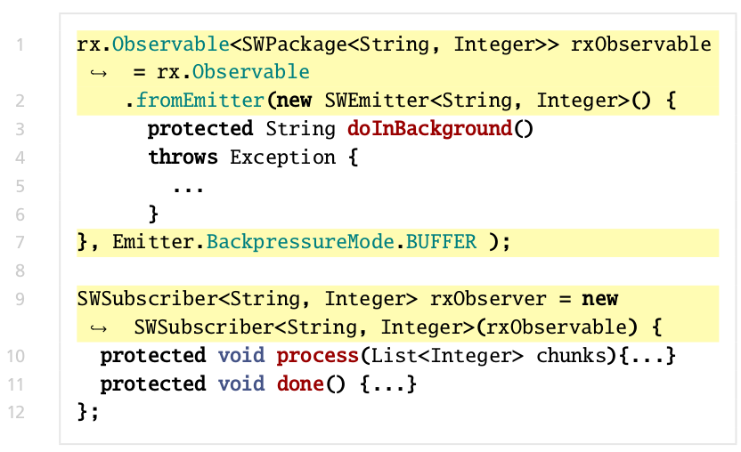
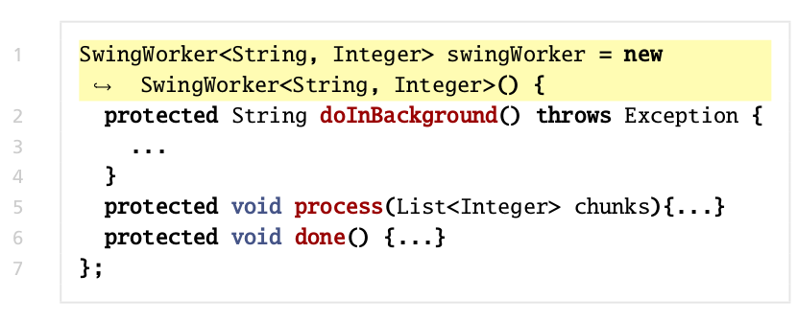

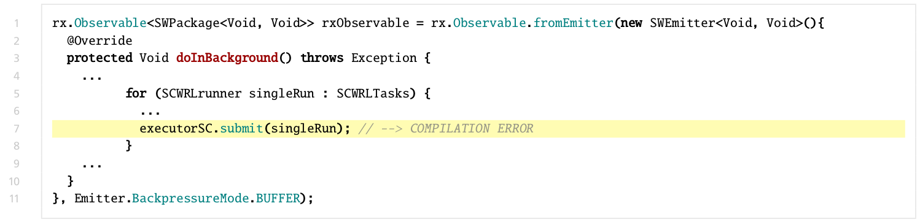
Limitations
← Questions
Nested SwingWorkers
Another SwingWorker here
SingleRun: instance of SWSubscriber
Notes:
7/10/16
|
| <number>

Slide 39
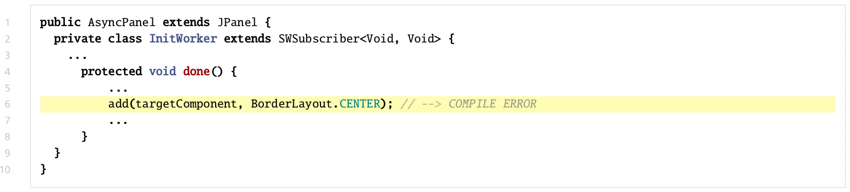
Limitations
← Questions
Name clashes
Originally a SwingWorker
Notes:
7/10/16
|
| <number>

