Slide 1

Software Engineering Design & Construction
Winter Semester 16/17
Dr. Michael Eichberg
Fachgebiet Softwaretechnik
Technische Universität Darmstadt
Open-Closed Principle

Slide 2
Open-Closed Principle
Software entities (classes, modules, functions, components, etc.) should be open for extension, but closed for modifications.
– Object-Oriented Software Construction; 2nd Edition; Bertand Meyer,1997
–Agile Software Development; Robert C. Martin; Prentice Hall, 2003
Notes:
Extension: Extending the behavior of a module.
Modification: Changing the code of a module.
Open for extension means that when requirements of the application change, we can extend the module with new behaviors that reflect those changes. We change what the module does.
Closed for modification means that changes in behavior do not result in changes in the module's source or binary code.

Slide 3
Reasons for closing modules against changes/for making modules open for extension
The module was delivered to customers and a change will not be accepted. If you need to change something later, hopefully you opened your module for extension!
The module is a third-party Library/Framework and only available as binary code. If you need to change something, hopefully the third-party opened the module for extension!
Not having to change existing code means modular compilation, testing and debugging.

Slide 4

To enable extending an entity without modifying it, abstract over subparts of its behavior.
Abstraction is the Key
Notes:
Many programming languages allow to create abstractions that are fixed and yet represent an unbounded group of possible behaviors!
Different kinds of abstraction mechanisms exist:
Object-oriented languages
abstractions are encoded in abstract base classes resp. interfaces.
unbounded group of possible behaviors is represented by all the possible derivative classes resp. implementations.
Functional languages
abstractions are encoded in function types.
unbounded group of possible behaviors is represented by all the possible first-class functions of the declared type.
In the following, we shortly discuss the two main ways of abstracting over variability in object-oriented programs.

Slide 5
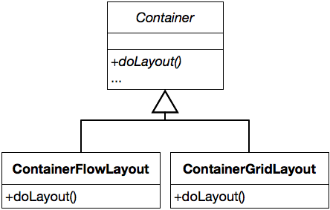
Abstracting Over Variations
Notes:
Container declares the layout functionality but does not implement it. The rest of Container is implemented against the abstraction.
Concrete subclasses fill in the details over which Container’s implementation abstract.

Slide 6
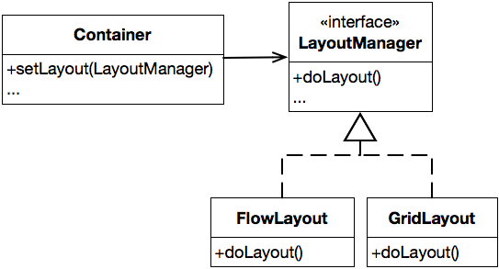
Abstracting Over Variations
Notes:
Container delegates the layout functionality to an abstraction. The rest of its functionality is implemented against this abstraction.
To change the behavior of an instance of Container we configure it with the LayoutManager of our choice.
We can add completely new behavior by implementing our own LayoutManager.

Slide 7
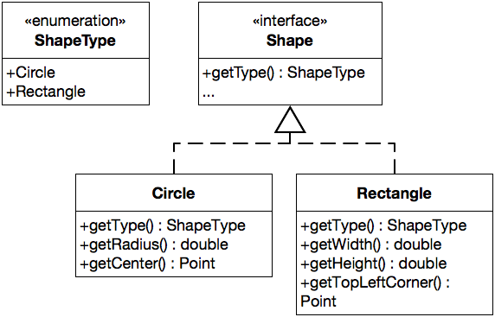
A Possible Design for Drawable Shapes
Drawing is implemented in separate methods (e.g., of class Application).
Notes:
Each Shape identifies itself via the enumeration ShapeType.
Realizations of Shape declare specialized methods for the shape type they represent.
(Such a design may be desirable, because you don’t want to pollute the interface of Shape/you want to have a SRP compliant solution.)

Slide 8
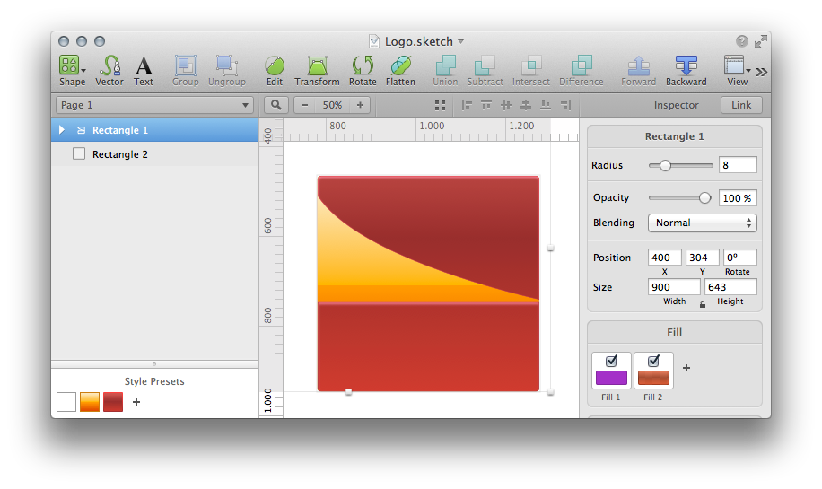
Consider an application that draws shapes - circles and rectangles – on a standard GUI.

Slide 9
Implementation of the Drawing Functionality
class Application {
public void drawAllShapes(List<Shape> shapes) {
for(Shape shape : shapes) {
switch(shape.getType()) {
case Circle:
drawCircle((Circle)shape);
break;
case Rectangle:
drawRectangle((Rectangle)shape);
break;
} } }
private void drawCircle(Circle circle) { ... }
private void drawRectangle(Rectangle rectangle) { ... }
}
Notes:
Does this design conform to the open-closed design principle?
Evaluating the proposed design
Adding new shapes is hard, we need to:
Implement a new realization of Shape.
Add a new member to ShapeType. This possibly leads to a recompile of all other realizations of Shape.
drawAllShapes (and every method that uses shapes of different types) must be changed. We have to hunt for every place that contains conditional logic that distinguishes between types of shapes and we have to add code to it.
drawAllShapes is hard to reuse! When we reuse it, we have to bring along Rectangle and Circle.

Slide 10
Assessing Designs
Rigid designs are hard to change – every change causes many changes to other parts of the system.
Fragile designs tend to break in many places when a single change is made.
Immobile designs contain parts that could be useful in other systems, but the effort and risk involved with separating those parts from the original system are too big.
Some
Terminology
Notes:
I.e., when we want to evaluate a design, we can ask ourselve: Does it show signs of rigidity, fragility or immobility?

Slide 11
Evaluating the Design
Our design is rigid, fragile and immobile.
The proposed design violates the open-closed design principle with respect to extensions with new kinds of shapes.
We need to close our module against this kind of change by building appropriate abstractions.
class Application {
public void drawAllShapes(List<Shape> shapes) {
for(Shape shape : shapes) {
switch(shape.getType()) {
case Circle:
drawCircle((Circle)shape);
break;
case Rectangle:
drawRectangle((Rectangle)shape);
break;
} } }
private void drawCircle(Circle circle) { ... }
private void drawRectangle(Rectangle rectangle) { ... }
}
Notes:
Assessing our design w.r.t. its rigidity, fragility and immobility:
Our example design is rigid: Adding a new shape causes many existing classes to be changed.
Our example design is fragile: Many switch/case (if/else) statements that are both hard to find and hard to decipher.
Our example design is immobile: drawAllShapes and drawXXX is hard to reuse.

Slide 12
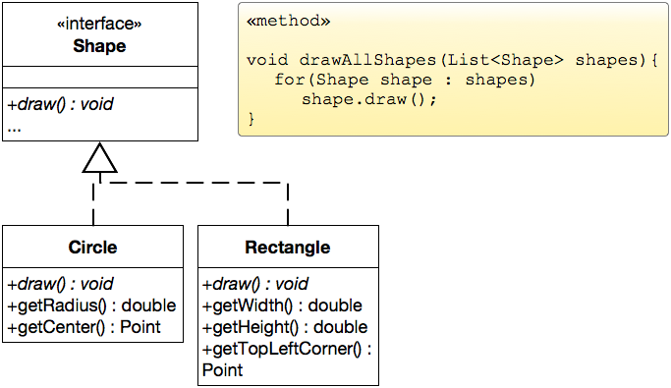
Refined Design for Drawable Shapes
Notes:
Makes adding new shapes possible without modification. We just need to implement a new realization of Shape.
drawAllShapes only depends on Shape. We could reuse it unchanged; however, it has become so trivial that there is no immediate need.
But, now Shape has two responsibilities: a “knowing” and a “doing” responsibility.

Slide 13
Evaluating the Extensibility
Refined Design for Drawable Shapes
This solution complies to the open-closed design principle.
Notes:
Do ask yourself whether this unconditional statement is true!

Slide 14


Evaluating the Extensibility
Refined Design for Drawable Shapes
This solution complies to the open-closed design principle.
These abstractions are more of an hindrance to several other kinds of changes.
Notes:
The statement: “This solution complies to the open-closed design principle.” is – of course – not unconditionally correct. It is not possible to be open for all kinds of extension and also be closed for modification.
Examples of other types of extensions:
Consider extending the design with further shape functions:
shape transformations, shape dragging, …
calculating the intersection or union of shapes, etc.
Consider adding support for different operating systems. The implementation of the drawing functionality varies for different operating systems.

Slide 15
Abstractions May Support or Hinder Change!
Change is easy if change units correspond to abstraction units.
Change is tedious if change units do not correspond to abstraction units.
Notes:
In our example, adding a new type of Shape is easy as it is directly supported by inheritance and subtyping.

Slide 16
Abstractions Reflect a Viewpoint
No matter how “closed” a module is, there will always be some kind of change against which it is not closed.
Notes:
In general, there is no model that is natural to all contexts.

Slide 17
Imagine: Development of a "Zoo Software"
On the "Natural" Model Structure
Three stakeholders:
Veterinary surgeon:What matters is how animals reproduce!
Trainer: What matters is the intelligence!
Keeper: What matters is what they eat!

Slide 18
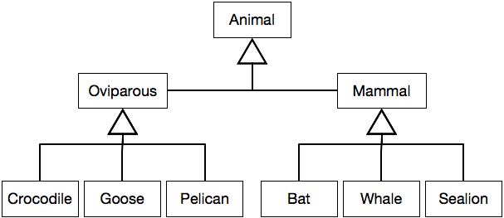
One Possible Class Hierarchy When Modeling Animals
Notes:
Do you see a problem? (In other words: whose viewpoint was chosen?)
When we consider the classes Oviparous and Mammal it is obvious that the class hierarchy reflects the veterinary surgeon's understanding.

Slide 19
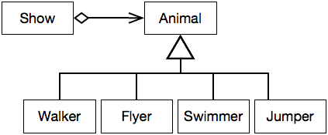
The Animal World From a Trainer's Viewpoint
The Show
The show shall start with the pink pelicans and the African geese flying across the stage. They are to land at one end of the arena and then walk towards a small door on the side. At the same time, a killer whale should swim in circles and jump just as the pelicans fly by. After the jump, the sea lion should swim past the whale, jump out of the pool, and walk towards the center stage where the announcer is waiting for him.

Slide 20
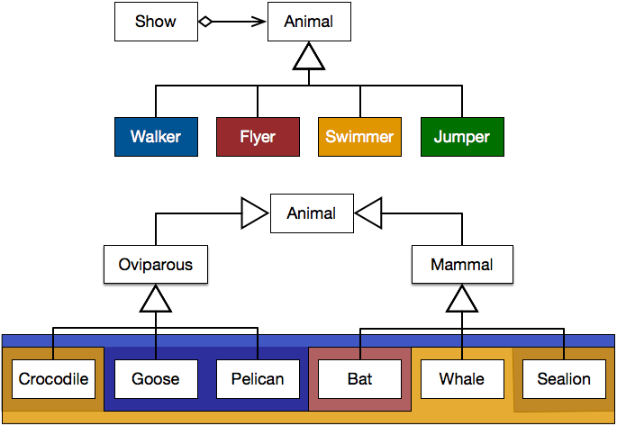
Models Reflecting Different Viewpoints Overlap
Notes:
Elements of a category in one model correspond to several categories in the other model (and vice versa).
Adopting the veterinary viewpoint hinders changes concerning trainer’s viewpoint (and vice versa).

Slide 21

Most programming languages such as Java and tools do not well support modeling the world based on co-existing viewpoints.
No matter how “closed” a module is, there will always be some kind of change against which it is not closed.
Notes:
Using a programming language which offers more advanced modeling mechanisms (such as Scala), it may be possible to create a design that more closely models the presented world.

Slide 22
Strategic Closure
Choose the kinds of changes against which to close your module.
Guess at the most likely kinds of changes.
Construct abstractions to protect against those changes.
Prescience derived from experience:
Experienced designers hope to know the user and an industry well enough to judge the probability of different kinds of changes.
Invoke open-closed principle against the most probable changes.

Slide 23
Be Agile
Recall that guesses about the likely kinds of changes to an application over time will often be wrong.
Conforming to the open-closed principle is expensive:
Development time and effort to create the appropriate abstractions.
Created abstractions might increase the complexity of the design.
Needless, Accidental Complexity.
Incorrect abstractions supported/maintained even if not used.
Be agile: Wait for changes to happen and close against them.

Slide 24
Open-Closed Principle
Software entities (classes, modules, functions, components, etc.) should be open for extension, but closed for modifications.
Abstraction is the key to supporting the open-closed design principle.
No matter how closed a module is, there will always be some kind of change against which it is not closed.
– Object-Oriented Software Construction; 2nd Edition; Bertand Meyer,1997
– Agile Software Development; Robert C. Martin; Prentice Hall, 2003

