Slide 1
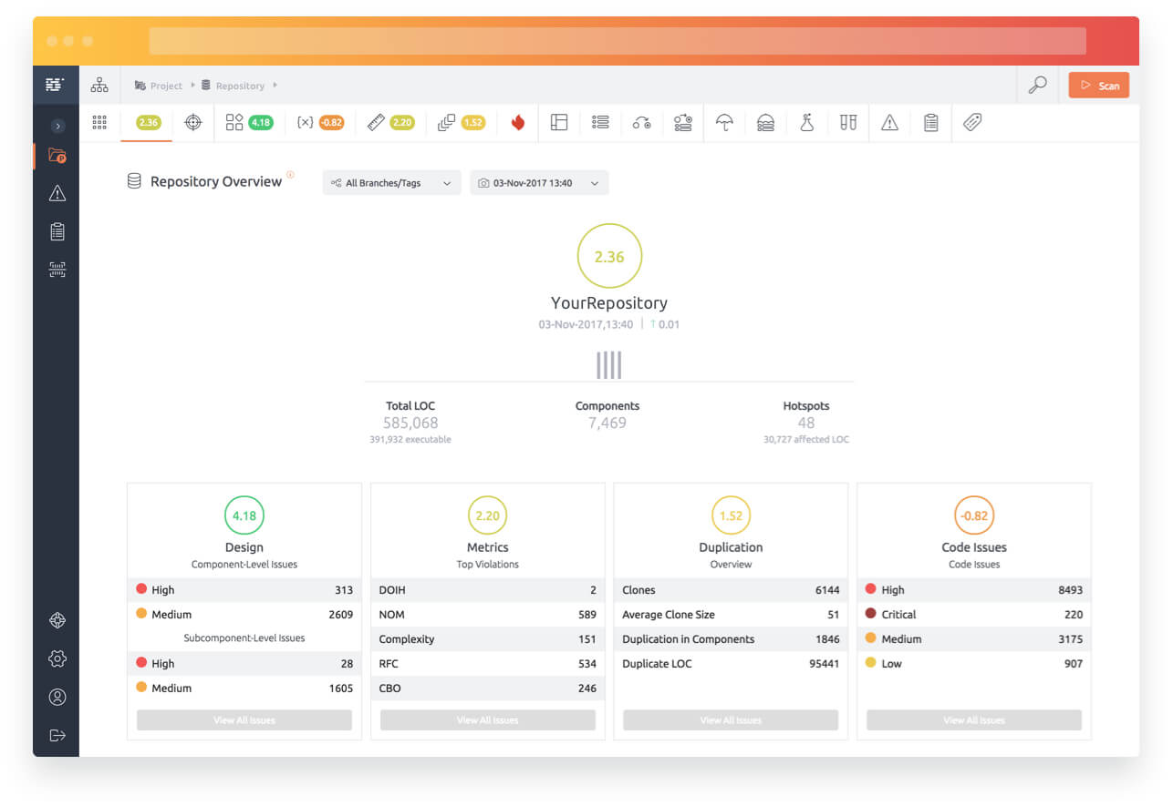





The Challenge
Defective Software
Your team
Gamma, our software analytics platform
Time is ticking

Slide 2

What is Gamma?
1
Intelligent Analyzer
Gamma is a state-of-the-art software analysis platform that allows you to analyse complex software systems.
Use Gamma's anti-pattern detection algorithms to find structures issues in your code.
2
Not just smart - but also sexy.
Beyond developing an effective software analyser, we've put tons of time and effort into creating a great user experience with the help of intuitive dashboards and infographics.
3
Quick ranking & fixing your issues
Gamma - The hotspot rating engine. Gamma uses a proprietary 'multi-vector' diagnostic technology to analyse hotspots in software components. This helps you find and fix the biggest issues first.
4
Easy Setup
Via direct upload or through supported version control systems such as Git, and SVN or through online platforms like GitHub and BitBucket.

Slide 3
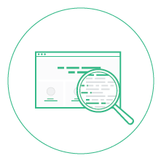
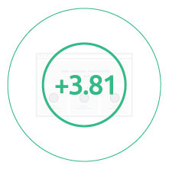

Let the games begin!
1
2
3
4
Team Up!
Analyse
Score
Winner takes all
Create a team with 2-4 of your smartest friends. (Extra points given for creative team names)
You have 90 minutes to analyse and improve a chosen open source software with the help of Gamma.
The team with the highest overall Gamma quality score wins.
Winning team receives a €20 Amazon gift card (per person) and a Gamma T-shirt.

Slide 4
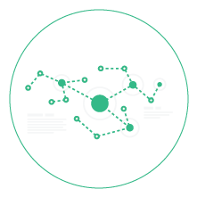


Wondering if our Gamma Challenge is something for you?
If 2 of 4 things appeal to you, you should join in!
Kickass Bug Fixing
Machine Learning
Beer & Snacks
An organic cotton t-shirt

Slide 5
We're always up for a good challenge...
What about you?
Where:
When:
What you need:
TU Darmstadt
Raum C205 in S2102
06/02/2018
9:50 - 11:30am
Your Laptop
Snacks & drinks provided
Each participant receives a Gamma T-shirt as a thank you.

Slide 6
We know software
1
Over 20 years experience building and analysing business critical software applications
2
More than 500 Million lines of code analysed from over 1,000 applications.
3
Experience in alanyzing some of the most complex software applications on the planet today.
Autonomous driving software
Geo-seismic systems for oil exploration
Operating systems
High throughput telecommunications systems.

Slide 7

acellere.com
mygamma.io

