Slide 1

Software Engineering Design & Construction
Winter Semester 16/17
Dr. Michael Eichberg
Fachgebiet Softwaretechnik
Technische Universität Darmstadt
The Scala Collections API

Slide 2
Content
Design Goals
Design Decisions in the Scala Collections API
Example on Inheritance

Slide 3
Design Goals of the Scala Collections API
 | User | Extender
Internal Design Goal | Avoid code duplication Everything defined in one place only | Avoid code duplication
External Design Goal | Similar usability Efficient Data Structures Lightweight Syntax | Lightweight Syntax
Notes:
The table shows the internal and external design goals behind the Scala Collections API, categorized after internal and external design goals as well as goals for the user and goals for possible extender (API user).
The Scala 2.8 Collections API contains a large number of collection operations, which exist uniformly on many different collection implementations. Implementing every collection operation anew for every collection type would lead to an enormous amount of code, most of which would be copied from somewhere else. Such code duplication could lead to inconsistencies over time, when an operation is added or modified in one part of the collection library but not in others. The principal design objective of the new collections framework was to avoid any code duplication, defining every operation in as few places as possible.
The design approach was to implement most operations in collection “templates” that can be flexibly inherited from individual base classes and implementations.
Furthermore the Collections should be easy to use: A small vocabulary of 20-50 methods is enough to solve most collection problems in a couple of operations. With the Scala Collection you can achieve with a single word what used to take one or several loops. You can express functional operations with lightweight syntax and combine operations effortlessly.

Slide 4
Mutable and Immutable Collections
Scala collections systematically distinguish between
Mutable collections
Can be updated or extended in place
You can change, add, or remove elements
Immutable collections
These collections never change
Operations will return a new collection and leave the old collection unchanged
Erklärungen in Notizen und UML mit mutable und immutable collections auf zwei Seiten
Some
Terminology
Notes:
Scala collections systematically distinguish between mutable and immutable collections. A mutable collection can be updated or extended in place. This means you can change, add, or remove elements of a collection as a side effect. Immutable collections, by contrast, never change. You have still operations that simulate additions, removals, or updates, but those operations will in each case return a new collection and leave the old collection unchanged.

Slide 5
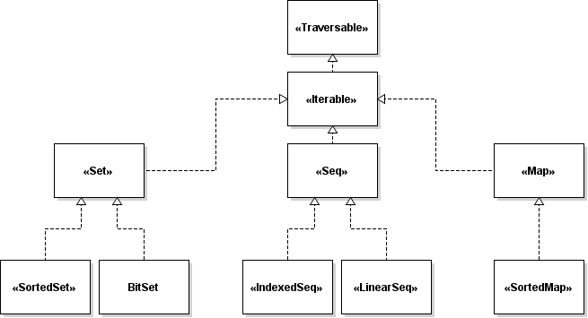
Overview of the Scala Collections API
Notes:
The following figure shows all collections in package scala.collection. These are all high-level abstract classes or traits, which generally have mutable as well as immutable implementations.

Slide 6
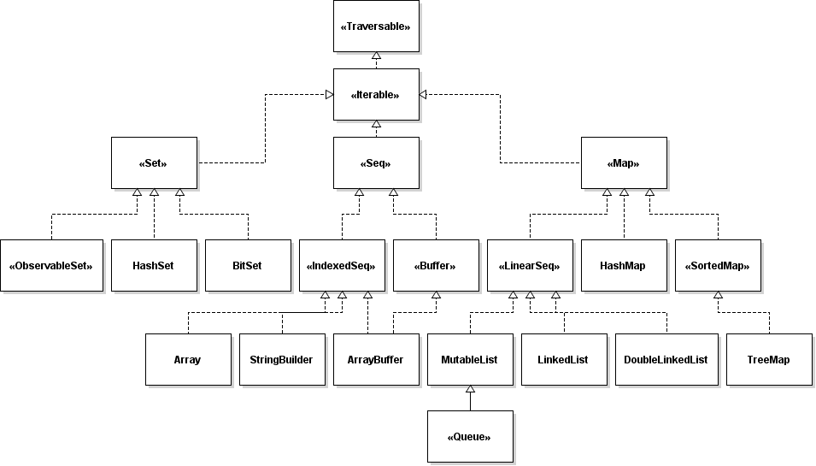
Overview of the Mutable Collections
Notes:
Scala collections systematically distinguish between mutable and immutable collections. A mutable collection can be updated or extended in place. This means you can change, add, or remove elements of a collection as a side effect.

Slide 7
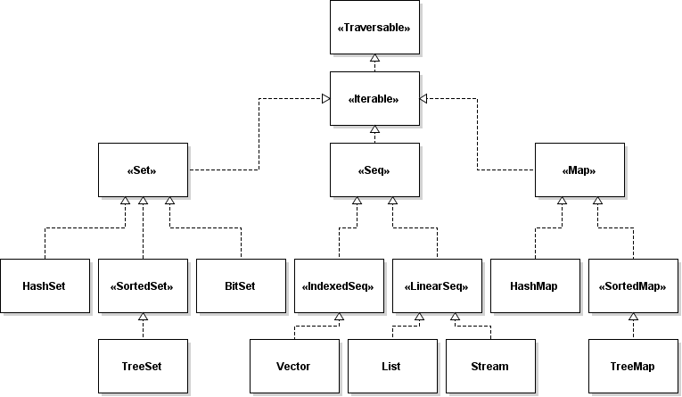
Overview of the Immutable Collections
Notes:
Immutable collections, by contrast, never change. You have still operations that simulate additions, removals, or updates, but those operations will in each case return a new collection and leave the old collection unchanged.

Slide 8
Design Goals: Uniform Methods
The following methods are implemented by every collection:
Foreach
Adding Elements
Map
Conversions (e.g. toArray)
Copying operations (e.g. copyToBuffer)
Size info (e.g. isEmpty)
Element retrieval (e.g. find)
Sub-collection retrieval operations (e.g. filter)
Subdivision operations (e.g. partition)
Element tests (e.g. exists)
Folds (e.g. sum)
String (e.g. mkString)
View (you will learn more about that later)
Notes:
One of the biggest advantages of the Scala collections is, that they all share a broad variety of methods that are uniform over all collections. All the uniform methods are inherited from the respective base classes as possible, which reduces the code duplication. Such code duplication could lead to inconsistencies over time, when an operation is added or modified in one part of the collection library but not in others. Through this design, where one functionality is only defined at exactly one part of the library, the effort for maintaining and extending the code is minimized.
Furthermore the set of collections can easily be extended by users which also profit from the wide range of inherited functionality. How which functionality is inherited in detail is shown in an example later on.

Slide 9
Design Goals: Uniform Methods (Example)
1. Traversable(1, 2, 3)
2. Iterable("x", "y", "z")
3. Map("x" -> 24, "y" -> 25, "z" -> 26)
4. Set(Color.red, Color.green, Color.blue)
5. SortedSet("hello", "world")
6. Buffer(x, y, z)
7. IndexedSeq(1.0, 2.0)
8. LinearSeq(a, b, c)
Notes:
Every kind of collection can be created by the same uniform syntax, writing the collection class name followed by its elements:

Slide 10
Example for lightweight syntax
1. val (minors, adults) = people partition (_.age < 18)
This code snippet partitions a collection of people into minors and adults depending on their age. Because the partition method is defined in the root collection type TraversableLike, this code works for any kind of collection, including arrays. The resulting minors and adults collections will be of the same type as the people collection.
Notes:
This code is much more concise than the one to three loops required for traditional collection processing. Furthermore, the partition operation is quite fast, and will get even faster on parallel collections on multi-cores.

Slide 11
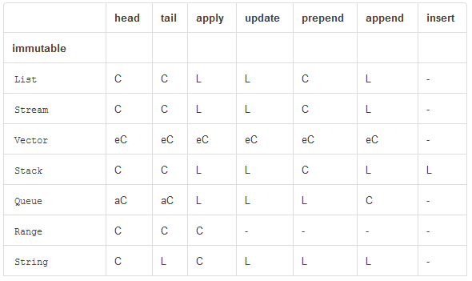
Design Goals: Efficient Data Structures
C = constant time, eC = , effectively constant time, aC = amortized constant time, L = linear with size, Log = proportional to the logarithm of the collection size
Source: http://docs.scala-lang.org/overviews/collections/performance-characteristics
Notes:
Collection operations are tuned and optimized in the libraries. As a result, using collections is typically quite efficient. You might be able to do a little bit better with carefully hand-tuned data structures and operations, but you might also do a lot worse by making some suboptimal implementation decisions along the way. What’s more, collections have been recently adapted to parallel execution on multi-cores.
The primary reason for picking one collection type over another is that different collection types have different performance characteristics. You can see the performance characteristics of some common operations on collections summarized in the following three tables.

Slide 12
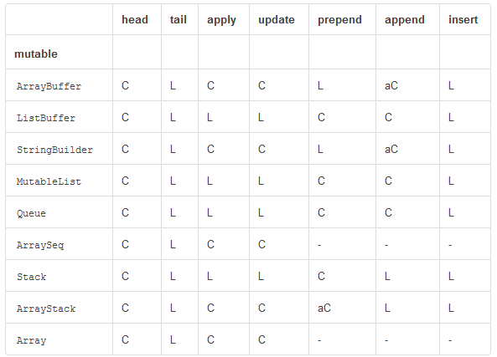
Design Goals: Efficient Data Structures
C = constant time, eC = , effectively constant time, aC = amortized constant time, L = linear with size, Log = proportional to the logarithm of the collection size
Source: http://docs.scala-lang.org/overviews/collections/performance-characteristics
Notes:
Performance characteristics of mutable data structures

Slide 13
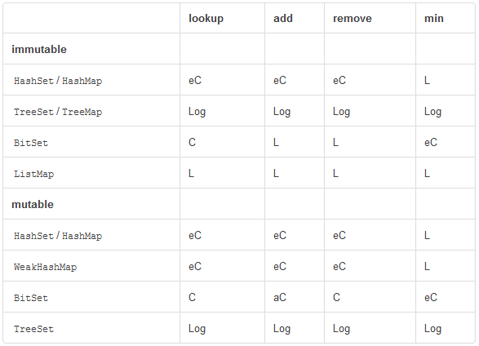
Design Goals: Efficient Data Structures
C = constant time, eC = , effectively constant time, aC = amortized constant time, L = linear with size, Log = proportional to the logarithm of the collection size
Source: http://docs.scala-lang.org/overviews/collections/performance-characteristics
Notes:
Performance characteristics of set and map types

Slide 14
Design Decisions in the Scala Collections API: Builder
The following code shows the implementation of filter in trait TraversableLike:
1. def filter(p: Elem => Boolean): Repr = {
2. val b = newBuilder
3. foreach { elem => if (p(elem)) b += elem }
4. b.result
5. }
Notes:
The main design objectives of the collection library redesign were to have, at the same time, natural types and maximal sharing of implementation code. In particular, Scala’s collections follow the “same-result-type” principle: wherever possible, a transformation method on a collection will yield a collection of the same type. For instance, the filter operation should yield, on every collection type, an instance of the same collection type. Applying filter on a List should give a List; applying it on a Map should give a Map, and so on. In this section, you will find out how this is achieved.
The “same-result-type” principle is achieved by using generic builders and traversals over collections in so-called implementation traits. These traits are named with a Like suffix; for instance, IndexedSeqLike is the implementation trait for IndexedSeq, and similarly, TraversableLike is the implementation trait for Traversable.
Collection traits such as Traversable or IndexedSeq inherit all their concrete method implementations from these traits. Implementation traits have two type parameters instead of one for normal collections. They parameterize not only over the collection’s element type (“Elem”), but also over the collection’s representation type (“Repr”).
The type parameter, Elem, stands for the element type of the traversable whereas the type parameter Repr stands for its representation. There are no constraints on Repr. In particular Repr might be instantiated to a type that is itself not a subtype of Traversable. That way, classes outside the collections hierarchy such as String and Array can still make use of all operations defined in a collection implementation trait.
Taking filter as an example, this operation is defined once for all collection classes in the trait TraversableLike. An outline of the relevant code is shown above. The trait declares two abstract methods, newBuilder and foreach, which are implemented in concrete collection classes. The filter operation is implemented in the same way for all collections using these methods. It first constructs a new builder for the representation type Repr, using newBuilder. It then traverses all elements of the current collection, using foreach. If an element x satisfies the given predicate p (i.e., p(x) is true), it is added to the builder. Finally, the elements collected in the builder are returned as an instance of the Repr collection type by calling the builder’s result method.

Slide 15
Design Decisions in the Scala Collections API: Builder Factory
The following code shows the implementation of map in trait TraversableLike:
1. def map[B, That](f: Elem => B)
2. (implicit bf: CanBuildFrom[Repr, B, That]):That = {
3. val b = bf(this)
4. this.foreach(x => b += f(x))
5. b.result
6. }
The CanBuildFrom trait:
1. package scala.collections.generic
2.
3. Trait CanBuildFrom[-From, -Elem, +To] {
4. // Creates a new builder
5. def apply(from: From): Builder[Elem, To]
6. }
Notes:
A bit more complicated is the map operation on collections. For instance, if f is a function from String to Int, and xs is a List[String], then xs map f should give a List[Int]. Likewise, if ys is an Array[String], then ys map f should give an Array[Int]. The question is how do we achieve that without duplicating the definition of the map method in lists and arrays. The newBuilder/foreach framework shown in trait TraversableLike is not sufficient for this. Futhermore, even the result type constructor of a function like map might depend in non-trivial ways on the other argument types.
The first listing shows trait TraversableLike’s implementation of map. It’s quite similar to the implementation of filter shown in trait TraversableLike. The principal difference is that where filter used the newBuilder method, which is abstract in TraversableLike, map uses a builder factory that’s passed as an additional implicit parameter of type CanBuildFrom.
The second listing shows the definition of the trait CanBuildFrom, which represents builder factories. It has three type parameters: From indicates the type for which this builder factory applies, Elem indicates the element type of the collection to be built, and To indicates the type of collection to build. By defining the right implicit definitions of builder factories, you can tailor the right typing behavior as needed. Take class BitSet as an example. Its companion object would contain a builder factory of type CanBuildFrom[BitSet, Int, BitSet]. This means that when operating on a BitSet you can construct another BitSet provided the element type of the collection to build is Int. If this is not the case, the compiler will check the superclasses, and fall back to the implicit builder factory defined in mutable.Set’s companion object.

Slide 16
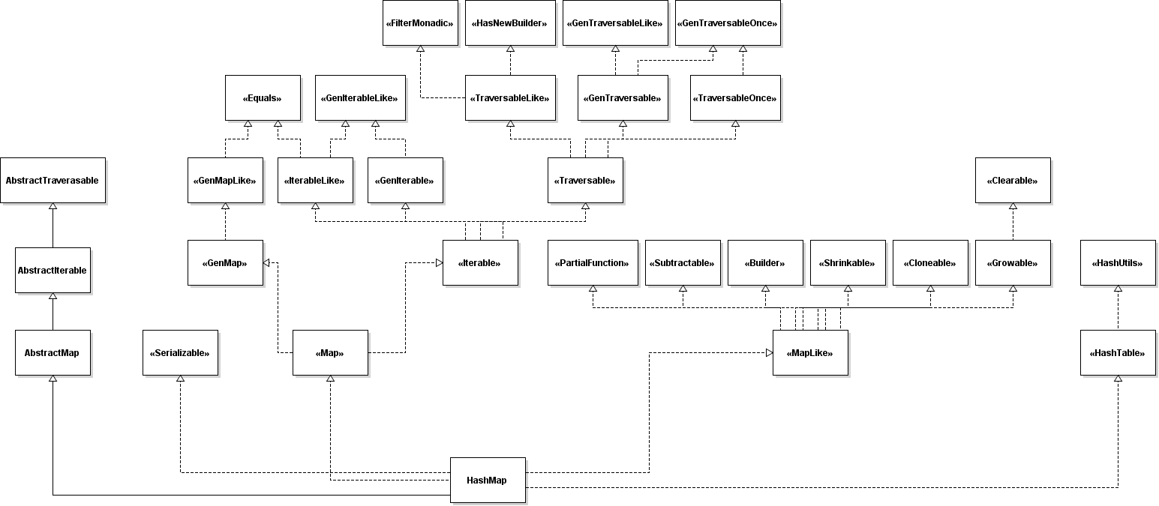
Example on Inheritance: HashMap
Notes:
This UML diagram shows the inheritance hierarchy of the collection class HashMap (mutable). The diagram is already simplified and does not contain double traits, traits from which no functionality is inherited or traits that are obvious (Any, AnyRef etc.). Also all traits connected to parallelizable are skipped, since the focus lies on the base functionalities.
In the following section we will show the reason for this inheritance structure and will explain which functionality is inherited and from where. As already discussed, the main design goal of the collections API was to avoid code duplication, therefore ideally every functionality is defined at exactly one place.

Slide 17
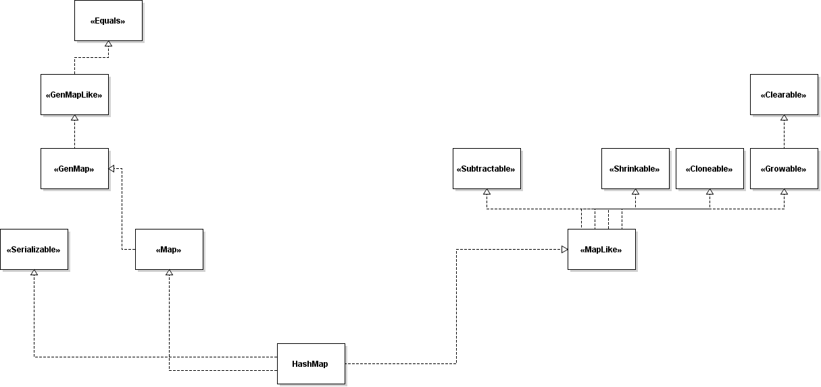
Example on Inheritance: HashMap
Notes:
The first group of traits which we explain are so called marker interfaces. From these traits the HashMap class inherits only very basic functionalities. In detail these functionalities are:
Trait Function Description
Shrinkable -= Removes elements from the collection
--= Remove all elements from the collection
Growable += Adds elements to the collection
++= Adds all elements produced by a TraversableOnce
Clearable clear() Clears the content of the collection
Cloneable clone() Ensures cloneability with Java (extends java.lang.cloneable)
Subtractable - Creates a new collection from this collection with an/some elements removed
-- Creates a new collection from this collection by removing all elements of another collection
Equals canEqual Method for equality checking
Serializable Ensures serializability with Java (extends java.io.Serializable)

Slide 18
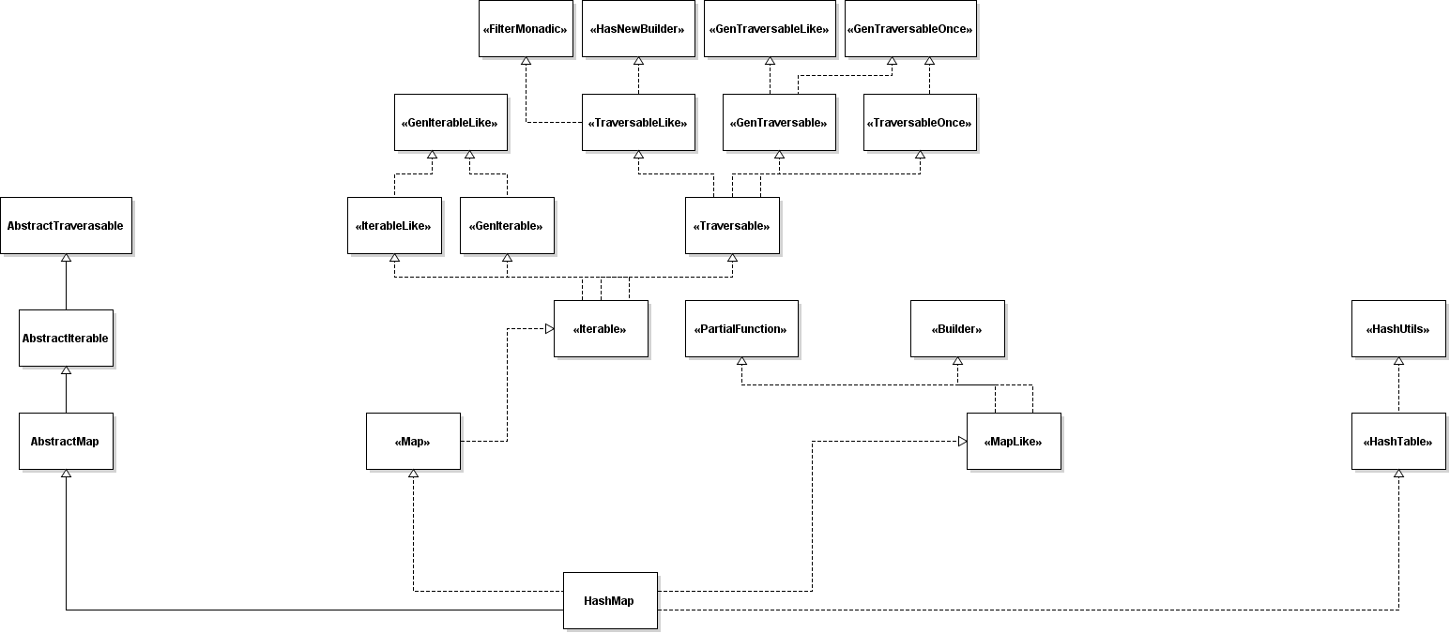
Example on Inheritance: HashMap

Slide 19
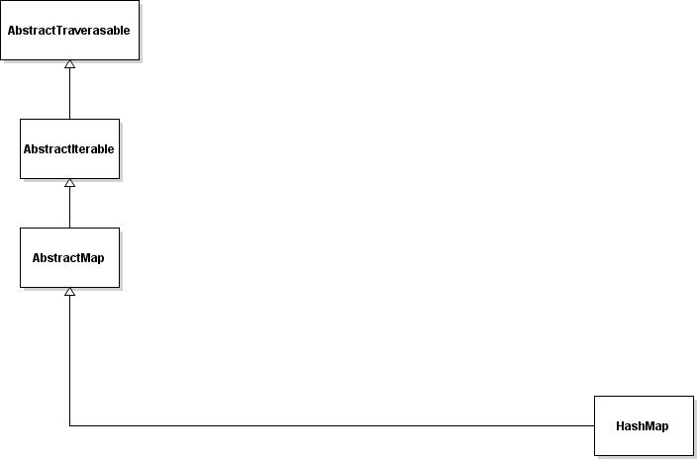
Example on Inheritance: HashMap
Notes:
HashMap also inherits from AbstractMap and hereby from AbstractIterable and AbstractTraversable. These classes are explicit instantiations of the Map / Iterable / Traversable traits to reduce class file size in subclasses.

Slide 20
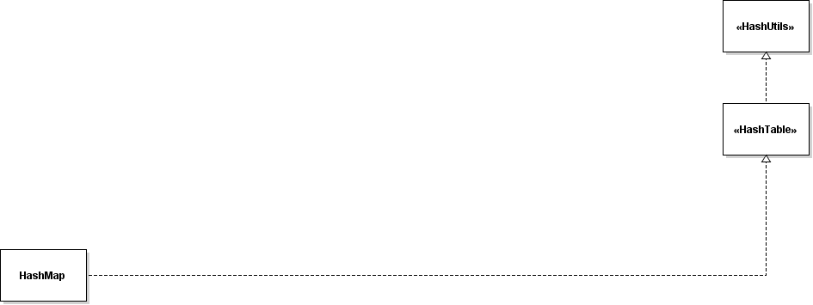
Example on Inheritance: HashMap
Notes:
The HashMap internally uses a HashTable. The functionalities are inherited from the trait HashTable and HashUtils.

Slide 21
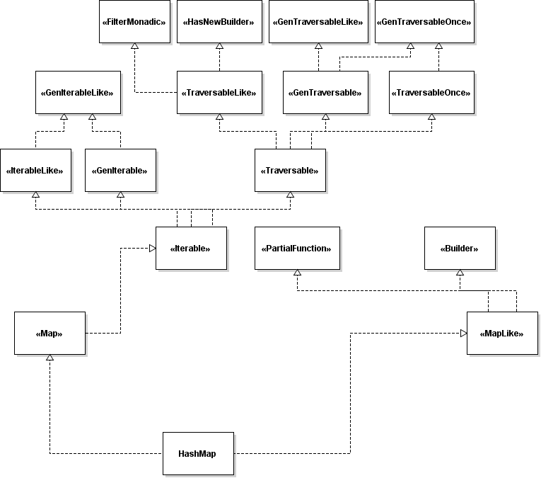
Example on Inheritance: HashMap

Slide 22
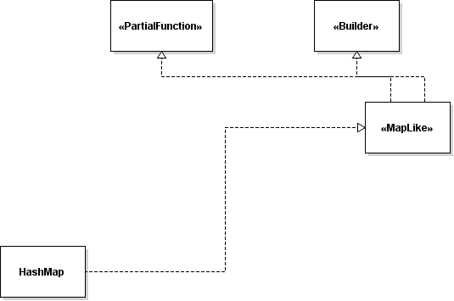
Example on Inheritance: HashMap
Notes:
From the shown traits the HashMap class inherits the following functionalities:
Trait Description
MapLike Independently of its representation this trait provides most of the operations of a (mutable) Map like add, count, drop, exists, isEmpty, toString
PartialFunction Applies this partial function to the given argument when it is contained in the function domain
Builder A builder lets one construct a collection incrementally, by adding elements to the builder with += and then converting to the required collection type with result.

Slide 23
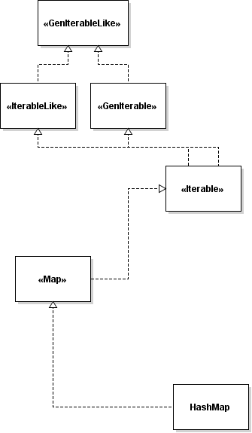
Example on Inheritance: HashMap
Notes:
From the shown traits the HashMap class inherits the following functionalities:
Trait Description
Iterable Base trait for all Scala collections that define an iterator method to step through one-by-one the collection's elements
IterableLike Concrete implementations for iterable collection functionality like find, fold, forall, head, slide, view
GenIterable
GenIterableLike

Slide 24
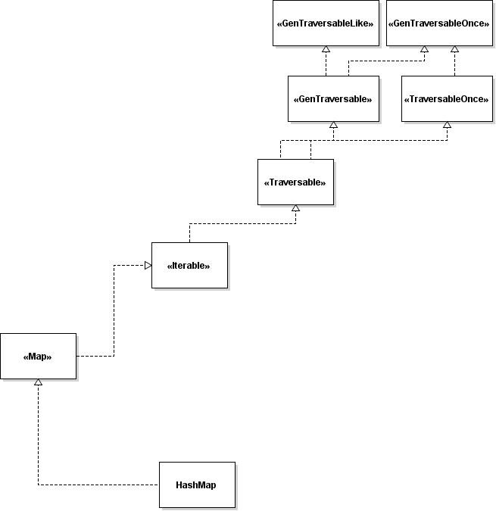
Example on Inheritance: HashMap
Notes:
From the shown traits the HashMap class inherits the following functionalities:
Trait Description
Traversable This is a base trait of all kinds of Scala collections. It implements the behavior common to all collections, in terms of a method foreach like filter, groupBy, last, map, scan, split
TraversableOnce A template trait for collections which can be traversed either once only or one or more times. Inherited methods are for example: addString, aggregate, max, min, mkstring, product, reduce, sum, toList, toMap, toSet, toVector
GenTraversable
GenTraversableLike
GenTraversableOnce

Slide 25
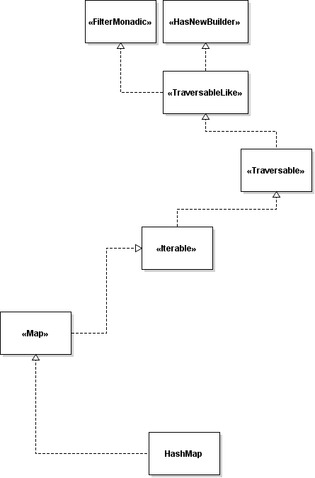
Example on Inheritance: HashMap
Notes:
From the shown traits the HashMap class inherits the following functionalities:
Trait Description
TraversableLike Concrete implementations for traversable collection functionality
HashNewBuilder
FilterMonadic A template trait that contains just the map, flatMap, foreach and withFilter methods of trait TraversableLike

