Slide 1
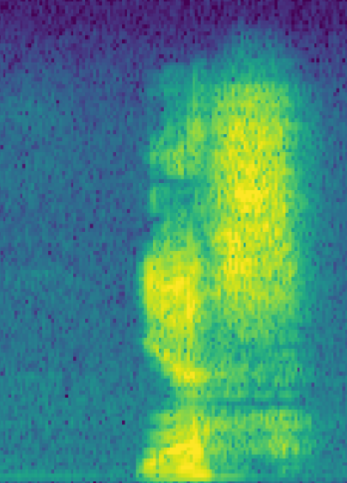
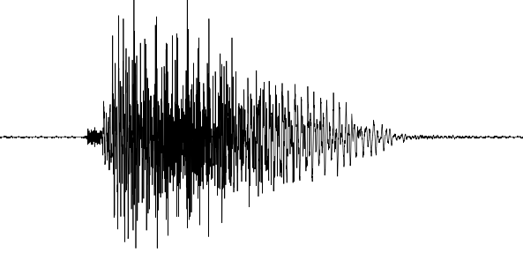
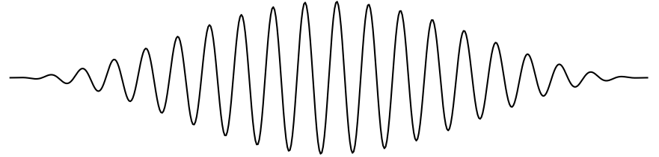
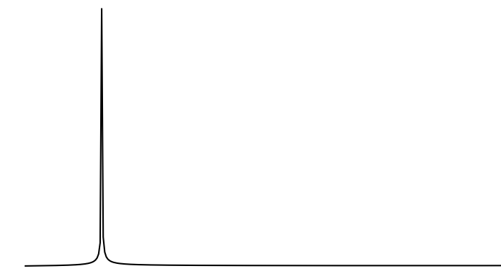
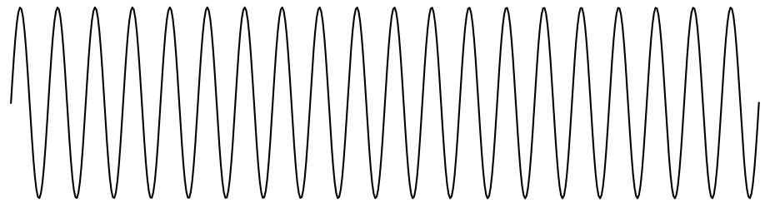
256 samples
windowing
FFT
124 x 129
spectrogram
sliding window

Slide 2
Waveform Buffer
FFT Coeff.
Heap & Stack
Tensor Arena
Model
67k
85k
Code
.bss
.rodata
.text
RAM
Flash

