Slide 1
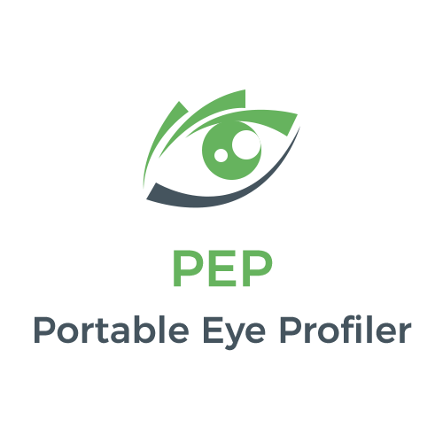

Slide 2
PORTABLE EYE PROFILER
Ayush Yadav
Vibhu Agrawal
Saurabh Khandelwal
Birla Institute of Technology and Science, Pilani – Hyderabad Campus

Slide 3
The Problem
80% of all blindness can be prevented
Unreachable healthcare solutions
Scarcity of trained professionals
Only a few thousand diagnostic devices available for 1.31 billion pair of eyes

Slide 4
The Constraints
Affordability
Ease of Use
Accessibility
Portability

Slide 5
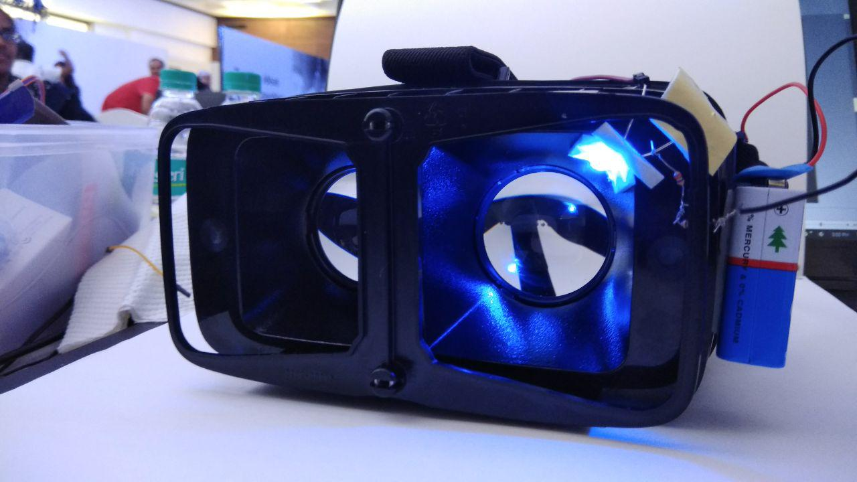
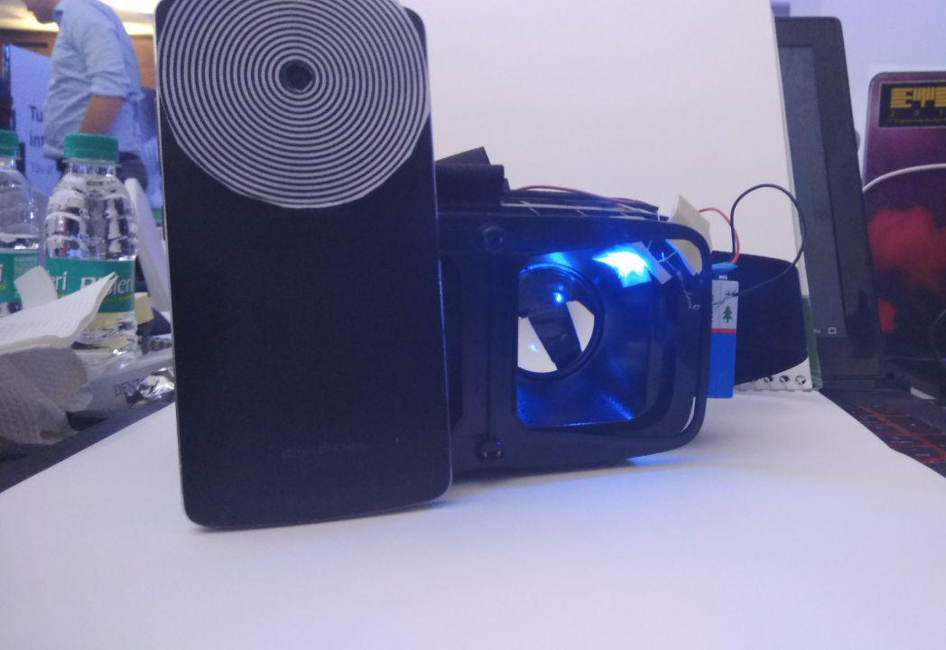
Solution
Notes:
Nothing means anything and we are all going to die (unless we crack neuroscience)

Slide 6
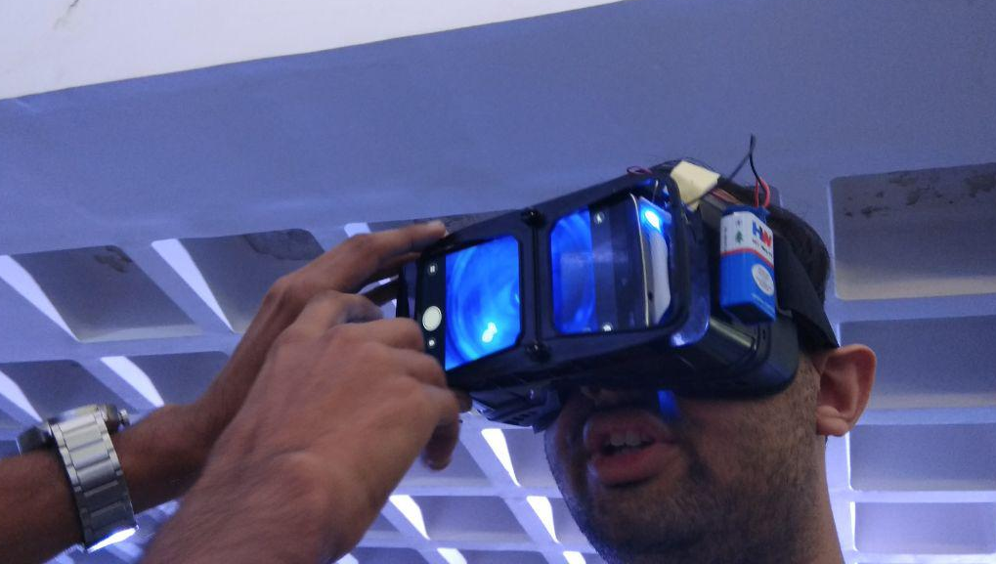
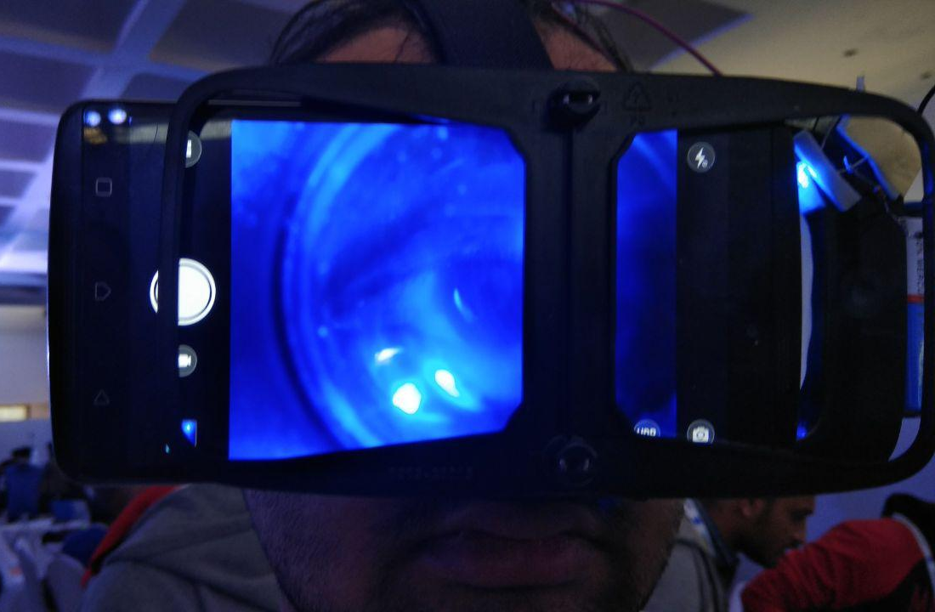
USE

Slide 7
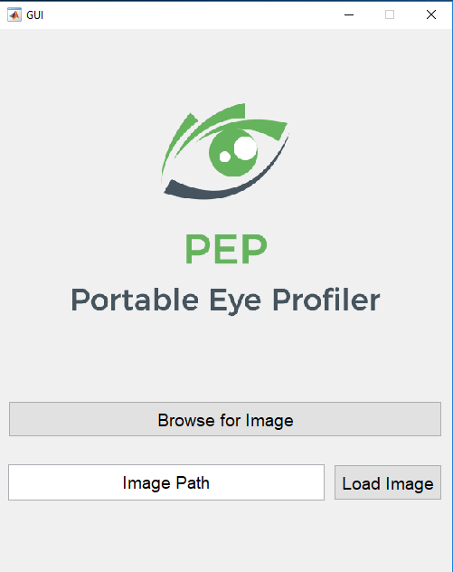
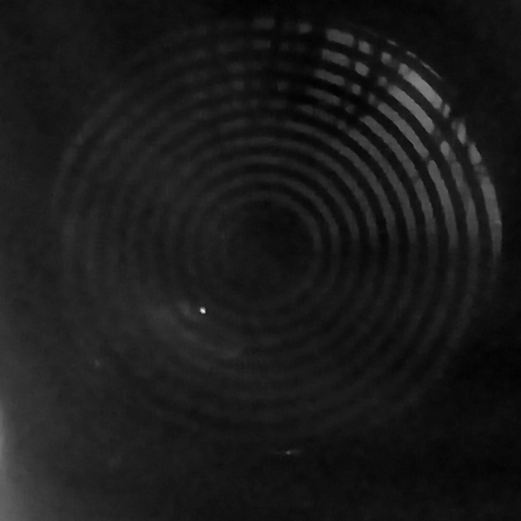
GUI and processing

Slide 8
Challenges in the making
Illumination of the Placido Rings
Narrow field of Illumination by flash
Cup base LED Model for uniform illumination
Foreground illumination for reflection rather than projection
Closed Design of VR One Plus
Software Optimizations

Slide 9
How we propose to take it forward?
Modular add-ons for portable diagnostics
Large scale data collection for multiple diseases
Scalability

Slide 10
THANK YOU ZEISS

