Slide 1
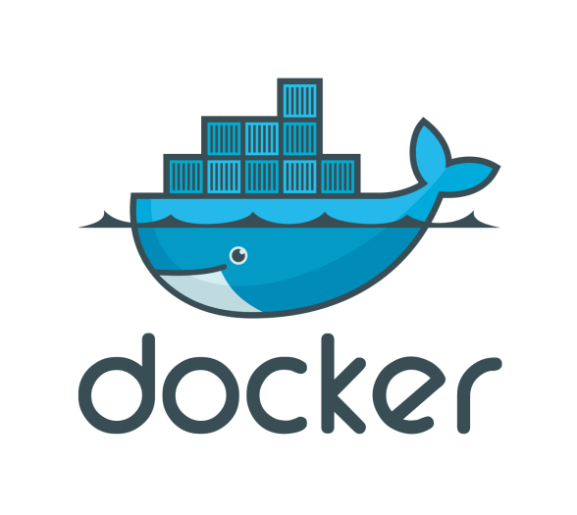
DOCKER concepts
28/04/2017

Slide 2
Sommaire
Introduction
Installing docker
Introduction to images
Managing containers
Building images
Building images
Volumes
Networking
Docker machine
Docker compose
Docker Swarm
Security

Slide 3
Introduction

Slide 4
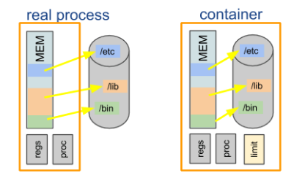
Container based virtualization
Isolated systems
Containers share the same OS kernel
Containers hold the components necessary to run the desired software

Slide 5
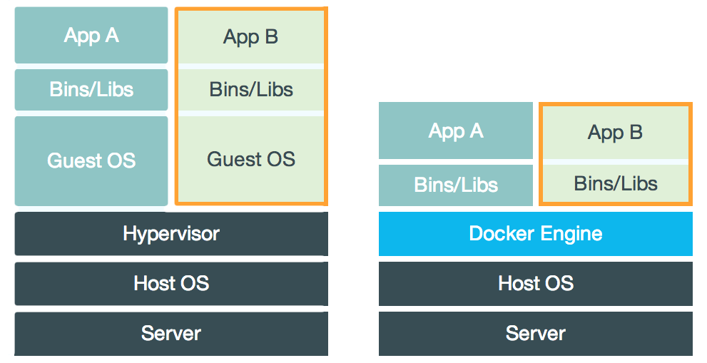
Container based virtualization

Slide 6
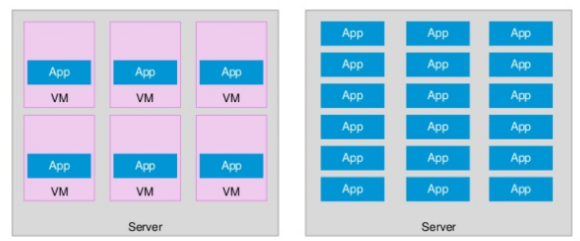
Container based virtualization

Slide 7
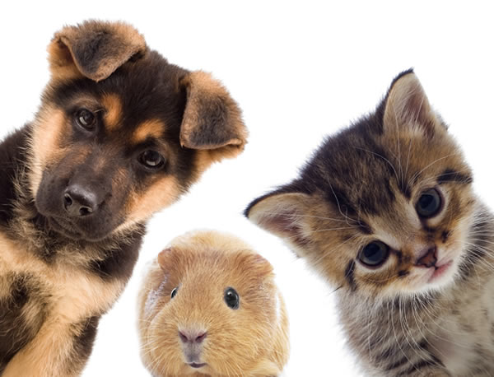
Pets vs Cattle

Slide 8
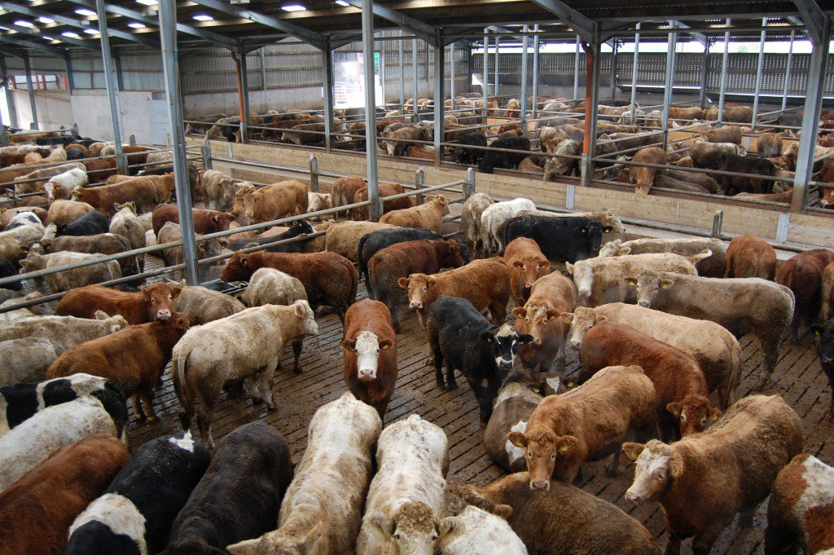
Pets vs Cattle

Slide 9
Docker Container
Docker
API
Docker container
cgroups and namespaces
Union file systems

Slide 10
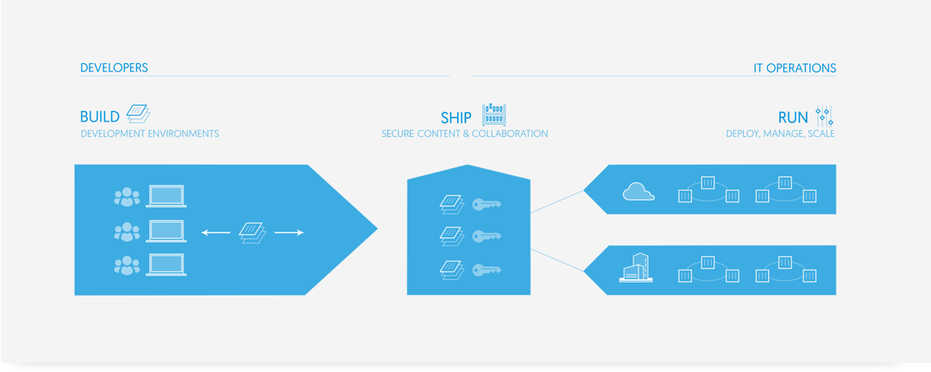
Build Ship Run

Slide 11
Advantages of running docker
Rapid application deployment (infra as code) + testing
Portability across machines (hardware agnostic )
Version control and component reuse (tag , layers)
Sharing (registry)
Lightweight footprint and minimal overhead
Simplified maintenance ( immutable infrastructure )

Slide 12
Drawbacks
Be aware of security
Don't use it for monolitic application
You should respect some best practices
(https://github.com/docker/labs/tree/master/12factor)
1 - Codebase
2 - Dependencies
3 - Configuration
4 - External services
5 - Build / Release / Run
6 - Processes
7 - Port binding
8 - Concurrency
9 - Disposability
10 - Dev / Prod parity
11 - Logs
12 - Admin processes

Slide 13
Installing Docker

Slide 14
Installing Docker
apt-get update
apt-get install -y apt-transport-https ca-certificates linux-image-extra-$(uname -r) linux-image-extra-virtual
apt-key adv --keyserver hkp://p80.pool.sks-keyservers.net:80 --recv-keys 58118E89F3A912897C070ADBF76221572C52609D
echo "deb https://apt.dockerproject.org/repo ubuntu-xenial main" | sudo tee /etc/apt/sources.list.d/docker.list
apt-get update
apt-get install -y docker-engine
service docker start
usermod -aG docker ubuntu

Slide 15
Introduction to images

Slide 16
Differences bw images and containers :
Image
inert, immutable, file
snapshot of a container
Container
running instance of that image

Slide 17
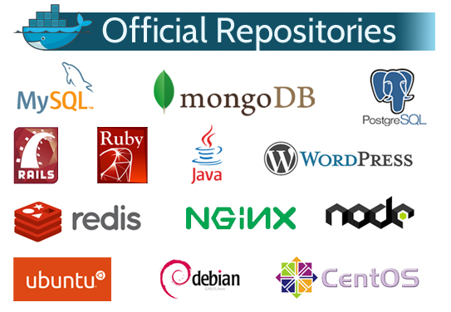
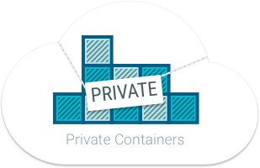
Where to find docker images ?
Docker Hub https://hub.docker.com/
Public Registry
Share images with co-workers
Manage images with tags
Use official Images
Build your own and store it in a private registry

Slide 18
Managing containers

Slide 19
Intro to docker cli
docker --help
docker run hello-world
docker --version
docker pull
docker run
docker exec
docker inspect
docker rm
docker ps
docker stats
docker logs
…

Slide 20
Building images

Slide 21
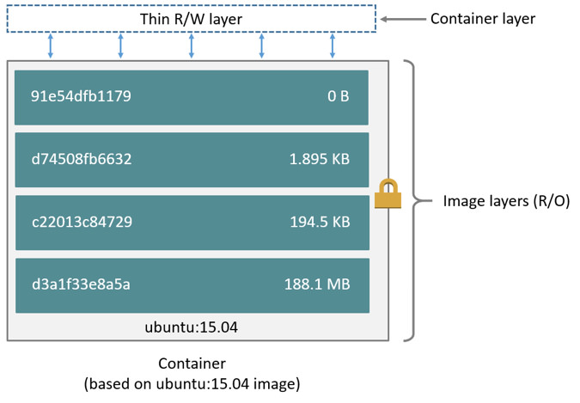
Images and layers

Slide 22
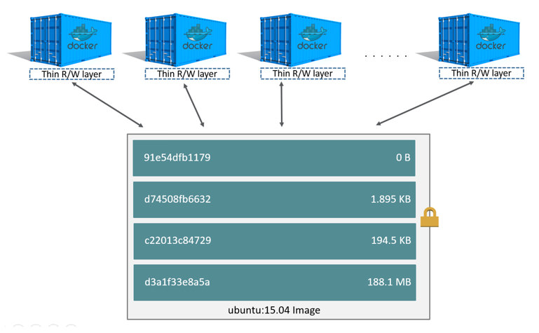
Images and layers

Slide 23
Images management
docker import / export
docker tag
docker push / pull
docker rmi

Slide 24
Dockerfile
Docker can build images automatically by reading the instructions from a Dockerfile
Instructions :
FROM
RUN
ADD
ENV
EXPOSE
LABEL
USER
WORKDIR
VOLUME
…
docker build -t shykes/myapp .

Slide 25
Volumes

Slide 26
Data volumes
Data persistence
Share data between containers
Plugins ( host directory, shared storage, … )
docker run -d -p 80:80 -v /home/ubuntu/localdir:/usr/share/nginx/html/ --name nginxsth nginxsth:latest

Slide 27
Networking

Slide 28
Port mapping
Default:
Containers can make connections to the outside world
Outside world cannot connect to containers
Mapping:
To accept incoming connections :
specify option -P or -p IP:host_port:container_port in 'run' command
iptables -t nat -L -n

Slide 29
DNS
Embedded DNS
Embedded DNS to provide service discovery for containers (127.0.0.11:53)
Key/value store in Docker Engine
Network-scoped (Containers not on the same network cannot resolve each other's addresses)

Slide 30
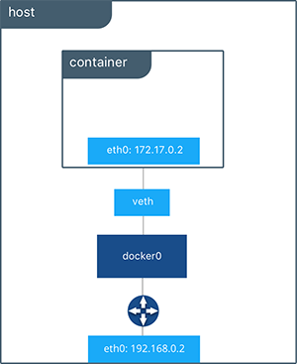
Bridging

Slide 31
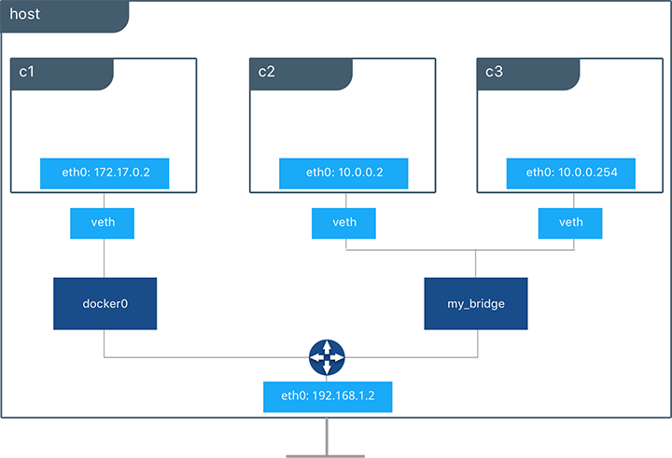
Bridging

Slide 32
Network demo
docker network create --driver bridge isolated_nw
docker run -d -P --network=isolated_nw nginxsth:latest
docker network inspect isolated_nw
docker exec -ti fb82aad80f58 bash
ping 172.18.0.2 => ok
ping reverent_ramanujan => KO
docker run -d -P --network=isolated_nw --name c1 nginxsth:latest
docker run -d -P --network=isolated_nw --name c2 nginxsth:latest
docker exec -ti c1 bash
ping c2 => ok

Slide 33
Network demo
docker network create --driver bridge front
docker network create --driver bridge back
docker run -d --net=front --name web nginxsth
docker run -d --net=front --name proxy nginxsth
docker network connect back proxy
docker run -d --net=back --name app nginxsth
web
proxy
app
front
back

Slide 34
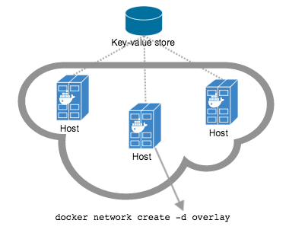
Multihost networking
Overlay outside swarm mode
Requires a valid key-value store service
Consul, Etcd, and ZooKeeper
Configure docker engines to use the key-value store
Overlay in swarm mode
Embedded key-value store

Slide 35
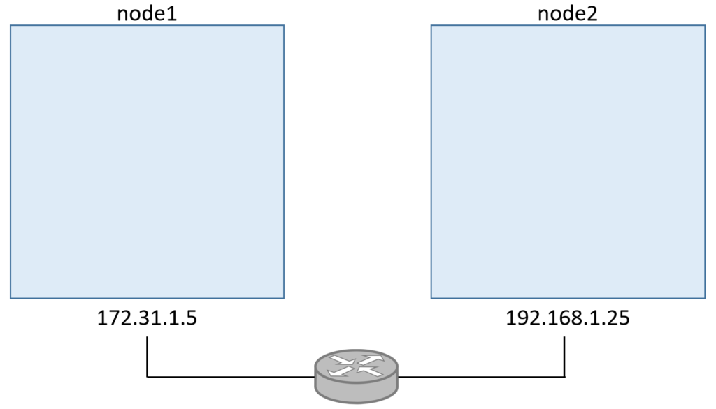
Overlay VXLAN

Slide 36
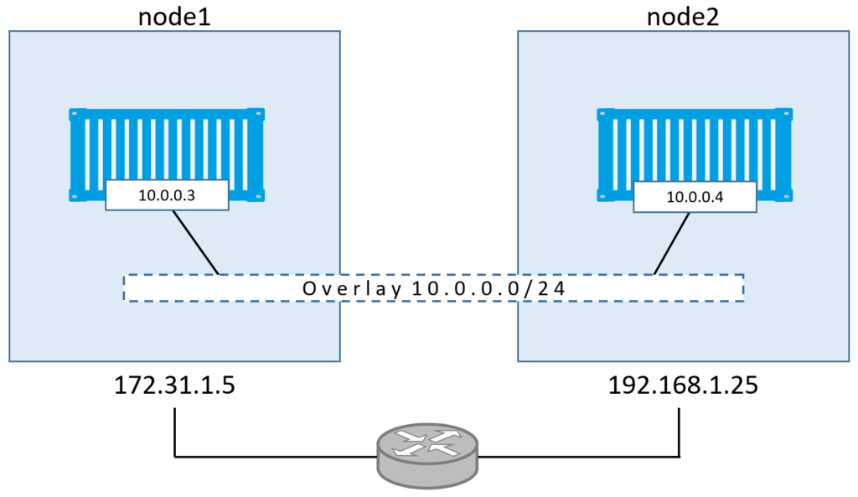
Overlay VXLAN

Slide 37
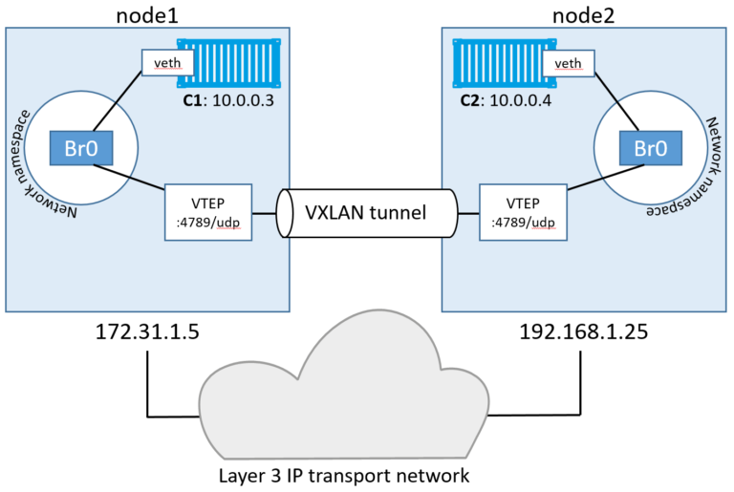
Overlay VXLAN

Slide 38
Docker machine

Slide 39
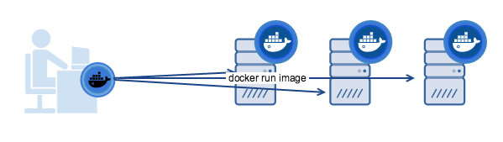
Docker machine
Docker machine enables you to
Provision and manage multiple remote Docker hosts
Provision Swarm clusters
Docker machine
Automatically creates hosts
Installs Docker Engine on them
Configures the docker clients (~/.docker)
Drivers
AWS (ok)
Openstack (ok)
Virtualbox (ok)
Azure
Google Compute Engine
VMware
...

Slide 40
Docker compose

Slide 41
Docker compose
Tool for defining and running multi-container Docker applications
=> compose file
Create and start all the services
=> docker compose up

Slide 42
Docker compose
version: '2'
services:
db:
image: mysql:5.7
volumes:
- db_data:/var/lib/mysql
restart: always
environment:
MYSQL_ROOT_PASSWORD: wordpress
MYSQL_DATABASE: wordpress
MYSQL_USER: wordpress
MYSQL_PASSWORD: wordpress
wordpress:
depends_on:
- db
image: wordpress:latest
ports:
- "80:80"
restart: always
environment:
WORDPRESS_DB_HOST: db:3306
WORDPRESS_DB_PASSWORD: wordpress
volumes:
db_data:

Slide 43
Docker Swarm

Slide 44
Docker Swarm
Manage a cluster of Docker Engines:
Scaling
State reconciliation
Multi-host networking
Service discovery
Load balancing
Rolling updates
…

Slide 45
Schedulling
Schedulling Strategies
Spread
Binpack
Random
Filters
Node constraint filter
Node name
Label
Storage driver
etc
Container filters
Affinity
Label
etc

Slide 46
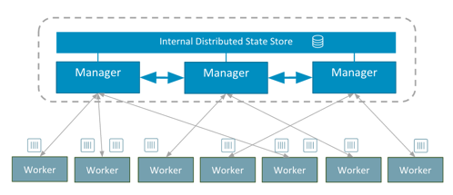
Architecture

Slide 47
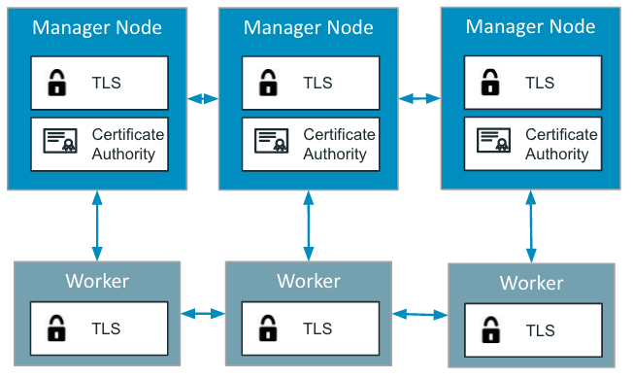
Encryption
Control plane
A CA is created with swarm init on the manager nodes
All communication is encrypted over TLS.
The node keys and certificates are automatically renewed (default 90 days)
Data plane
IPSEC tunnels with AES algorithm between nodes. Keys are automatically rotated by managers every 12 hours.
docker network create --opt encrypted --driver overlay my-multi-host-network

Slide 48
Internal Load balancing ( from container to container )
2 options (--endpoint-mode )
DNS RR
IPVS Virtual IP (VIP)
docker service inspect myservice
[. . .]
"VirtualIPs": [
{
"NetworkID": "a59umzkdj2r0ua7x8jxd84dhr",
"Addr": "10.0.0.3/24"
},
]

Slide 49
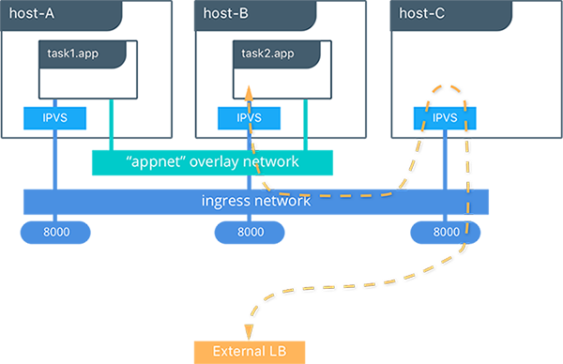
External Load balancing ( to internet )
Docker Routing Mesh

Slide 50
Stack
Task = atomic unit ~ container
Service = group of n tasks
Stack = collection of services ~ application
services:
lb:
image: dockercloud/haproxy
links:
- web
ports:
- "80:80"
roles:
- global
web:
image: dockercloud/quickstart-python
links:
- redis
target_num_containers: 4
redis:
image: redis

Slide 51
Secret management
Use it for data that should not be
transmitted over a network
stored unencrypted in a Dockerfile or in your application’s source code.
such as a
Password
SSH private key
SSL certificate
etc
docker secret create
docker secret inspect
docker secret ls
docker secret rm
--secret flag for docker service create

Slide 52
Security

Slide 53
Security
SANS Institute checklist:
Ensure good host security
Check Image Provenance
Monitor Containers
Do Not Run Container Processes as Root
Do Not Store Secrets in Containers
Base Image Security
Limit container resources
https://www.sans.org/reading-room/whitepapers/auditing/checklist-audit-docker-containers-37437

Slide 54
News

Slide 55
New in 1.13
Compose to deploy stack in Swarm
New cli commands : docker container and docker image
Docker system command
Secret management
Experimental :
Docker service logs
Docker Metrics in Prometheus format

