Slide 1
TRACK 1 · HEAT-RISK SCREENING
Screening Urban Heat Risk
Ranking street-level measurement stations by summer-heat exposure to tell a city where to intervene first
Kriti Shrestha & Jonas Juchelka
Computational Data Analysis with Python · TUM School of Engineering and Design · Spring 2026
Notes:
OPENING (≈45s). Good morning. Our project is a heat-risk SCREENING tool. The core idea in one line: cities are warming, but a city has a limited cooling budget — it cannot plant trees or add shade everywhere, so it must decide WHERE to look first.
We turn that into a ranking problem over measurement stations. Note the two-lens framing at the bottom — this is the spine of the whole talk. The ABSOLUTE lens asks which locations are hottest across all cities (mostly: which CITY is warm). The WITHIN-CITY lens strips out the city's background climate and asks where the local micro-hot-spots sit — the differences a planner can actually change with trees, shade or water.
On the title: we deliberately did NOT put our headline numbers here — we want to earn them through the talk, not assert them upfront. I'm Jonas, this is Kriti, and we'll both present. Let's start with the problem.

Slide 2
AGENDA
Part 1 of 4
01
Introduction & Problem Definition
02
Analysis
03
Results
04
Limitations & Open Questions
CDAP · Heat-Risk Screening · Track 1
Notes:
TRANSITION. Four parts. We're in Part 1 — framing the problem and why it matters for public health. Then Analysis (the data and how we model it), then Results, then an honest look at Limitations and Open Questions. I'll keep coming back to this tracker so you always know where we are.

Slide 3
PART 1 · PROBLEM DEFINITION
Cities can't cool everywhere — so heat becomes a ranking problem, asked at two scales
Within one city, some streets run several °C hotter than their neighbours. That heat is a real health risk — for the elderly, young children, and people with heart or lung conditions. A planner cannot treat every location, so the real task is to rank locations by heat and decide where to look first.
1
The ABSOLUTE question
2
The WITHIN-CITY question
Across all cities, which locations are hottest in absolute terms — and can geography predict them?
Inside a single city, where do the local micro-hot-spots sit — once the city's background climate is removed?
Mostly a question about which CITY runs warm.
The micro-climate a planner can actually change.
CDAP · Heat-Risk Screening · Track 1
2 / 12
Notes:
PROBLEM (≈1:15). The public-health stakes first: prolonged heat causes heat stress and raises summer mortality, concentrated in the elderly, young children, and people with cardiovascular or respiratory conditions. Exposure depends heavily on WHERE you are — so location matters.
Now the key move of the whole project: we don't ask one question, we ask TWO, because 'hot' means two different things to a planner.
Question 1, ABSOLUTE (orange): which stations are hottest across ALL cities? We'll see this is dominated by climate — it basically tells you which CITY is warm. Useful for prioritising between cities, but it doesn't tell you what to do on a given street.
Question 2, WITHIN-CITY (teal): inside one city, with the city's climate level removed, where are the local hot spots? THIS is the micro-climate — the thing trees, shade and water features can actually move.
Why split them? Because — spoiler for Part 3 — one of these turns out to be predictable from geography and the other does not, and that contrast is our central finding. Last line is our success criterion: we are NOT chasing a high accuracy number; we want a screen that is honest about what it can and cannot do.

Slide 4
AGENDA
Part 2 of 4
01
Introduction & Problem Definition
02
Analysis
03
Results
04
Limitations & Open Questions
CDAP · Heat-Risk Screening · Track 1
Notes:
TRANSITION to Analysis. Now the engine room: the dataset, how we clean it, how we turn it into one row per station, what the data shows, and how we model it. Three short code slides in this part show exactly how each step is implemented.

Slide 5
PART 2 · ANALYSIS · THE DATA
Our evidence: hourly street-level temperature from 375 sensors across 6 European cities
375
6
4
3
measurement stations
European cities
summers · 2019–2022
months each · Jun–Aug
1
hourly
8,832
≥ 50%
measured variable: ta (°C)
temporal resolution
max summer hours / station
data-availability cut-off
Dataset FAIRUrbTemp (Amini et al., 2026, Scientific Data) — 811 low-cost-to-commercial sensors across Europe; we use the 6 cities with usable summer coverage. Cities Zurich · Basel · Bern · Berlin · Amsterdam · Birmingham. QC automated quality control with expert validation; original + flagged values provided.
ta = air temperature in °C, the only measured variable. Unit of analysis one station = one row in the modelling table.
CDAP · Heat-Risk Screening · Track 1
3 / 12
Notes:
DATA (≈1:15). The whole analysis rests on a single measured quantity — hourly air temperature, in degrees Celsius, at street level. No humidity, no land cover, no satellite imagery. Keep that in mind; it returns as our central limitation.
Scale: 375 stations, 6 European cities, four summers 2019–2022, June through August. The theoretical maximum is about 8,832 summer hours per station (4 years × ~92 days × 24 h). We keep only stations with at least 50% of those hours, so a sparse record can't produce a noisy percentile.
Provenance: this is the FAIRUrbTemp dataset, Amini and colleagues, Scientific Data 2026 — 811 low-cost-to-commercial sensors across Europe. After our availability filter, six cities have usable summer coverage; three others (Biel, Freiburg, Novi Sad) drop out here because they fall below the 50% coverage cut. The data ships with automated quality control plus expert validation, and provides both original and flagged values.
If asked 'why 6 not 9?': purely the availability filter — better to drop a thin station than to trust a percentile built on a handful of hours.

Slide 6
HOW WE IMPLEMENTED IT
From hourly records to one labelled row per station
# Heat metric: each station's 95th-percentile summer temperature
risk = (summer.groupby(['city','station_id'])['ta']
.quantile(0.95).reset_index(name='p95'))
# ABSOLUTE hotspot: top quartile across ALL cities (climate-driven)
risk['is_hotspot_absolute'] = (
risk['p95'] >= risk['p95'].quantile(0.75)).astype(int)
# WITHIN-CITY hotspot: top quartile INSIDE each city (microclimate)
risk['is_local_hotspot'] = risk.groupby('city')['p95'].transform(
lambda s: (s >= s.quantile(0.75)).astype(int))
One groupby defines heat (p95); the two targets differ only by whether the quartile is taken globally or per city.
Code
Notes:
CODE 1 (≈30s). This is the heart of the data step and it's deliberately tiny. First line: collapse every station's summer hours to one number, its 95th-percentile temperature — p95. Then the two targets, and notice they differ by ONE thing: the absolute label takes the top quartile across all stations everywhere; the within-city label takes the top quartile INSIDE each city via a groupby-transform. Same heat measure, two reference frames — that single distinction generates the entire two-lens story. Both target rates come out near 25% by construction.

Slide 7
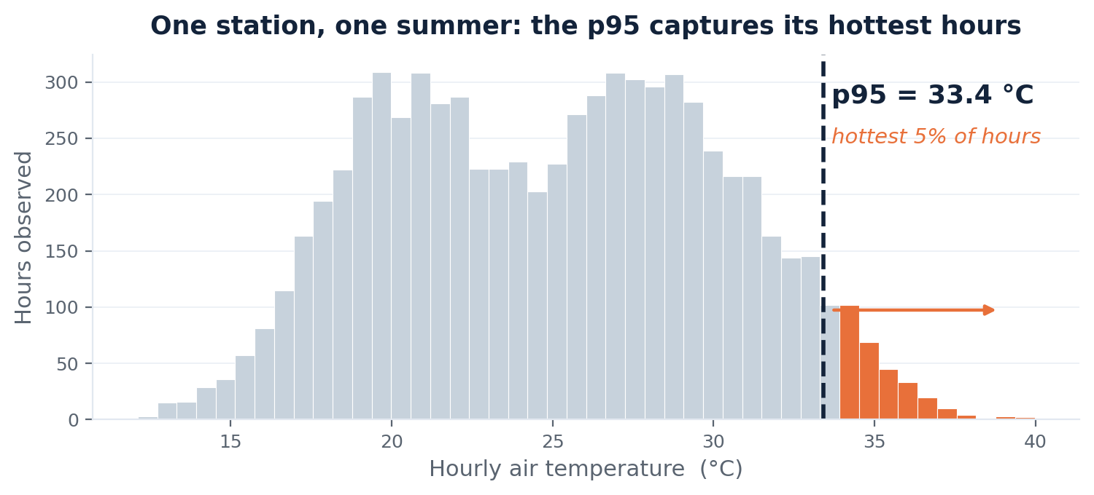
PART 2 · ANALYSIS · FROM RAW RECORDS TO A TABLE
Each station collapses to one heat score — its summer p95 — after strict quality control
What we do to the data
Heat = summer p95
the 95th-percentile hourly temperature — the hottest hours, robust to a single freak reading a plain max would chase.
Quality handling
'NA' and the sentinel −999 both folded to missing; Unicode-NFC names so umlaut stations match the metadata.
Availability filter
keep stations with ≥ 50% of possible summer hours, so a sparse record can't fake a percentile.
Location features
lat/lon, distance & bearing to centroid, local station density, neighbourhood heat — geography only, no temperature.
p95 = 95th percentile: the temperature exceeded only 5% of the hours. Figure illustrative single-station distribution.
CDAP · Heat-Risk Screening · Track 1
4 / 12
Notes:
CLEANING & p95 (≈1:10). The figure shows ONE station's hourly summer temperatures. Rather than describe a station by its mean (drowns the heat) or its max (over-reacts to one freak hour), we use the 95th percentile — the orange tail. p95 says 'how hot does this place get in its hottest 5% of hours' — exactly the exposure that matters for health, and it's robust.
On the right, the four things we do to the data. Quality handling: missing values appear as both 'NA' and a −999 sentinel — we fold both to proper NA; we also NFC-normalise station names so umlaut stations like Basel's Münsterplatz match the metadata tables. Availability filter as discussed. And the only inputs the model ever sees are LOCATION features — coordinates, distance and bearing to the city centre, local sensor density, and neighbourhood heat. Crucially, none of the model's features is the station's own temperature. That keeps the prediction honest and is what the next code slide enforces.
This figure is illustrative — a schematic of one station — not the full dataset; the real per-city distributions come on the next slide.

Slide 8
HOW WE IMPLEMENTED IT
A leak-free pipeline: neighbourhood heat is recomputed inside every fold
class KNNNeighbourP95(BaseEstimator, TransformerMixin):
"""Mean p95 of the k=5 nearest TRAINING stations (leak-free)."""
def fit(self, X, y=None): # memorise TRAIN coords + p95
A = np.asarray(X, float)
self.lat_, self.lon_, self.p95_ = A[:,0], A[:,1], A[:,2]
return self
def transform(self, X): # look up neighbours among
... # TRAIN stations only -> no leak
# Every step fit on the training fold, then applied to the held-out fold
pipe = Pipeline([('pre', ColumnTransformer(...)), ('clf', model)])
A test station never sees its own p95 through a neighbour — the feature is rebuilt from training stations in each fold.
Code
Notes:
CODE 2 (≈40s) — our methodological showpiece; expect a Q&A question here. The richest feature is 'neighbourhood heat': the average p95 of a station's five nearest neighbours, a proxy for sitting in a hot pocket. But it's built FROM temperatures, so naive use leaks the answer: if a test station's neighbours include training stations whose p95 we already know, information bleeds across the train/test split.
We prevent that with a custom scikit-learn transformer. On fit() it memorises ONLY the training stations' coordinates and p95. On transform() it computes neighbour averages using training stations only. Wrapped in a Pipeline, every step — imputation, scaling, this kNN feature — is fit on the training fold and merely applied to the held-out fold. So during cross-validation a station never sees its own answer. If someone asks 'isn't kNN-p95 leakage?' — this slide is the answer: no, because it's refit per fold from training neighbours only.

Slide 9
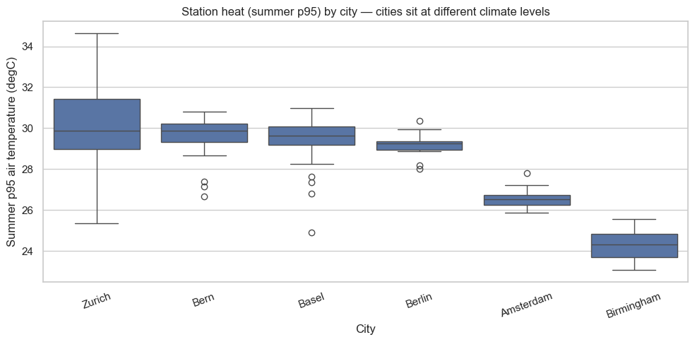
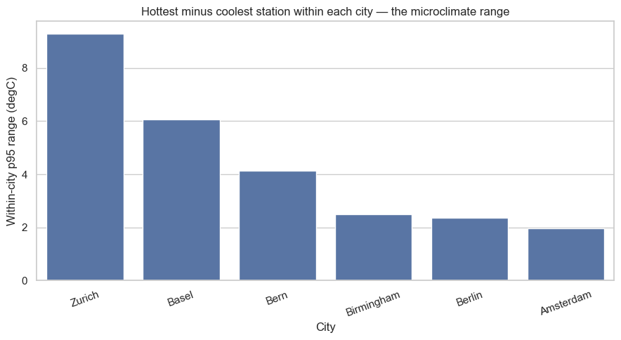
PART 2 · ANALYSIS · EXPLORATORY DATA ANALYSIS
Climate sets each city's level; yet within a single city stations span up to ~9 °C
Lens 1 · between cities (absolute)
Lens 2 · within each city (microclimate)
Cities sit at different levels
Zurich dominates absolute heat
Microclimate is everywhere
Zurich's median p95 ≈ 30 °C, Birmingham ≈ 24 °C — a ~6 °C climate gap.
it alone holds 72 of ~95 absolute hotspots; several cities contribute none.
every city has an internal spread — Zurich ~9 °C, even Amsterdam ~2 °C.
CDAP · Heat-Risk Screening · Track 1
5 / 12
Notes:
EDA (≈1:15). Two plots, one per lens. LEFT, between cities: each box is a city's spread of station p95s, hottest-first. The cities sit at clearly different LEVELS — Zurich's median around 30 °C, Birmingham around 24 — a roughly 6 °C climate gap. This is why the absolute label is climate-dominated: Zurich alone holds 72 of about 95 absolute hotspots, several cities contribute none.
RIGHT, within cities: the hottest-minus-coolest station INSIDE each city. Every city has real internal spread — Zurich about 9 °C, Basel about 6, and even flat Amsterdam around 2. So microclimate genuinely exists everywhere; it's a real signal worth trying to predict.
The three read-offs at the bottom are the honest takeaways we can make BEFORE any modelling — note we are NOT yet claiming within-city is unpredictable; we've only shown the signal exists. That sets up the modelling question: can geography recover either of these? Important nuance for Q&A: the within-city RANGE being large doesn't guarantee it's predictable — a large spread can still be spatially unstructured. That's exactly what we test next.

Slide 10
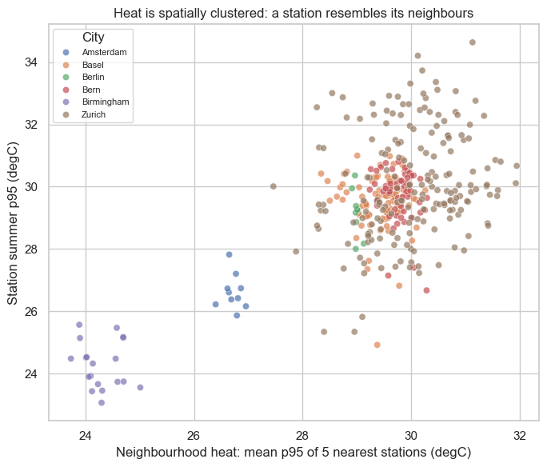
PART 2 · ANALYSIS · MODELLING APPROACH
We frame screening as classification and climb a dummy-to-logistic-to-forest model ladder on both lenses
A model ladder, simple → complex
1
Dummy (stratified)
no-skill floor any real model must beat
2
Logistic Regression
interpretable linear baseline
3
Random Forest
flexible non-linear, kept shallow (depth ≤ 5)
Honest comparison: stratified 5-fold CV · class_weight = balanced · inner-CV grid search scored by average precision · tuned once on the absolute target, settings reused for both lenses → fair.
Why a neighbourhood feature? Heat is spatially clustered — a station resembles its neighbours, so location carries real signal.
Stratified k-fold CV = cross-validation keeping the hotspot share equal in each fold. Average precision PR-curve summary suited to a rare positive class.
CDAP · Heat-Risk Screening · Track 1
6 / 12
Notes:
MODELLING (≈1:15). The screening question — 'is this station a hotspot, yes or no?' — is naturally CLASSIFICATION, and classification hands us the tool a screen needs: a tunable decision threshold (Part 3).
We climb a ladder. A stratified DUMMY gives the no-skill floor — if we can't beat it, geography is worthless. Logistic regression is the interpretable linear step. Random Forest is the flexible non-linear step, kept deliberately SHALLOW (depth ≤ 5) so it can't just memorise stations. We run the WHOLE ladder on BOTH targets, so the absolute-vs-within-city contrast is built into the design, not bolted on.
The fairness scaffolding matters for Q&A: stratified 5-fold CV keeps the hotspot share equal per fold; class_weight='balanced' makes the models attend to the rare hotspot class without resampling; hyper-parameters are chosen by an inner-CV grid search scored on average precision; and we tune ONCE on the absolute target and reuse those settings for both lenses, so the comparison can't be gamed.
The figure on the right justifies our richest feature: own p95 versus neighbours' p95 — a clear positive trend means heat is spatially clustered, so a station resembles its neighbours and location genuinely carries signal. We expect only MODEST skill from geography alone — and as we'll see, that modest expectation is itself the finding, because the true drivers (land cover, sealing, building density) aren't in this data.

Slide 11
HOW WE IMPLEMENTED IT
The ladder and the fair-comparison scaffolding, in one place
cv = StratifiedKFold(n_splits=5, shuffle=True, random_state=42)
dummy = DummyClassifier(strategy='stratified') # no-skill floor
logit = GridSearchCV(LogisticRegression(class_weight='balanced'),
{'clf__C': [0.1, 1, 10]},
scoring='average_precision', cv=cv)
rf = GridSearchCV(RandomForestClassifier(class_weight='balanced'),
{'clf__n_estimators': [200, 400],
'clf__max_depth': [3, 5, None]},
scoring='average_precision', cv=cv)
logit.fit(X, y_abs); rf.fit(X, y_abs) # tune once, reuse for both
Stratified folds, balanced classes, inner-CV tuning on average precision — tuned on the absolute target, applied to both.
Code
Notes:
CODE 3 (≈30s). Everything from the previous slide, concretely. StratifiedKFold for equal hotspot shares. class_weight='balanced' on both real models. Each model wrapped in GridSearchCV with its own inner CV, scored on average_precision — the PR-based score that suits a 25% positive rate far better than accuracy. The forest's depth grid includes a shallow 3 and 5 plus unrestricted, and the search picks shallow, which is why it doesn't overfit. Last line: we fit the search on the absolute target only, then reuse those settings for both lenses — the single most important fairness choice in the project.

Slide 12
AGENDA
Part 3 of 4
01
Introduction & Problem Definition
02
Analysis
03
Results
04
Limitations & Open Questions
CDAP · Heat-Risk Screening · Track 1
Notes:
TRANSITION to Results. We now have a fair ladder on both lenses. Three things to answer: does geography predict heat (and which lens)? how would we actually operate the screen? and does it hold up under stress — new cities, more data?

Slide 13
PART 3 · RESULTS · THE CENTRAL CONTRAST
Between-city heat is predictable (ROC-AUC ≈ 0.70); within-city microclimate sits at chance
Target (lens) | No-skill dummy | Random Forest — basic | Random Forest — enriched
Absolute (across cities) | 0.52 | 0.682 | 0.698
Within-city (microclimate) | 0.50 | 0.503 | 0.526
Cross-validated ROC-AUC · 0.5 = no skill · 'enriched' adds the leak-free neighbourhood-heat feature
THE TAKEAWAY
Geography predicts WHICH CITY is hot. It cannot yet predict WHERE the hot spots sit within a city — the within-city model is statistically indistinguishable from guessing. Enriched spatial features add only a small lift (0.682→0.698; 0.503→0.526) and do not change the picture.
ROC-AUC prob. the model ranks a random hotspot above a random non-hotspot; 0.5 = chance, 1.0 = perfect.
CDAP · Heat-Risk Screening · Track 1
7 / 12
Notes:
CORE RESULT (≈1:20) — the single most important slide. Read the table by ROWS. Top row, ABSOLUTE lens: the dummy sits at 0.52, the Random Forest reaches 0.698 — well above chance. Geography clearly predicts absolute heat. Bottom row, WITHIN-CITY lens: the SAME model reaches only 0.526, essentially the 0.50 no-skill line. Geography cannot recover microclimate.
Footnote defines ROC-AUC: the probability the model ranks a random true hotspot above a random non-hotspot. 0.5 is a coin flip; 0.70 is useful-but-modest.
The 'enriched' column adds our leak-free neighbourhood feature: it helps a little on both (0.682→0.698, 0.503→0.526) but the lift is small and doesn't rescue within-city. So the contrast that frames the whole project survives: between-city heat is predictable, within-city is not, and the reason is that the true micro-climate drivers — land cover, sealing, building density — simply aren't in the data.
Be precise in Q&A: 'within-city not predictable' is a claim about THIS feature set, not a claim that micro-climate is inherently random. We'll back the gap with confidence intervals in Part 4 so it isn't just two point estimates.

Slide 14
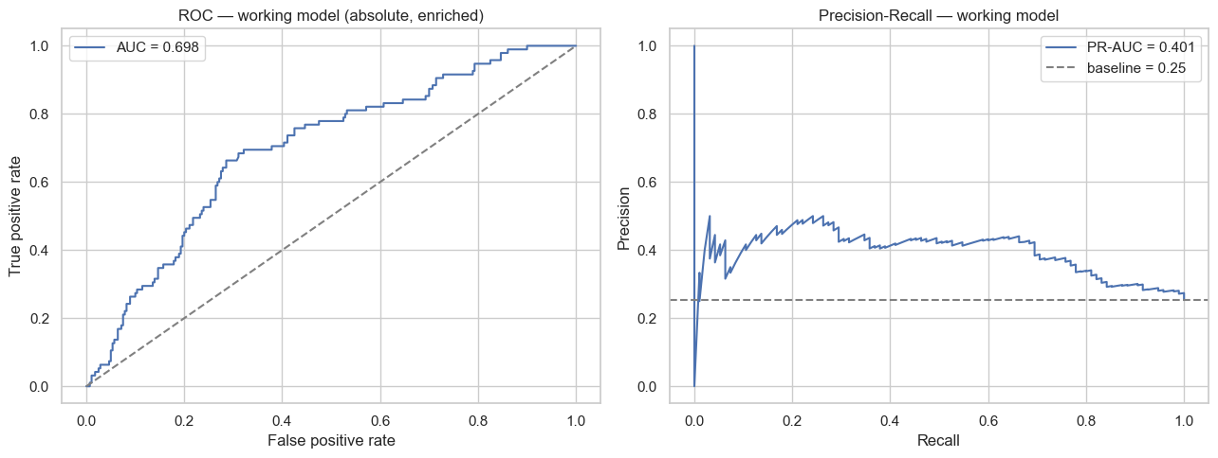
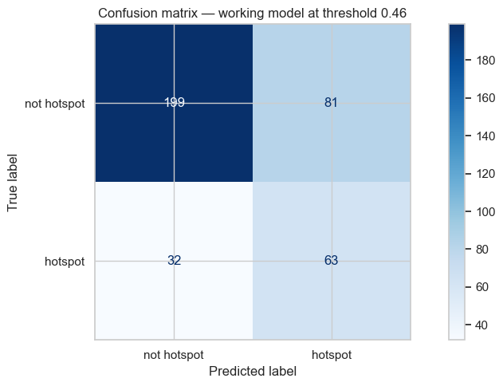
PART 3 · RESULTS · THE WORKING MODEL
The absolute screen has real skill — tuned to a 3:1 miss-cost, it catches two-thirds of true hotspots
Working model = absolute-target Random Forest (enriched). Both curves sit well above their no-skill lines.
At threshold 0.46 (a miss = 3× a false alarm)
0.698
0.401
66%
44%
ROC-AUC (0.5 = no skill)
PR-AUC (0.25 base rate)
recall — 63 of 95 caught
precision — of 144 flagged
PR-AUC area under precision–recall curve; baseline = positive rate (0.25). Recall / Precision caught of all true / correct of all flagged.
CDAP · Heat-Risk Screening · Track 1
8 / 12
Notes:
WORKING MODEL (≈1:25). From here we operate the ONE model with real skill — the absolute-target Random Forest. Left: ROC and precision-recall curves. ROC-AUC 0.698, both curves clearly above their no-skill baselines (the diagonal, and the 0.25 dashed line). PR-AUC is 0.401 against a 0.25 base rate — meaningful because with only 25% positives, plain accuracy is useless; you'd get 75% by always saying 'not a hotspot'.
Right, the operating point. A screen needs a decision threshold, and the costs aren't symmetric: missing a genuinely hot area (FN) leaves people unprotected, while a false alarm (FP) just sends a reviewer to an ordinary site. We weight a miss as 3× a false alarm and pick the threshold that minimises expected cost — that lands at 0.46.
The confusion matrix at 0.46: of 95 true hotspots we catch 63 and miss 32 — 66% recall. Of 144 we flag, 63 are real — 44% precision. So we deliberately over-include: a longer shortlist, because every flagged site gets a human review anyway. That's the right posture for a SCREEN, not a final verdict.
If asked about the 81 false alarms: most are borderline stations, and as the backup shows, they concentrate in Zurich — the biggest, most varied city.

Slide 15
HOW WE IMPLEMENTED IT
Choosing the operating threshold by expected cost, not by default 0.5
# A missed hotspot (FN) costs 3x a false alarm (FP)
COST_FN, COST_FP = 3, 1
def expected_cost(y, p, thr):
yh = (p >= thr).astype(int)
tn, fp, fn, tp = confusion_matrix(y, yh).ravel()
return COST_FN*fn + COST_FP*fp
grid = np.linspace(0.05, 0.95, 91)
t_star = grid[np.argmin([expected_cost(y_abs, p_best, t)
for t in grid])] # -> t_star = 0.46
The 3:1 cost makes the screen lean toward catching real hotspots — a policy choice, stated explicitly.
Code
Notes:
CODE 4 (≈30s). The threshold isn't a default 0.5 — it's a policy. We encode the asymmetry directly: a false negative costs three, a false positive costs one. We sweep 91 thresholds and pick the one minimising total expected cost; it comes out at 0.46. The point for the examiners: this number is a transparent, editable decision a city could change. If a city had more reviewers, it could raise the cost ratio and flag even more; if budgets were tight, lower it. The 3:1 is our recommendation, not a law.

Slide 16
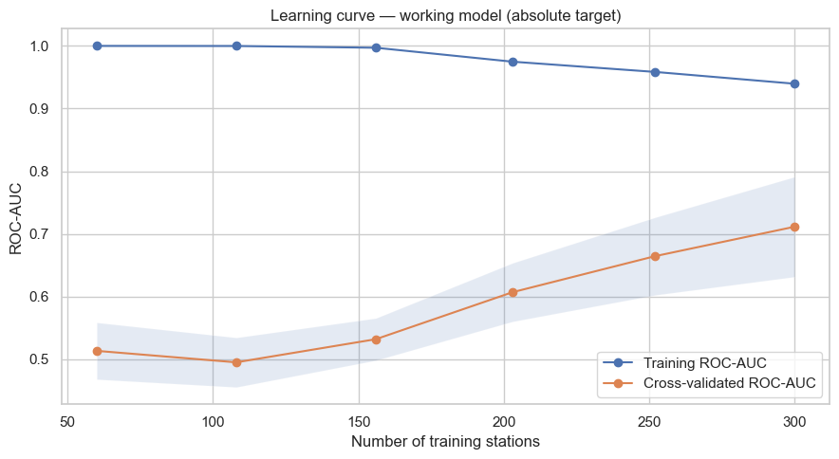
PART 3 · RESULTS · STRESS TESTS
The screen works only where we already measure — it collapses to chance on a brand-new city
Does it transfer to an unseen city?
Would more data help?
Leave-one-city-out: train on five cities, predict the sixth.
Three scorable held-out cities average ≈ 0.48 — at or below chance. The 0.70 does not survive.
Absolute lens: CV score still climbing (0.51→0.71) → more stations help. Within-city: flat at chance → feature-limited, not data-limited.
Leave-one-city-out each fold holds out one whole city; Birmingham/Amsterdam have no absolute hotspots, Berlin only one → unscorable.
CDAP · Heat-Risk Screening · Track 1
9 / 12
Notes:
STRESS TESTS (≈1:25). Two questions a sceptical city would ask. LEFT: does it generalise to a city we've NEVER instrumented? Leave-one-city-out — train on five, predict the sixth. The orange bar is the in-sample mixed-fold 0.70; the teal bars are held-out cities: Zurich 0.564, Basel 0.420, Bern 0.463 — averaging about 0.48, at or below chance. The 0.70 does NOT survive. Why? Much of the absolute model's skill was learning each city's own climate LEVEL; a brand-new city has no anchor on the temperature scale, so the model is lost. Three cities are unscorable — Birmingham and Amsterdam have zero absolute hotspots, Berlin just one — so we report the honest 0.48 over the three substantive cities, not the 0.39 that the single-positive Berlin fold drags down.
RIGHT: would MORE data help? The learning curve for the absolute model still climbs at the full sample (0.51 up to 0.71, not flattening) — so more stations would keep helping. But within-city stays flat at chance regardless of sample size — its limit is FEATURES, not data. That's the key diagnostic distinction: between-city is data-limited, within-city is feature-limited. It tells the city exactly where to invest, which is the bridge to our recommendation.

Slide 17
AGENDA
Part 4 of 4
01
Introduction & Problem Definition
02
Analysis
03
Results
04
Limitations & Open Questions
CDAP · Heat-Risk Screening · Track 1
Notes:
TRANSITION to Limitations & Open Questions. We've shown what works. A strong project is honest about what doesn't — so we now quantify the uncertainty, state the limitations plainly, lay out the open questions, and only then give the recommendation.

Slide 18
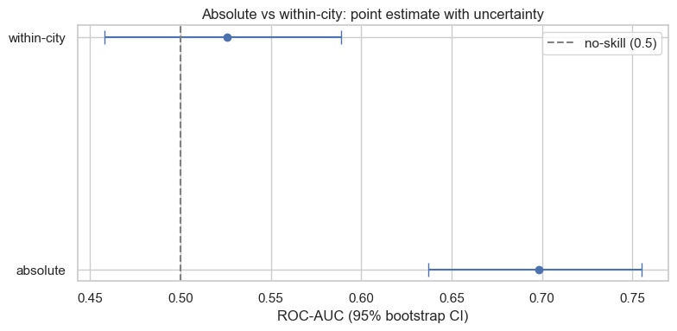
PART 4 · LIMITATIONS & OPEN QUESTIONS
The two lenses differ for real — but thin features cap how far our claims can go
Honest limitations
Thin features
coordinates, distance, density & sensor height only proxy the real drivers — land cover, surface sealing, building density. This is why within-city is hard.
The within-city label is relative
a hotspot in a cool city isn't hot in absolute terms — the two lenses must be read together.
Intervals don't overlap: absolute 0.70 [0.64–0.76] vs within-city 0.53 [0.46–0.59], which still includes 0.5. The gap is real, not sampling noise.
Small sample
a few hundred stations; two cities with only ~10 → every interval widens and small-city transfer scores are noisy.
Climate excluded by design
removed from the within-city target to isolate micro-climate — a scope choice, not an oversight.
Bootstrap 95% CI resample stations with replacement 2,000×, recompute ROC-AUC, take the 2.5–97.5% range. Epistemic vs aleatoric shrinkable-with-data vs irreducible.
CDAP · Heat-Risk Screening · Track 1
10 / 12
Notes:
LIMITATIONS (≈1:20). First, we PROVE the central contrast isn't a fluke. Bootstrap confidence intervals — resample stations 2,000 times, recompute ROC-AUC. Absolute lands at 0.70 with a 95% interval of 0.64–0.76, comfortably above chance. Within-city is 0.53 with 0.46–0.59, which still straddles 0.5. The intervals DON'T overlap, so the gap between the lenses is a real difference, not sampling noise — and within-city genuinely cannot be distinguished from guessing.
Now the honest limitations. The big one: thin features. Latitude, longitude, distance, density and sensor height are weak stand-ins for what actually drives micro-climate — land cover, surface sealing, building density. That's THE reason within-city is hard, and we say so plainly. Second, the within-city label is relative — a within-city hotspot in cool Birmingham isn't hot in absolute terms, so the lenses must be read together. Third, small sample — a few hundred stations, two cities with only ten — which widens every interval. Fourth, we EXCLUDE climate from the within-city target on purpose, to isolate micro-climate; that's a deliberate scope choice.
Framing for Q&A: two kinds of uncertainty. Epistemic — shrinkable with more or better data (our wide intervals, our thin features). Aleatoric — irreducible: fine-scale surroundings no coordinate can ever capture. We're honest that some of the within-city gap may be aleatoric.

Slide 19
PART 4 · LIMITATIONS & OPEN QUESTIONS
Three open questions — and the data that would answer each
Can micro-climate be predicted at all — with the right features?
Q1
Our within-city model fails, but the learning curve says this is a FEATURE gap, not a data gap. Land cover, surface sealing and building density (e.g. from satellite / Local Climate Zones) are the obvious next inputs.
Can the screen ever transfer to an un-instrumented city?
Q2
Today it can't — skill came from learning each city's own climate level. Features that carry climate directly (regional baselines, reanalysis) might let it place a new city on the scale.
Is the 25% top-quartile cut the right definition of 'hotspot'?
Q3
A quartile is a modelling convenience. A health-anchored threshold (e.g. nights above a fixed °C) would tie the screen to outcomes — and should be tested for ranking stability.
CDAP · Heat-Risk Screening · Track 1
11 / 12
Notes:
OPEN QUESTIONS (≈1:10). Three we genuinely can't close with this data — each paired with the evidence that points to an answer.
Q1 — can micro-climate be predicted at all? Our model fails, but the learning curve told us this is a FEATURE gap, not a data gap. So the test is: add real surface descriptors — land cover, sealing, building density, ideally from satellite or Local Climate Zone maps — and re-run. We'd expect the within-city AUC to move; if it doesn't, the residual is aleatoric.
Q2 — can the screen ever serve an un-instrumented city? Right now, no: leave-one-city-out collapses because skill came from learning each city's own level. Features that carry climate directly — regional baselines, reanalysis temperature — might give a new city an anchor.
Q3 — is top-quartile the right definition of a hotspot? It's a convenient cut. A health-anchored threshold — say, number of tropical nights above a fixed temperature — would tie the screen to actual outcomes, and we'd want to check that station rankings stay stable as the threshold moves, which is exactly the sensitivity analysis Track 1 asks for. We did stability checks on the quartile; extending them to health thresholds is the next step.

Slide 20
PART 4 · RECOMMENDATION
Deploy a two-tier screen where we already measure — and invest in land-cover features next
TIER 1 · prioritise cities & areas
TIER 2 · shortlist inside a city
Use the ABSOLUTE view to rank where heat is worst across the cities we monitor.
Use the model as a FILTER: catches ~66% of hotspots; ~44% of flags are real.
Backed by a CI that stays above chance — safe to act on.
A human confirms each flagged site — the model shortlists, it never decides.
Only inside instrumented cities — it does not transfer to a new one.
The within-city model is NOT deployable alone — it sits at chance.
The story in one line: between-city heat is predictable, within-city micro-climate is not, and that gap is real — so screen heat in the cities we monitor, always with human review, and buy better features (land cover) first, more stations second.
12 / 12
Notes:
RECOMMENDATION & CLOSE (≈1:15) — land the story. Everything funnels to a two-tier screen.
TIER 1, between cities (orange): use the absolute view to rank where heat is worst across the cities we monitor. It's predictable and its skill is backed by a confidence interval above chance — safe to act on. One guardrail: only inside instrumented cities, because it doesn't transfer.
TIER 2, inside a city (teal): use the working model as a FILTER to shortlist candidate hot spots for a site visit. At threshold 0.46 it catches about two-thirds of true hotspots and about 44% of its flags are real. A human confirms each flagged site — the model shortlists, it never decides. And the explicit caution: the within-city model is NOT deployable on its own; it sits at chance.
The one-line story — say it slowly: between-city heat is predictable, within-city micro-climate is not, and we PROVED that gap is real. So screen heat in the cities we monitor, always with human review, and the single most valuable next investment is better FEATURES — real land cover, sealing, building density — first, more stations second.
That's the honest, decision-relevant conclusion. Thank you — happy to take questions.

Slide 21
BACKUP
One slide per figure — kept off the main flow so we talk, not read. Pull these up on demand in Q&A.
Notes:
Divider only. These backups exist so the main deck stays sparse and talk-driven; each reproduces one figure with explicit read-offs for questions.

Slide 22
BACKUP
p95 — why the 95th percentile is our heat measure
How to read it
x-axis: one station's hourly summer temperatures; the orange tail is its hottest 5% of hours.
The dashed line is p95 — the value exceeded only 5% of the time.
Mean would be dragged down by cool nights; max would chase a single freak hour. p95 captures sustained peak heat.
Figure is illustrative (schematic of one station), not the full dataset.
CDAP · Heat-Risk Screening · Track 1
B-1
Notes:
Use if asked 'why p95 and not mean/max/exceedance count?' — robustness + health relevance.

Slide 23
BACKUP
Between-city distribution — climate sets each city's level
How to read it
Each box = one city's spread of station p95s, ordered hottest-first.
Medians differ by ~6 °C (Zurich ≈ 30 °C → Birmingham ≈ 24 °C): a climate gap, not microclimate.
This is why the ABSOLUTE label is climate-dominated — Zurich holds 72 of ~95 absolute hotspots.
Whiskers/outliers show within-city spread too — the bridge to figure B-3.
CDAP · Heat-Risk Screening · Track 1
B-2
Notes:
The empirical basis for 'absolute = which city is warm'.

Slide 24
BACKUP
Within-city range — microclimate exists everywhere
How to read it
Bar = hottest minus coolest station INSIDE each city (city climate removed).
Zurich spans ~9 °C; Basel ~6 °C; even flat Amsterdam ~2 °C.
So there IS a real local signal to explain — large range, though, does not guarantee it is predictable.
Motivates carrying the within-city target through the whole analysis.
CDAP · Heat-Risk Screening · Track 1
B-3
Notes:
Counter to 'maybe microclimate just doesn't exist' — it does; it's just not recoverable from geography.

Slide 25
BACKUP
Spatial clustering — why we engineered a neighbourhood feature
How to read it
x: mean p95 of a station's 5 nearest neighbours; y: the station's own p95.
Clear positive trend → heat is spatially clustered; a station resembles its surroundings.
Justifies the kNN-neighbourhood-p95 feature as a proxy for local context.
Colour = city; the between-city separation is visible as distinct clouds.
CDAP · Heat-Risk Screening · Track 1
B-4
Notes:
Feature-engineering rationale; pairs with the leak-free transformer (Code 2).

Slide 26
BACKUP
ROC & PR curves — the working model has real skill
How to read it
Left (ROC): curve well above the diagonal; AUC = 0.698.
Right (PR): curve well above the 0.25 baseline; PR-AUC = 0.401.
PR-AUC matters because positives are only 25% — accuracy would be misleading.
This is the absolute-target Random Forest with enriched features.
CDAP · Heat-Risk Screening · Track 1
B-5
Notes:
Evidence the absolute screen is usable; the operating point is chosen on the PR trade-off.

Slide 27
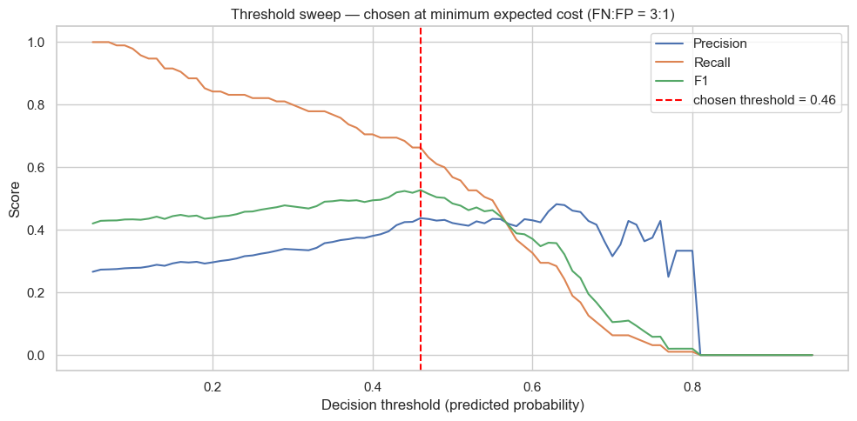
BACKUP
Threshold sweep — choosing 0.46 by expected cost
How to read it
Precision rises and recall falls as the threshold increases.
Red line = chosen threshold 0.46, the minimum-expected-cost point under a 3:1 miss:false-alarm cost.
At 0.46: recall ≈ 66%, precision ≈ 44% — a deliberately inclusive screen.
Move the cost ratio → the threshold moves; it's an editable policy.
CDAP · Heat-Risk Screening · Track 1
B-6
Notes:
Shows the threshold is principled, not arbitrary; pairs with Code 4.

Slide 28
BACKUP
Confusion matrix at 0.46 — and where the errors live
How to read it
63 of 95 true hotspots caught (recall 66%); 32 missed.
144 flagged in total; 63 real (precision 44%); 81 false alarms.
Errors concentrate in Zurich (87 of 113) — the biggest, widest-range city → most borderline cases.
Expected, not alarming: it flags where a planner should check most on the ground.
CDAP · Heat-Risk Screening · Track 1
B-7
Notes:
Pre-empts 'why so many false alarms?' and 'why all in Zurich?'.

Slide 29
BACKUP
Learning curve — more data helps only the between-city screen
How to read it
Orange = cross-validated AUC; blue = training AUC.
Absolute CV score climbs 0.51 → 0.71 and is still rising → more stations would help.
Train-vs-CV gap = variance; the shallow forest still generalises.
Within-city (not shown) stays flat at chance → feature-limited, not data-limited.
CDAP · Heat-Risk Screening · Track 1
B-8
Notes:
The diagnostic that splits 'data problem' (absolute) from 'feature problem' (within-city).

Slide 30
BACKUP
Bootstrap CIs — the gap between lenses is real
How to read it
Dots = ROC-AUC; bars = 95% bootstrap intervals (2,000 resamples).
Absolute 0.70 [0.64–0.76] — entirely above the 0.5 no-skill line.
Within-city 0.53 [0.46–0.59] — still includes 0.5, i.e. indistinguishable from chance.
Intervals don't overlap → the contrast is a real difference, not sampling noise.
CDAP · Heat-Risk Screening · Track 1
B-9
Notes:
The statistical backbone of the central claim; lead with this if challenged on 'two point estimates'.

