Slide 1
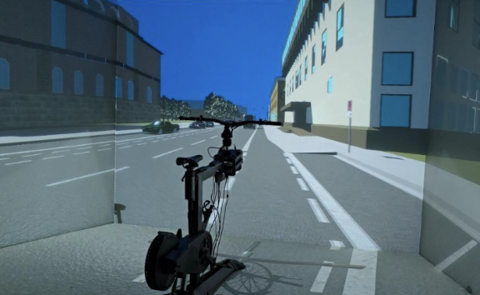
Investigating cyclists’ speed responses and steering-related simulator sickness
A CAVE bicycle simulator study
Supervisor
Student
27.08.2026
Tian Zheng M.Sc.
Xiaoting Deng
Kriti Shrestha
Experimental Studies on Testbeds and Simulators
TUM School of Engineering and Design
Chair of Traffic Engineering and Control
Univ.-Prof. Dr.-Ing. Klaus Bogenberger

Slide 2
Agenda
01
Background
Method · the CAVE bicycle simulator study, RQ1, RQ2
Results (RQ1) · Conclusion & Discussion
Results (RQ2) · Conclusion & Discussion
Limitation & Future work
02
03
04
05
Notes:
(20 s)
Here is the structure of our presentation.
I will first introduce the background and the methodology.
Then we will explain our research question separately.
After that, we will present the results and discuss what they mean.

Slide 3
Background
Cycling is increasingly popular as a sustainable urban transport mode
Cyclists remain among the most vulnerable road users
Research gap
Limited evidence on cyclists’ responses to automated shuttle buses
Limited understanding of simulator sickness and observed behaviour
Automated vehicles are gradually introduced to road traffic
External HMIs might support cyclists’ decisions to brake, yield or pass
3
Notes:
Cycling is becoming more popular in cities.
It is sustainable, flexible, and space-efficient.
But cyclists are still among the most vulnerable road users.
This becomes especially important when automated vehicles enter road traffic.
Automated vehicles are gradually introduced to road traffic
And in this situation, an external HMI may help cyclists to communicate with an automated vehicle by giving information about whether the cyclist should do
And when a simulator environment was provided to carry out relevant studies, most of the bike simulator studies mainly focus on common vehicles but not automated ones
And also we lack evidence to prove simulator sickness has a significant effects on observed behaviour

Slide 4
Background · CAVE bicycle simulator
CAVE bicycle simulator
Risky street interaction → Controlled experiment
Safe
Critical cyclist-bus encounters can be tested without exposing riders to real traffic
Repeatable
Every participant can experience the same scenarios and traffic conditions
Measurable
Steering, position and speed are logged frame by frame
4
Notes:
Brief introduction to CAVE bike simulator
It turns a risky street interaction into a controlled experiment.
It’s safe, repeatable and measurable because testing in such an environment allows us to study human behaviour under controlled conditions, with a realistic traffic experience but without having to be exposed to the real world

Slide 5
Background
Building on an earlier CAVE-simulator study
Second wave
Earlier study
+
More participants
Zafar (2026):
41 participants recruited · 108 usable drives
Focused on perceived safety, HMI acceptance and visual attention
_
Incomplete old data
+
RQ1: Speed response
Speed reduction at HMI onset
Bus vs. Infrastructure HMI
What remained open?
Speed reduction at HMI onset
Bus vs. Infrastructure HMI response
Steering changes vs. MISC ratings
+
RQ2: Steering and sickness
Steering changes vs. MISC ratings
5
Notes:
Our work builds on an earlier study, which obtained 108 usable drives from 41 participants
But this study focused on perceived safety, HMI acceptance, and visual attention.
In the second data-collection wave, which is our current study, we added more participants.
But we could not simply use every recorded drive Because some data were inaccurate or incomplete.
Several questions also remained open.
How much did cyclists slow down around HMI onset?
Was the speed response different for the Bus and Infrastructure HMI?
And was steering behaviour connected to reported simulator sickness?
These questions bring the motivation of our two research questions.

Slide 6
Study design
Data collection
RQ1
RQ2
Methodology

Slide 7
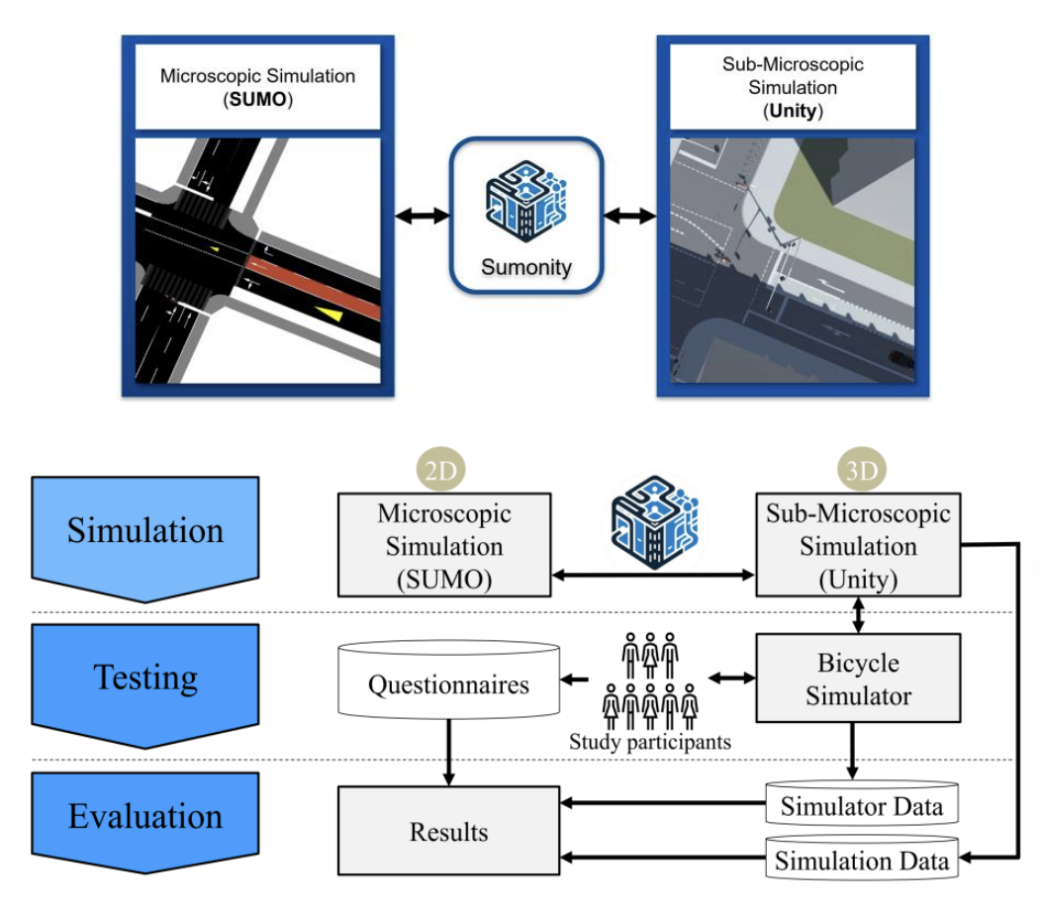
Methodology · CAVE bicycle simulator
Simulator framework
Human-in-the-loop testing: Participants interact with the virtual traffic through the bicycle simulator
Multimodal data collection: Simulator trajectories and questionnaire responses are recorded
Integrated evaluation: Simulation, simulator and subjective data are combined for analysis
7
Notes:
This figure shows the main framework.
SUMO controls the overall traffic simulation.
Unity creates the detailed three-dimensional environment.
These two systems were connected synchronised by Sumonity
The cyclist is included as a human participant through the physical bicycle simulator.
So this is a human-in-the-loop experiment.
At the same time, we collect simulator trajectories and questionnaire responses.
Finally, these different data sources are combined for evaluation.
This is the main role of the laboratory: connecting a real person with a controlled virtual traffic system.

Slide 8
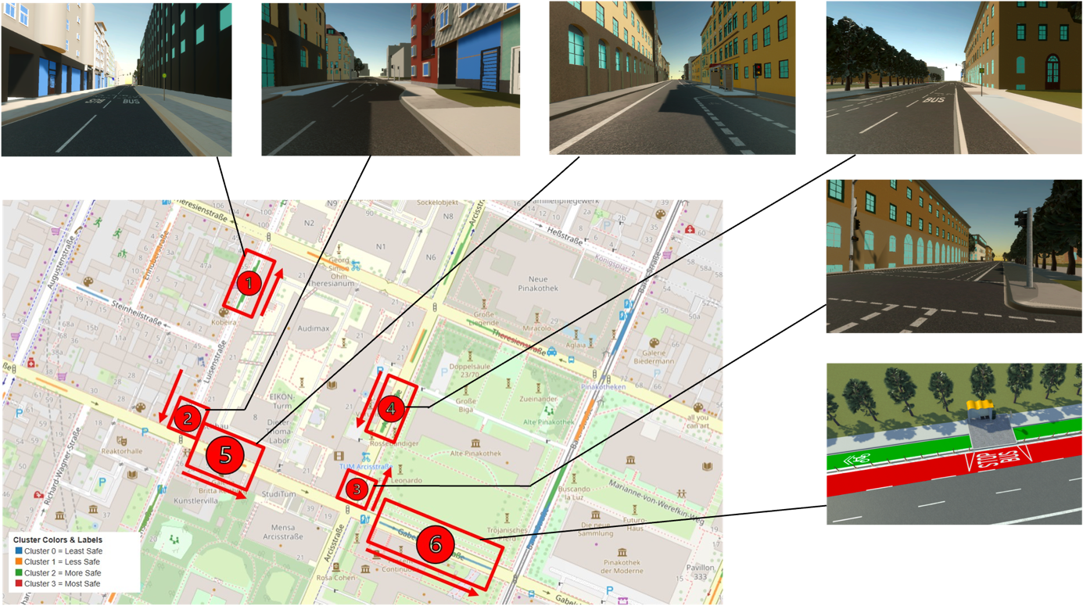
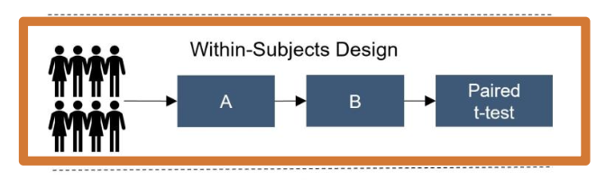
Methodology · Study design
Study design
⑤ Road-side stop
Within-subject design
3 drives per cyclist
Three conditions: No HMI, Bus HMI and Infrastructure HMI
Six bus-stop scenarios per drive
HMI order and routes were randomized
Repeated measures enabled within-cyclist comparisons
⑥ Protected bike lane
8
Notes:
We used a within-subject design.
Each cyclist completed three drives.
Across these drives, they encountered three HMI conditions: no HMI, Bus HMI, and Infrastructure HMI.
Each drive has six bus-stop scenarios.
The routes and HMI order were randomised to reduce order effects.
Stops 5 and 6 are especially important for our analysis.
Stop 5 is a roadside stop.
Stop 6 includes a protected bicycle lane.

Slide 9



Methodology · Data collection
Data were collected from three sources
Questionnaire
Self-reported simulator sickness
Simulator
Cyclists’ trajectory
Camera
Videos
Misery Scale (MISC), an 11-point scale from 0 (“nothing”) to 10 (“vomiting”)
Collected before the first drive and again after every drive
Position (bike, bus)
Speed
Steering
HMI status
Logged automatically throughout each drive
MP4 video clips
Recorded for gesture
analysis
*excluded from this study — processing the large files was beyond the project’s scope
9
Notes:
We collected data from three sources.
Participants fill in questionnairs before the first drive and after each drive to report their sickness level and driving patterns
Second, cyclists’ trajectory and bus positions, speed, steering, and HMI status were automatically recorded by simulator
Third, we also recorded videos for gesture analysis.
But since the video files were very large, they were not included in the current analysis.

Slide 10
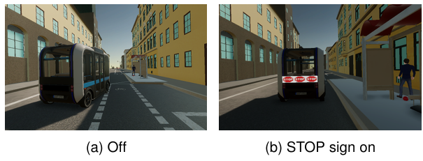
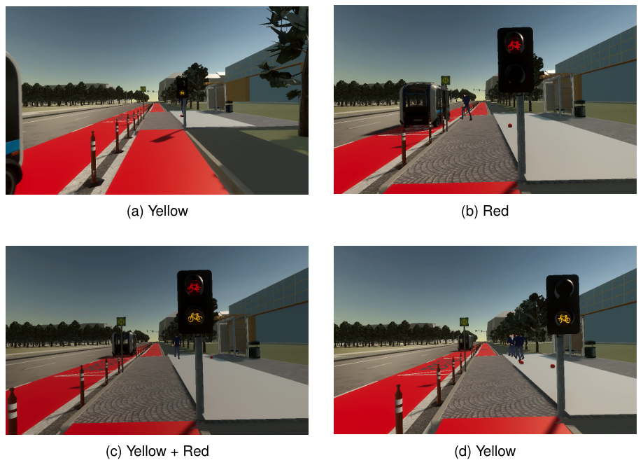
Methodology · RQ1
What differences in cyclists’ speed are observed across different HMI types (Bus-HMI and Infrastructure-HMI)?
Bus HMI
Infra HMI
A STOP warning appears on the rear of the automated moving shuttle
A roadside signal warns the cyclist independently of the bus display
Notes:
Our first research question focuses on speed.
It compares short-term speed responses across different HMI types
The Bus HMI is installed in the shuttle bus.
A direct STOP sign appears on the rear of the moving bus.
While the Infrastructure HMI is a fixed roadside signal.
It gives a warning independently of the display on the bus.

Slide 11
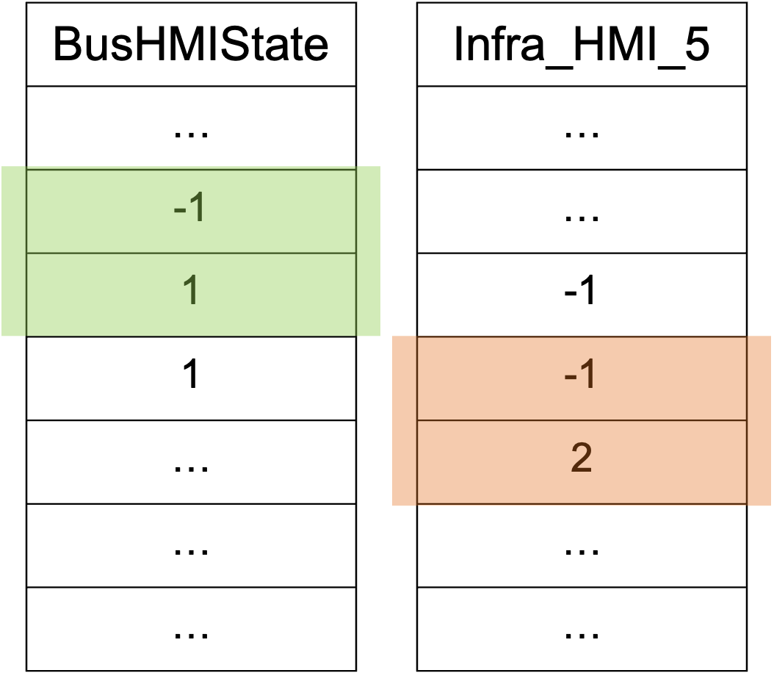
Methodology · RQ1
Definition and selection of HMI events
File name: SimBike.csv
353
HMI events identified after the complete-drive selection
Identified as a Bus-HMI event
272
events retained for visualisation across Stops 1-6
Identified as an Infra-HMI event
156
events at Stops 5-6 for the Bus- vs Infra-HMI analysis
(60 for bus, 96 for Infra)
BusHMIState changes
from inactive → 1
First active signal after
the channel changes from −1
Selection criteria
• Stops 5 and 6, where both HMI types were available
• Complete ±3 s windows
• Valid bus-position data
• Eligible Bus HMI in the same drive
One state transition becomes one HMI onset event
Notes:
The next step was to define an HMI event.
We used the HMI-state channels in the simulator data.
For the Bus HMI, when the state changed from inactive to active.
For the Infrastructure HMI, we selected the first active signal after the inactive state.
So one state transition became one HMI onset event.
We filtered all 353 events and selected 156 events at Stops 5 and 6 for the direct Bus-versus-Infrastructure comparison
By applying some specific criteria
Each event needed a complete six-second window and valid bus-position data.

Slide 12




Methodology · RQ1
Pre- and post-HMI windows of each HMI event
Pre-HMI period
HMI onset
Post-HMI period
$− 3s$
$t=0$
$+ 3s$
Use the HMI activation time as $t=0$, extract bicycle speed from the 3s pre-HMI and 3s post-HMI windows
Calculate the arithmetic mean of the speed samples separately for each event and period
Each event produces two mean-speed observations “Pre” and “Post”
Linear mixed-effects model
Handles repeated observations
Accounts for individual baseline
Allows unequal numbers of observations
Outcome
Mean cyclist’s speed during the pre- or post-HMI window
Fixed effects
Period, HMI-type, bus stop, Period × HMI-Type
Random effects
Random intercept by participant
Notes:
For every HMI event, we used the activation time as time zero.
We extracted speed record during the three seconds before the activation and three seconds after it.
We then calculated the mean speed separately for both periods.
So every event produced two observations: one pre-HMI value and one post-HMI value.
We analysed these values using a linear mixed-effects model Because it’s the ideal choice for analyzing repeated observations
And different part of the model were set up accordingly
Such as mean bicycle speed as an outcome and period, HMI-type and stop and an interaction term as independent variables

Slide 13

Methodology · Peak-deceleration location
Where did cyclists’ peak deceleration occur?
Calculation of peak-deceleration for all post-HMI windows
Extract the 3s window after each HMI onset
Apply an approximately 0.3s centred moving average to bicycle speed
Calculate acceleration from smoothed speed
Identify the sample with the most negative acceleration (strongest slowdown)
Distance at the moment of strongest deceleration:
$$L_{peak_deceleration_location}=\sqrt{{(x_{bike}−x_{bus})}^{2}+{(z_{bike}−z_{bus})}^{2}}$$
$x_{bike} ,z_{bike}$, $x_{bus}$, $z_{bus}$:
bicycle and bus positions in the horizontal plane
13
Notes:
In addition for speed response, we also wanted to know where the strongest slowdown happened.
So we included this as an exploratory analysis,
For all 3s post-HMI window.
First, we smoothed the bicycle speed to reduce small fluctuations.
then calculated acceleration from the smoothed speed.
so that the most negative acceleration represents the strongest slowdown.
At that exact moment, the distance between the bicycle and the bus were obtained by calculated the Euclidean distance
I will now hand over to Kriti for RQ2 and the descriptive overview.

Slide 14




Steering as a signal of sickness
Methodology · RQ2
Steering deflection
Angle between handlebar and frame heading — independent of which way the route turns
Three 80-second windows
Measured at the start, middle, and end of each drive — 131 of 133 drives qualified
Key measure: wobble change (IQR)
The change in steering “wobble” from the first to the last window of a drive
Compared to each rider’s own baseline
A model separates “this rider generally” from “this drive, for this rider”

Slide 15
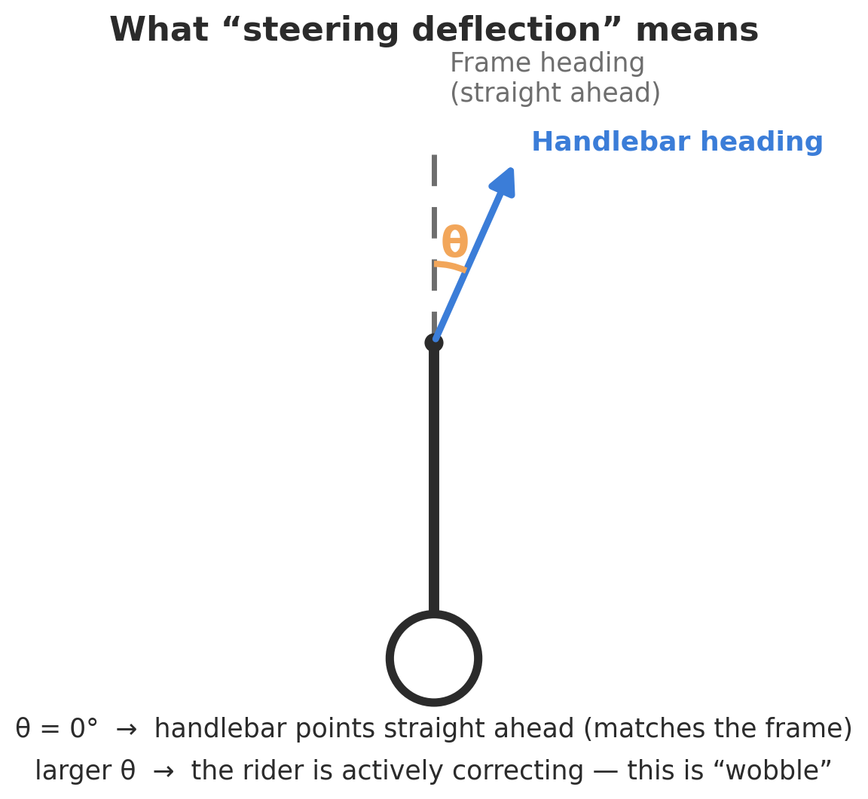
What “steering wobble” means
Methodology · RQ2
Steering deflection is the angle between where the handlebar points and where the bike frame points.
0° means the handlebars are aligned with the frame — riding straight, no correction
A larger angle means the rider is actively correcting — this is what we call “wobble”
It only measures the rider’s own steering, independent of which way the route itself turns
We summarise wobble using a statistic (IQR) that reflects typical side-to-side correction, ignoring rare one-off jerks
Steering deflection = angle between handlebar and frame heading

Slide 16
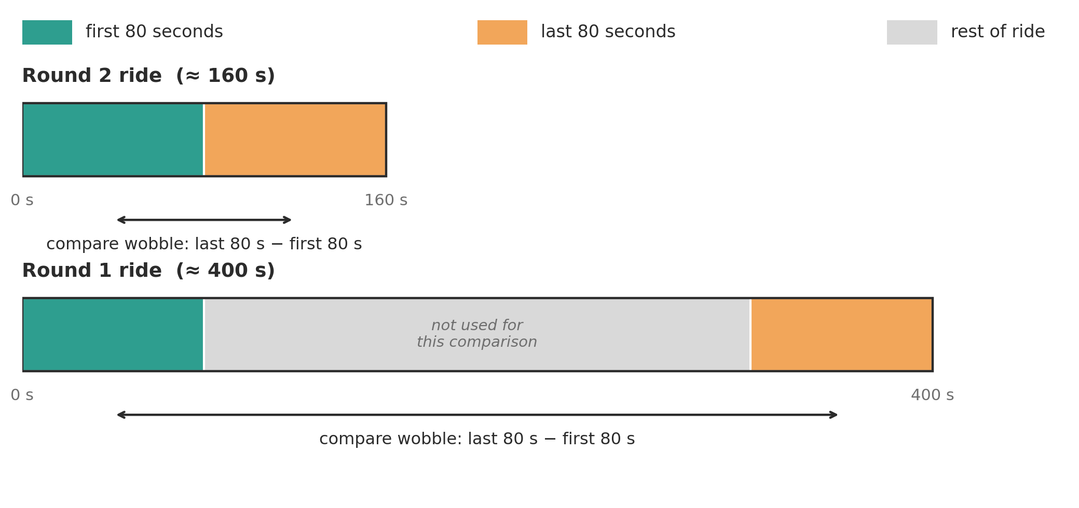
Comparing rides of different lengths fairly
Methodology · RQ2
Ride lengths varied a lot between the two collection rounds — so wobble is measured in the same fixed 80-second window near the start and end of every ride, whatever its total length.
Same 80-second window regardless of ride length — 131 of 133 drives qualified

Slide 17
Results
Descriptive data
RQ1 · Conclusion & Discussion
RQ2 · Conclusion & Discussion

Slide 18
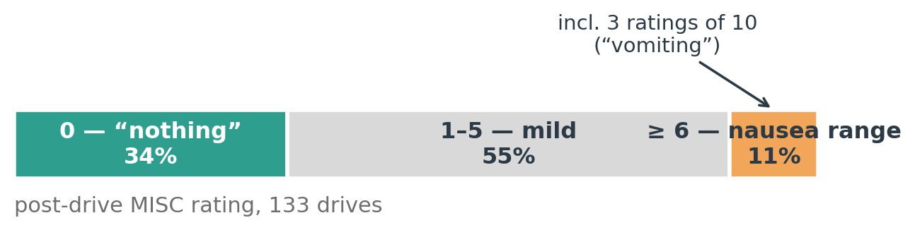
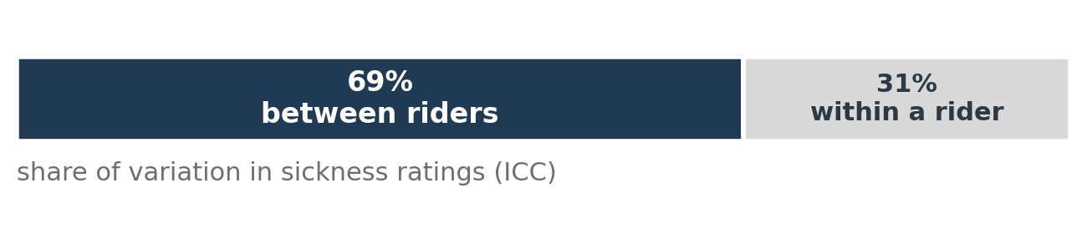
The data at a glance
Result · Descriptive results
48
Participants
133
Drives
7.2 m/s
Avg. riding speed (cap ≈ 7.5 m/s)
→ RQ2 always compares a rider against their own average, not against other riders.

Slide 19
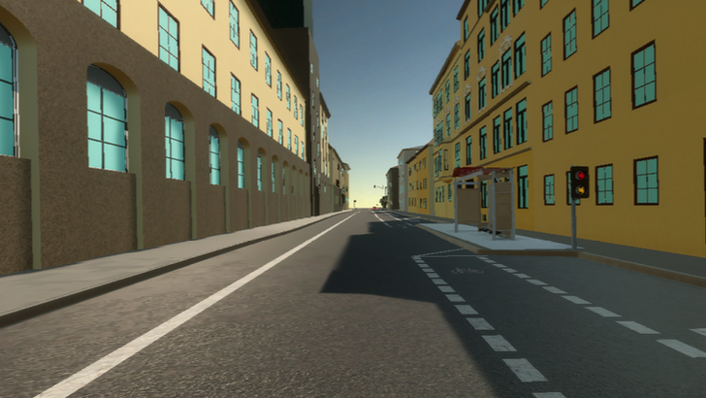
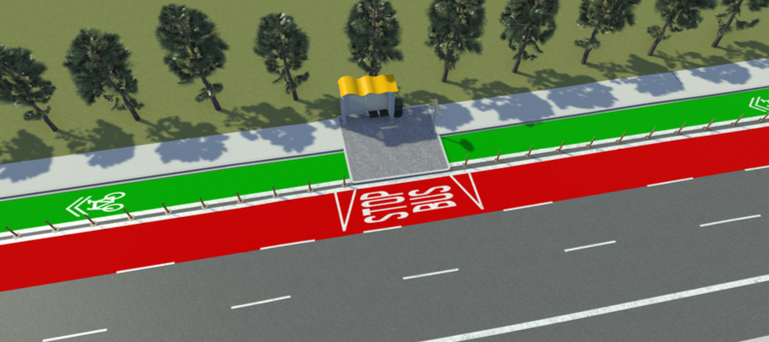
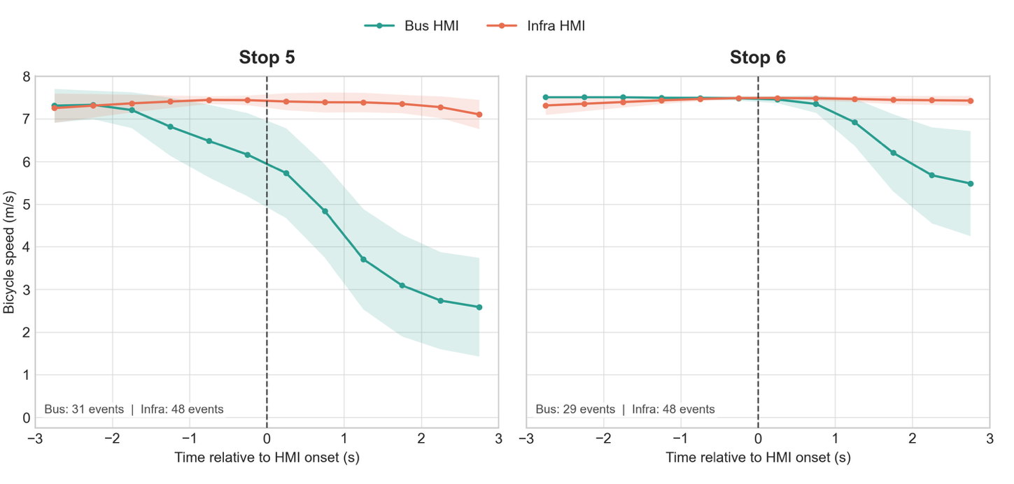
Result · RQ1 · Speed profiles
Speed around Bus-HMI followed by a clear slowdown;
Speed around infra-HMI remains near the speed limit (7.5 m/s)
Stop | HMI-type | Event No. | Pre-HMI speed, Mean (SD), m/s | Post-HMI speed, Mean (SD), m/s | Change, Mean (SD), m/s
5 | Bus | 31 | 6.906 (1.376) | 3.828 (2.524) | −3.078 (2.567)
5 | Infra | 48 | 7.373 (0.616) | 7.268 (0.973) | −0.105 (0.689)
6 | Bus | 29 | 7.497 (0.051) | 6.504 (1.659) | −0.993 (1.656)
6 | Infra | 48 | 7.375 (0.497) | 7.440 (0.343) | +0.065 (0.603)
Stop 5
Stop 6
Visulisation of mean speed using 0.5s interval
Notes:
Thanks, Kriti.
I will now come back to the results for RQ1.
In comparison, speed around the Infrastructure HMI changed very little at either stop.
It remained close to the simulator speed limit.
Here I did some extra visualisation work to see the speed change more intuitively.
The green line represents the Bus HMI, and the orange line is the Infrastructure HMI.
Both at Stop 5 and 6, mean speed around the Bus HMI has an obvious decrease, but at Stop 5, the slowdown starts earlier.

Slide 20
Result · RQ1 · Mixed-effects model
Reference condition:
Pre-HMI · Infrastructure HMI · Stop 5
Contrasts:
Post vs. Pre · Bus vs. Infrastructure HMI · Stop 6 vs. Stop 5
Fixed effect | Coef. | Std.Err. | z | P | 0.025 | 0.975
 | 7.047 | 0.153 | 46.155 | <.001 | 6.747 | 7.346
Period | -0.020 | 0.176 | -0.114 | 0.909 | -0.366 | 0.326
HMI-type | -0.183 | 0.202 | -0.907 | 0.364 | -0.578 | 0.212
 | 0.682 | 0.139 | 4.920 | <.001 | 0.410 | 0.953
 | -2.058 | 0.284 | -7.239 | <.001 | -2.615 | -1.501
Cyclists maintained a higher mean speed around bus stop at protected bake lane (Stop 6) than at road-side stop (Stop 5)
(Station effect: β = +0.68 m/s; p < .001)
Intercept
Cyclist around Bus-HMI onset has a stronger pre-to-post slowdown, about 2.06 m/s slower than around Infra-HMI
(Interaction: β = −2.06 m/s; p < .001)
Station
The response depended on the combination of period and HMI type, not on either alone
(Period: p = .909; HMI type: p = .364)
Period × HMI-type
Notes:
So First we can notice a station effect.
Cyclists generally maintained a speed about 0.68 metres per second higher at Stop 6, with the protected bicycle lane, than at Stop 5.
A more important result, which we can notice here is the interaction between period and HMI type.
In simple terms, the pre-to-post speed reduction was about 2.06 metres per second stronger around the Bus HMI than around the Infrastructure HMI.

Slide 21
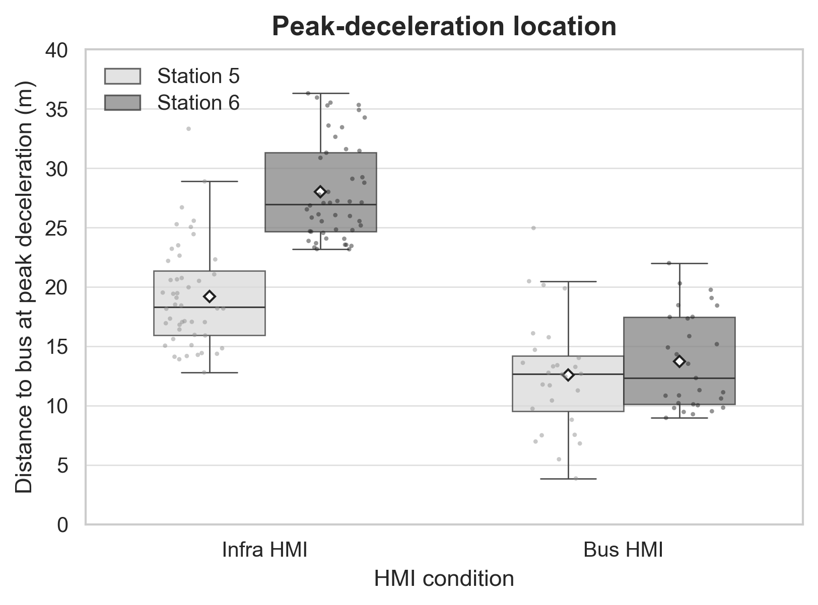
Result · Peak-deceleration location
The location of cyclists’ peak deceleration varied across HMI types and bus stop configurations
Peak-response locations under Bus HMI remained similar across both stops, but differs under Infra-HMI (Bus HMI ≈ 13-14 m; Infra HMI ≈ 19-28 m)
The difference between the two HMI types was particularly apparent at Stop 6
(Median difference Infra-Bus: Stop 5 ≈ 4.5 m; Stop 6 ≈ 14 m)
Exploratory result
(no inferential test was conducted )
Notes:
The peak-deceleration locations also showed an interesting pattern.
Under the Bus HMI, the peak-deceleration location remained quite similar at both stops
Under the Infrastructure HMI, it varied more.
The difference of peak-deceleration locations between the two HMI types was especially visible at Stop 6.
However, this result is exploratory.
We did not conduct an inferential significance test, so we describe it as a pattern rather than a confirmed effect.

Slide 22
RQ1 · Conclusion & Discussion
Cyclists’ speeds were not generally lower before HMI onset, but their short-term speed adjustments after HMI onset differed between the HMI-types.
ASB may have attracted more attention from cyclists than the fixed infrastructure
Actual behaviour change is not the same as perceived reliance.
The Infrastructure HMI, though rated more “familiar” by cyclists in the earlier work, produced weaker behavioural response
Bus-stop layout and road context (e.g. a nearby crossing) also shape when the reaction happens.
Notes:
To summarise RQ1, cyclists were not generally slower before the HMI appeared.
The main difference happened after HMI activation.
The Bus HMI produced a stronger short-term behavioural response than the Infrastructure HMI.
One possible explanation is that the moving bus and its direct STOP message attracted more attention.
So perceived reliance and actual behaviour are not necessarily the same. The Infrastructure HMI was rated as more familiar in the earlier study, but familiarity did not lead to a stronger speed response.
And last one is that the bus-stop layout also appears to influence when the cyclist reacts.
Here’s everything for RQ1
I will now hand back to Kriti for the rest of the slides

Slide 23
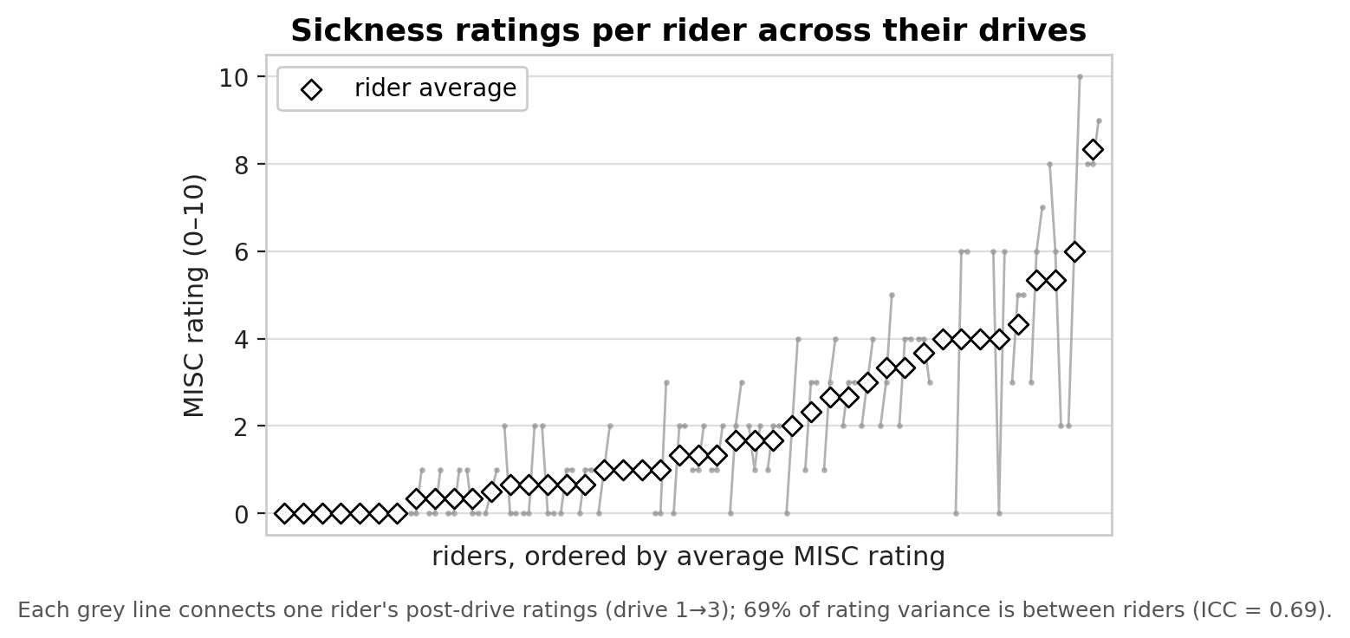
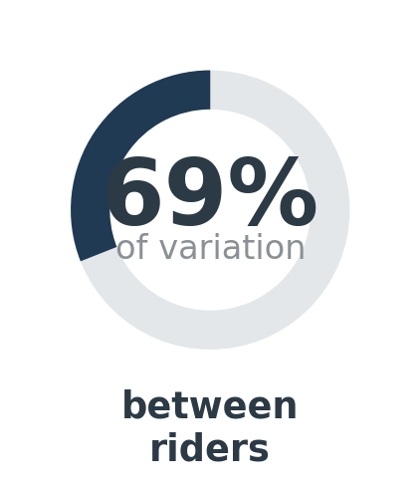
Sickness is mostly a trait of the person, not the drive
Result · RQ2
69% of all variation in sickness ratings sits between riders (not between drives) — so every RQ2 analysis compares each rider only against their own average.
Fig. 4.4 — Post-drive sickness ratings per rider
Notes:
69 percent of all variation in sickness rating is between people not between drives.

Slide 24
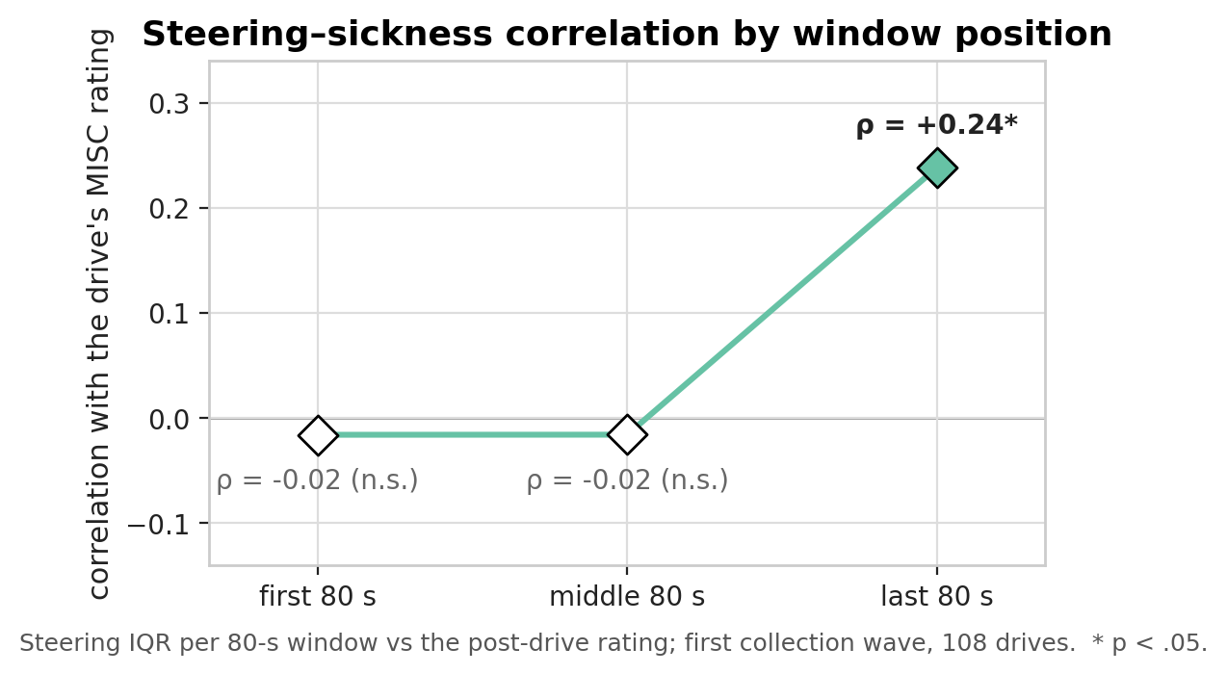
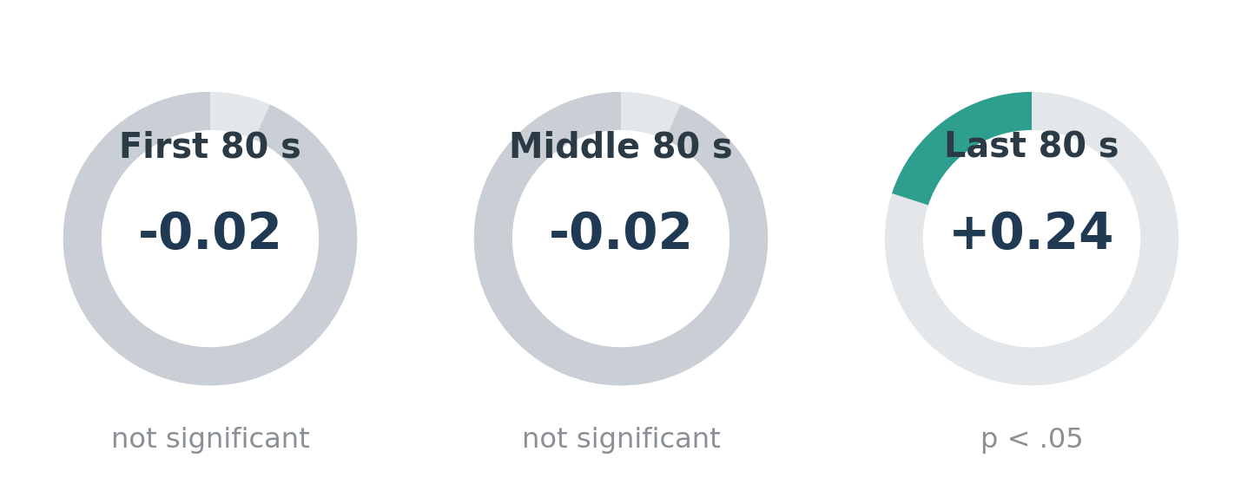
The steering signal appears only later in a drive
Result · RQ2
Steering wobble was compared with the drive’s rating separately for the first, middle, and last 80 seconds of riding.
Fig. 4.5 — Steering–sickness correlation by window position

Slide 25
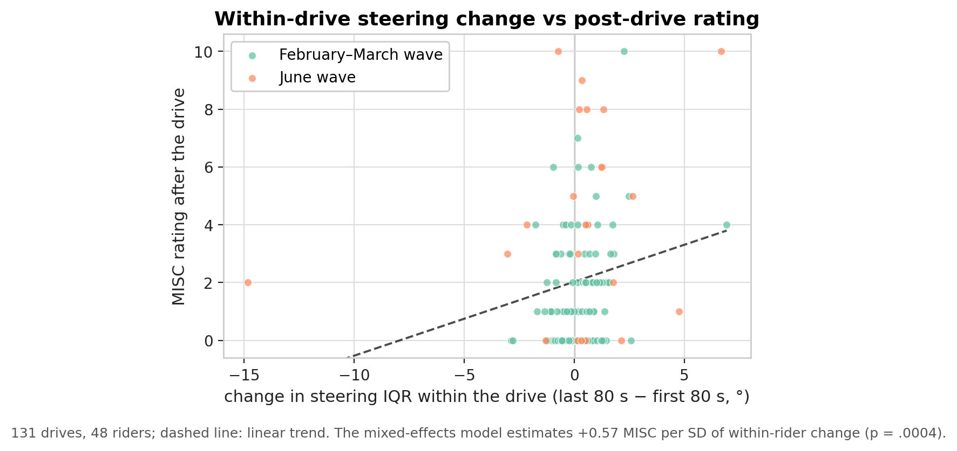
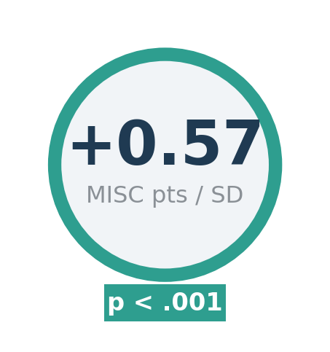
Confirmed: steering wobble tracks a rider’s own sickness
Result · RQ2
On drives where a rider’s steering degraded more than usual for them, their sickness rating was higher — +0.57 MISC points per SD of change (p < .001) — supporting H2a/H2b.
Fig. 4.6 — Within-drive steering change vs. post-drive rating
Notes:
Increses in o.57 points on the sickness scale for every sd increse in wobble

Slide 26



What the steering result means
Discussion & Conclusion
Sensory conflict
Why between-rider comparisons fail
Two different kinds of signal
Growing conflict between what the eyes see and what the inner ear feels progressively degrades fine motor control — surfacing as extra handlebar corrections
Baseline riding style varies too much between people; only a rider’s own deviation from their own normal carries a signal
RQ1’s speed change is a deliberate response to the HMI; RQ2’s steering drift is an involuntary by-product of the rider’s internal state

Slide 27
Limitation & Future work

Slide 28
Where this could go next
Limitation & Future work
Limitation
Validate the simulator against real-road cycling to test whether it reproduces absolute values or only relative differences between conditions
Collect data where sickness varies more within a rider (longer/more provocative drives, in-drive ratings) to sharpen the RQ2 signal
Keep one consistent drive protocol across future recruitment waves
Bring in the video/gaze data
usable sample reduced to 32 of 48 participants
no gaze/video data to explain the behaviour
MISC treated as continuous though it is an ordinal scale
primary measure chosen using the same data it was tested on

Slide 29
References
Abadi, M. G., Hurwitz, D. S., Sheth, M., McCormack, E., & Goodchild, A. (2019). Factors impacting bicyclist lateral position and velocity in proximity to commercial vehicle loading zones: Application of a bicycling simulator. Accident Analysis & Prevention, 125, 29–39. https://doi.org/https://doi.org/10.1016/j.aap.2019.01.024
Bos, J. E., MacKinnon, S. N., & Patterson, A. (2005). Motion sickness symptoms in a ship motion simulator: Effects of inside, outside, and no view. Aviation, Space, and Environmental Medicine, 76(12), 1111–1118.
Flaticon. (n.d.). Free icons and stickers [Icon library]. Freepik Company S.L.U.
Guo, X., Tavakoli, A., Angulo, A., Robartes, E., Chen, T. D., & Heydarian, A. (2023). Psycho-physiological measures on a bicycle simulator in immersive virtual environments: How protected/curbside bike lanes may improve perceived safety. Transportation Research Part F: Traffic Psychology and Behaviour, 92, 317–336. https://doi.org/10.1016/j.trf.2022.11.015
Huertas-Leyva, P., Dozza, M., & Baldanzini, N. (2018). Investigating cycling kinematics and braking maneuvers in the real world: E-bikes make cyclists move faster, brake harder, and experience new conflicts. Transportation Research Part F: Traffic Psychology and Behaviour, 54, 211–222. https://doi.org/10.1016/j.trf.2018.02.008
Jashami, H., Cobb, D., Sinkus, I., Liu, Y., McCormack, E., Goodchild, A., & Hurwitz, D. (2024). Evaluation of bicyclist physiological response and visual attention in commercial vehicle loading zones. Journal of Safety Research, 88, 313–325. https://doi.org/10.1016/j.jsr.2023.11.018
Kaß, C., Schoch, S., Naujoks, F., Hergeth, S., Stemmler, T., Keinath, A., & Keukum, A. (2020). Using a Bicycle Simulator to Examine the Effects of External HMI on Behavior of Vulnerable Interaction Partners of Automated Vehicles. Proceedings of the Driving Simulation Conference 2020 Europe VR, 157–164.
Pechinger, M., & Lindner, J. (2024). Sumonity: Bridging SUMO and Unity for enhanced traffic simulation experiences. SUMO Conference Proceedings, 5, 163–177.
Zheng, T., Pechinger, M., Lindner, J., & Bogenberger, K. (2025, September 26). Validating Bicycle Simulators Active Steering in a CAVE Virtual-Reality environment. https://doi.org/10.82157/dsa/2025/21
Zafar, A. (2026). Investigating look-ahead points of cyclists in a bicycle simulator [Unpublished master’s thesis]. Technical University of Munich, Chair of Traffic Engineering and Control.

Slide 30
Thank you for your attention
Investigating cyclists’ speed responses and steering-related simulator sickness
A CAVE bicycle simulator study

