Slide 1
Credit Card Data Analysis
Shubham Thakur

Slide 2
Introduction
Since the 1980s, credit card usage has soared all around the world. The convenience and safety of not carrying cash, the possibility of paying in installments, non price benefits like bonuses, rewards, and shopping miles, and quick and easy access to credit are among the factors that contributed to the widespread adoption of credit cards by consumers. There has been a significant increase of credit card usage . As the credit card network spreads and more persons get into its ambit, there is possibility of increase of Credit Card fraud and also credit card loan default as it can lead to huge debt over the consumers.

Slide 3
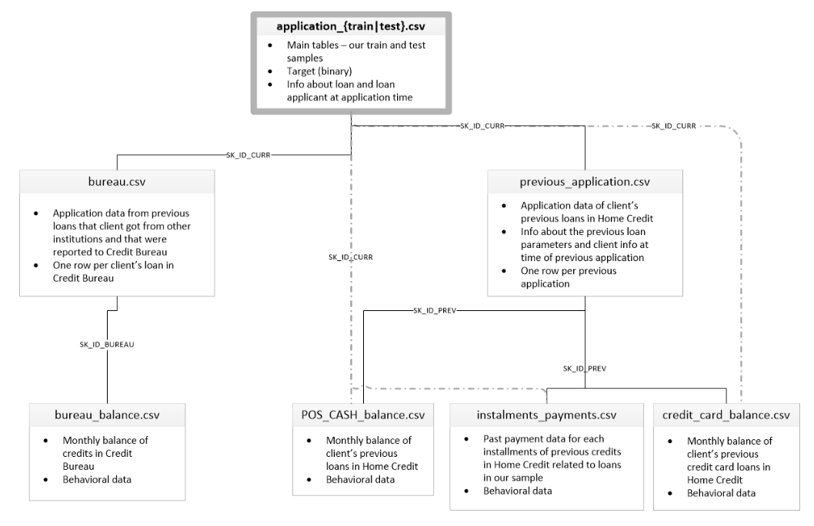
Data Considered for this analysis

Slide 4
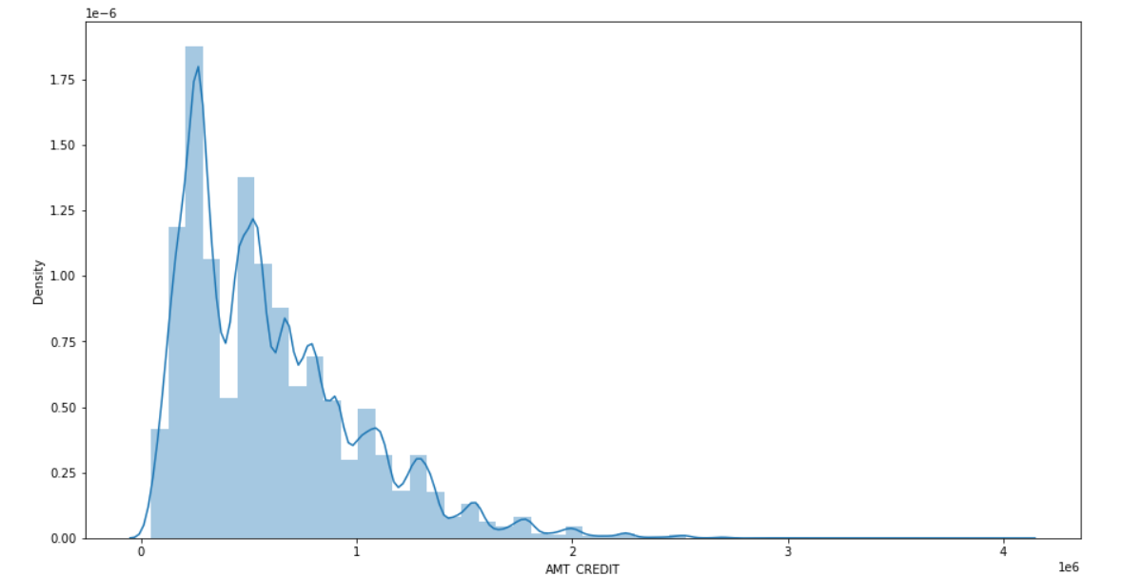
DISTRIBUTION OF CREDIT LIMIT GIVEN TO CONSUMER
In this we have analysed distribution of Credit limit which tells us what is credit limit given to most of applicants and help us in deciding what limit can be given to new applicant

Slide 5
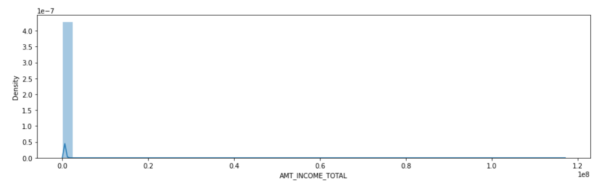
DISTRIBUTION OF INCOME OF CONSUMER
In this we have analysed distribution of income of consumer which tells us what is the income of most of applicants and as from this graph we can see most of applicants have the same income level.

Slide 6
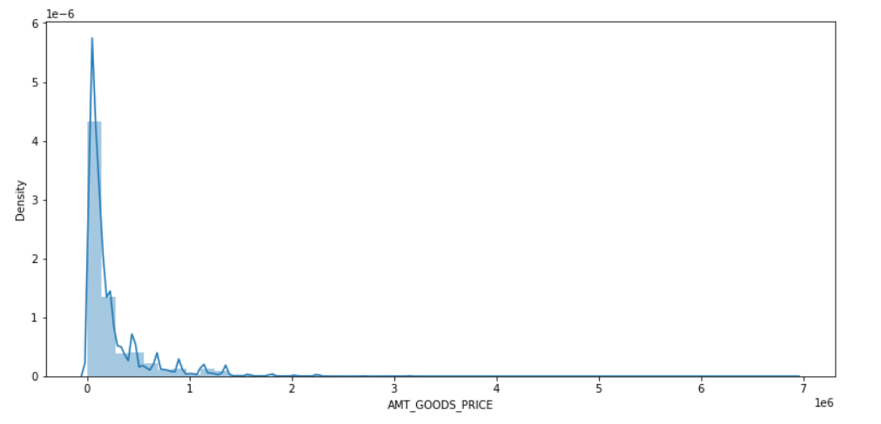
DISTRIBUTION OF PURCHASING PRICE OF GOODS BY CONSUMER
In this we have analysed purchasing price of goods. This data shows the distribution of spends between the consumer which helps in deciding the credit limit also. So we can see from above that most of people have similar Purchasing price of goods

Slide 7
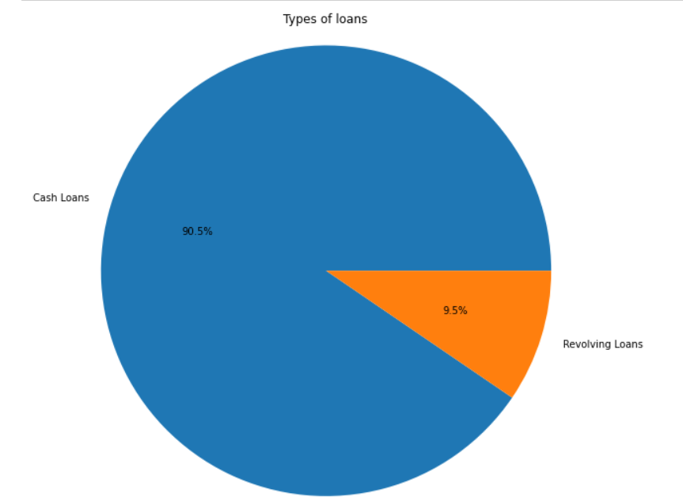
DISTRIBUTION ON TYPE OF LOANS CONSUMER PREFER
In this we have analysed type of loans which customer take from their credit card. It helps in taking risk assessment as in above analysis it is clear that 90.5% people take Cashloans

Slide 8
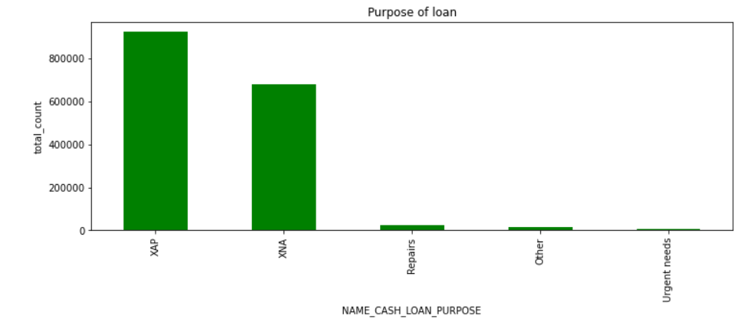
PURPOSE OF CASH LOAN
In this we have analysed purpose of loan for which people take loans and we can analyse using this that for this particular purpose people prefer taking loan so this shows target market for Credit Card

Slide 9
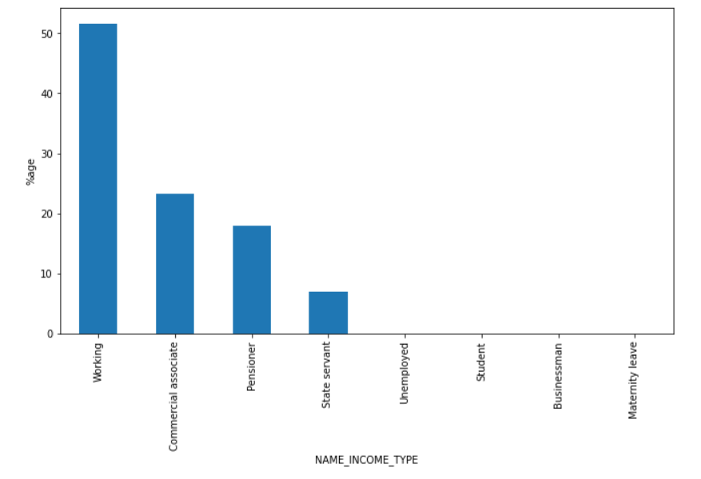
INCOME SOURCE DISTRIBUTION OF APPLICANTS
In this we have analysed income source of applicants, using this we can find that mostly(50% approx.) Working class people use credit card and again we can find target audience for credit card based on income source

Slide 10
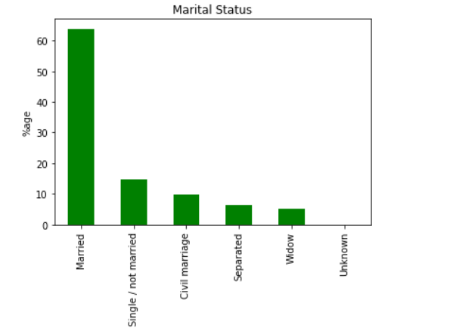
MARITAL STATUS OF APPLICANTS
In this we have analysed Martial Status of applicants. It shows that more than 60% applicants are married which shows there need of using credit card due to extra responsibilities and also we can find the target market for credit card as well

Slide 11
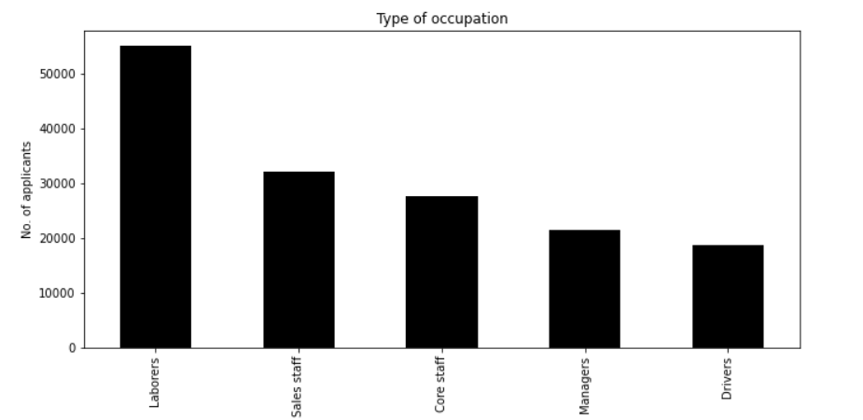
OCCUPATION OF APPLICANTS
In this we have analysed occupation of applicants. It shows that Laborers are the one applying mostly for credit card followed by sales staff and core staff. It also gives risk assessment as laborers have less income so there are chances of loan default also

Slide 12
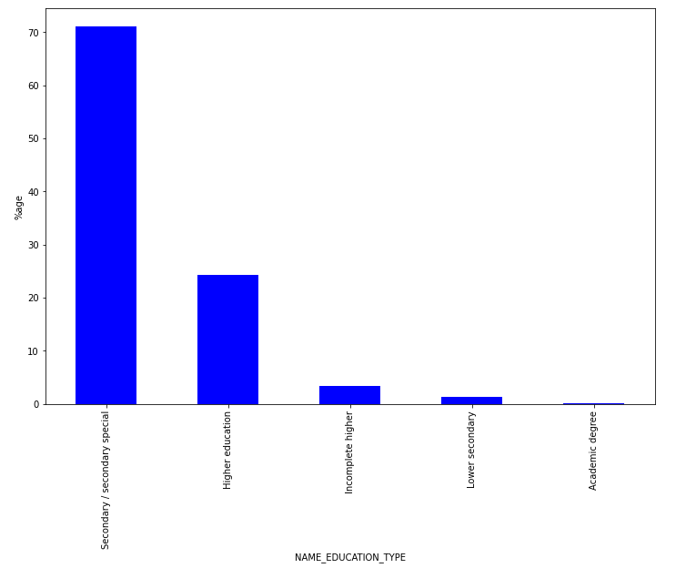
EDUCATION TYPE OF APPLICANTS
In this we analysesd education type of applicants. As more than 70% applicants have Secondary education.
It helps in taking risk assessment of profile as high education qualification means less chances of loan not repayment.

Slide 13
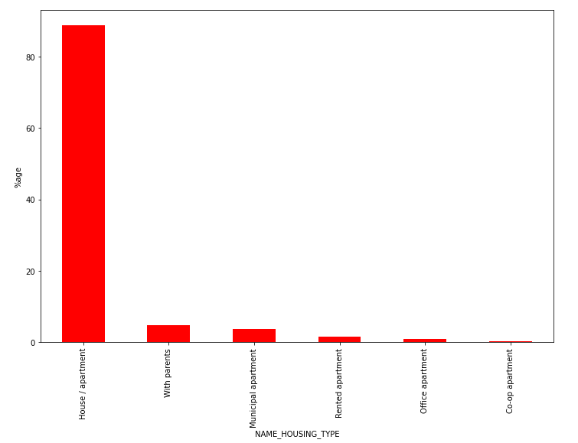
APPLICANTS CURRENT HOUSING LIVING TYPE
In this we analysed Current housing living situation of applicants and from this we can find what is the housing type where most of applicants live which gives maximum values to House/Apartments. It also gives us target market of Credit Card

Slide 14
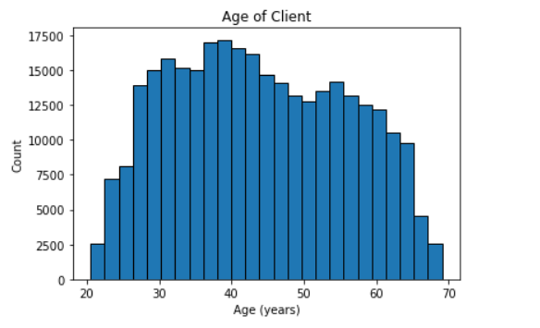
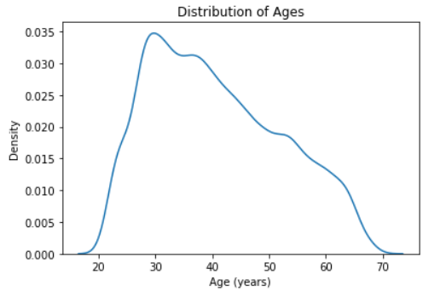
APPLICANTS AGE ANALYSIS
APPLICANTS AGE DISTRIBUTION
APPLICANTS AGE DISTRIBUTION WHO COULD NOT REPAY LOAN
Here we have analysed age of applicants and there loan repayment capacity, As we can see from above data how younger people are not able to pay their loan as compared to older people. So it helps in risk assesment

Slide 15
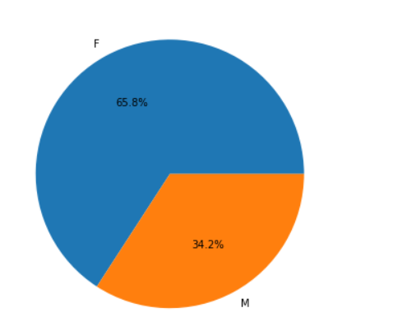
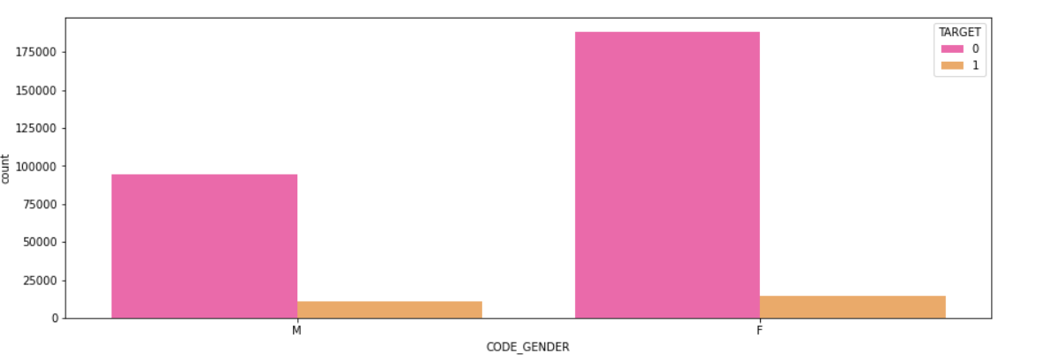
Gender Distribution among applicants
Here we have analysed gender of applicants and as this shows that there are more female applicants in the data as compared to male and also Female tends to repay loan timely as compared to Male

Slide 16
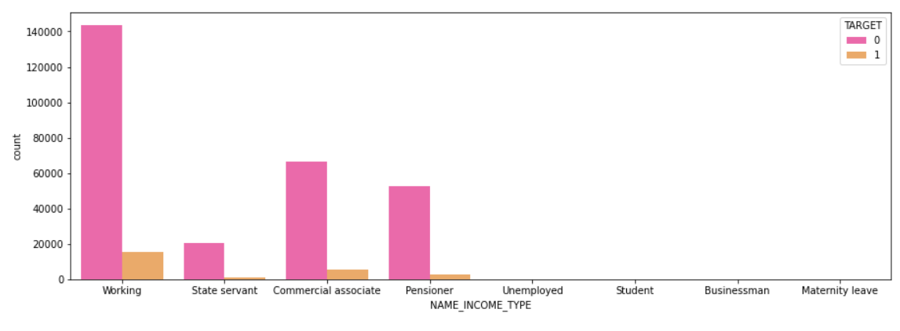
Income sources of Applicant's in terms of loan is repayed or not
Target 0 means loan is paid on time
Target 1 means loan is not paid on time

Slide 17
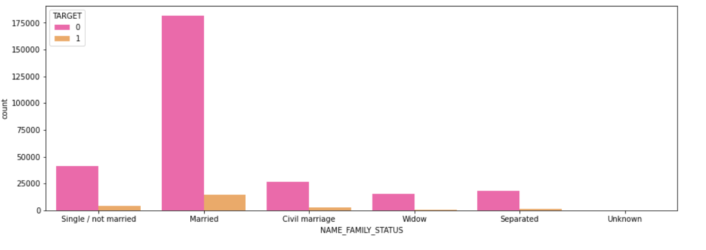

Family Status of Applicant's in terms of loan is repayed or not
Target 0 means loan is paid on time
Target 1 means loan is not paid on time

Slide 18
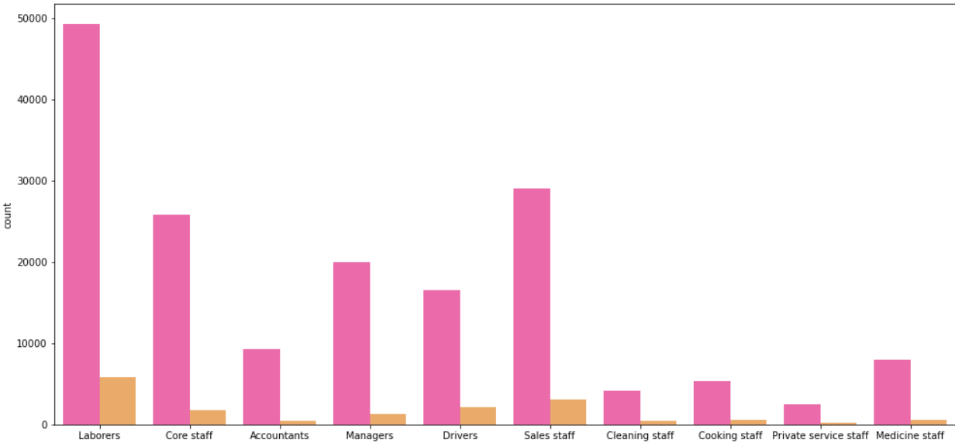
Occupation of Applicant's in terms of loan is repayed or not
Target 0 means loan is paid on time
Target 1 means loan is not paid on time

Slide 19
EXPLORATION OF PREVIOUS DATA OF APPLICANTS
In Earlier slides we analysed the data of current applications and looked at the trend and distribution of various features now we will look into previous application data and give some useful analysis

Slide 20
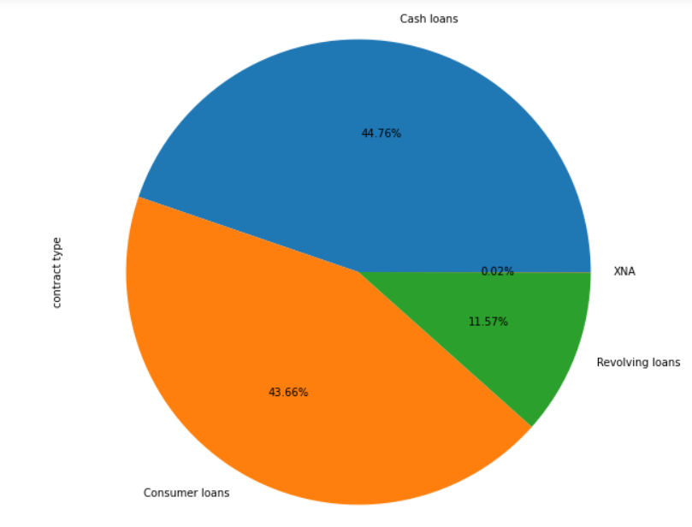
Contract product type of previous application
In this we have analysed type of loans which customer take from their credit card. It helps in taking risk assessment as in above analysis it is clear that approx. same number of people take Cash Loans and Consumer Loans and few people prefer Revolving Loans

Slide 21
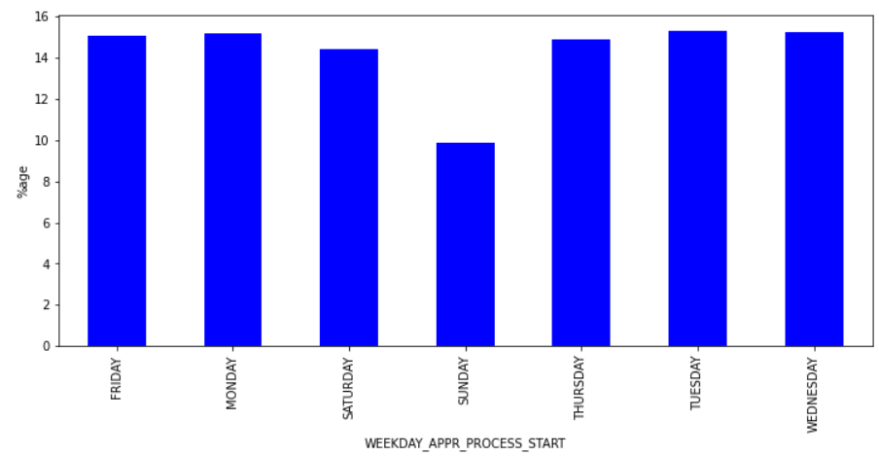
On which day clients applied in previous application
In this we have analysed on which day client applied previous application which shows us that all days except (Sat & Sun) have equal distribution of applicants

Slide 22
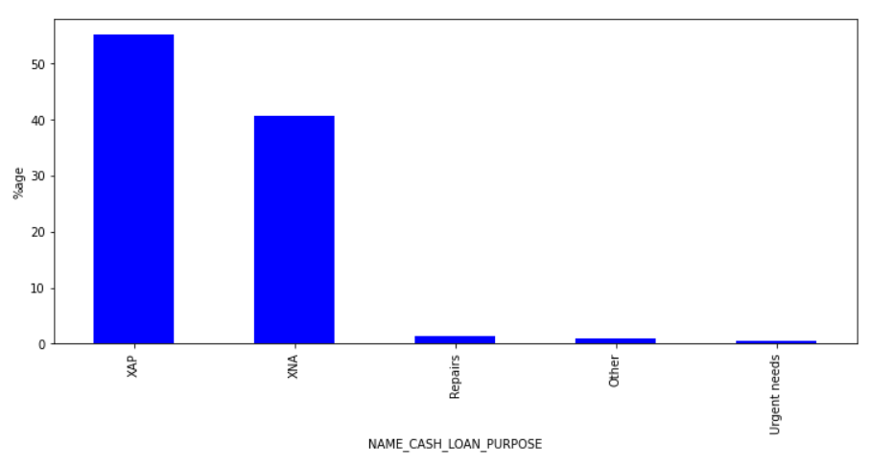
Purpose of CASH LOANS in Previous Application
In this we have analysed purpose of CASH loan for which people take loans and we can analyse using this that for this particular purpose people prefer taking loan so this gives us risk assessment also as CASH loans are more risky than revolving loans

Slide 23
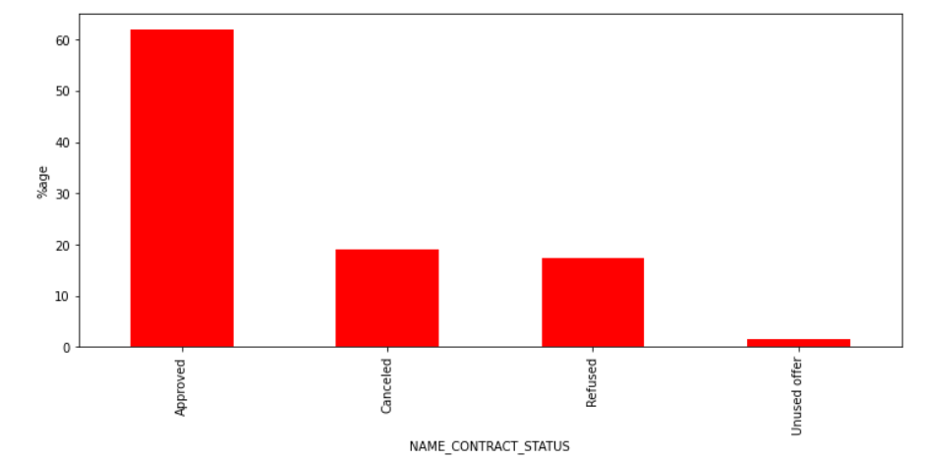
Contract was approved or not in previous application
From this we can check whether the Contract was approved or not in previous application and we can fo further analysis by checking why they were rejected and what was the purpose now and previously so we can finally make decision on whether to approve this time or not

Slide 24
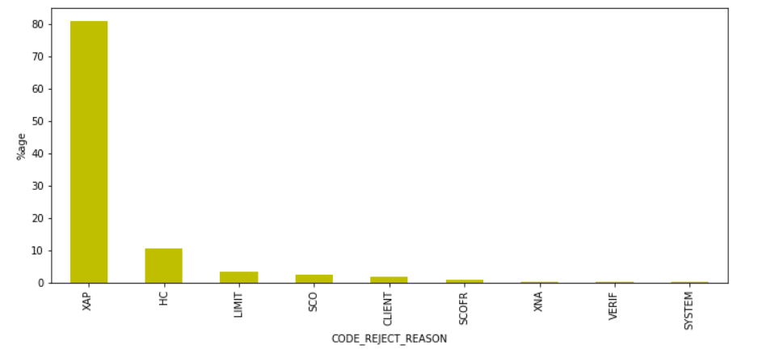
Why previous application was rejected
From this we can check why they were rejected previously and what was the purpose now and previously so we can finally make decision on whether to approve this time or not

Slide 25
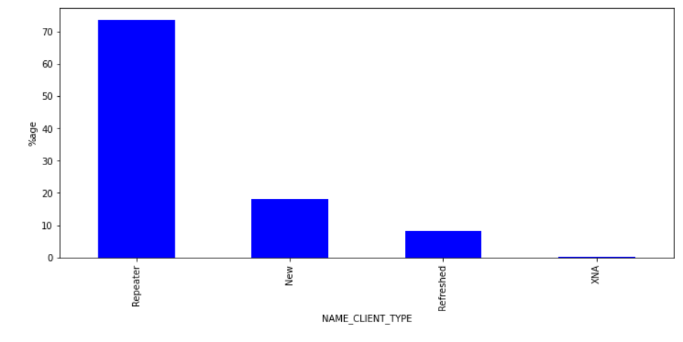
Was Client New or Repeater when applying for previous application
From this we can check is applicant repeater or his application new or refreshed. It helps us in getting the feedback of the system and customer are repeating so they might like the rewards, offers or other services of the Credit Card

Slide 26
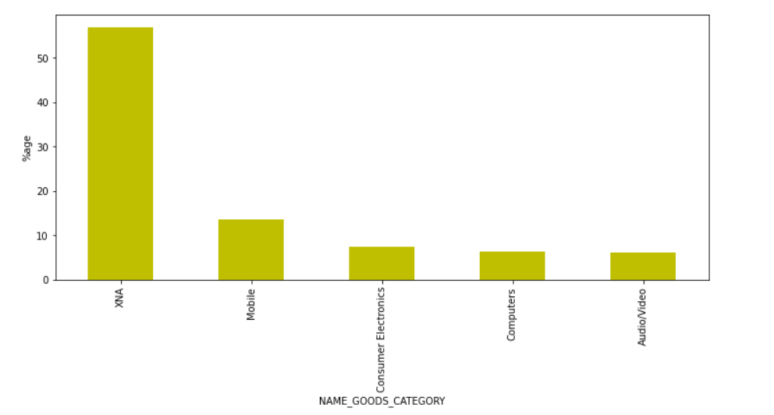
Purpose of Loan for previous application
In this we have analysed purpose of loan for which people take loans and we can analyse using this that for this particular purpose people prefer taking loan so this shows target market for Credit Card

Slide 27
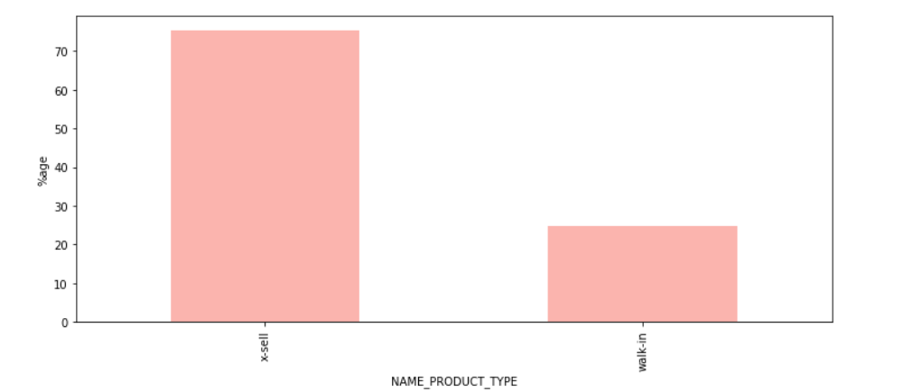
Was previous application X-Sell or Walk-In
In this we have analysed as previous applicants comes under X-sell or Walk-in as we can see 70% are X-sell which tells us existing customers are taking more loans

Slide 28
CONCLUSION
In this I analysed the Credit card applicant data. First I started with checking the whole dataset and analysed which features are required for further analysis process. I started with checking Credit Limit distribution which resulted that most of applicants are given same credit limit
I also analysed Type of loans which consumer take which gives us maximum(90%) as CASH and if we look at previous application data cash loans were 44% which tells us trend is changing towards CASH Loans more
I also checked income sources, education level, housing situation of applicants which can help in checking the repayment ability of applicant
Age analysis is also done which shows that as age increases loan repayment ability of person also increases. So the risk of Loan default is low among high age people
Analysis on previous application data is also done which shows us how many repeaters and how many new people have applied
Previous application data also shows rejection reason and purpose of application of loan

