Slide 1
Digital portfolio
STUDENT NAME : S.THANIGAIVEL
REGISTER NO & NMID : 2224035657 & 855119AA1A9B810A5CD43A56AACD49D6
DEPARTMENT : BSC CS
COLLEGE : SRI DEVI ARTS & SCIENCE COLLEGE AT PONNERI
UNIVERSITY : MADRAS UNIVERSITY

Slide 2
PROJECT TITLE
GUESS THE NUMBER
GUESS THE NUMBER

Slide 3
AGENDA
1.PROBLEM STATEMENT 5.PORTFOLIO DESIGN & LAYOUT
2.PROJECT OVERVIEW 6.FEATURES & FUNCTIONALITY
3.END USERS 7.RESULTS & SCREENSHOTS
4.TOOLS & TECHNOLOGIES 8.CONCLUSION
9.GITHUB LINK

Slide 4
PROBLEM STATEMENT
The program should generate a random number between 1 and 100 when the page loads or the game is reset.
The user should enter their guess using a number input field and click a "Guess" button.
The game should:
Display a message if the guess is too low, too high, or correct.
Track and display the number of attempts taken to guess correctly.
A "Reset" button should allow the user to start a new game with a new random number.

Slide 5
project overview
This is a simple web-based guessing game created using HTML, CSS, and JavaScript.
The computer randomly selects a number between 1 and 100, and the player tries to guess it. After each guess, the game gives feedback—telling the user if the guess is too low, too high, or correct.
It also tracks the number of attempts and has a Reset button to start a new game.

Slide 6
who are the end users ?
👶 Children and Students
They can play the game for fun and learn about numbers.
🧑‍💻 Beginners Learning to Code
People learning HTML, CSS, and JavaScript can use this as a small project.
🎮 Anyone Looking for a Quick Game
Casual users who want a simple and fun guessing game in the browser.
👨‍🏫 Teachers
Educators can use this to teach basic web development and logic.

Slide 7
tools & techniques
✅ Tools Used:
HTML – For creating the webpage layout.
CSS – For styling the page (fonts, colors, layout).
JavaScript – For game logic and interactivity.
🛠️ Techniques Used:
Random Number Generation – Using Math. random() to pick a number between 1 and 100.
DOM Manipulation – To display messages and update input fields.
Event Handling – Using onclick to trigger functions when buttons are clicked.
Input Validation – Ensuring guesses are numbers within the allowed range.
Conditional Logic – Checking if the guess is too high, too low, or correct.

Slide 8
A successful simple portfolio uses a single-page layout. The user scrolls down to see all the content, making it quick and easy to navigate. The design should be clean, with plenty of negative space to make your work the focal point. Header: The top of the page should have your name, a brief one-line description of what you do (e.g., "Web Developer" or "UI/UX Designer"), and a clear navigation menu for easy jumping to different sections on the page (About, Work, Contact). Hero Section: Immediately below the header, a "hero" section should greet visitors. This is where you can put a welcoming message, a profile picture, and a strong call-to-action like "View My Work." About Section: This section is for a short biography. Keep it concise. Talk about your skills, your passions, and what you're looking for. Use the same and heading styles from the provided code for consistency. Work Section: This is the most crucial part. Showcase a few of your best projects. You don't need to show everything. Pick 3-5 of your strongest pieces. For each project, include a project title, a brief description, and a link to the live demo or code repository. You could reuse the .card class to frame each project. Contact Section: At the bottom of the page, include links to your professional social media profiles like LinkedIn or GitHub, and a way for people to contact you, like an email address. You could also include a simple contact form.
portfolio design & layout

Slide 9
Features & functionality
Random Number Generation:
Automatically picks a secret number between 1 and 100 when the page loads or the game resets.
User Input:
Allows the player to enter their guess through a number input field restricted to values between 1 and 100.
Guess Validation:
Checks if the input is a valid number within the specified range and prompts the user if it’s invalid.
Attempts Counter:
Keeps track of how many guesses the player has made.
Winning Message:
Displays a congratulatory message showing the number of attempts once the correct number is guessed.
Reset Function:
Resets the game by generating a new secret number, clearing attempts, and resetting the input and messages.

Slide 10
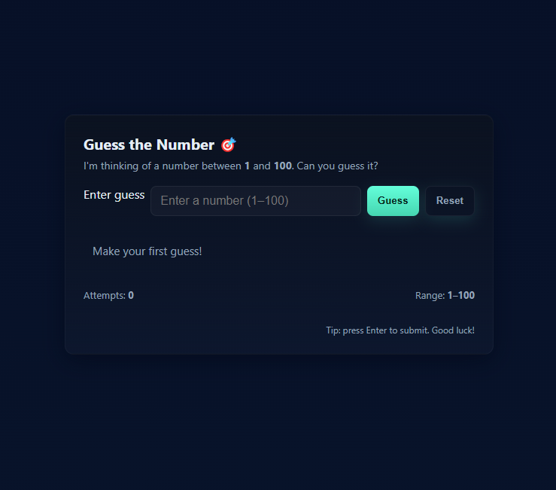
results & screenshots
🎯 You enter 45 → “Too low! Try again.” 🎯 You enter 78 → “Too high! Try again.” 🎯 You enter 63 → “🎉 Correct — 63
is the number! Attempts: 3”

Slide 11
conclusion
This game is a great example of how to combine logic, user input, and dynamic UI updates to create a simple but engaging web-based application. It’s perfect for beginners to practice DOM manipulation, conditionals, and functions in JavaScript.

Slide 12
https://github.com/sthanigaivel24111bsccs-bit/Thanigaivel_24111.git
Github link

