Slide 1
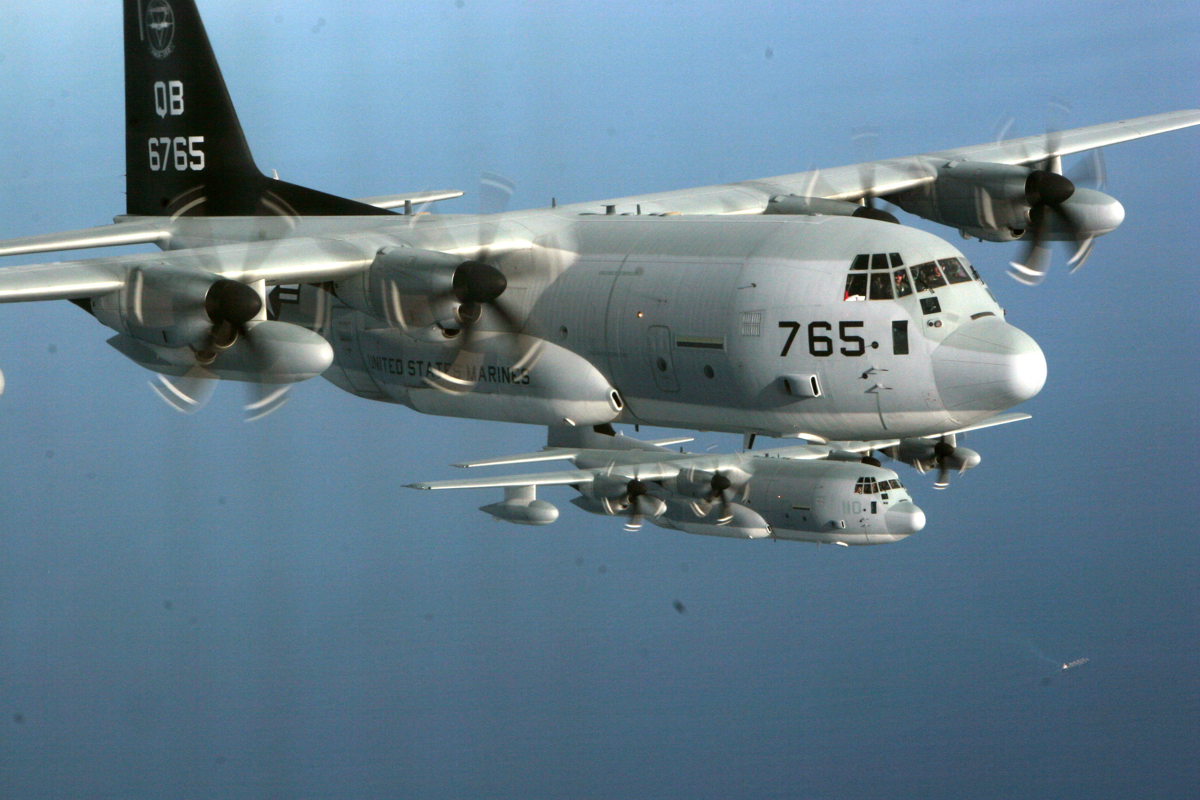
End of NP Tour Brief
Stephen Harding
Tour with 56160
stephen.harding@navy.mil

Slide 2
Agenda
SCHSIM (Stochastic Compiler Hacks as Software IMmunization)
  Brief history of ROP (Return Oriented Programming)
  Classical mitigation strategies
  What we've been doing with SCHSIM
Post Compiler Hacks
  Binary Thinning
    Trace based
    Software evolution

Slide 3
History of ROP
What is ROP?

Slide 4
History of ROP
What is ROP?
ROP (Return Oriented Programming)
  Memory corruption exploitation that overcomes many of the memory protections in place on modern operating systems.
  Best understood in the context of preceding memory corruption exploits.

Slide 5
Stack Frame Review
Decreasing
Addresses
Function Arguments
push %ebp
mov %esp, %ebp
mov arg_1, $8(%ebp)
.
.
.
mov arg_n, $[4*n + 4](%ebp)
call foo
Return Address
Old Base Pointer
Other Housekeeping
Stuff
Local Variables

Slide 6
Stack Frame Review
void foo()
{
char buff[10], c;
char * b = buff;
printf("What's your name? ");
while((c = getchar()) != '\n') {
*b++ = c;
}
*b = 0;
printf("hello %s!\n", buff);
}
int main()
{
bar();
return 0;
}
Decreasing
Addresses
Return Address
Old Base Pointer
char buff[10]
char c
char * b

Slide 7
Stack Frame Review
$ gcc foo.c
$ ./a.out
What's your name? Stephen
Hello Stephen
$

Slide 8
Stack Frame Review
$ gcc foo.c
$ ./a.out
What's your name? Stephen
Hello Stephen
$
Decreasing
Addresses
Return Address
Old Base Pointer
'e'
'n'
'\0'
?
?
'S'
't'
'e'
'p'
'h'
char c = '\n'
char * b = buff + 8

Slide 9
Stack Frame Review
$ gcc foo.c
$ ./a.out
What's your name? Stephen Harding
Hello Stephen Harding
segmentation fault (core dumped) ./a.out
$
Decreasing
Addresses
'g'
'\0'
Return Address
Old Base Pointer
'r'
'd'
'i'
'n'
'e'
'n'
' '
'H'
'a'
'S'
't'
'e'
'p'
'h'
char c = '\n'
char * b = buff + 16

Slide 10
Stack Frame Review
Classic Buffer overflow exploit
Decreasing
Addresses
Expoit code
$ gcc foo.c
$ cat exploit | ./a.out
What's your name?
$
<new address>
Return Address
Old Base Pointer
?
?
?
?
?
?
?
?
?
?
?
?
?
?
?
char c
char * b

Slide 11
Memory Corruption Mitigation
W ⊕ X
ASCII armoring
Stackguard
ASLR

Slide 12
ROP (Return Oriented Programming)
Decreasing
Addresses
<gadget address/value>
.
.
.
pop %ecx
pop %eax
ret
.
.
.
<gadget address/value>
<gadget address>
Return Address
.
.
.
Old Base Pointer
?
?
?
?
mov %eax, (%ecx)
ret
?
?
?
?
?
.
.
.
?
?
?
?
?
?
char c
char * b

Slide 13
SCHSIM
Utilizing the UCI Multicompiler to diversify binaries

Slide 14
SCHSIM
Utilizing the UCI Multicompiler to diversify binaries
  Fork of the LLVM/Clang project
  Produces 'diversified' binaries
  Uses multiple mechanisms to randomize binaries
    Stochastic NOP (and NOP-like) insertion
    Register randomization
    Stack-frame shuffling
    (several others)

Slide 15
SCHSIM
Utilizing the UCI Multicompiler to diversify binaries
Diversified Firefox Pilot Program
  Challenges with compilation and distribution

Slide 16
SCHSIM
Utilizing the UCI Multicompiler to diversify binaries
Diversified Firefox Pilot Program
  Challenges with compilation and distribution
  Makes use of the HPC resources
    Includes its own set of challenges
    (solved by using VMs)

Slide 17
SCHSIM
Utilizing the UCI Multicompiler to diversify binaries
Diversified Firefox Pilot Program
  Challenges with compilation and distribution
  Makes use of the HPC resources
  Challenges with assessing the security properties of diversified builds.

Slide 18
Post Compiler Hacks
Binary thinning motivation
  There may be 'harmful' parts of the program
    (e.g. netcat -e)
  Unused portions of the program may harbor vulnerabilities.

Slide 19
Post Compiler Hacks
Binary thinning techniques
  Trace based (Jason's initial work)

Slide 20
Post Compiler Hacks
Binary thinning techniques
  Trace based (Jason's initial work)
  Genetic Algorithm to do it automatically

Slide 21
Genetic Algorithm Overview
Original Binary
Fitness Function

Slide 22
Genetic Algorithm Overview
Original Binary
Fitness Function
Population

Slide 23
Genetic Algorithm Overview
Original Binary
Fitness Function
Population
Member
Mutate

Slide 24
Genetic Algorithm Overview
Original Binary
Fitness Function
Fitness
Population
Member
Mutate

Slide 25
Genetic Algorithm Overview
Original Binary
Fitness Function
Fitness
Population
Search
Member
Mutate

Slide 26
Genetic Algorithm Overview
Original Binary
Fitness Function
Fitness
Population
Search
Member
Thinned Binary
Mutate

Slide 27
Genetic Algorithm Overview
Program Representation:
.
.
.
.
.
.
andl $-16, %esp
subl $32, %esp
movl $79, 28(%esp)
movl $42, %eax
movl 28(%esp), %edx
movl %edx, 4(%esp)
movl %eax, (%esp)
call printf
movl $0, %eax
.
.
.
andl $-16, %esp
subl $32, %esp
movl $79, 28(%esp)
movl $42, %eax
movl 28(%esp), %edx
movl %edx, 4(%esp)
movl %eax, (%esp)
call printf
movl $0, %eax
.
.
.

Slide 28
Genetic Algorithm Overview
Mutation Operations:
Copy
Delete
Swap
Two Point Crossover

Slide 29
4014b0: e8 a3 f9 ff ff callq 400e58 <bindtextdomain@plt>
4014b5: 48 8d 3d 9b 2e 00 00 lea 0x2e9b(%rip),%rdi
4014bc: e8 67 f9 ff ff callq 400e28 <textdomain@plt>
4014c1: 48 8b 3d 98 3f 20 00 mov 0x203f98(%rip),%rdi
4014c8: e8 f3 26 00 00 callq 403bc0 <close_stdout+0x1950>
4014cd: 85 db test %ebx,%ebx
4014cf: 7e 47 jle 401518 <iswprint@plt+0x530>
4014d1: 4c 8b 35 b0 3f 20 00 mov 0x203fb0(%rip),%r14
4014d8: 0f 1f 84 00 00 00 00 nopl 0x0(%rax,%rax,1)
4014df: 00
4014e0: 48 8b 7d 00 mov 0x0(%rbp),%rdi
4014e4: 49 8b 36 mov (%r14),%rsi
4014e7: 48 83 c5 08 add $0x8,%rbp
4014eb: e8 e8 f9 ff ff callq 400ed8 <fputs_unlocked@plt>
4014f0: 83 eb 01 sub $0x1,%ebx
4014f3: 74 23 je 401518 <iswprint@plt+0x530>
4014f5: 49 8b 3e mov (%r14),%rdi
4014f8: 48 8b 47 28 mov 0x28(%rdi),%rax
4014fc: 48 3b 47 30 cmp 0x30(%rdi),%rax
401500: 0f 83 f0 04 00 00 jae 4019f6 <iswprint@plt+0xa0e>
401506: c6 00 20 movb $0x20,(%rax)
401509: 48 83 c0 01 add $0x1,%rax
40150d: 48 89 47 28 mov %rax,0x28(%rdi)
401511: eb cd jmp 4014e0 <iswprint@plt+0x4f8>
401513: 0f 1f 44 00 00 nopl 0x0(%rax,%rax,1)
401518: 45 84 e4 test %r12b,%r12b
40151b: 74 23 je 401540 <iswprint@plt+0x558>
40151d: 48 8b 05 64 3f 20 00 mov 0x203f64(%rip),%rax
401524: 48 8b 38 mov (%rax),%rdi
401527: 48 8b 47 28 mov 0x28(%rdi),%rax
40152b: 48 3b 47 30 cmp 0x30(%rdi),%rax
40152f: 0f 83 ed 04 00 00 jae 401a22 <iswprint@plt+0xa3a>
401535: c6 00 0a movb $0xa,(%rax)
401538: 48 83 c0 01 add $0x1,%rax
40153c: 48 89 47 28 mov %rax,0x28(%rdi)
401540: 31 ff xor %edi,%edi
401542: e8 f1 f8 ff ff callq 400e38 <exit@plt>
401547: 0f b6 50 01 movzbl 0x1(%rax),%edx
40154b: 3a 15 25 2e 00 00 cmp 0x2e25(%rip),%dl
401551: 0f 85 28 ff ff ff jne 40147f <iswprint@plt+0x497>
401557: 0f b6 40 02 movzbl 0x2(%rax),%eax
40155b: 3a 05 16 2e 00 00 cmp 0x2e16(%rip),%al
401561: 0f 85 18 ff ff ff jne 40147f <iswprint@plt+0x497>
401567: 49 8b 3c 24 mov (%r12),%rdi
40156b: e8 d0 04 00 00 callq 401a40 <iswprint@plt+0xa58>
40158f: e8 c4 f8 ff ff callq 400e58 <bindtextdomain@plt>
401594: 48 8d 3d bc 2d 00 00 lea 0x2dbc(%rip),%rdi
40159b: e8 88 f8 ff ff callq 400e28 <textdomain@plt>
4015a0: 90 nop
4015a1: 90 nop
4015a2: 90 nop
4015a3: 90 nop
4015a4: 90 nop
4015a5: 90 nop
4015a6: 90 nop
4015a7: 90 nop
4015a8: 90 nop
4015a9: 90 nop
4015aa: 90 nop
4015ab: 90 nop
4015ac: 4d 89 e0 mov %r12,%r8
4015af: 90 nop
4015b0: 90 nop
4015b1: 90 nop
4015b2: 90 nop
4015b3: 90 nop
4015b4: 90 nop
4015b5: 83 eb 01 sub $0x1,%ebx
4015b8: 85 db test %ebx,%ebx
4015ba: 0f 8e fb 03 00 00 jle 4019bb <iswprint@plt+0x9d3>
4015c0: 48 8b 45 00 mov 0x0(%rbp),%rax
4015c4: 45 31 c0 xor %r8d,%r8d
4015c7: 45 31 db xor %r11d,%r11d
4015ca: 80 38 2d cmpb $0x2d,(%rax)
4015cd: 41 bc 01 00 00 00 mov $0x1,%r12d
4015d3: 41 ba 01 00 00 00 mov $0x1,%r10d
4015d9: 49 b9 01 00 00 00 01 mov $0x20100000001,%r9
4015e0: 02 00 00
4015e3: 0f 85 d2 03 00 00 jne 4019bb <iswprint@plt+0x9d3>
4015e9: 0f b6 70 01 movzbl 0x1(%rax),%esi
4015ed: 48 8d 78 01 lea 0x1(%rax),%rdi
4015f1: 40 84 f6 test %sil,%sil
4015f4: 74 16 je 40160c <iswprint@plt+0x624>
4015f6: 89 f1 mov %esi,%ecx
4015f8: 31 d2 xor %edx,%edx
4015fa: 66 0f 1f 44 00 00 nopw 0x0(%rax,%rax,1)
401600: 83 e9 45 sub $0x45,%ecx
401603: 80 f9 29 cmp $0x29,%cl
401606: 0f 86 c4 00 00 00 jbe 4016d0 <iswprint@plt+0x6e8>
40160c: 45 84 c0 test %r8b,%r8b

Slide 30
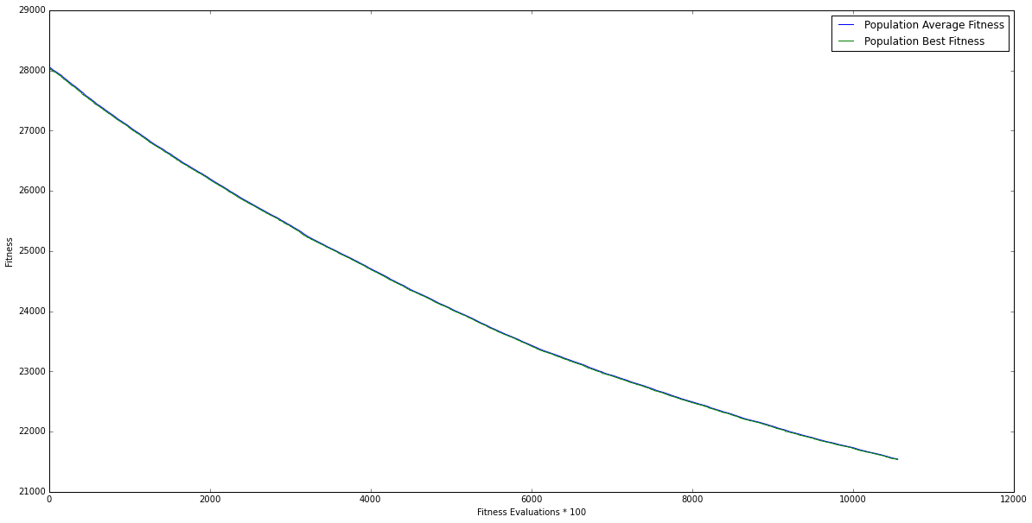
Some Experimental Results
A plot of echo over ~ 1M fitness evaluations

Slide 31
Questions?

