Slide 1
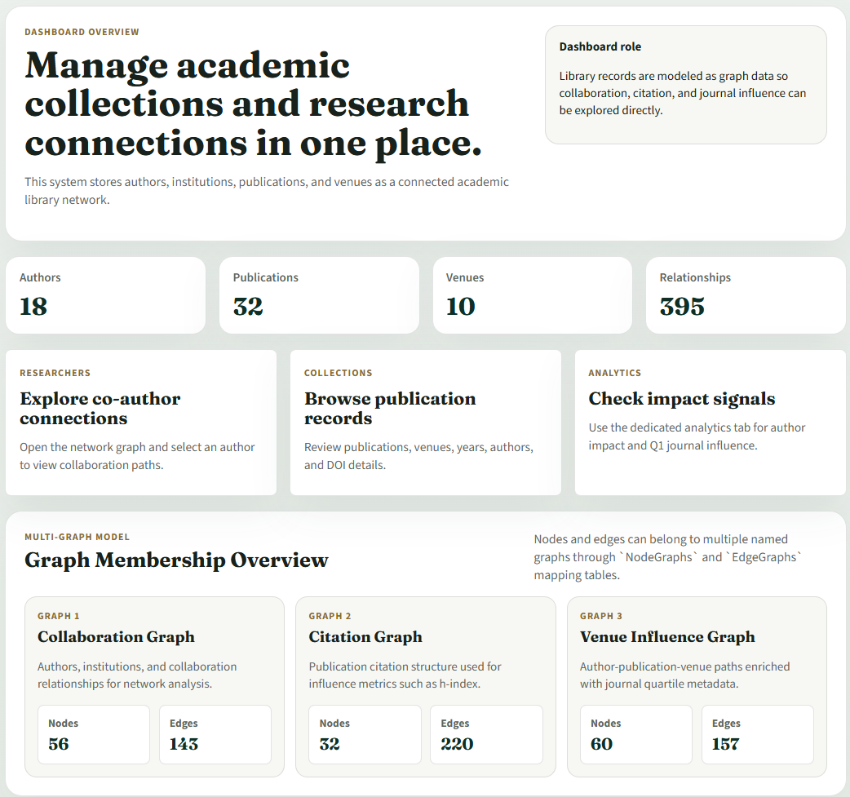
GRAPH DATABASE FINAL DEMO
Academic Library
Management System
A graph-oriented academic library prototype for exploring researchers, publications, citations, venues, and collaboration networks.
Safal Shrestha | Mamun Abdullah | Swikriti Shrestha
01

Slide 2
ACADEMIC LIBRARY MANAGEMENT SYSTEM
Problem Statement
Traditional library systems store records, but relationship discovery is the real challenge.
HIDDEN LINK
HIDDEN LINK
HIDDEN LINK
TRADITIONAL Library Management System LIMITATION
Collaboration
Citation
Venue Impact
Academic data is highly connected, but ordinary record tables make collaboration, citation, affiliation, and journal influence difficult to explore as a network.
Who works with whom, and how strong is that relationship?
Which papers influence future work?
Which authors connect through top-tier journals?
PROJECT NEED
From records to relationships
The project needed a graph database structure plus visual query results, not just CRUD tables.
02

Slide 3
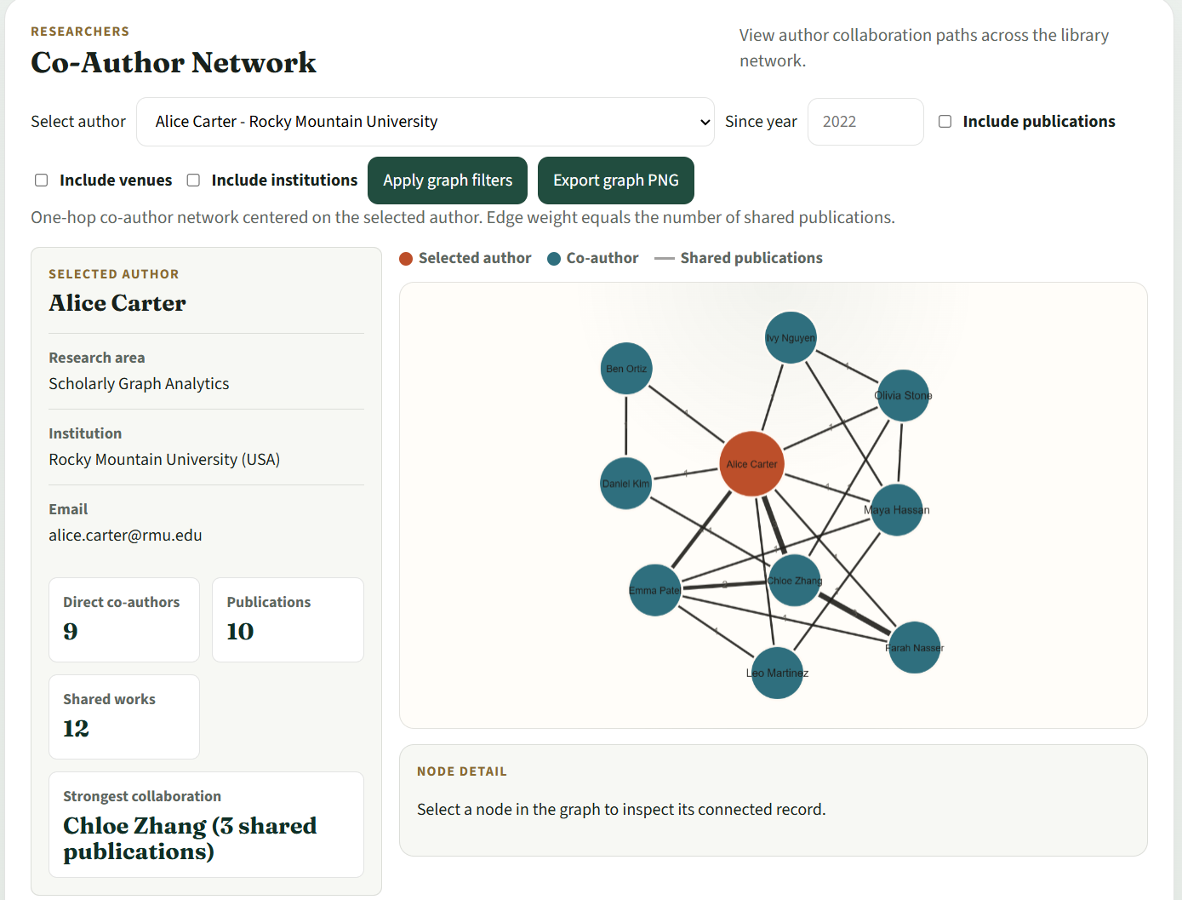
ACADEMIC LIBRARY MANAGEMENT SYSTEM
Project Solution / Overview
A graph-oriented academic library platform built around nodes, edges, and visual analytics.
WHAT WE BUILT
WHAT WE ADDED
WHAT IT ENABLES
Connected academic records
Typed relationships
Interactive insight
Authors, institutions, publications, and venues become graph nodes that can be explored together.
Co-author, citation, affiliation, authored, and published-in relationships are stored as typed edges.
Required graph queries return both data tables and network visualizations.
03

Slide 4
ACADEMIC LIBRARY MANAGEMENT SYSTEM
System Architecture
The prototype is organized as a simple three-layer web system.
FRONTEND LAYER
BACKEND LAYER
DATABASE LAYER
Vanilla JS + Cytoscape.js
Python + Flask REST API
SQLite
Dashboard, search, CRUD forms, analytics pages, interactive graph rendering, CSV and PNG export.
Seeding, validation, CRUD endpoints, graph query execution, and normalized response objects.
Nodes, Edges, subtype tables, Graphs, NodeGraphs, and EdgeGraphs.
RUNTIME FLOW
Browser actions call Flask API endpoints; the backend traverses SQLite graph tables; Cytoscape.js renders the returned nodes and edges.
04

Slide 5
ACADEMIC LIBRARY MANAGEMENT SYSTEM
Graph Database Model
A normalized relational schema that behaves like a graph database.
NODE STORAGE
EDGE STORAGE
SUBTYPE TABLES
MULTI-GRAPH
Nodes
Edges
Domain details
Graph views
NodeID, NodeType, DisplayLabel, AttributesJson, CreatedAt. Supports Author, Institution, Publication, Venue.
EdgeID, SourceNodeID, TargetNodeID, EdgeType, EdgeYear, Weight, MetadataJson.
Authors, Institutions, Publications, and Venues store type-specific attributes.
Graphs, NodeGraphs, and EdgeGraphs allow the same node or edge to belong to multiple graphs.
CORE DESIGN IDEA
The single Nodes table gives every object a graph identity. The single Edges table gives every relationship a traversable direction, type, weight, year, and metadata.
05

Slide 6
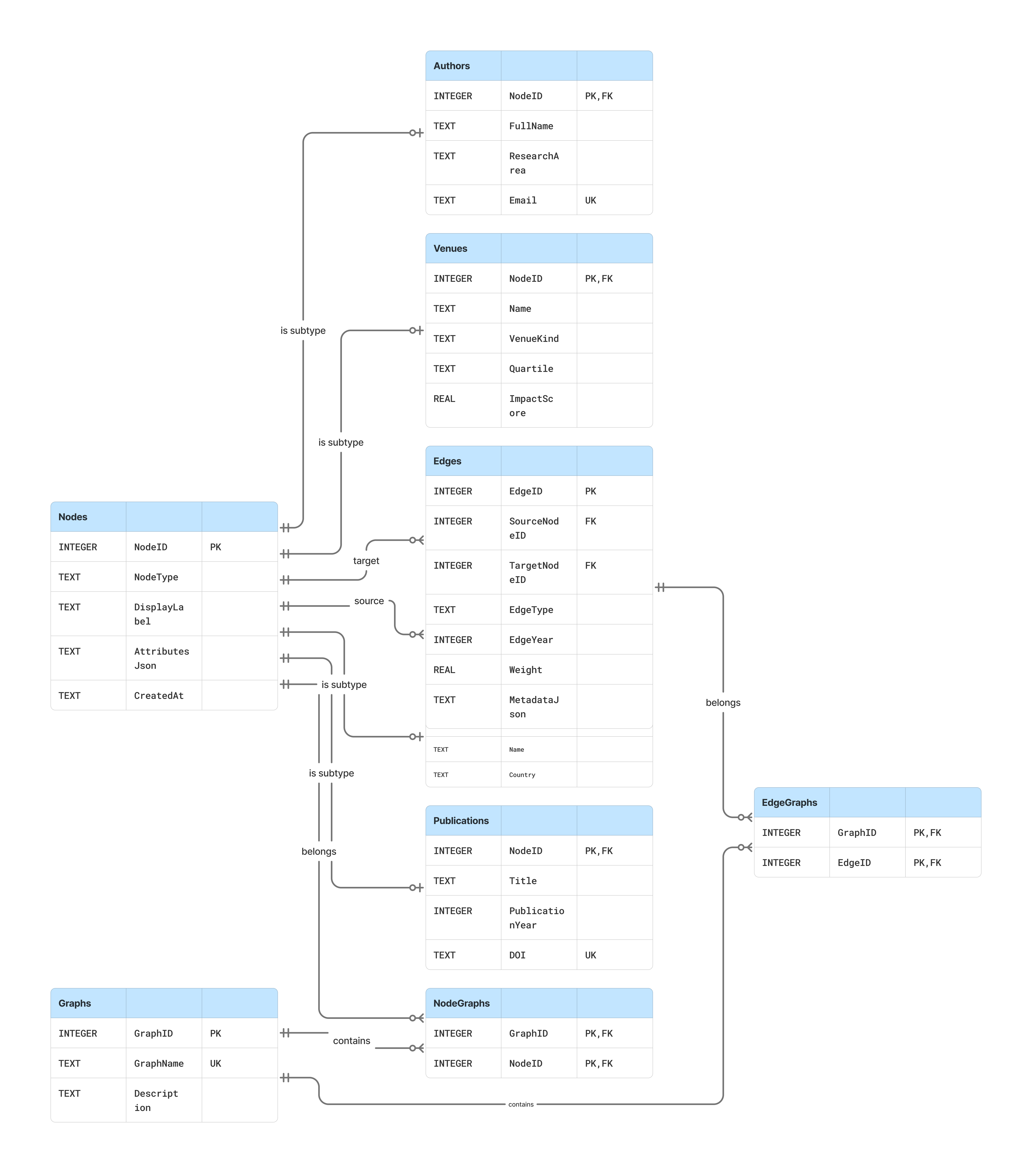
ACADEMIC LIBRARY MANAGEMENT SYSTEM
ER Diagram
Physical schema: nodes, edges, subtype tables, and graph membership mapping.
SCHEMA PATTERN
Nodes as supertype
Authors, Institutions, Publications, and Venues share NodeID as both primary key and foreign key.
RELATIONSHIP PATTERN
Edges connect any node type
SourceNodeID and TargetNodeID both reference Nodes, enabling cross-type graph relationships.
GRAPH MEMBERSHIP
Multiple logical graphs
NodeGraphs and EdgeGraphs assign records to collaboration, citation, and venue influence graph views.
06

Slide 7
ACADEMIC LIBRARY MANAGEMENT SYSTEM
Seeded Dataset
The demo dataset is large enough to prove the graph behavior.
Authors
Institutions
Venues
Publications
Relationships
18
6
10
32
395
GRAPH 1
GRAPH 2
GRAPH 3
Collaboration Graph
Citation Graph
Venue Influence Graph
56 nodes / 143 edges. Authors, institutions, and collaboration relationships for network analysis.
32 nodes / 220 edges. Publication citation structure used for influence metrics such as h-index.
60 nodes / 157 edges. Author-publication-venue paths enriched with journal quartile metadata.
Edge types used in the dataset: AUTHORED, AFFILIATED_WITH, PUBLISHED_IN, CITES, CO_AUTHOR.
07

Slide 8
ACADEMIC LIBRARY MANAGEMENT SYSTEM
Technology Stack & Implementation
Lightweight tools, enough structure for a complete working prototype.
DATABASE
BACKEND
FRONTEND
SQLite
Python + Flask
HTML/CSS/JS
Normalized schema, seeded dataset, foreign-key constraints, indexes.
REST API, query engine, validation, CRUD, seeding, analytics.
Dashboard, forms, search, analytics views, browser session.
VISUALIZATION
QUALITY
EXPORTS
Cytoscape.js
Tests
CSV + PNG
Interactive graphs, node drill-down, highlighting, PNG export.
Python and Node query tests verify core behavior.
Tables export to CSV and graph surfaces export to image files.
08

Slide 9
ACADEMIC LIBRARY MANAGEMENT SYSTEM
Prototype Dashboard
First view of the running system: counts, navigation, and graph membership.
SYSTEM STATUS
Live entity counts
Authors, publications, venues, and relationships are loaded from the database.
NAVIGATION
Focused workflows
Researchers, Collections, and Analytics divide the prototype into demo-ready tasks.
MULTI-GRAPH PROOF
Graph membership overview
Dashboard shows named graph views with node and edge counts.
09

Slide 10
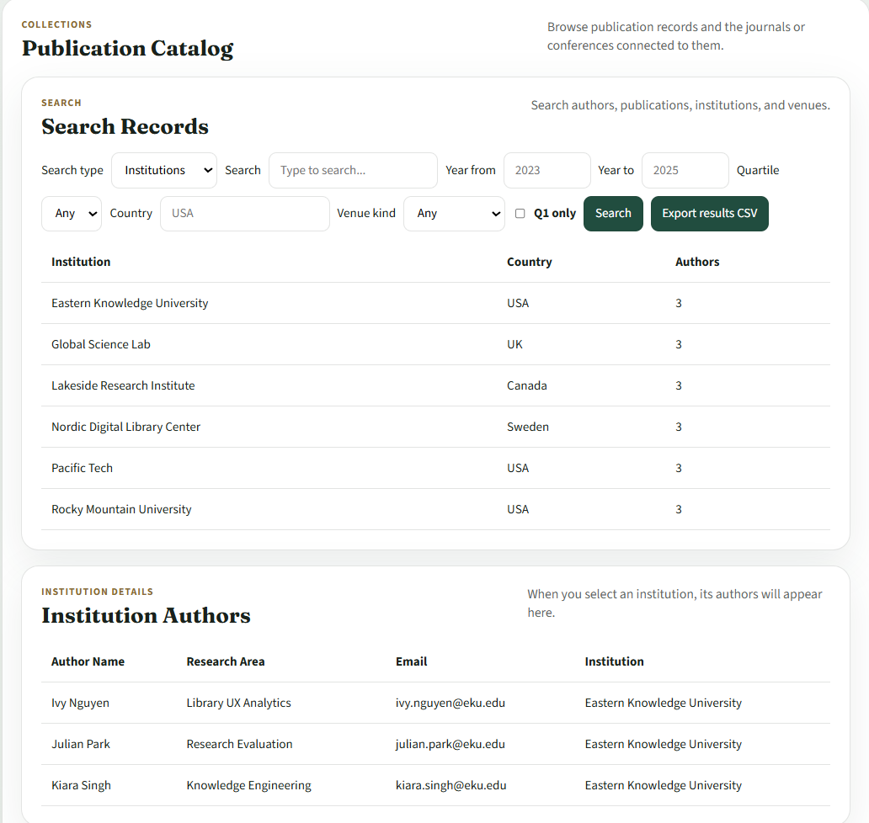
ACADEMIC LIBRARY MANAGEMENT SYSTEM
System Functionality
Search, filtering, catalog browsing, and management workflows.
SEARCH
Cross-entity lookup
Search authors, publications, institutions, and venues with filters for year, country, quartile, and venue type.
COLLECTIONS
Publication catalog
Browse publication metadata, venues, authors, and DOI values.
MANAGEMENT
CRUD with validation
Create, edit, and delete records while protecting duplicates and unsafe deletions.
CSV export
Live filters
10

Slide 11
ACADEMIC LIBRARY MANAGEMENT SYSTEM
Query 1: Co-Author Network
Given an author, retrieve and visualize their collaboration network.
INPUT
Selected author
Example: Alice Carter, with optional year and graph expansion filters.
EXECUTION
CO_AUTHOR edges
The query follows co-author relationships; edge weight equals shared publication count.
OUTPUT
Interactive network
Cytoscape.js renders the graph with selected author, collaborators, edge labels, and node drill-down.
11

Slide 12
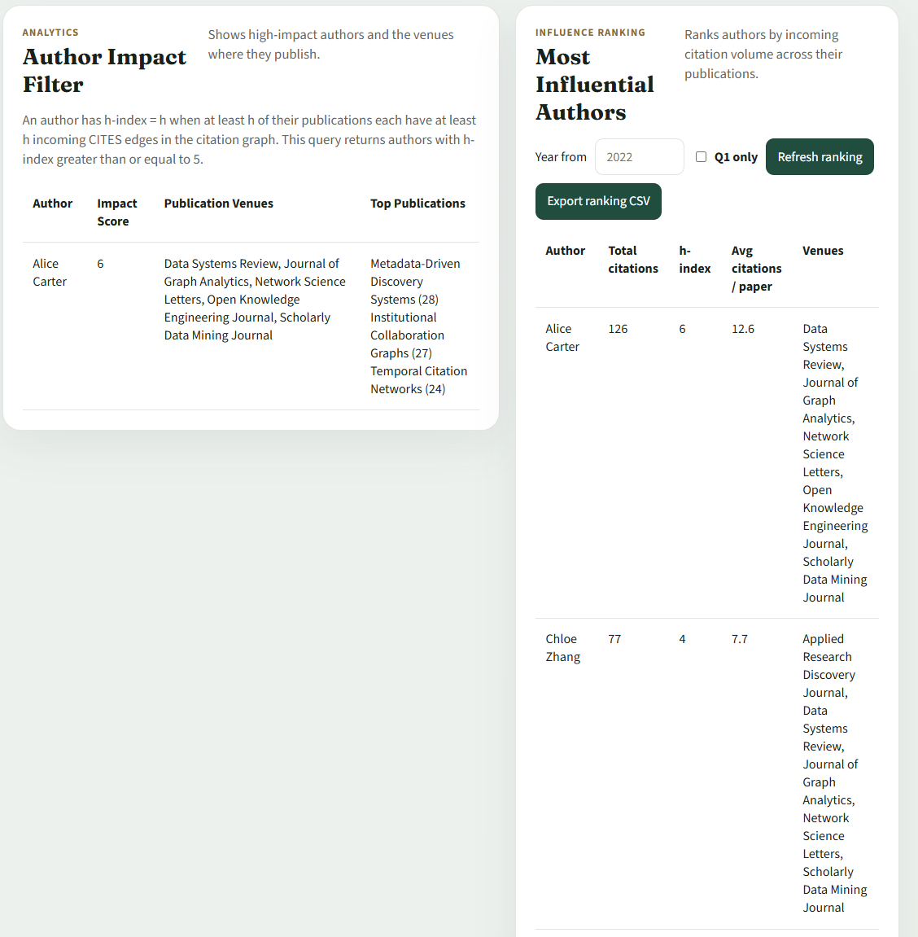
ACADEMIC LIBRARY MANAGEMENT SYSTEM
Query 2: h-index Filter
Identify authors with h-index >= 5 and show publication venues.
DEFINITION
An author has h-index h when at least h of their publications each have at least h incoming CITES edges.
SCHEMA LINK
Citation graph
Publications cite publications through CITES edges in the Edges table.
RESULT
Author impact table
The interface displays author name, h-index score, publication venues, and top cited publications.
12

Slide 13
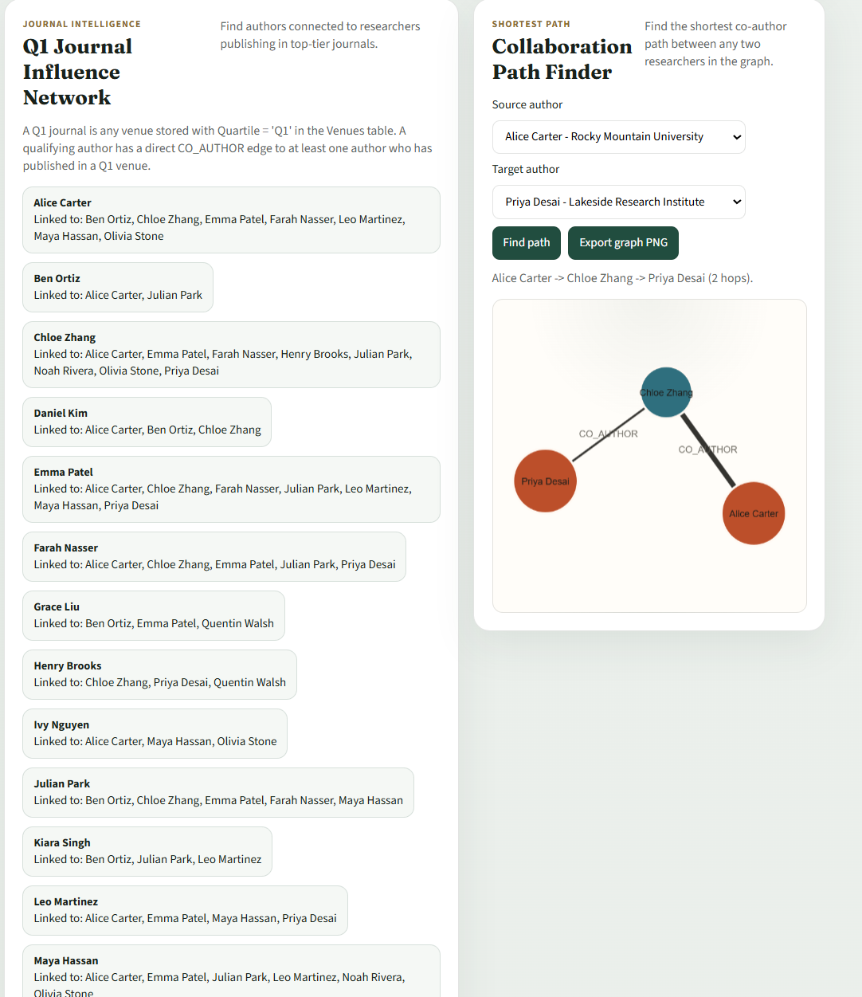
ACADEMIC LIBRARY MANAGEMENT SYSTEM
Query 3: Q1 Journal Influence Network
Find authors linked to researchers publishing in top-tier journals.
Q1 DEFINITION
A Q1 journal is any venue where Venues.Quartile = 'Q1'. The metadata is stored directly in the Venues subtype table.
EXECUTION
Influence expansion
The query identifies Q1-publishing authors, then follows CO_AUTHOR edges to connected authors.
EXTRA FEATURE
Shortest path
The analytics view also demonstrates shortest collaboration paths between two researchers.
13

Slide 14
ACADEMIC LIBRARY MANAGEMENT SYSTEM
Key Takeaways
What the final prototype demonstrates.
TAKEAWAY
TAKEAWAY
Static records became explorable relationships.
One schema supports multiple graph views.
The project transforms library data into an academic network that can be searched, analyzed, and visualized.
Collaboration, citation, and venue influence graphs share the same normalized Nodes and Edges foundation.
TAKEAWAY
TAKEAWAY
The required queries are connected features.
Visualization makes the insight understandable.
Co-author, h-index, and Q1 influence queries all reuse the same graph model instead of isolated one-off tables.
Network diagrams reveal collaboration paths, influence links, and graph structure faster than tables alone.
14

Slide 15
ACADEMIC LIBRARY MANAGEMENT SYSTEM
Limitations, Future Work
Where the project stands and how the live demo will run.
LIMITATIONS
FUTURE WORK
Current boundaries
Next improvements
SQLite is suitable for a prototype, but not ideal for very large academic graphs.
Authentication is simplified and not production-ready.
Dataset is seeded for demo purposes instead of imported from real sources.
Analytics cover required queries but not advanced graph algorithms yet.
Move to PostgreSQL or Neo4j for scale.
Add secure backend authentication and role-based access.
Import real data from DBLP/OpenAlex/Crossref/ORCID.
Add PageRank, centrality, community detection, and trend analytics.
Add saved searches, dashboards, reports, and improved mobile support.
CLOSING MESSAGE
The Academic Library Management System proves that a lightweight relational backend can still deliver graph-style academic discovery, analytics, and visual exploration.
15

