Slide 1
ADA/CIP/DCRM
Architecture for projects like Bet Recommendation and Bonus Optimisation Budgeting/Templating
July 2022

Slide 2
Sportsbook High Level Stats
On an average day, there are 72K (max 88K) sports event, 1.2M (max 1.6M) sports and 11M (max 15M) selection update events.
On an average day, there are 750K no of bets (max 1.8M) and 100K no of players placing these bets (max 240K), and 8M click stream events.
On an average day, there are 250-450K players betting
Taking 90 days period, on average there are 2M players active in Sports, however it can peak around 4M too if a big event is happening
Taking 365 days period, on average there are 6M players active in sports
*bwin, party, gambookers, coral, Ladbrokes, Gambookers, Sportingbet Gioco Digitale, Gamebookers

Slide 3
Bonus Optimisation
Budgeting:
The flexibility
Offer Category/templating:
The ability to have set of predefined offers for a category/template like churn, sports adhoc, reactivation, active, gaming weekly etc

Slide 4
CRM use cases
Static, slowly changing
Time sensitive, dynamically changing
Sports offering
Multidimensional, depending on the input parameters or additional constraints
Game recommendation per provider, theme, category, etc
Model recommendations need to be calculated once, and filtering needs to happen based on the inputs

Slide 5
Static, slowly changing – CASIA game recommendations
Toasters
Target players with the daily list
Overlays
Scheduled
Campaigns
Campaign Hub
Entain platform
Optimove
Target groups
Email
Real-time
Campaigns
Player Inbox
Kafka stream
Push notifications
CASIA
Teradata
Historical Player Data
Real Time Player Data
Entain Platform

Slide 6
Time sensitive, dynamically changing
Toasters
Target players with the daily list
Overlays
Scheduled
Campaigns
Campaign Hub
Entain platform
Optimove
Target groups
Email
Real-time
Campaigns
Player Inbox
Kafka stream
Push notifications
SIA/ Optimus
Teradata
Historical Player Data
Real Time Player Data
Entain Platform

Slide 7
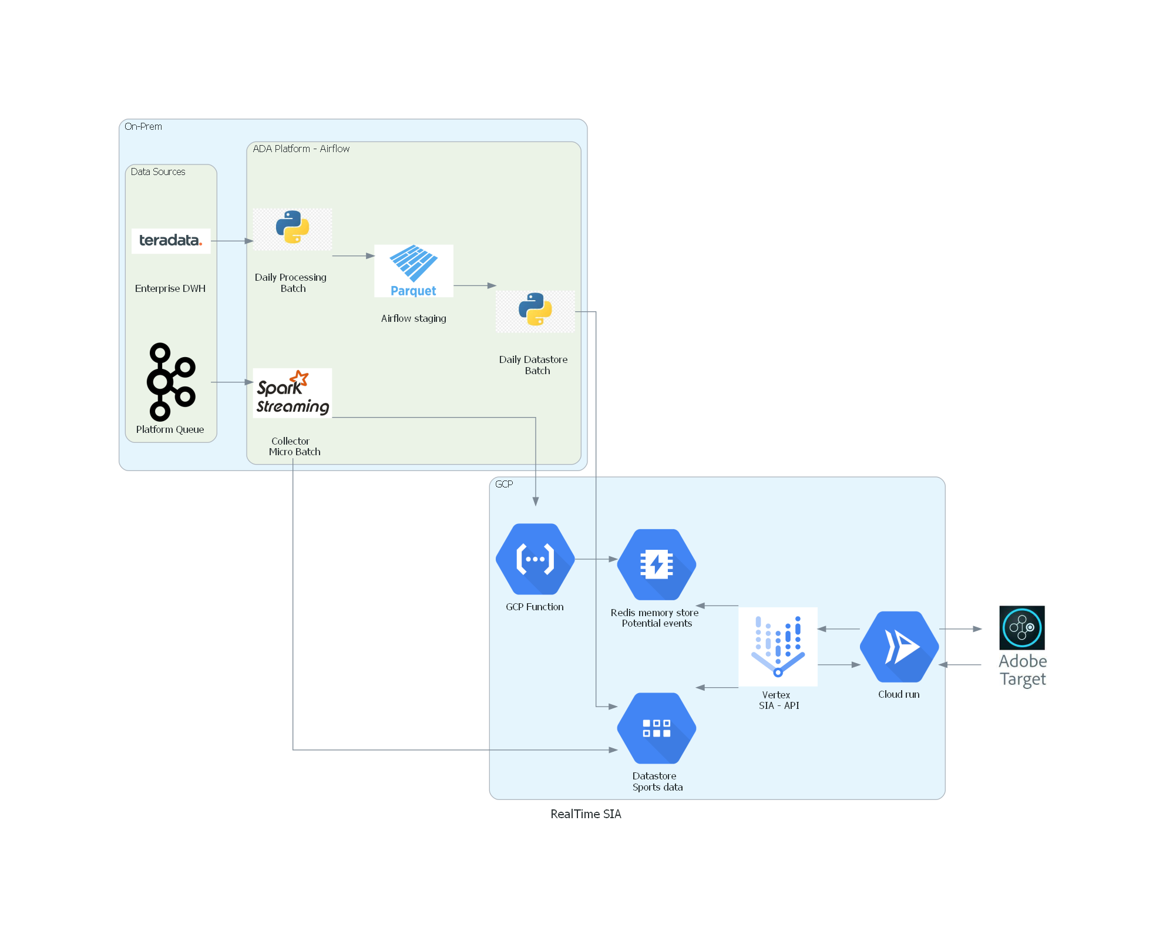
SIA – Bet Recommendation POC

Slide 8
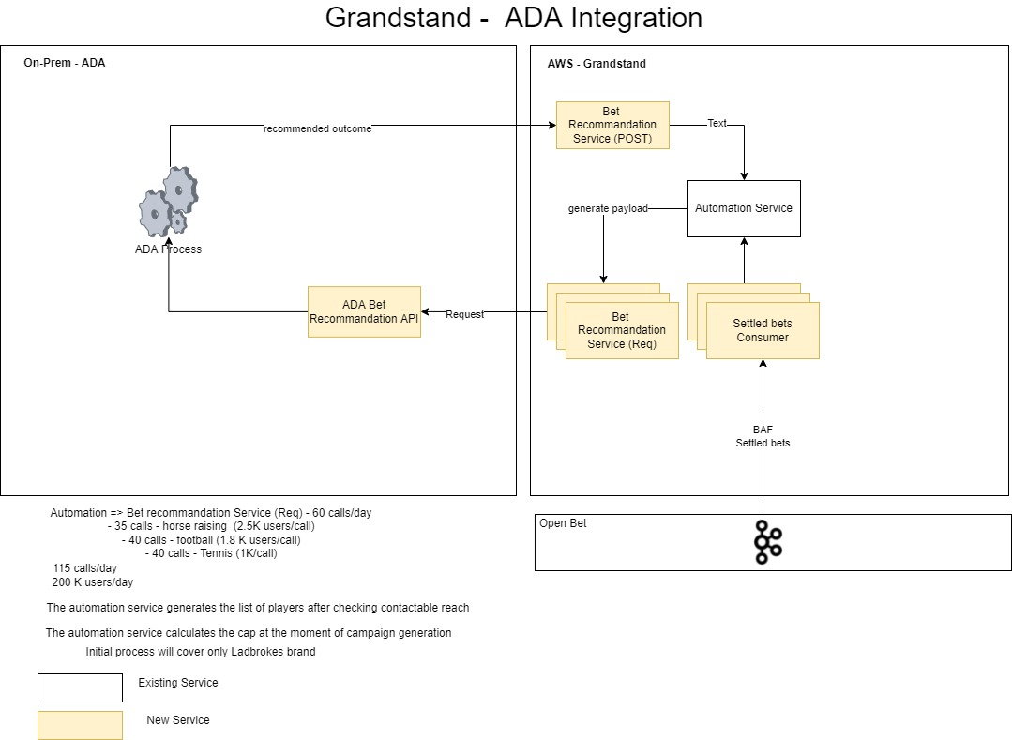
SIA – Bet Recommendation GRANDSTAND

