Slide 1
Bonus Optimisation
Optimus
May 2022

Slide 2
Agenda
OPTIMUS
Current model solution
Potential improvements
Readiness to go live
Q&A

Slide 3
Bonus Optimisation Model
OPTIMUS
Training period: 2019.01.02 - 2020.02.28 & 2020.09.01 – 2021.09.30
Target: CLV Delta + NGR
Features
Transactional & categorical data:
daily summary tables (FD_Player_Summary)
Scoring Date
Country, Brand, SOA, First Deposit Processor, parent_device_type, age,...
NGR
Betting activities – quantity and volume
Deposit activities – quantity and volume
First deposit method
Features computed on different timeframes (1D,3D,7D,30D,180D,365D,Lifetime), e.g. Today_Deposit_Amount, L3D_Deposit_Amount,...
CLV and Churn Score of previous day
Balance
...
Input Data
NGR
CLV Delta
 | day 0 | day 1 | day 2 | day 3
The Input Data will contain player level metrics to be considered as model inputs, covering recent to lifetime behaviours and activity
Scenarios
Model Training Based on offers given on day 1
x
x | x
xx
 |  | x
Any of {L, M, H, VH}
No Offer
x denotes promotion being offered
Bonus related data:
Dim_Award, Dim_Player_Award, ...
Design Considerations | Approach | Detail
Target Variable Predicted Value | CLV Delta + NGR | player level (not product specific) CLV Delta = End-of-Day 3 – End-of-Day 0 NGR = Sum of Day 1 to 3
Follow-up Offers | Players communicated offers on day 2 and 3 will be included in the model build and will only be classified as per their day 1 treatment
Multiple Offers | Players communicated more than one offer per day will be included in the model build. They will contribute towards only one model for such day, dictated by the highest offered amount and how that is classified.
Offered bonus type counts and amounts on different timeframes
(1D,3D,...), e.g. L365D_Freebet_Count, L1D_Depsoit_Absolute_Cost
Last bonus offered (type, cost, transacted Y/N

Slide 4



Bonus Optimisation Model
OPTIMUS
Scope:
Casino or product-agnostic offers, such as bonuses
ATL and BTL offers both considered for training
Exclusions
Free roll & Tournaments – Poker specific offer, currently out of scope
Sign-ups – out of scope by design, as they are acquisition offers
Free Bet, Odds Boost Tokens or Risk-Free Tokens – Sportsbook specific and currently out of scope. To be revised for Phase 2.
Offer Category | Offer Level | Player Activity Type
 |  | New | Active | Inactive
Deposit Bonus Absolute | Low | ü | ü | ü
 | Mid | ü | ü | ü
 | High | ü | ü | ü
 | Very High | ü | ü | ü
Deposit Bonus Percentage | Low | ü | ü | ü
 | Mid | ü | ü | ü
 | High | ü | ü | ü
 | Very High | ü | ü | ü
Freespins | Low | ü | ü | ü
 | Mid | ü | ü | ü
 | High | ü | ü | ü
 | Very High | ü | ü | ü
Cash |  | ü | ü | ü
Bingo Ticket |  | ü | ü | ü
No Offer |  | ü | ü | ü
Total
45 models

Slide 5






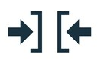
Bonus Optimisation Solution
OPTIMUS
Goal: Identify the optimal daily offer to recommend for each player, in order to maximise revenue return.
Player Behaviour
Historical revenue uplifts when bonused / not bonused
Offer type and offer level
Recent and historical player-level activity
Offer catalogue that sets the available offers and their grouping
Decisioning Steps
Score each player against each available offer
Recommend offer with highest future value for player
Action
Recommended offer for player & fulfilment
Offer Grouping Model Output
Offer Grouping |  | Player
Type | Level | Predicted Value per player and offer
Bonus | Medium | £57
Deposit Bonus (%) | Medium | £55
Deposit Bonus (%) | High | £26
Bonus (Cash) | Low | £22
Freespin | Low | £19
No Bonus |  | £18
…
Deposit Bonus (%) | Low | £10
Bonus (Cash) | High | -£2
Offer Catalogue
Offer | Cost | Active
£5 Bonus (Cash) on login | £ 5 | Y
Deposit bonus, 100% Match up to £50 | £ 50 | Y
150 Freespins on Starburst | £ 1.50 | N
…
Deposit £5 for 30 Freespins | £ 1.2 | Y
Free Bingo Game | £ 2.50 | N
 |  | Offer Grouping |  | Player
Offer | Cost | Type | Level | Predicted Value
£5 Bonus (Cash) on login | £ 5 | Bonus (Cash) | Low | £22
Deposit £5 for 30 Freespins | £ 1.2 | Freespin | Low | £19
 | £ 0 | No Bonus |  | £18
Deposit bonus, 100% Match up to £50 | £ 50 | Deposit Bonus (%) | Low | £10
Optimisation Phase
Recommendation
Offer | Player
£5 Bonus (Cash) on login

Slide 6
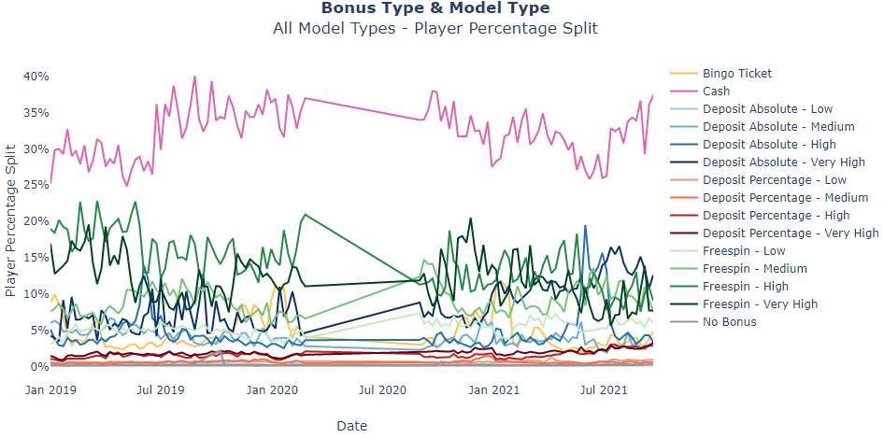
Bonus Optimisation Model Output
OPTIMUS
The graph shows the weekly distribution of the weekly percentage split of the player population as a timeseries by different bonus types, with the table showing the average per bonus type across the period analysed, broken out by bonus level and rolled up where appropriate
Cash is the most dominant winning score within the broken out Bonus Types, accounting for 32.2% of winning scores on average across the period analysed
Freespin, however, was the most dominant when the levels were rolled up into their respective Bonus Groups, accounting for 40.5% of the player base
Bonus Type | Proportion
Cash | 32.2%
Freespin - High | 14.2%
Freespin - Very High | 11.9%
Freespin - Medium | 9.1%
Deposit Absolute - Very High | 8.3%
Freespin - Low | 5.3%
Deposit Absolute - High | 4.8%
Bingo Ticket | 4.6%
Deposit Absolute - Medium | 3.9%
Deposit Percentage - Very High | 1.9%
Deposit Percentage - High | 1.6%
Deposit Percentage - Low | 0.7%
Deposit Percentage - Medium | 0.6%
Deposit Absolute - Low | 0.3%
No Bonus | 0.5%
Bonus Group | Proportion
Freespin | 40.5%
Cash | 32.2%
Deposit Absolute | 17.3%
Bingo Ticket | 4.6%
Deposit Percentage | 4.8%
No Bonus | 0.5%

Slide 7
Improvement options

Slide 8
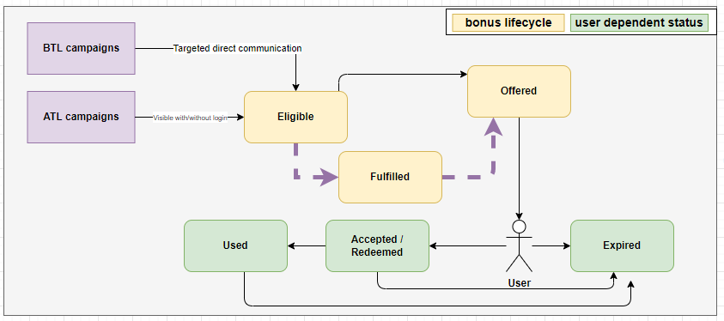
Improvement options: Probability to be offered
OPTIMUS
The model training is based on the information when a bonus is offered
However, depending on the campaign setup maybe not all the players are going to be offered.
E.g. player has to login, or deposit 10, bet 10 and then offered a bonus.
Probability to be offered

Slide 9
Improvement options: Budget Constraints
OPTIMUS
Constrained Optimus:
The model scores and selects the highest ROI offer per individual for all players who were active in the last 365 days.
The budget optimisation (after model scoring) is conducted by applying the budget constraint to make sure that the overall bonus issued (across ALL scored players) is not exceeding the predefined budget cost amount.
Illustration:
CRM team inputs £1000 as the daily bonus costs budget
Model:
Daily Scoring:
100,000 players have been active in the last 365 days
Let’s assume that each player’s model score is a £5 bonus
Constrained Optimus, the optimisation process:
Switch 99,800 players from £5 to No Bonus not to exceed the budget
Keep the top 200 ROI players’ score to £5.
The overall amount is £1000
CRM team targets a specific segment of players, who haven't been active between 180-365 days.
10,000 players targeted
Out of the 10,000, 9950 players have no offer and 50 have £5.
The overall bonus issued for the day is 50*5=£250
For argument sake the redemption is 10% so the overall cost is £25 instead of the £1000.
Disconnect:
Lack of information about the target segment
Redemption rate

Slide 10
Improvement options: Offer Fatigue
OPTIMUS
Feedback mechanism. Introduce a player level offer exclusion - if a player has been targeted with an offer, that would consider an automatic exclusion from the optimisation stage for the individual

Slide 11
Additional ideas
OPTIMUS
Bonus Journeys and missions for sequential bonusing
Preference towards specific offers based on offer setup
Robust setup for automated experimentation of different data driven solutions in parallel

Slide 12
Readiness to go live
OPTIMUS
Provide insights to CRM team on bonus costs expectations with the unconstrained setup ETA: 25/05/2022
Enable the ability to send communication without an offer. ETA:15/06/2022

Slide 13
Q & A

