Slide 1
DATA LAKE
11th August 2021

Slide 2

Use Cases
A/B TEST:
A/B test is a process of measuring Entain’s label feature changes .
Behavioral & Transaction data of users will be consumed from Entain label and streamed over Kafka using micro-services , Spark streaming/ Apache pinot to Datalake raw-zone.
A/B test performs statistical algorithms on behavioral and transactional data which is in Cleanse Zone to justify the website feature significance as well as generates the statistics in production-zone.
AI/ML:
AI/ML is Entain’s user web page personalization engine.
AI/ML consumes data from cleanse zone for training/retraining model and consumes real-time streamed data from raw-zone for generating recommendations which will be pushed to Entain’s NoSQL DB which is recommendation DB .
Entain’s Label sources recommendation’s data from Entain’s No SQL DB.
Affliates Analytics:
Affliates Analytics provides the insights of Entain’s Affliates , in terms of commission generated , Bonus issued , Revenue generated etc.
Affliates consumes the data from Oracle Stand by servers using batch ETL and stored in Cleanse layer.
Data from Cleanse layer will be transformed into Analytics form and stored in production-zone.
Superset/Tableau/MicroStrategy/Zaplin will be accessing the production zone via data service layer to produce visualizations/analytics in business readable format.

Slide 3





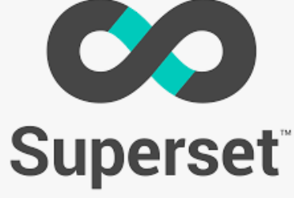



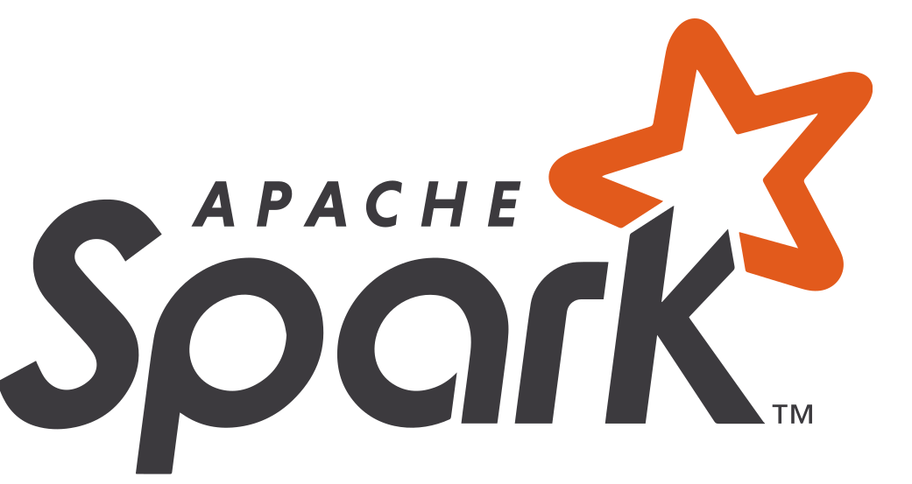

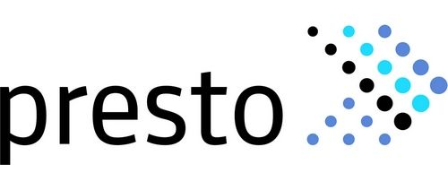






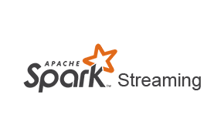
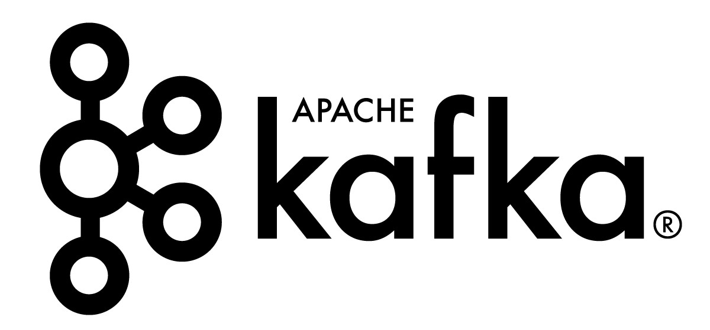
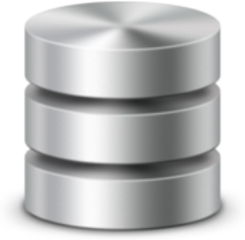

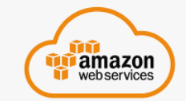
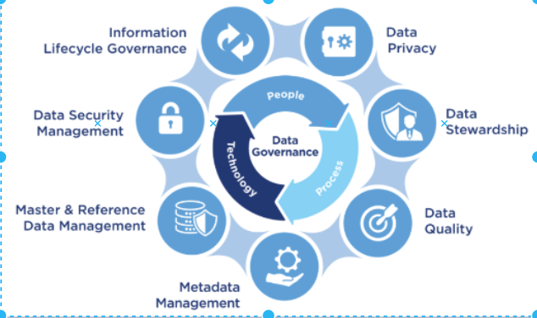
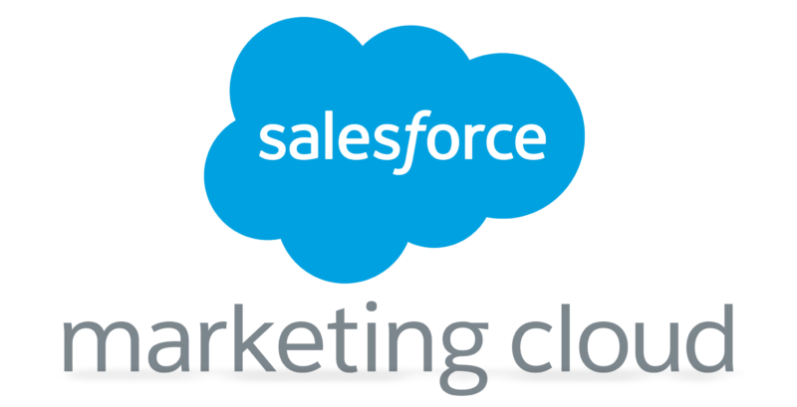

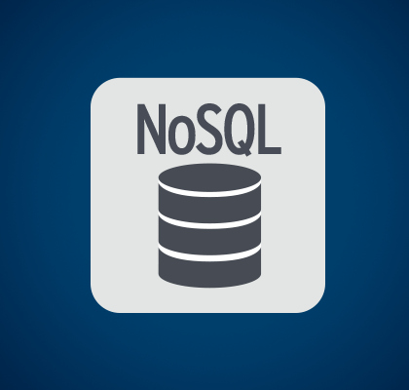

Data Lake Architecture
EXTERNAL APPLICATIONS (OB, PLAYTECH)
DATA LAKE
2
1
microservices
Raw Zone
Cleanse Zone
Production Zone
NON-US APPLICATIONS
Entain Data
Teradata/Excels/Csvs
US APPLICATIONS
3
2
1
AI/ML (Apache Spark )
microservices

Slide 4

Data Lake
The Hadoop Distributed File System (HDFS) is the primary data storage system used by Hadoop applications. Hadoop itself is an open-source distributed processing framework that manages data processing and storage for big data applications.
Raw Zone:
Data lake stores data in its raw form. In most cases, this means that the data is not suitable for consumption (e.g., every field is a text string). However, it may still provide value to data scientists.
Cleanse Zone:
The Cleanse Zone in a data lake is the first stage of transformation of ingested data.
This zone contains structures that provide some increased value over the pure raw data in the Cleanse Zone.
A Cleanse Zone will contain data within typed table structures.
For data that has been ingested from structured sources, the additional benefit gained from the Cleanse Zone is that the data is available in typed columns and not merely as strings.
For non-structured sources, processing needs to be done on the data to get it into the Cleanse Zone.
Production Zone:
Production zone where clean, processed and aggregated data is kept.
Each individual development team will access Cleanse layer and transforms the data into respective business requirements and further provide access to the downstream or reporting.

Slide 5

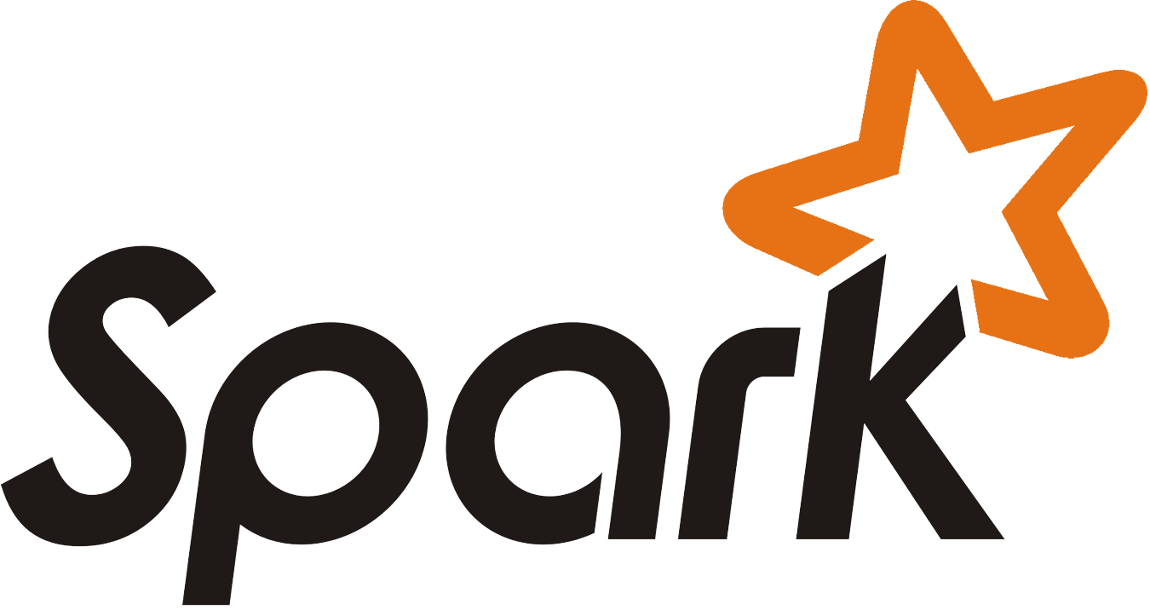
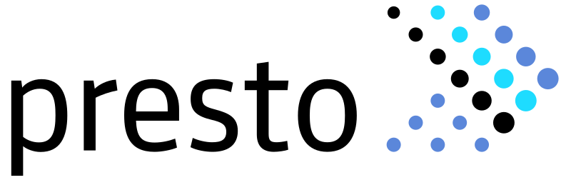

Data Service Providers
Spark is a fast and general processing engine compatible with Hadoop data.
Spark is used as a streaming engine to process the data from kafka to Raw Zone , used for batch processing in the Cleanse Zone as well as Production Zone and Spark-SQL used for Analytics/Reporting
.
Apache Hive is a data warehouse software project built on top of Apache Hadoop for providing data query and analysis.
Hive gives an SQL-like interface to query data stored in various databases and file systems that integrate with Hadoop.
Presto used as interface for Analytics/Reporting to consume the data from Production-Zone & Other Databases like Teradata ,MySQL etc combinedly .
Hue is a web-based tool to access the data from Production Zone and provide the visualizations instantly .

Slide 6


Monitoring and Analytics
Prometheus monitors the Data Lake applications and trigger alerts in real-time.
Grafana is used for visualizing the metrics data collected by Prometheus.
Transactional and behavioral data collected from different sources will be persisted in Elasticsearch and create the real-time CRM dashboards for analysis.

Slide 7



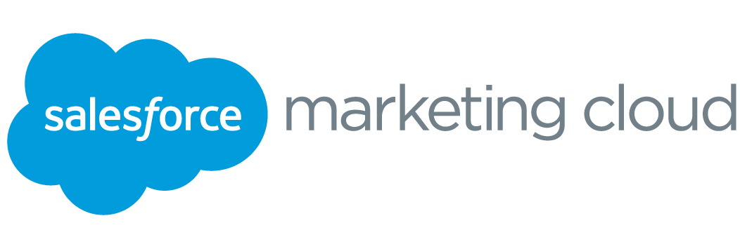
Campaign Targeting
Snapchat is used for user communication through advertisements for which segments are created in Adobe DMP.
A data management platform that helps you build unique audience profiles so you can identify your most valuable segments and use them across any digital channel. Understand your audiences - get a complete view of your audience by combining all of your data sources in one place.
Salesforce Marketing Cloud is a marketing platform that has capabilities to support many facets of marketing including multi-channel campaign execution, dynamic customer journeys, pre- and post-campaign analytics including audience building and segmentation, social media engagement and advertising.

Slide 8
Data Transportation
Apache NiFi is used for processing the transactional and behavior data from kafka.
Apache Kafka is used for stream-processing and handling real-time data feeds coming distributed systems.
Debezium is a distributed platform for change data capture. Debezium is used for bringing the historical transactional data from entain applications db to Data Lake

Slide 9
Data Providers
ENTAIN APPLICATIONS/DB
User Interaction tool for the Entain platform which captures the users gaming/behavioral activities.
EXTERNAL APPLICATIONS (OB, PLAYTECH)
Open bet: LCG Sports betting activities are captured.
Playtech: LCG Casino game activities are captured.
Stores Entian user's recommended personalized content.
Entain Data
Teradata/Excels/Csvs
Entain business intelligence data as well as any other product specific data.

Slide 10
Micro-Services
TEP-Streams the Transaction data from Entain applications to Data Lake.
JFS-Streams the Recommendation data from AI/ML application into Entain's NoSQL db and serves the data to other Entain Application.
SPF-Frontend interface for Behavioral data that is coming from Google cloud.
SPP-Process the Behavioral data and publishes to Kafka for Data Lake consumption.

Slide 11
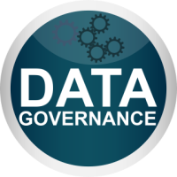
Data Governance
Data governance is a program of decision rights and accountabilities to appropriately treat data as a strategic asset, including managing, leveraging and protecting it accordingly.
Data stewardship: A data stewardship program is the operational implementation of a data governance program. Data stewards do the day-to-day work of administering the enterprise’s data.
Data quality: A proactive management of the quality of data in the enterprise.
Metadata management: A formal process of defining and documenting data assets across the enterprise.
Master and reference data management: An enterprise management of data elements that are critical and shared across data systems.
Data security management: A defined, and documented inventory of what data needs to be secured, who can access it, and how to secure it.
Data privacy: Information privacy is a vital area of risk identification and management. New legislation requires organizations to assess compliance efforts in handling customer data.
Information lifecycle governance: The management of data/information from creation to disposition. It establishes enterprise standards, policies and procedures for data retention and destruction.

