Slide 1

Apache NIFI
Apache NiFi is a real time data ingestion platform, which can transfer and manage data transfer between different sources and destination systems. It supports a wide variety of data formats like logs, geo location data, social feeds, etc. It also supports many protocols like SFTP, HDFS, and KAFKA, etc
Apache NiFi- General Features
Apache NiFi provides a web-based user interface, which provides seamless experience between design, control, feedback, and monitoring.
It is highly configurable. This helps users with guaranteed delivery, low latency, high throughput, dynamic prioritization, back pressure and modify flows on runtime.
It also provides data provenance module to track and monitor data from the start to the end of the flow.
NiFi also provides support to secure protocols like SSL, HTTPS, SSH and other encryptions.
It also supports user and role management and also can be configured with LDAP for authorization.

Slide 2
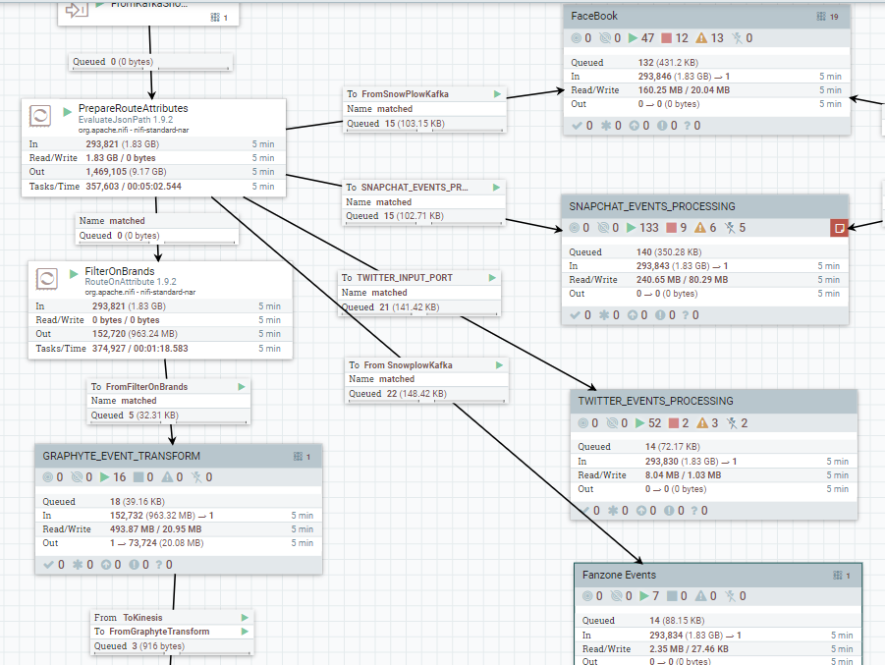
Apache NIFI Workflow

Slide 3

Apache Kafka Scaling - SOP
STEP1:Deploy all the asserts to kfk004,kfk005 nodes and bring up the new services, newly added brokers will automatically join the cluster, but it won’t have any involvement directly in cluster.
STEP2:Rebalancing:-This step should always be performed only in low peak hours.
1.Check specific topic’s lag in Kafka Manager, please make sure that there is no lag for all the consumer groups in the Kafka Manager. Make note of the current retention.ms parameter of the topic, update the topic retention.ms to 5 minutes(300000ms) through Kafka Manager(PFA), so that it will expire all the read messages of consumers from the brokers, then it takes lesser time to swap the partitions across the brokers.
2.Go to Kafka Manager, generate the new partitions assignment with all the brokers (including kfk004,kfk005) selected in Kafka Manager.
3.Run Partition assignments for the topic in Kafka Manager, this will actually rebalance the partitions to all brokers.
4.Wait for the partitions assignment to complete, because it may take some time to swap the partitions across the brokers if the data is huge in the partitions, check the data folder of the brokers for that topic and make sure that you see the data in all the brokers.

Slide 4
5.Sometimes specific partitions of the topic will not elect it’s leader, though it does not have impact, we must manually elect the leader for those partitions of the topic by running this script kafka_replica_election.sh in any broker.
6.Check the producer,consumer,kafka brokers logs for any ERROR’s.
7.Update back retention.ms parameter of the topic with previous value through Kafka Manger.
8.Monitor the brokers, producer and consumer of the topic for some time.
STEP3:Repeat the STEP2 for all the topics in the Kafka.
ROLLBACK:
If something goes wrong, if we want to bring down the newly added brokers from the cluster, please follow below.
STEP4:
1.Please follow the STEP2’s 1st point.
2.Go to Kafka Manager, generate the new partitions assignment with only kfk001,kfk002, kfk003 selected(excluding kfk004,kfk005) in Kafka Manager.
3.Follow STEP2’s 3,4,5,6,7,8.
4.Please make sure you rebalanced all the topics back to kfk001,kfk002, kfk003 then you can stop the kfk004,kfk005 brokers from the cluster, then they will be excluded from the cluster.

Slide 5
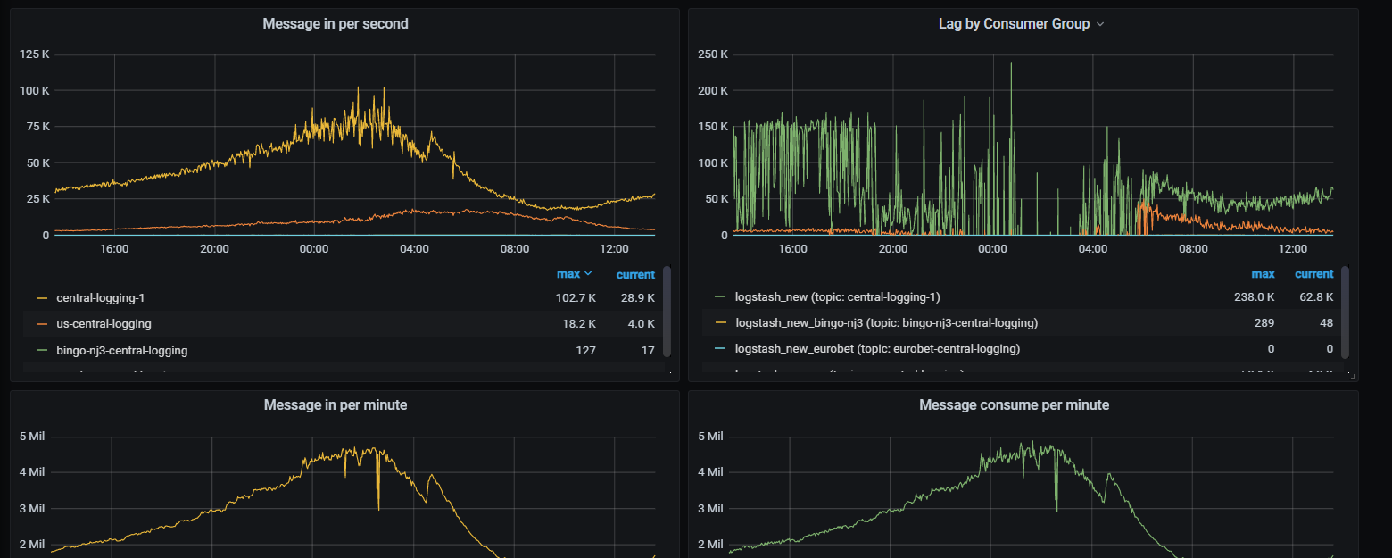
Apache Kafka- Monitoring with Prometheus

Slide 6
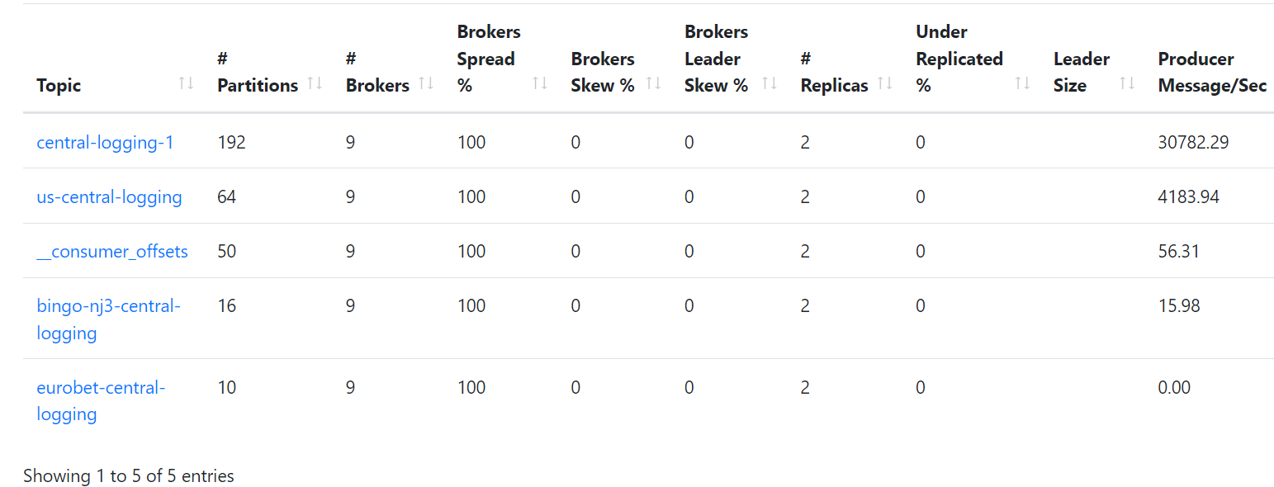
Apache Kafka- Monitoring with Kafka Manager

