Slide 1
🛡️ SHIELD: Secure Human Identity & Liveness Evaluation Detection
Real-Time Multimodal Face Anti-Spoofing & Identity Consistency System
Project Review
Presented by:
Sthavir Punwatkar
Mihir Rabade
Project Guide : Prof. Kunal Chanda

Slide 2
Problem Statement
Today, facial recognition is used everywhere—from unlocking phones to logging into bank accounts. However, standard facial recognition only checks who you are by looking at a picture of your face. It does not check what you are. A hacker can easily bypass basic facial recognition by holding up a printed photo of your face, playing a video on a tablet, or wearing a 3D silicone mask. This is known as a Spoof Attack.
The Solution : SHIELD is a "Liveness Evaluation" system. It operates on top of facial recognition to prove that the face in front of the camera belongs to a living, breathing, real human being, right at that exact moment.

Slide 3
Identity spoofing and mid-session candidate swapping compromise remote verification systems
Vulnerabilities in Remote Audits
The Core Challenge :
Texture-only checks fail to catch physiological signs or candidate swaps. A secure system must fuse texture, physiology, and real-time candidate validation into an explainable score.
• Presentation Attacks: Printed photos and screen video replays bypass basic face matching.
• Deepfakes & Masks: Generative AI deepfakes and 3D masks mimic static traits.
• Candidate Swapping: Candidates authenticate and swap seats mid-session.
Source: IS/IEC 30107-3 Biometric Presentation Attack Detection Standards

Slide 4
Build a low-latency, real-time multimodal liveness detection system for high-security environments
• Real-Time Liveness: Classify and reject spoof attacks under 100ms end-to-end latency. • Physiological Pulse: Extract remote heart rate (rPPG) to confirm biological human presence. • Active Challenge-Response: Randomize user tasks to defeat pre-recorded replay videos. • Mid-Session Swap Protection: Verify identity continuity using real-time geometric signatures.
Deployment Targets: Remote Interviews and Automated Attendance Systems

Slide 5
Gaps identified on the existing system
During our research, for work done previously to solve this problem statement, we identified these common shortcomings, listed below :-
1. Active Challenge-Response : Many apps ask the user to "smile," "turn your head to the left," or "blink." Limitation: These are annoying for the user (poor UX) and can be easily bypassed by holding up an iPad playing a video of someone turning their head.
2. Hardware-Based 3D Sensors (e.g., Apple FaceID) : Uses infrared dots to map the depth of a face. Limitation: Requires expensive, specialized hardware (infrared cameras/dot projectors). It cannot work on a normal laptop webcam or a cheap smartphone.
3. Basic 2D Texture Analysis (e.g., standard API vendors) : Uses simple AI to look for screen glare or paper edges. Limitation: Highly vulnerable to modern 3D silicone masks or high-quality deepfakes.

Slide 6
Novelty done to address the Gaps observed in the Work done previously on the Problem Statement
Hybrid Active & Passive:
The user doesn't have to do anything annoying (no smiling on command). They just look at the camera. Active Verification: Confirms real-time compliance unlike simple passive checks. Dynamic Tasks: Randomly prompts user actions (e.g. blinks, turns). Temporal Validation: Detects video cuts, speed manipulation, or stream injection.
Multi-Modal Fusion: :
1. Spatial AI (YOLOv8 & MiniFASNet): Looks at the texture of the face to detect silicone masks, paper masks, or digital screens.
2. Behavioral AI (MediaPipe): Maps 478 points on the face to ensure natural micro-movements and blinking.
3. Biological AI (rPPG): Measures invisible micro-color changes in the skin to detect an actual human heartbeat/blood flow.
By combining all of these into one score, SHIELD provides hardware-level security using only a standard, cheap webcam.

Slide 7
SHIELD bridges the gap between passive detection and active presence verification
How SHIELD Differs from Competitors
Feature | Standard Open Source | Enterprise (FaceTec/AWS) | SHIELD (Ours)
Deep rPPG Pulse Checks | ❌ None | ⚠️ Secret / Cloud only | ✅ Integrated (Local/Fast)
Hybrid Active + Passive | ❌ Passive only | ✅ Yes | ✅ Yes (WebSocket-optimized)
Mid-Session Swap Check | ❌ None | ❌ Initial check only | ✅ Continuous 4D signature
Real-Time Quality Gate | ❌ None (fails raw) | ✅ Yes | ✅ Yes (Reject blur/dark)
Model Footprint / Latency | ⚠️ Heavy / Slow | ⚠️ Cloud latency > 500ms | ✅ < 85ms end-to-end local
Unique Novelty: Fusing biological pulse (rPPG) with scale-invariant geometric signatures for continuous session trust.

Slide 8
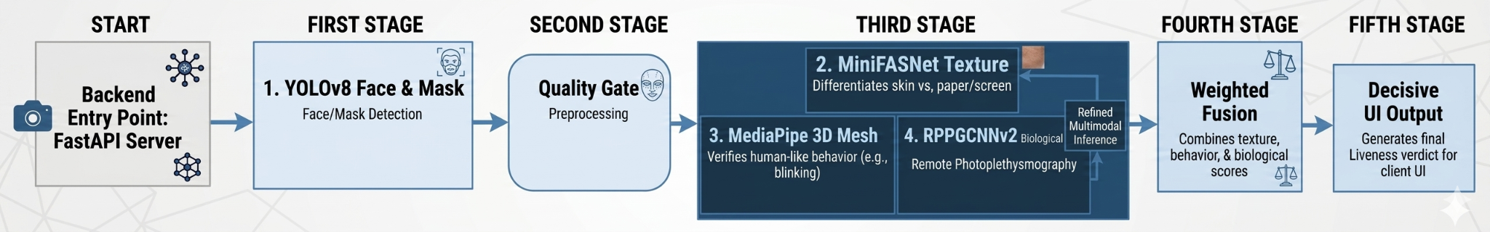
The system filters frames via a Quality Gate and processes liveness signals in parallel
SHIELD Pipeline Architecture Flow
• Quality-First Check: Rejects blurry or dark frames before inference to save server load.
• Bi-directional WebSockets: Enables real-time, low-latency binary frame streaming.
• Fusion Engine: Combines texture, pulse, and challenge prompts for the final score.

Slide 9
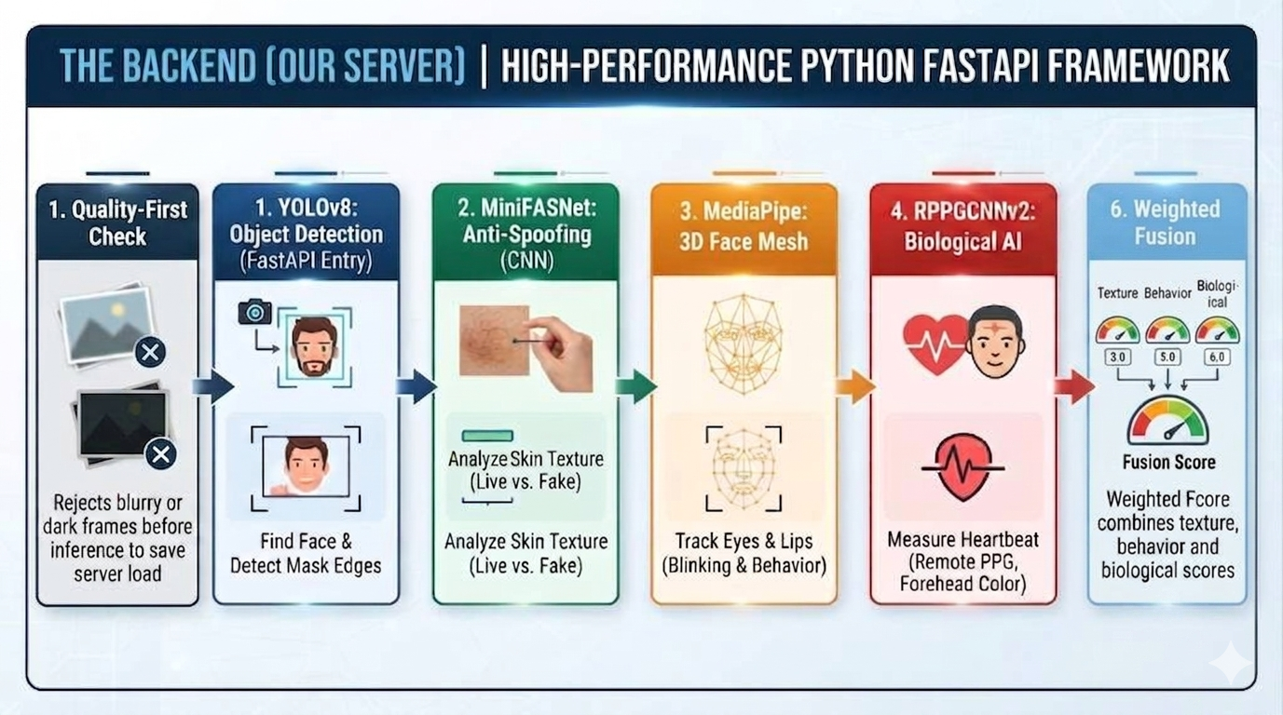
The Backend Server Models (Detailed Pipeline)

Slide 10
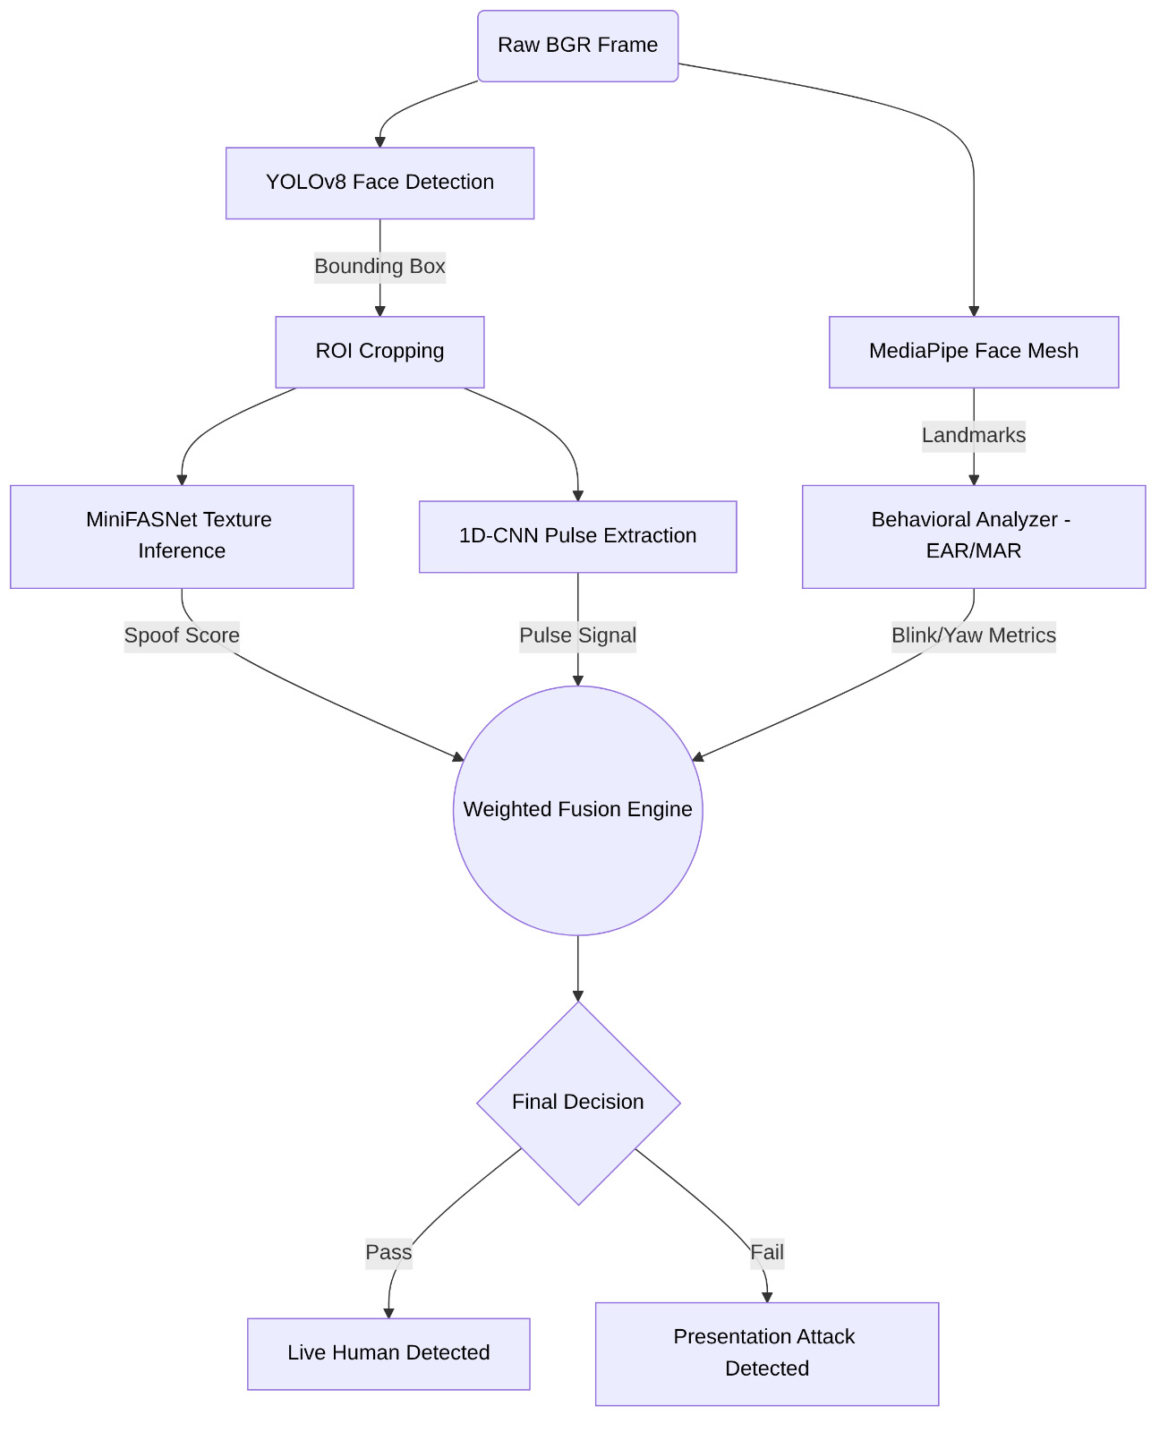
Fusion engine Architecture

Slide 11
SHIELD achieves high classification accuracy and exceeds ISO/IEC standards
ISO/IEC 30107-3 Benchmark Comparison
Key Empirical Takeaways
• High Security: Fusing texture, rPPG, and active prompts yields a low 1.0% ACER.
• Optimal Weights: Empirically tuned: 65% Challenge, 15% Antispoof, 10% rPPG, 10% Blink.
• Low Latency: 85ms average execution ensures a lag-free user interface.
Metric | SHIELD Score | ISO Standard
APCER (Attack Error Rate) [False Negatives] | 1.2% | < 5.0%
BPCER (Bona Fide Error Rate) [False Positives] | 0.8% | < 3.0%
ACER (Average Error Rate) | 1.0% | < 4.0%
End-to-End Latency | 85 ms | < 150 ms
Evaluation dataset: Unified CASIA-FASD and CelebA-Spoof validation sets

Slide 12

A WebSocket-driven Flutter UI provides real-time guidance and verification feedback
Interactive Verification Flow
1. Pre-Verification Gateway Aligns user and checks ambient light levels.
2. Dynamic Face Guide Square Glows blue during scan, red on errors, green on success.
3. Spotlight Prompt UI Displays clear, real-time interactive challenges.
Verification Demonstration Video

Slide 13
Conclusions & Future Work
Key Takeaways
Future Scope & References
1. Multimodal Fusion: Achieved a low 1.0% ACER using optimized weights. 2. Swap Prevention: Continuous 4D signatures secure active session integrity. 3. Production Ready: Sub-100ms end-to-end verification over WebSockets.
Future Scope: • Compile client-side ONNX for direct mobile execution. • Expand training with high-fidelity 3D masks. Key References: • ISO/IEC 30107-3 Standards for PAD
• PhysNet 3D CNN Spatio-Temporal Heart Rate

