Slide 1
AgriVision!
A Solution for Managing Vegetable Production and Demand
Developed by:
Uthayakumar Niruthigan & Suthakar Thiroshan
St John's College, Jaffna

Slide 2
Problem Statement
Current Challenges in Agriculture:
Lack of real-time demand data for farmers.
Overproduction leads to wastage; underproduction causes shortages.
Difficulty in deciding which crops to cultivate for maximum profitability.
Need for a Solution: A system to align crop production with market demands.

Slide 3
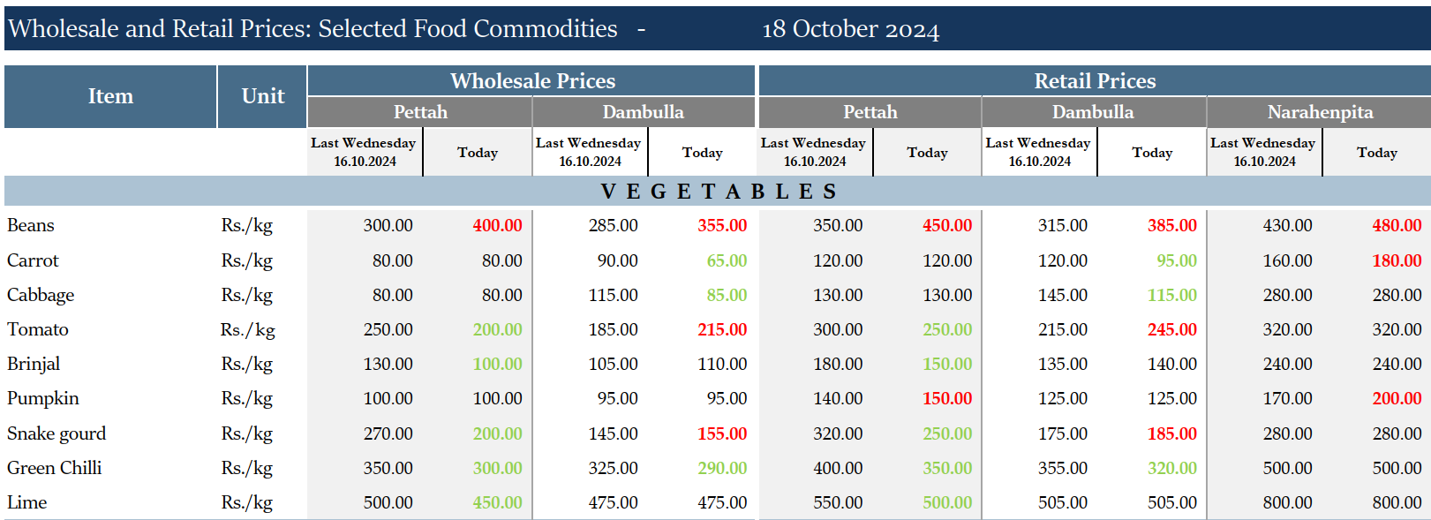
Problem Statement …

Slide 4
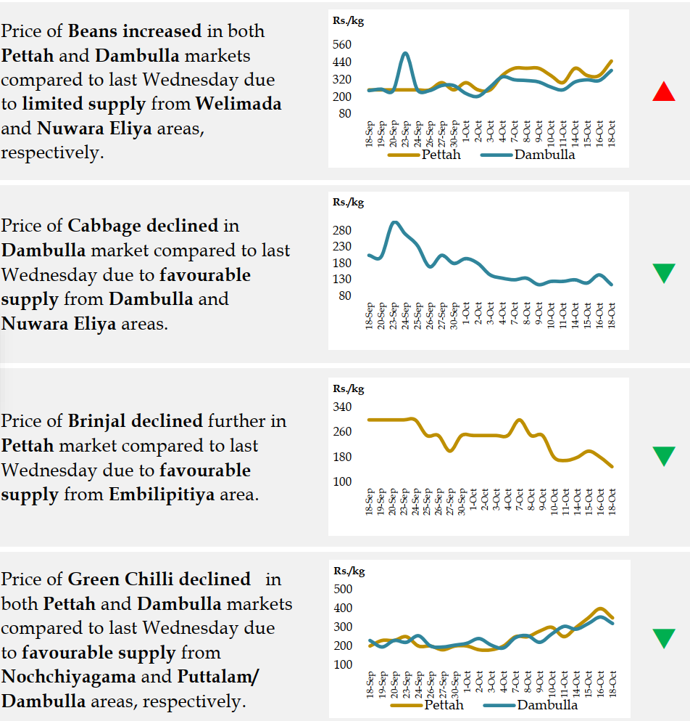
Problem Statement …

Slide 5
Overview of AgriVision App
AgriVision Features
Assists farmers in identifying crops with higher demand.
Simplifies crop data entry and updates.
Provides useful tips and details about crops, helping farmers make better decisions to reduce wastage and increase their income.
Enables data collection for agricultural policy-making.
$Demand \%=\frac{\text{Total} \text{Consumption}\text{ − }\text{Total} \text{Production} \text{by} \text{all} \text{Farmers}}{\text{Total} \text{Consumption}} ×100\%$

Slide 6
Benefits of AgriVision
For Farmers:
Informed crop selection for higher profits.
Minimised wastage and risk of overproduction.
Easy record-keeping and demand tracking.
For the People:
Stable vegetable availability in markets.
Controlled pricing due to balanced supply and demand.

Slide 7
Benefits of AgriVision …
For the Agriculture Department:
Centralised data for better policy-making and guidance.
Enhanced support for farmers based on trends.
For the Environment:
Promotes resource-efficient farming by reducing wastage and balancing production.
Minimises overproduction and unnecessary farming efforts.

Slide 8
Technical Aspects
Frontend:
Built with Flutter for cross-platform compatibility.
Backend:
Managed using Python for server-side logic and API handling.
Database:
SQL Server for secure and efficient data storage.

Slide 9
Future Developments
Integration with weather data for crop-specific advice.
Market pricing forecasts for informed decision-making.
Multi-language support for accessibility.
Mobile notifications for high-demand crop alerts.

Slide 10
Conclusion
AgriVision bridges the gap between farmers, markets, and policymakers.
Empowers farmers with actionable insights for sustainable agriculture.
Adoption of this system can revolutionise agricultural practices.

Slide 11
Thank You!

