Slide 1

Angular Part 2 – Data & Event Binding Wednesday, December 6, 2023

Slide 2


Agenda
Web Development Study github
Data Binding
Event Binding
Directives (if,ngIf, for, ngFor, ngModel, ngStyle, ngClass)
Small Exercise Todo List

Slide 3
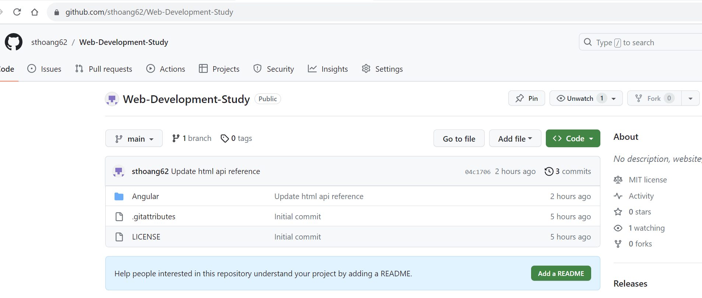
Web Development Study github

Slide 4
Data Binding
Data binding is the communication between Angular component and view/HTML/DOM
Two types of data binding
One-way: Changes in the view reflects changes in the component OR vice versa: changes in the component reflect the view
Two-way: Recursive Binding - Changes in the view reflects changes in the component AND changes in the component reflects the view

Slide 5

Data Binding One-way Binding Example – String Interpolation
File: app.component.ts
export class AppComponent {
title = 'AngularPart1’;
}
File: app.component.html
<h1 Hello {{ title }}! </h1>
title is assigned
View is updated
1. Update View
One-way Binding Collaboration Diagram

Slide 6
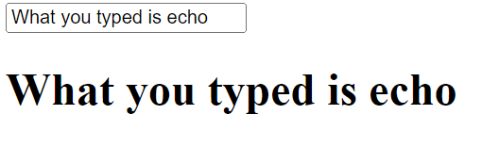
Data Binding Two-way Binding Example – Directive ngModel
File: app.component.ts
export class AppComponent {
echo = ‘’;
}
File: app.component.html
<input type="text" [(ngModel)]=“echo" />
<h1> {{ echo }}</h1>
1. Update Component
Component is Updated
View is Changed
2. Update View
Two-way Binding Collaboration Diagram

Slide 7
Data Binding
Different data binding types are below. Their syntax is expressed in the view/HTML
String Interpolation: {{ expression }}, e.g {{ title }}
Property binding: [target] = “expression”
Attribute binding: [target] = “expression”
Two-way binding: [(target)] = “expression”, e.g: ngModel
Class and Style binding: [target] = “expression” - Will be discussed in the future studies

Slide 8
Data Binding Property Binding: [target] = “expression”
The DOM is constructed from the parsed HTML during runtime. And thus, every element has its own runtime Javascript object such as button object (HTMLButtonElement). Then each Javascript object has properties e.g: innerText.
Element properties can be found @
https://developer.mozilla.org/en-US/docs/Web/HTML/Element
https://www.w3schools.com/jsref/
File: app.component.ts
export class AppComponent {
getButtonTitle(): string {
return "My Button Title"
}
}
File: app.component.html
<button [innerText]="getButtonTitle()"></button>

Slide 9
Data Binding Attribute Binding: [target] = “expression”
Attribute binding allows to set HTML attribute during runtime such as button disabled. It must be prefix with attr.
Element attributes can be found @
https://developer.mozilla.org/en-US/docs/Web/HTML/Element
https://www.w3schools.com/tags/
File: app.component.ts
export class AppComponent {
getButtonState(): boolean {
return true
}
}
File: app.component.html
<button [attr.disabled]="getButtonState()"></button>

Slide 10
Data Binding Attribute vs Property Binding
Attribute binding binds HTML attribute and is prefix with attr. such as <button [attr.disabled]="getButtonState()"></button>
Property binding binds DOM object property such as <button [disabled]="getButtonState()"></button>
Attribute and Property usually but not always have the same name such as attribute rowspan vs property rowSpan. Their semantic/meaning is the same but syntactically is different.

Slide 11
Event Binding Event Binding: (target) = “statement”
The DOM is constructed from the parsed HTML during runtime. And thus, every element has its own runtime Javascript object such as button object (HTMLButtonElement). Then each Javascript object has methods e.g: click.
Event binding allows one to listen to user input such as button is click
Element methods can be found @
https://developer.mozilla.org/en-US/docs/Web/HTML/Element
https://www.w3schools.com/jsref/
File: app.component.ts
export class AppComponent {
onButtonPressed(): void {
// Do something
}
}
File: app.component.html
<button (click)=“onButtonPressed()"></button>

Slide 12
Directives
Directives are instructions to add or modify the DOM
Directives are classified as following:
Component directives. It is used as the main class of component and contain information of how the component is processed e.g: @Component
Structural directives. It is used to modify the DOM elements e.g: *ngIf, *ngFor, and
Attribute directives. It is used to modify the style of the DOM elements e.g: [ngStyle], [ngClass]

Slide 13
Directives Component Directives
@Component({
selector: 'app-root’,
templateUrl: './app.component.html',
styleUrl: [‘./app.component.css’]
}
Selector: Tell Angular where to create and insert this component in the template HTML tag e.g: Insert this component between <app-root> tag
templateUrl: Defines HTML template file which is used by this component
styleUrl: Defines Style format file(s) which is used by this component

Slide 14
Directives Structural Directives - *ngIf or @if
*ngIf allows conditionally adding or not adding element to the DOM
File: app.component.ts
export class AppComponent {
isLogin = false;
}
File: app.component.html
<h1 *ngIf="isLogin else notLogin">You are logged in</h1>
<ng-template #notLogin>
<h1>You are NOT logged in</h1>
</ng-template>
@if (isLogin) {
<h1>You are logged in</h1>
}
@else {
<h1>You are NOT logged in</h1>
}

Slide 15
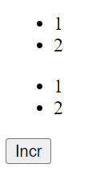
Directives Structural Directives - *ngFor or @for
*ngFor allows to repeat adding/deleting data in the DOM
File: app.component.ts
export class AppComponent {
incrList : number[] = [];
incr = 0;
onIncr() { this.incrList.push(++this.incr);
}
}
File: app.component.html
<ul>
<li *ngFor="let i of incrList">{{i}}</li>
</ul>
<button (click)="onIncr()">Incr</button>
<ul>
@for (i of incrList; track i) {
<li>{{i}}</li>
}
</ul>

Slide 16
Directives Attribute Directives - ngStyle
ngStyle allows to change the style of the element in the DOM
File: app.component.ts
export class AppComponent {
toggleBackground = true;
onToggleBackground() {
this.toggleBackground =
!this.toggleBackground;
}
}
File: app.component.html
<h1
[ngStyle]=
"{backgroundColor: toggleBackground ? 'blue' : 'red'}">
Toggle Background Text
</h1>
<button
(click)="onToggleBackground()">
Click to Change Background
</button>

Slide 17
Directives Attribute Directives – ngClass
ngClass allows to add/delete the CSS class of the element in the DOM
File: app.component.css
online { color: green }
File: app.component.ts
export class AppComponent {
isOnline = true;
}
File: app.component.html
<p [ngClass]="{ 'online': isOnline }">Username</p>

Slide 18
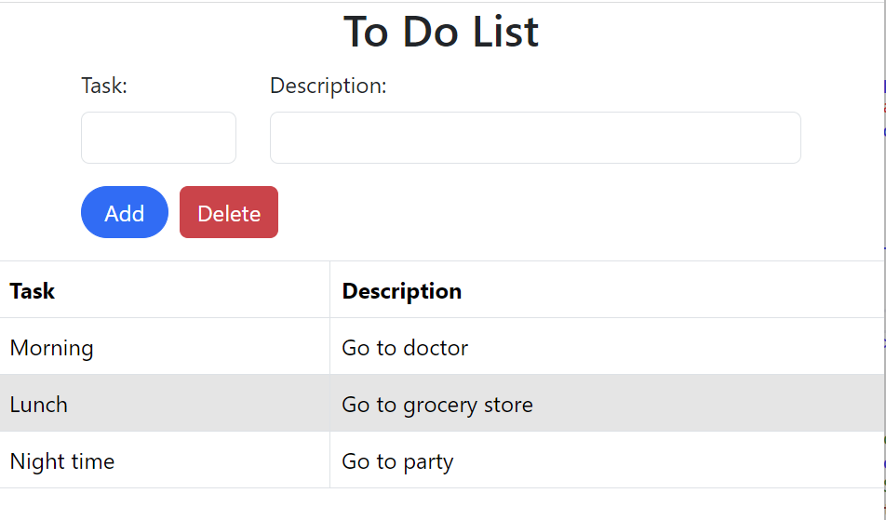
Exercise Todo List
From Visual Studio, use npm to install bootstrap as production or
From command line within the project folder use: npm i boostrap --save
Place the below in the angular.json
"styles": [
"node_modules/bootstrap/dist/css/bootstrap.min.css",
"src/styles.css"
],

Slide 19

Thank you
Sonny Hoang
sthoang62@gmail.com

