Slide 1

Angular Part 3 – Custom Databinding Wednesday, December 13, 2023

Slide 2


Agenda
Custom Property Binding with @Input
Custom Event Binding with @Output
Local Template Reference using #
@Viewchild Property Decorator
Content Projection using ng-content
@ContentChild Property Decorator
Small Exercise Todo List

Slide 3
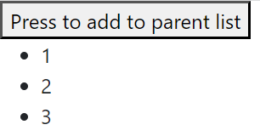
Custom Property Binding with @Input
Custom property binding is used with @Input directive to pass data from parent to the child.
The below example shows how the parent list in app component is passed to the child using (1) custom property [parentList]=“list” and (2) declare @Input in the child component. And then (3) parentList is used to render in the child HTML
File: app.component.ts
export class AppComponent {
list: number[] = []
incr = 0
onAdd (): void {
this.list.push(++incr)
}
}
File: child.component.html
<ul>
@for (item of parentList; track item) {
<li>{{item}}</li>
}
</ul>
3
2
1
File: child.component.ts
export class ChildComponent {
@Input() parentList: any
}
File: app.component.html
<button (click)="onAdd()">Press to add to parentList</button>
<app-child [parentList]="list"></app-child>

Slide 4
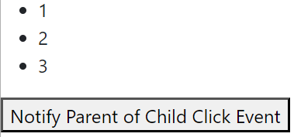
Custom Event Binding with @Output
Custom event binding is used with @Output directive to pass data from child to the parent.
The below example shows how the child component notify parent component. It is declared with (1) @Output and (2) notify the parent by using emit which trigger (3) onChildClick() in the parent component. Note on #3 that how $event is used as a parameter holder for the data of number.
File: child.component.html
<ul>
@for (item of parentList; track item) {
<li>{{item}}</li>
}
</ul>
<button (click)="onNotifyParent($event)">Notify Parent of Child Click Event</button>
File: app.component.ts
export class AppComponent {
list: number[] = []
onChildClick (idx: number): void {
this.list.push(idx)
}
}
3
File: child.component.ts
export class ChildComponent {
@Input() parentList: any
incr = 0
@Output() toParent = new EventEmitter()
onNotifyParent (event: any): void {
this.incr++
this.toParent.emit(this.incr)
}
}
1
File: app.component.html
<app-child (toParent)="onChildClick($event)" [parentList]="list"></app-child>
2

Slide 5

Local Template Reference using #
Local template reference allows template to have local variable that reference the HTML element
The below example shows #usrInput as local template variable and it is used to pass the element to the component
File: app.component.html
<input #usrInput placeholder="Type Anything"/>
<button (click)="onUsrInput(usrInput)">Press to acquire user input</button>
File: app.component.ts
export class AppComponent {
onUsrInput (inputEle: HTMLInputElement): void {
console.log(`User typed: ${inputEle.value}`)
}
}

Slide 6
@ViewChild Property Decorator DOM Access
ViewChild is used by the component to get access to the DOM element
The below example shows how #usrInput is accessed from the component. Its type is ElementRef
File: app.component.html
<input #usrInput placeholder="Type Anything"/>
<button (click)="onUsrInput()">Press to acquire user input</button>
File: app.component.ts
export class AppComponent {
@ViewChild('usrInput') inputEle!: ElementRef
onUsrInput (): void {
console.log(`User typed: ${this.inputEle.nativeElement.value}`)
}
}

Slide 7
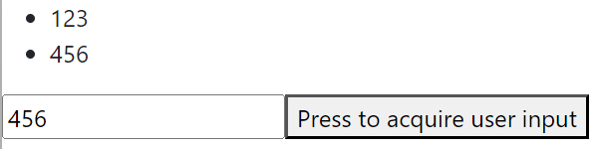
@ViewChild Property Decorator Child Component Access
ViewChild is also used by the parent component to get access to the child component
The below example shows how the parent access the child component. It is 1st declared the child component using @ViewChild. And 2nd it calls the child component method addItem. And 3rd the child component adds the item into itemList
File: app.component.html
<app-child></app-child>
<input #usrInput placeholder="Type Anything"/>
<button (click)="onUsrInput(usrInput)">Press to acquire user input</button>
File: child.component.html
<ul>
@for (item of itemList; track item) {
<li>{{item}}</li>
}
</ul>
1
2
3
File: app.component.ts
export class AppComponent {
@ViewChild(ChildComponent) child!: ChildComponent
onUsrInput (eleRef: HTMLInputElement): void {
this.child.addItem(eleRef.value)
}
}
File: child.component.ts
export class ChildComponent {
itemList: string[] = []
addItem (item: string): void {
this.itemList.push(item)
}
}

Slide 8
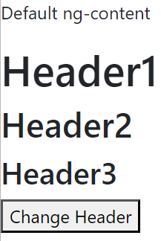
Content Projection using ng-content
Content projection is used to insert the HTML inside child component
The below example use ng-content to insert header1 attribute, header1class, and idHeader3 into child component
File: app.component.html
<app-child>
<p>Default ng-content</p>
<h1 #header1 header1>Header1</h1>
<h2 #header2 class="classHeader2">Header2</h2>
<h3 #header3 id="idHeader3">Header3</h3>
</app-child>
File: child.component.html
<ng-content></ng-content>
<ng-content select="[header1]"></ng-content>
<ng-content select=".classHeader2"></ng-content>
<ng-content select="#idHeader3"></ng-content>

Slide 9
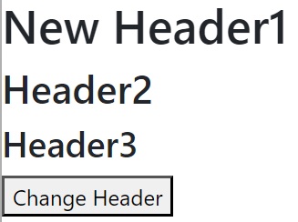
@ContentChild Property Decorator
ContentChild is used by the child to get the element references
The below example shows how we use ContentChild in the child component to get element of header1 that is passed from the parent component
2
File: app.component.html
<app-child>
<h1 #header1 header1>Header1</h1>
<h2 #header2 class="classHeader2">Header2</h2>
<h3 #header3 id="idHeader3">Header3</h3>
</app-child>
File: child.component.html
<ng-content select="[header1]"></ng-content>
<ng-content select=".classHeader2"></ng-content>
<ng-content select="#idHeader3"></ng-content>
1
File: app.component.ts
export class AppComponent {
@ViewChild(ChildComponent) childComponent!: ChildComponent
onHeaderChange (): void {
this.childComponent.changeHeader()
}
}
File: child.component.ts
export class ChildComponent {
@ContentChild('header1') headerEle!: ElementRef
changeHeader (): void {
this.headerEle.nativeElement.textContent = 'New Header1'
}
}

Slide 10
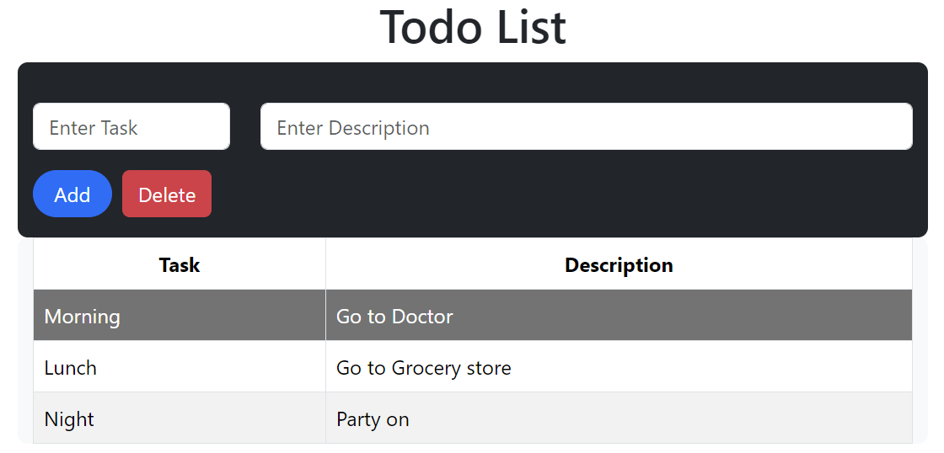
Small Exercise Todo List
This Powerpoint slides and Exercise solution (AngularPart3.zip) is located @ https://github.com/sthoang62/Web-Development-Study

Slide 11

Thank you
Sonny Hoang
sthoang62@gmail.com

