Slide 1

Angular Part 6 – Routing Wednesday, January 10, 2024

Slide 2


Agenda
Pages & Routing
Route & Query Parameters
Route Security & Guards

Slide 3
Pages & Routing
Routing allows us to navigate between pages using components
First we need to define the path such as http://localhost:4200/sales
Secondly we need to register the routes to angular
The redirect instruction tells Angular to redirect to sales when user enter http://local/host:4200
The path: ‘**’ tells Angular to goto http://localhost/:4200/sales if page not found
File: app.route.ts
import { type Routes } from '@angular/router'
import { SalesComponent } from './sales/sales.component'
import { ProductsComponent } from './products/products.component'
import { ServicesComponent } from './services/services.component'
export const routes: Routes = [
{ path: '', redirectTo: 'sales', pathMatch: 'full' },
{ path: 'sales', component: SalesComponent },
{
path: 'products',
component: ProductsComponent,
children: [
{ path: 'services', component: ServicesComponent }
]
},
{ path: '**', redirectTo: 'sales' }
]
File: main.ts
import { bootstrapApplication } from '@angular/platform-browser'
import { appConfig } from './app/app.config'
import { AppComponent } from './app/app.component'
bootstrapApplication(AppComponent, appConfig)
.catch((err) => { console.error(err) })
File: app.config.ts
import { type ApplicationConfig } from '@angular/core'
import { provideRouter } from '@angular/router'
import { routes } from './app.routes'
export const appConfig: ApplicationConfig = {
providers: [provideRouter(routes)]
}

Slide 4
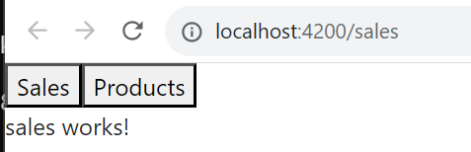
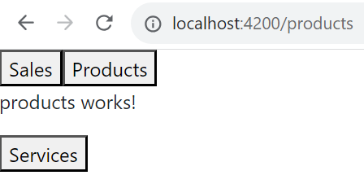
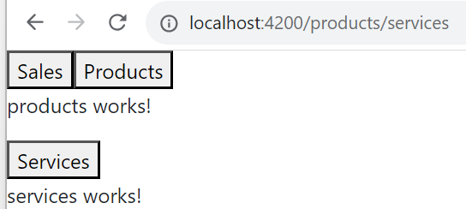
Pages & Routing
Next we bind the button click to the route by using routerLink directive
File: app.component.html
<button routerLink="/sales">Sales</button>
<button routerLink="/products">Products</button>
<router-outlet></router-outlet>
File: products.component.html
<p>products works!</p>
<button routerLink="/products/services">Services</button>
<router-outlet></router-outlet>
File: app.component.ts
import { Component } from '@angular/core'
import { CommonModule } from '@angular/common'
import { RouterModule, RouterOutlet } from '@angular/router'
@Component({
selector: 'app-root',
standalone: true,
imports: [CommonModule, RouterOutlet, RouterModule],
templateUrl: './app.component.html',
styleUrl: './app.component.css'
})
export class AppComponent {
title = 'AngularPart6'
}
File: products.component.ts
import { Component } from '@angular/core'
import { RouterModule, RouterOutlet } from '@angular/router'
@Component({
selector: 'app-products',
standalone: true,
imports: [RouterOutlet, RouterModule],
templateUrl: './products.component.html',
styleUrl: './products.component.css'
})
export class ProductsComponent {
constructor () {
console.log('ProductsComponent is created...')
}
}

Slide 5
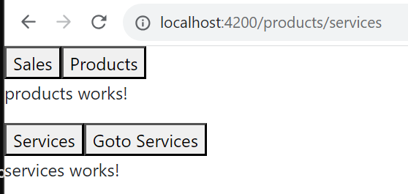
Pages & Routing Navigate Route Programmatically
We can also navigate the route programmatically by inject Router into our constructor and traverse the route when user presses the button
File: products.component.ts
import { Component } from '@angular/core'
// eslint-disable-next-line @typescript-eslint/consistent-type-imports
import { Router, RouterModule, RouterOutlet } from '@angular/router'
@Component({
selector: 'app-products',
standalone: true,
imports: [RouterOutlet, RouterModule],
templateUrl: './products.component.html',
styleUrl: './products.component.css'
})
export class ProductsComponent {
constructor (private readonly r: Router) {
console.log('ProductsComponent is created...')
}
onServices(): void {
void this.r.navigate(['/products/services'])
}
}
File: products.component.html
<p>products works!</p>
<button routerLink="/products/services">Services</button>
<button (click)="onServices()">Goto Services</button>
<router-outlet></router-outlet>

Slide 6
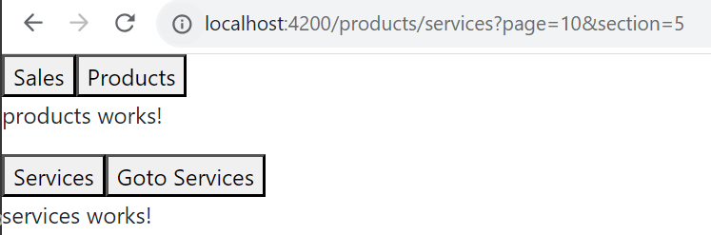

Route & Query Parameters
We can pass query parameters as http://localhost:4200/products/services?page=10&section=5 to component. And the component can access the query param by subscribe to queryParamMap
File: services.component.ts
import { Component } from '@angular/core'
// eslint-disable-next-line @typescript-eslint/consistent-type-imports
import { ActivatedRoute, RouterOutlet } from '@angular/router'
@Component({
selector: 'app-services',
standalone: true,
imports: [RouterOutlet, RouterOutlet],
templateUrl: './services.component.html',
styleUrl: './services.component.css'
})
export class ServicesComponent {
constructor (private readonly activatedRoute: ActivatedRoute) {
console.log('ServicesComponent is created...')
}
ngOnInit (): void {
this.activatedRoute.queryParamMap.subscribe(params => {
console.log(`page: ${params.get('page')}`)
console.log(`section: ${params.get('section')}`)
})
}
}
File: products.component.ts
import { Component } from '@angular/core'
// eslint-disable-next-line @typescript-eslint/consistent-type-imports
import { Router, RouterModule, RouterOutlet } from '@angular/router'
@Component({
selector: 'app-products',
standalone: true,
imports: [RouterOutlet, RouterModule],
templateUrl: './products.component.html',
styleUrl: './products.component.css'
})
export class ProductsComponent {
constructor (private readonly r: Router) {
console.log('ProductsComponent is created...')
}
onServices (): void {
console.log('onServices is called')
void this.r.navigate(['/products/services'], { queryParams: { page: 10, section: 5 } })
}
}

Slide 7
Route Security & Guards
Angular provides guards to protect the route,
To create the guard: ng generate guard guard-name. It will ask to generate CanActivate or Deactivate and you can choose to generate it
Two types of guard:
CanActivateFn – Prior to navigate to the page, the route is validated with functions
CanDeactivateFn – Prior to exit from the page, the route is validated with functions
File: app.route.ts
import { type Routes } from '@angular/router'
import { SalesComponent } from './sales/sales.component'
import { ProductsComponent } from './products/products.component'
import { ServicesComponent } from './services/services.component'
import { servicesGuard } from './services.guard'
import { servicesExitGuard } from './services-exit.guard'
export const routes: Routes = [
{ path: '', redirectTo: 'sales', pathMatch: 'full' },
{ path: 'sales', component: SalesComponent },
{
path: 'products',
component: ProductsComponent,
children: [
{ path: 'services', component: ServicesComponent, canActivate: [servicesGuard], canDeactivate: [servicesExitGuard] }
]
},
{ path: '**', redirectTo: 'sales' }
]

Slide 8
Route Security & Guards CanActivate
The below CanActivateFn is called prior to enter the services page. It returns true if the query parameters ‘page’ is existed otherwise false is returned
The function also indicates that the user cannot navigate to the services page with null in query parameters
import { type CanActivateFn } from '@angular/router'
export const servicesGuard: CanActivateFn = (route, state) => {
return (route.queryParamMap.get('page') !== null)
}

Slide 9
Route Security & Guards CanDeactivate
The below CanDeactivateFn is called when the user exits the services page. It returns true if the page that the user wants to go next is NOT /products otherwise it returns false
It also indicates that the user cannot go from services page to products page
1
import { Component } from '@angular/core'
// eslint-disable-next-line @typescript-eslint/consistent-type-imports
import { ActivatedRoute, RouterOutlet, RouterStateSnapshot } from '@angular/router'
@Component({
selector: 'app-services',
standalone: true,
imports: [RouterOutlet, RouterOutlet],
templateUrl: './services.component.html',
styleUrl: './services.component.css'
})
export class ServicesComponent {
constructor (private readonly activatedRoute: ActivatedRoute) {
console.log('ServicesComponent is created...')
}
canExit (nextState: RouterStateSnapshot): boolean {
return !nextState.url.startsWith('/products')
}
}
import { type CanDeactivateFn } from '@angular/router'
import { type ServicesComponent } from './services/services.component'
export const servicesExitGuard: CanDeactivateFn<unknown> = (component, currentRoute, currentState, nextState) => {
const c = component as ServicesComponent
return c.canExit(nextState)
}
2

Slide 10

Thank you
Sonny Hoang
sthoang62@gmail.com

