Slide 1
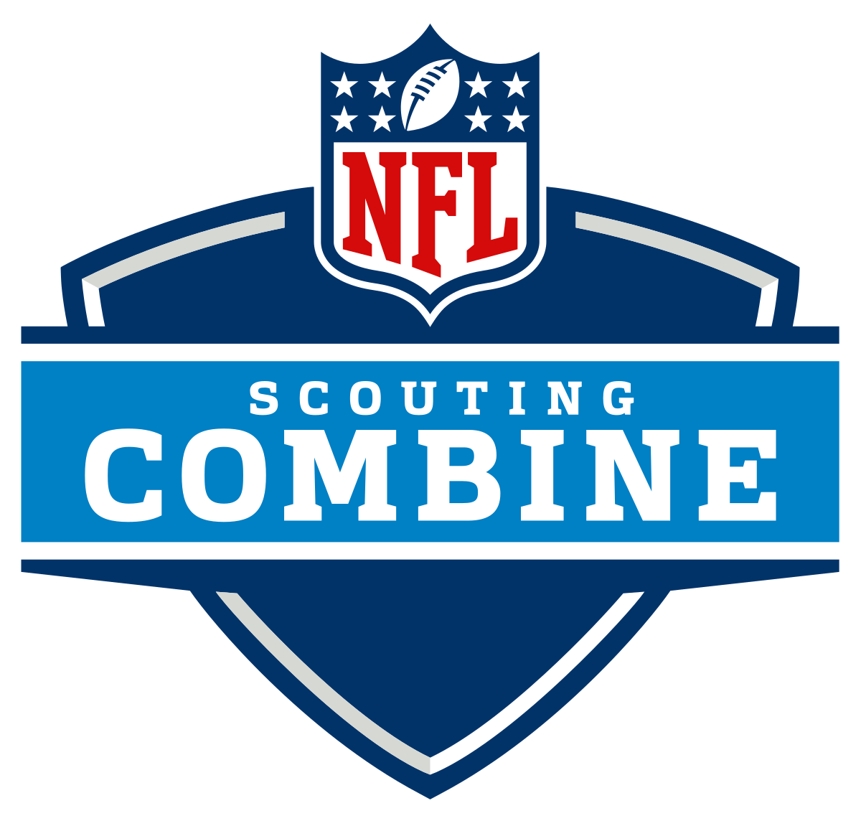
Predicting NFL Draft Outcomes from NFL Combine Data
Samuel Thomas

Slide 2
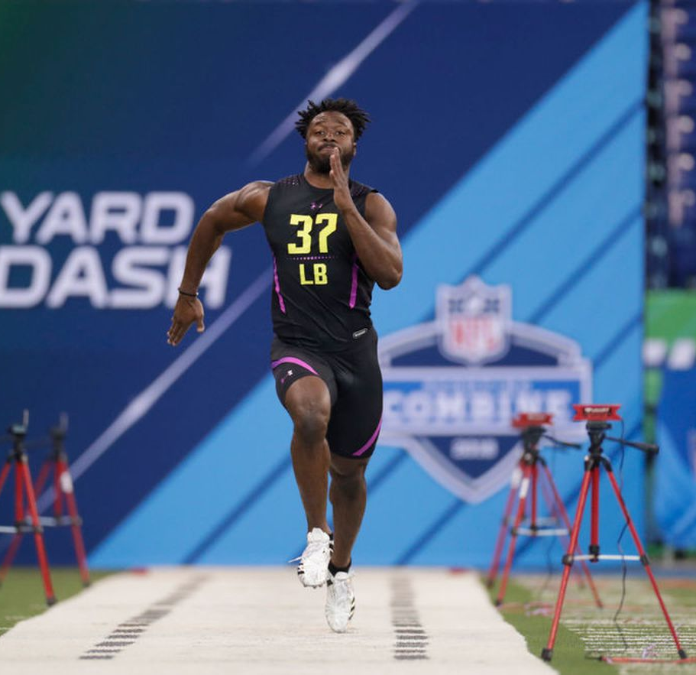
NFL Combine
Part of the scouting process for the NFL Draft
Manner in which most collegiate players enter the league
Physical drills, position skill drills, mental tests, interviews
Physical Drills
40-yard dash
225lb bench press
Vertical jump
Broad jump
20-yard shuttle
3-cone drill

Slide 3
Is it possible to determine whether a player is drafted based on their combine performance?

Slide 4
Data
All players that attended the combine from 2000 – 2017
5882
Broad jump length
20-Yard Shuttle
3-cone drill time
Year
AV
Team Drafted to
Round Drafted in**
Pick Selected
Name
Position
Height
Weight
40 yard-dash time
Reps of 225lb Bench
Vertical jump height

Slide 5
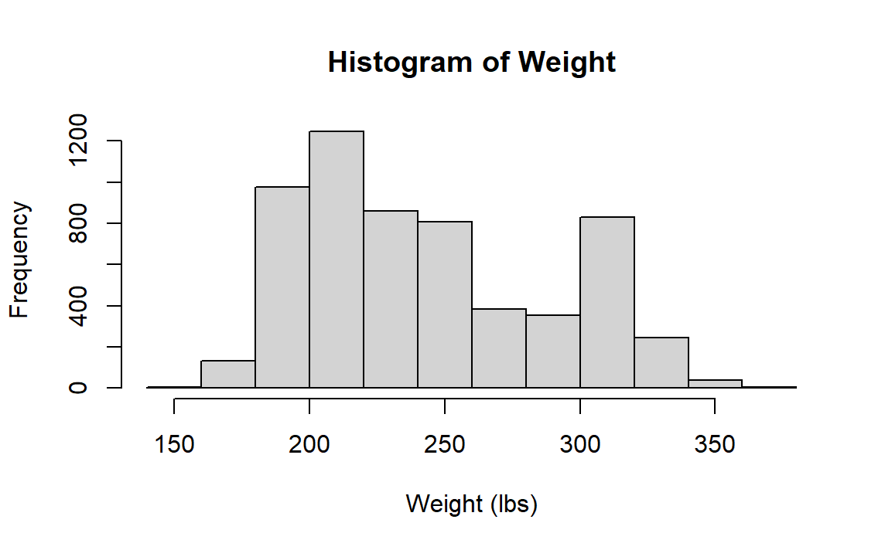
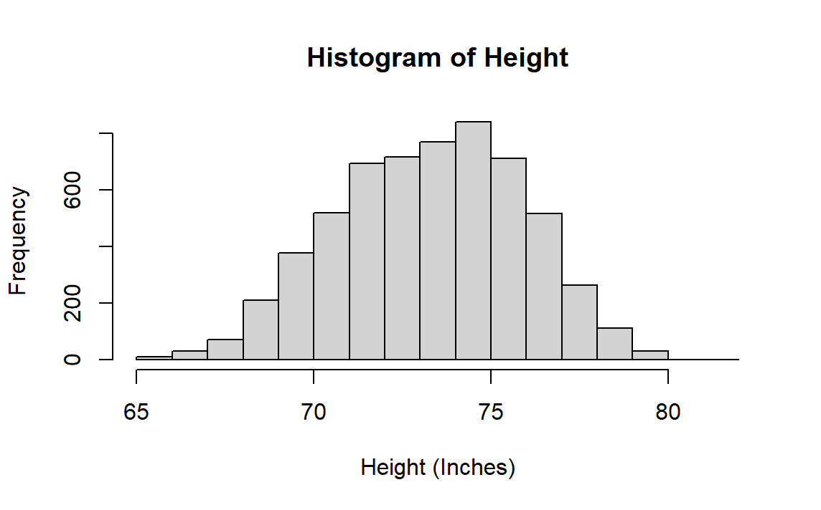
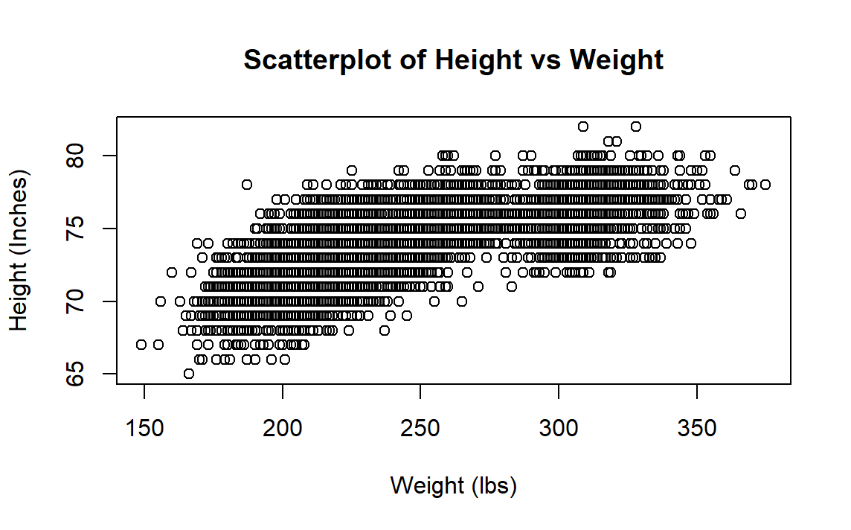
Exploratory Data Analysis

Slide 6
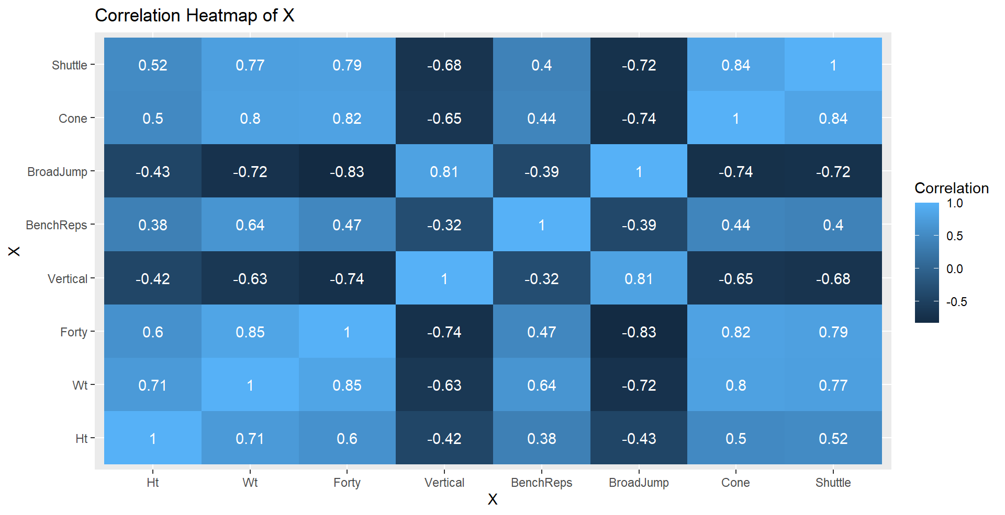
Correlation

Slide 7
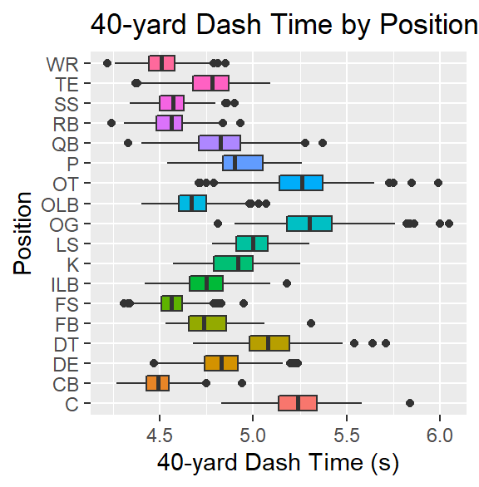
Missing Values
Many missing data values for each drill
Skip certain drills
Already have established result from a previous showcase
Believe completing drill will hurt their draft stock
Impute median performance of their position group

Slide 8
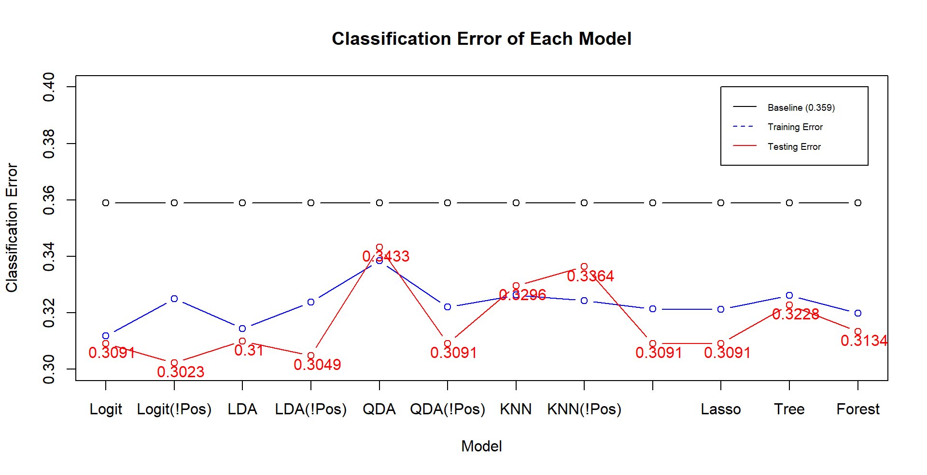
Models

Slide 9
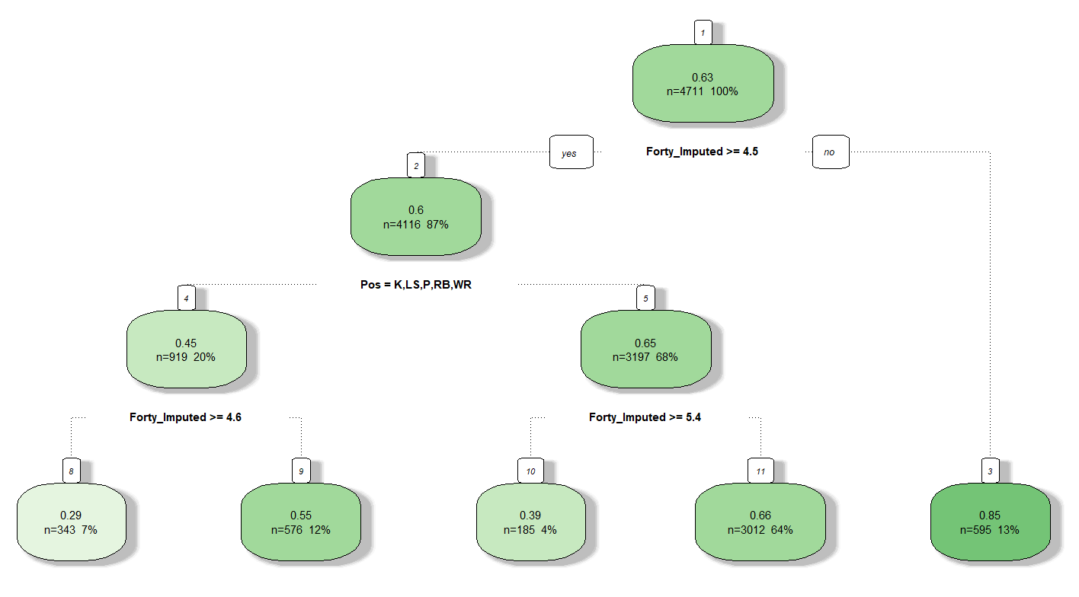
Models 2
Best Performers
Logit – 0.3091 / 0.3023
Normal covariates
LDA – 0.31 / 0.3049
Normal covariates
QDA (No Pos) – 0.3091
Normal covariates
Ridge (CV) – 0.3091
Highly correlated covariates
Most Important: Weight, 40-yard Dash
Lasso (CV) – 0.3091
Worst Performers
KNN (CV) – 0.3296 / 0.3364
Dimensionality vs Sample size
QDA – 0.3433
Tree (CV) – 0.3228

Slide 10
Discussion
Best models beat Baseline by about 0.05 (13.9% Improvement)
Main source of error: Type 1
Confusion matrix of Logit No Position
Most important predictors: 40-yard Dash Time, Weight
Obviously, a lot more to a player than six tests, height, weight, position
Actual / Predicted | 0 | 1
0 | 136 | 285
1 | 69 | 681

Slide 11

Next Steps
Implement SVM, Binary PCR
Improve imputation method
40-yd Dash: Use Weight (0.85) or Broad jump (-0.83)
Predict exact round
Predict success in the NFL

Slide 12
Thank You!

