Slide 1
Information Visualization
Investigating Climate Change

Slide 2
Research Questions
What is the evolution of climate change and effective variables on Earth?
What pairs of these variables are correlated in this regard over time?
What regions are most affecting and most affected over time?

Slide 3
Goal of the Visualization
Visual exploration of historical climate and human-related data variables
Pairwise comparison of variables
High-level and detailed representations
Dynamic, linked, and integrated
Bidimensional exploration

Slide 4
Data Dimensions
Geographical Dimension
  Region name
Temporal Dimension
  Year of given measurement
Value Dimension
  Value of measurement for given variable

Slide 5
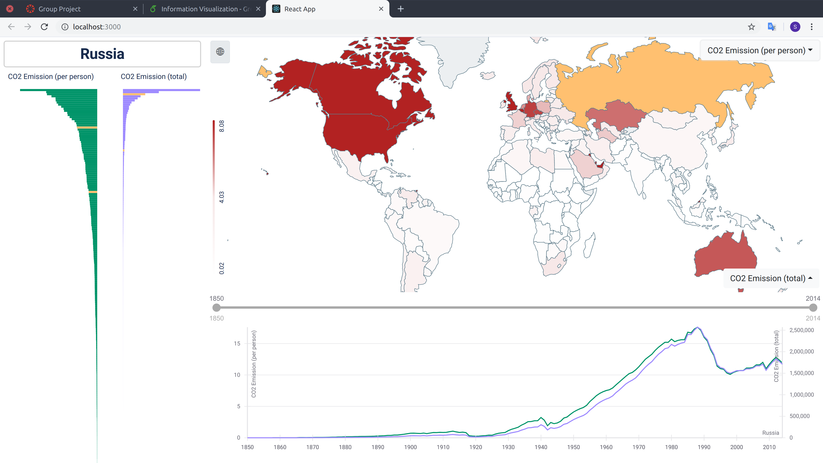
Application

Slide 6
Motivation of Design
Chloropleth Map: geographical
Time-series Plot: temporal
Parallel Bar Chart: ordinal
Time Range Slider: temporal selection
Dataset Selector: variable selection

Slide 7
Visualization Insights
High-level and detailed view of dataset can be inspected simultaneously
Distribution of dataset can be seen both geographically and in the bar chart
Country comparison enabled through brushing and linking
Time slider scrubbing shows dynamic changes in distribution over time
Dataset selection allows many different pairs

