Slide 1
HEALTH CARE
Cost Analysis
An in-depth review of health care costs in the US

Slide 2
Summary:
In an effort to understand the rise in health care costs in the United States, we have analyzed the historical health care trends over the past decade.
By leveraging the skills that we have acquired during the boot camp, we hope to paint a picture of where health care costs are today and where they are trending to be in the future.
Topics we will cover:
Health Care Costs Per state Vs. Average Income Per state
Health Care Costs Over Time
Uninsured Rates Vs. Hospital/Personal Health Care Costs
Historical look at Brand and Generic drug prices
Total Drug Spending in the US
Medicare Enrollment by state / Region

Slide 3
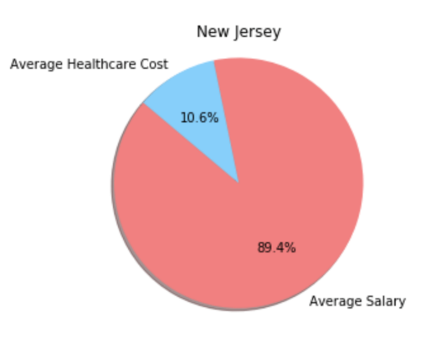
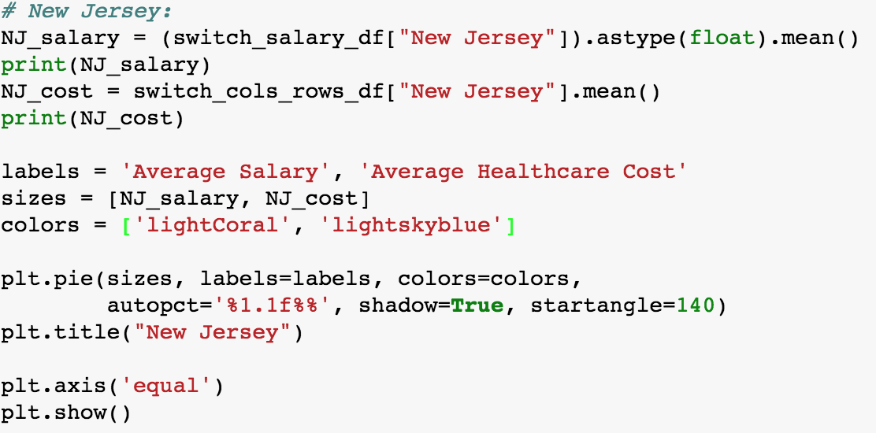
How was the analysis done?
The data we obtained gave us the average salaries of all fifty states from 2004 to 2014 and also the average amount of dollars spent on the healthcare costs.
We leveraged data from healthdata.gov, CMS, DHHR, Census, and the Kaiser foundation.

Slide 4
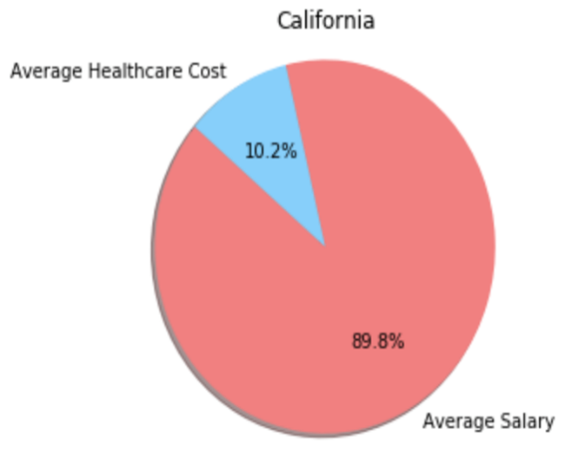
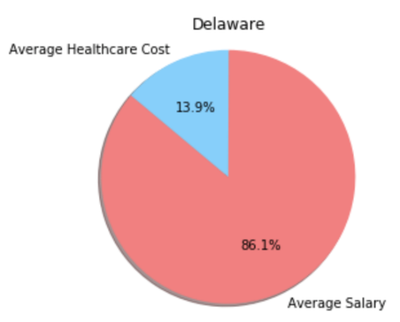
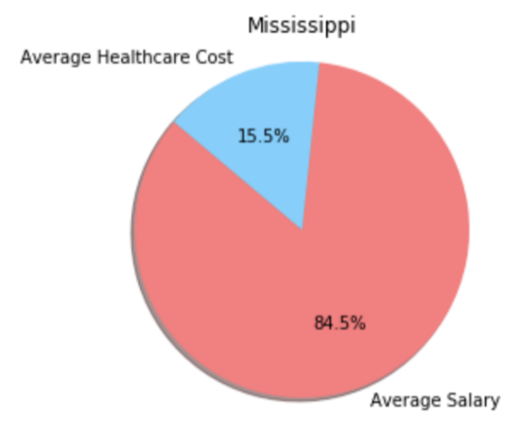
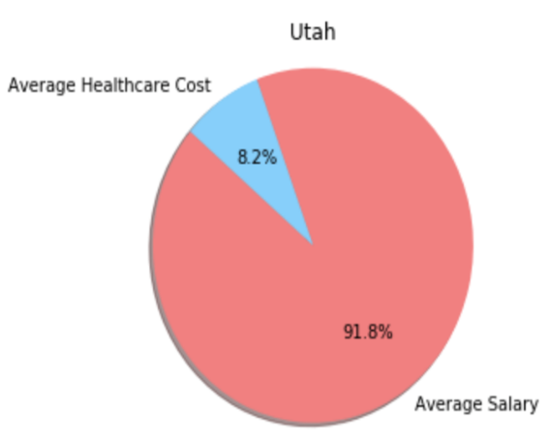
Healthcare Costs and Average Salary In US
Rising health insurance premiums and out-of-pocket expenses are having a considerable impact on Americans.
It is surprising to see the proportion of an average salary spent for the healthcare cost in the following states.

Slide 5
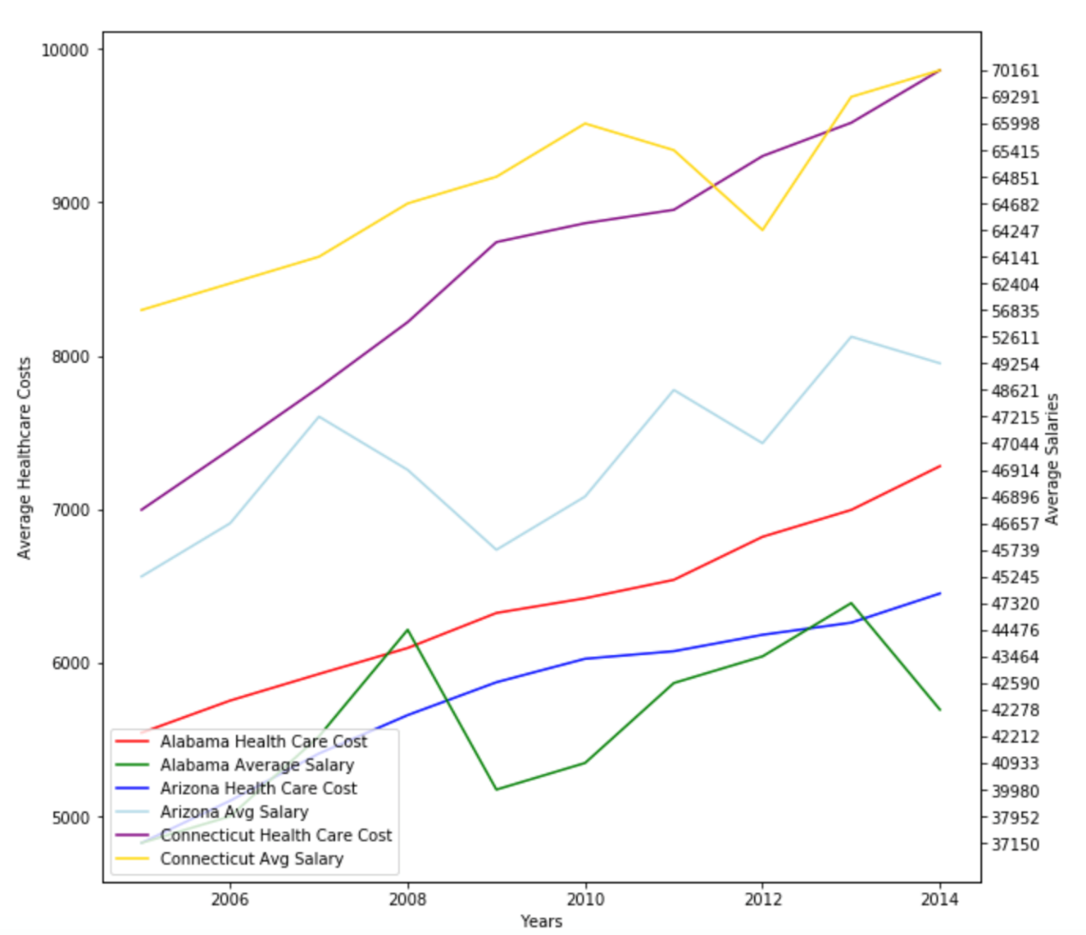
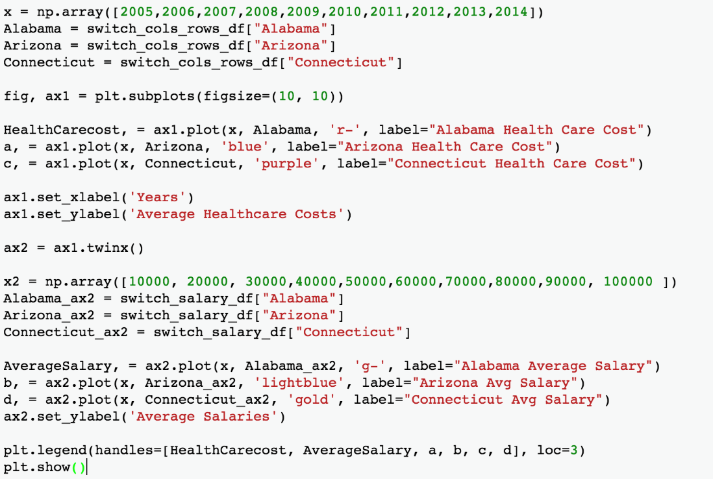
Depressing Look at Income Growth Vs Healthcare Cost Increase
It is depressing to see the income growth versus healthcare costs of average Americans over the years. While it is true for most states, the following graph shows the comparison of a few states over the course of almost ten years.

Slide 6
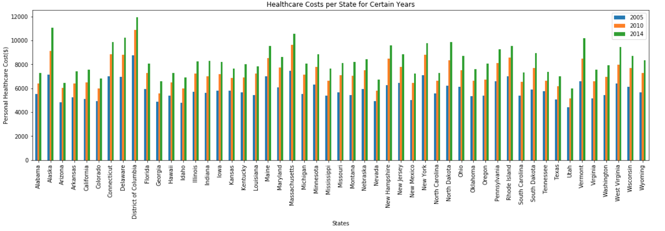
Personal Healthcare Costs For US States
Average healthcare spending has increased substantially over the course of a decade.
This phenomenon has hit the Americans painfully as they have to spend a large sum on the healthcare premiums.

Slide 7

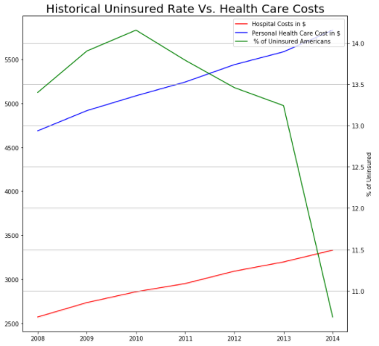
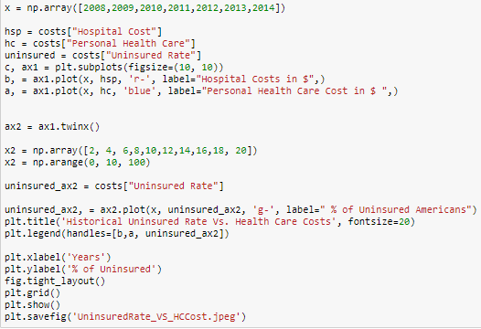
Percentage of Uninsured Vs. Health Care costs
As the percentage of uninsured Americans declines, it has little to no effect on the cost of health care

Slide 8
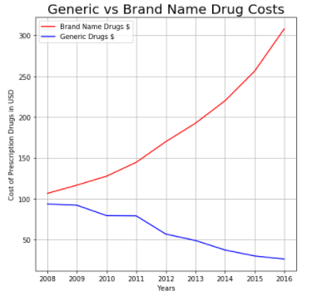
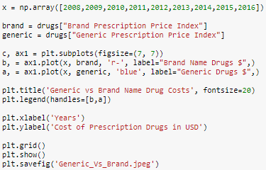
The Rising cost of Brand Name Drugs and decline of Generics
This decrease in uninsured Americans also had no effect on the rising cost of Brand name drugs, but may have been a factor in the decline of generics

Slide 9
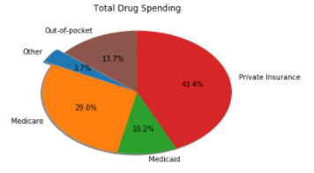
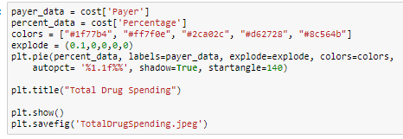
Total Drug Spending in the US
A majority of drug spending in the united states is paid by private insurance.
The second largest payer for prescription drugs would be the government assistance program Medicare.

Slide 10
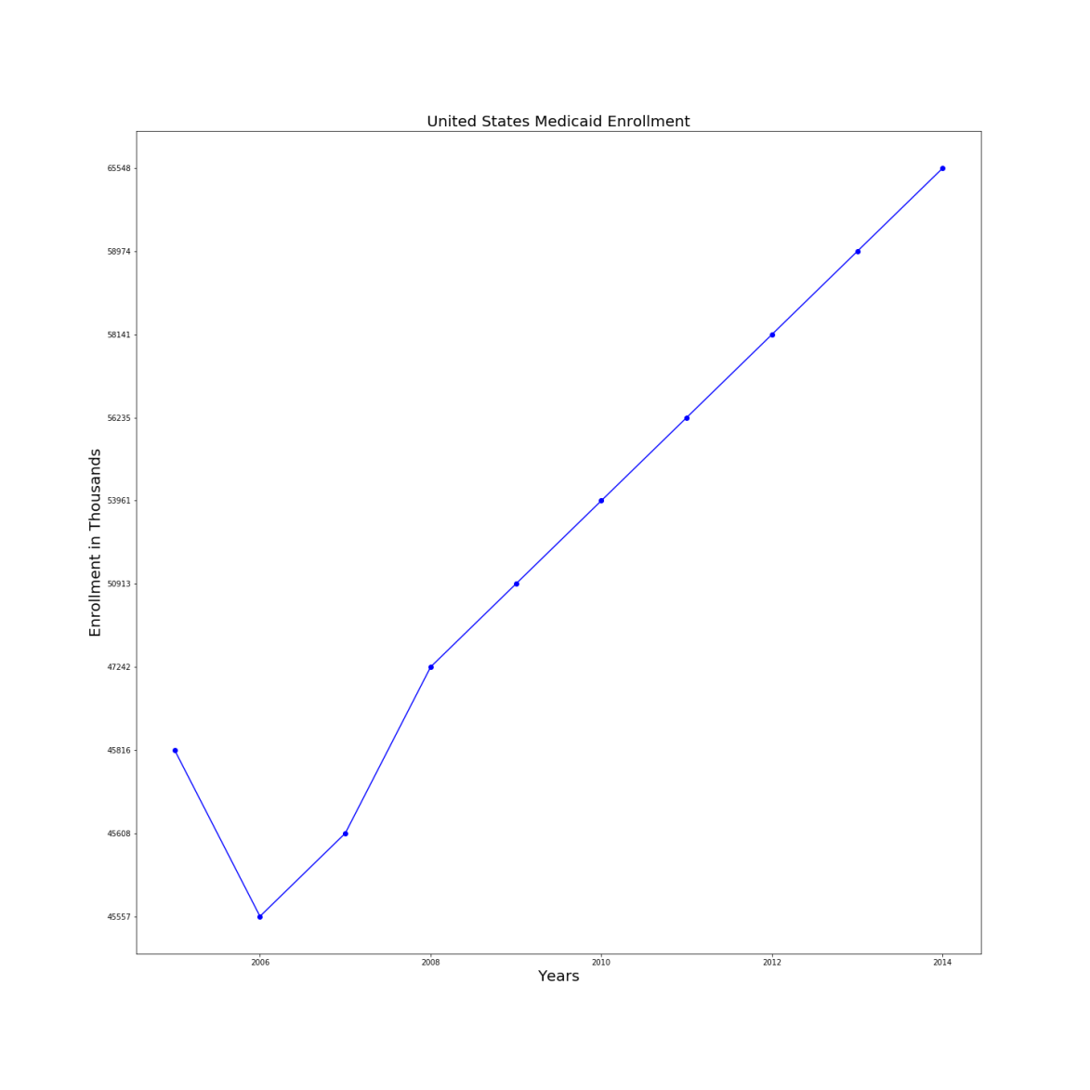
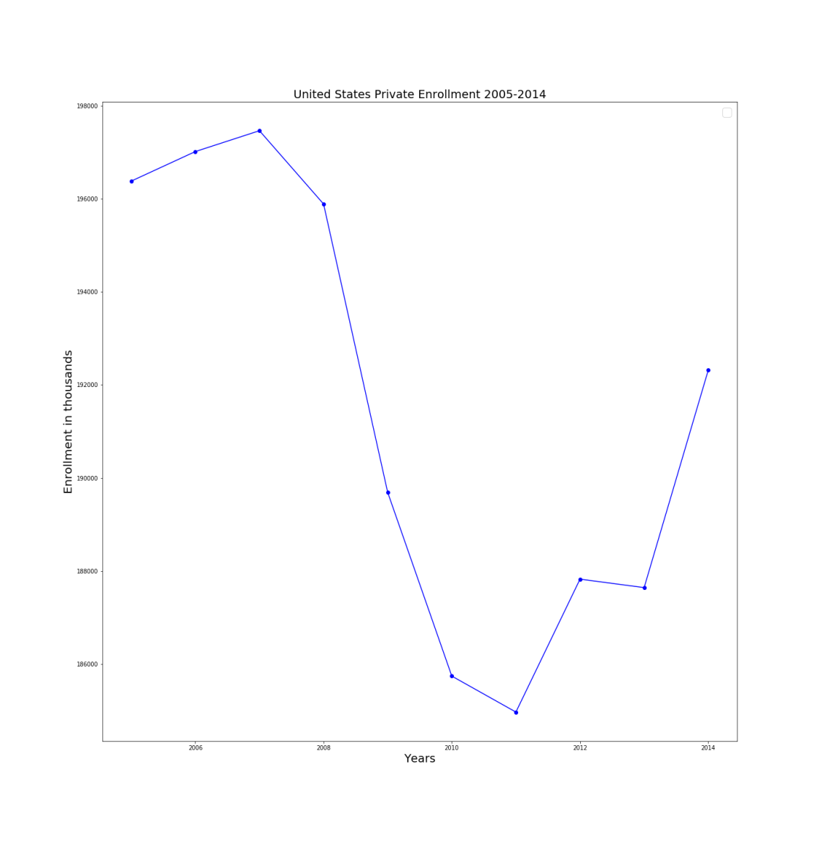
Medicaid vs Private Enrollment 2005-14

Slide 11
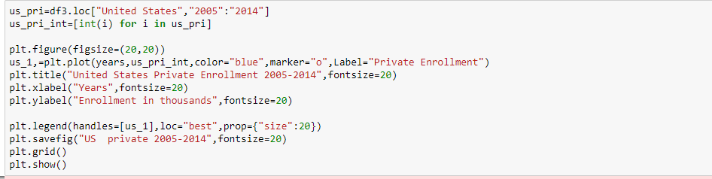
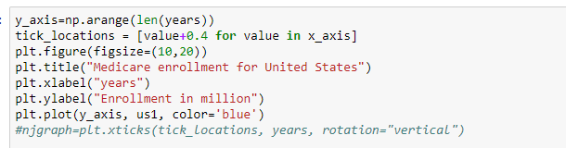
Code for US Enrollment

Slide 12
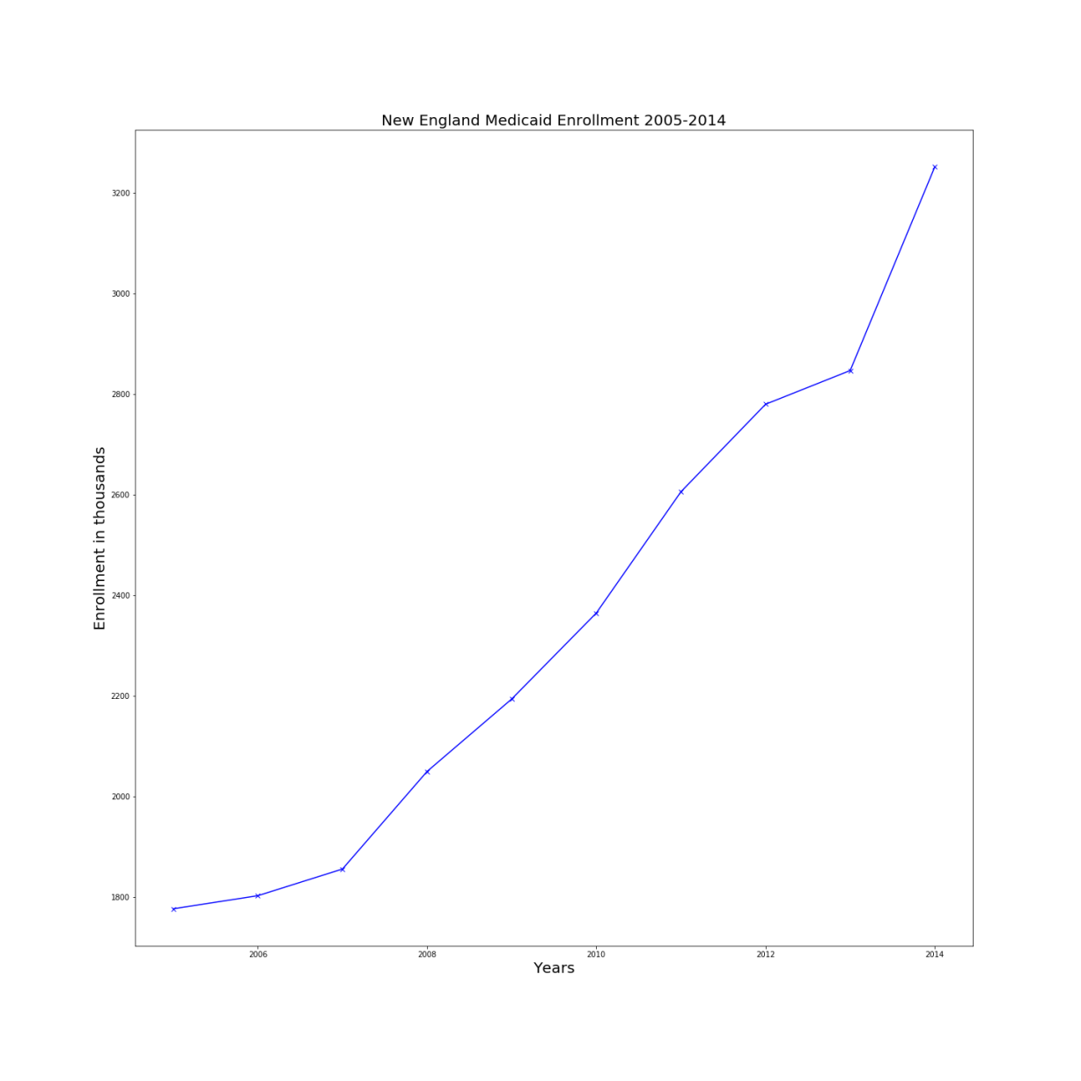
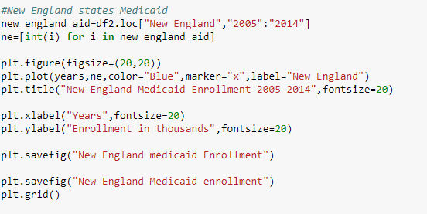
New England Region

Slide 13
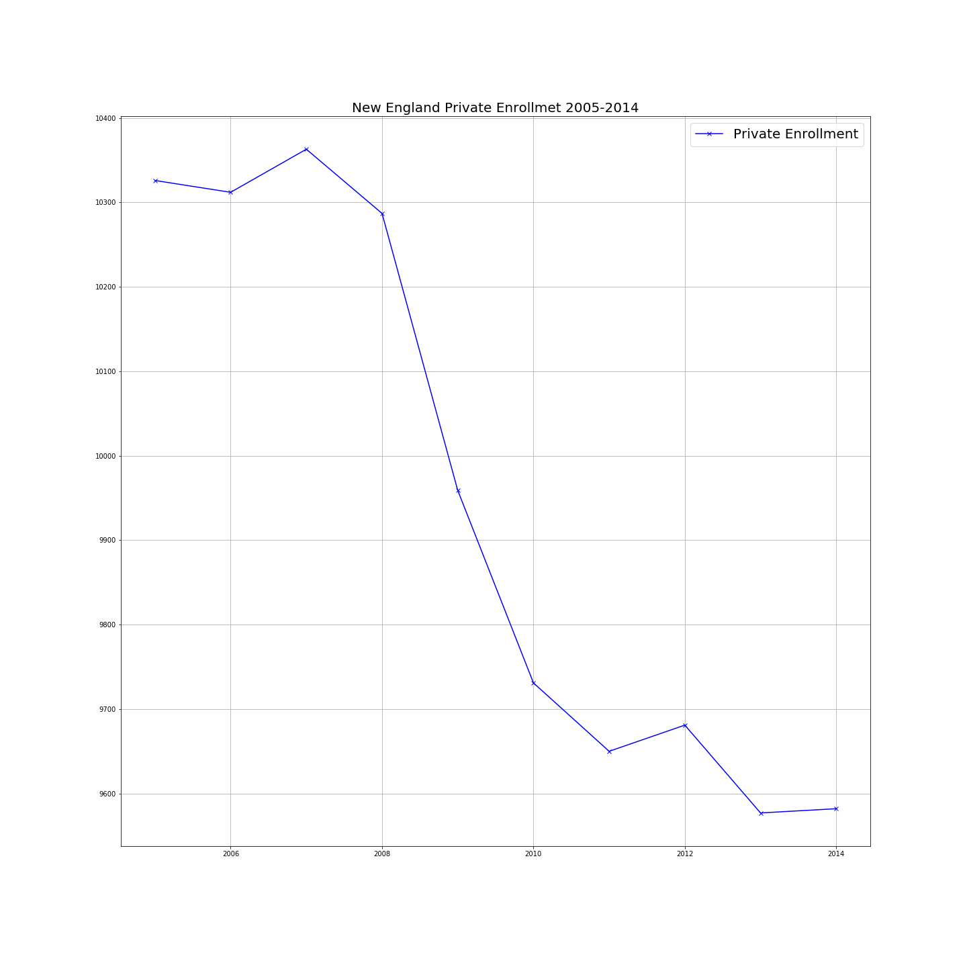

New England Private Enrollment

Slide 14
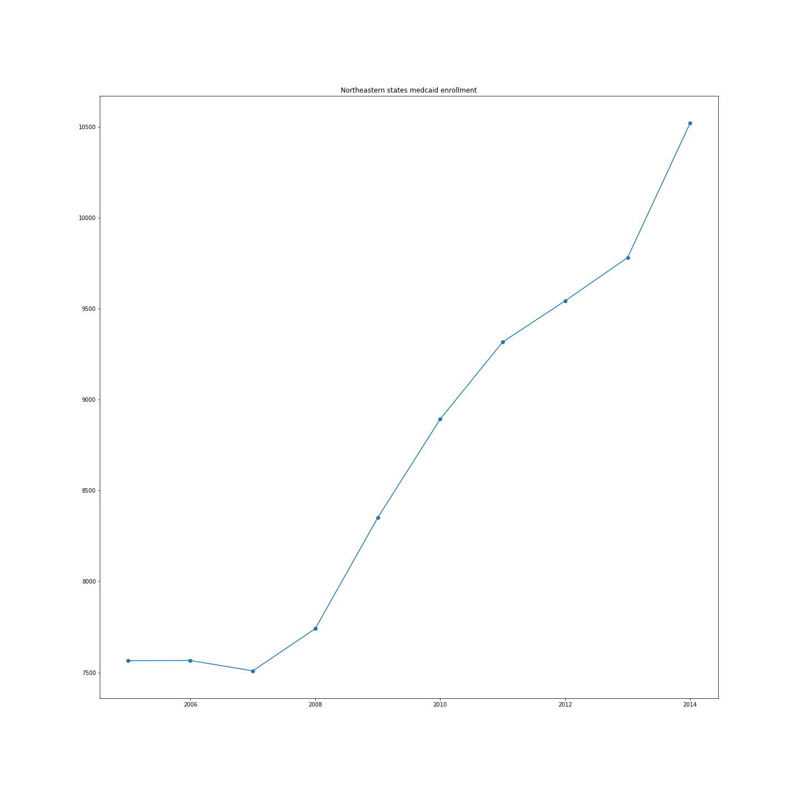
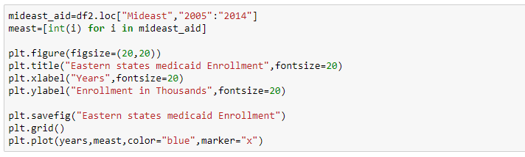
Northeast Medicaid Enrollment

Slide 15
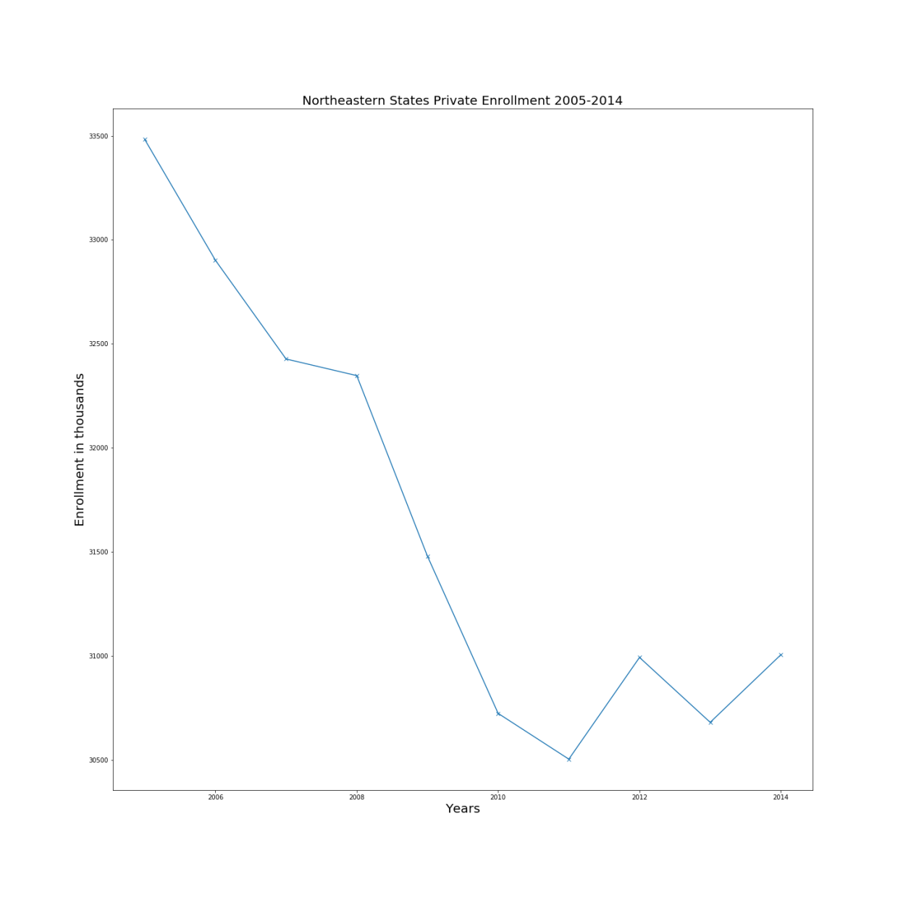
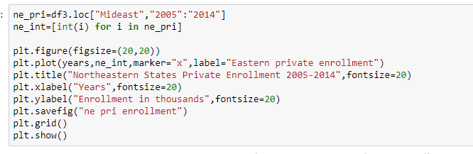
Northeast Private Enrollment

Slide 16
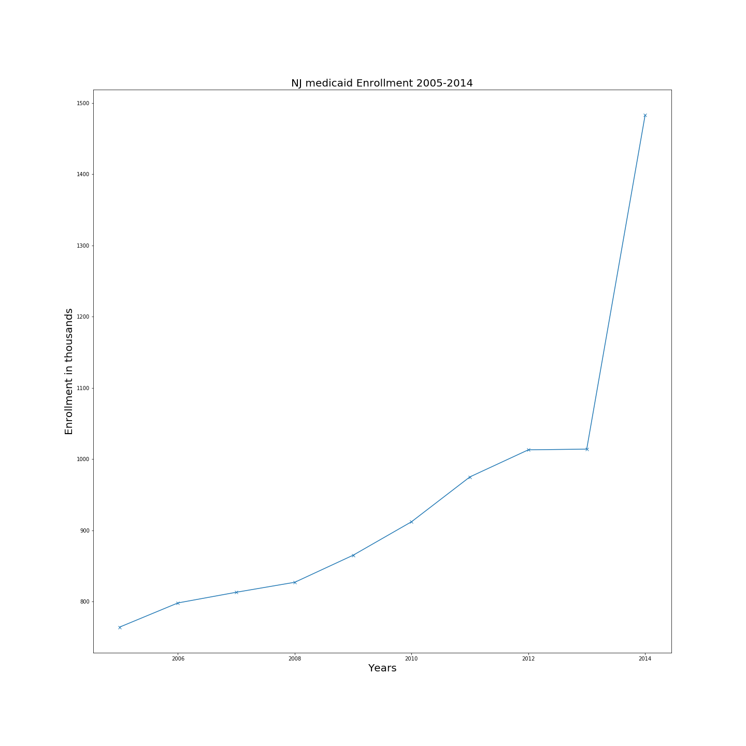
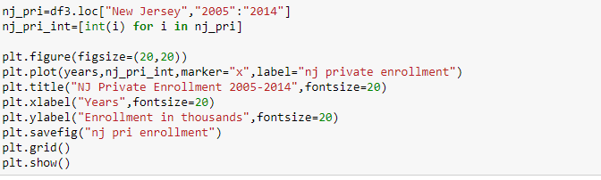
Our State Medicaid vs Private

Slide 17

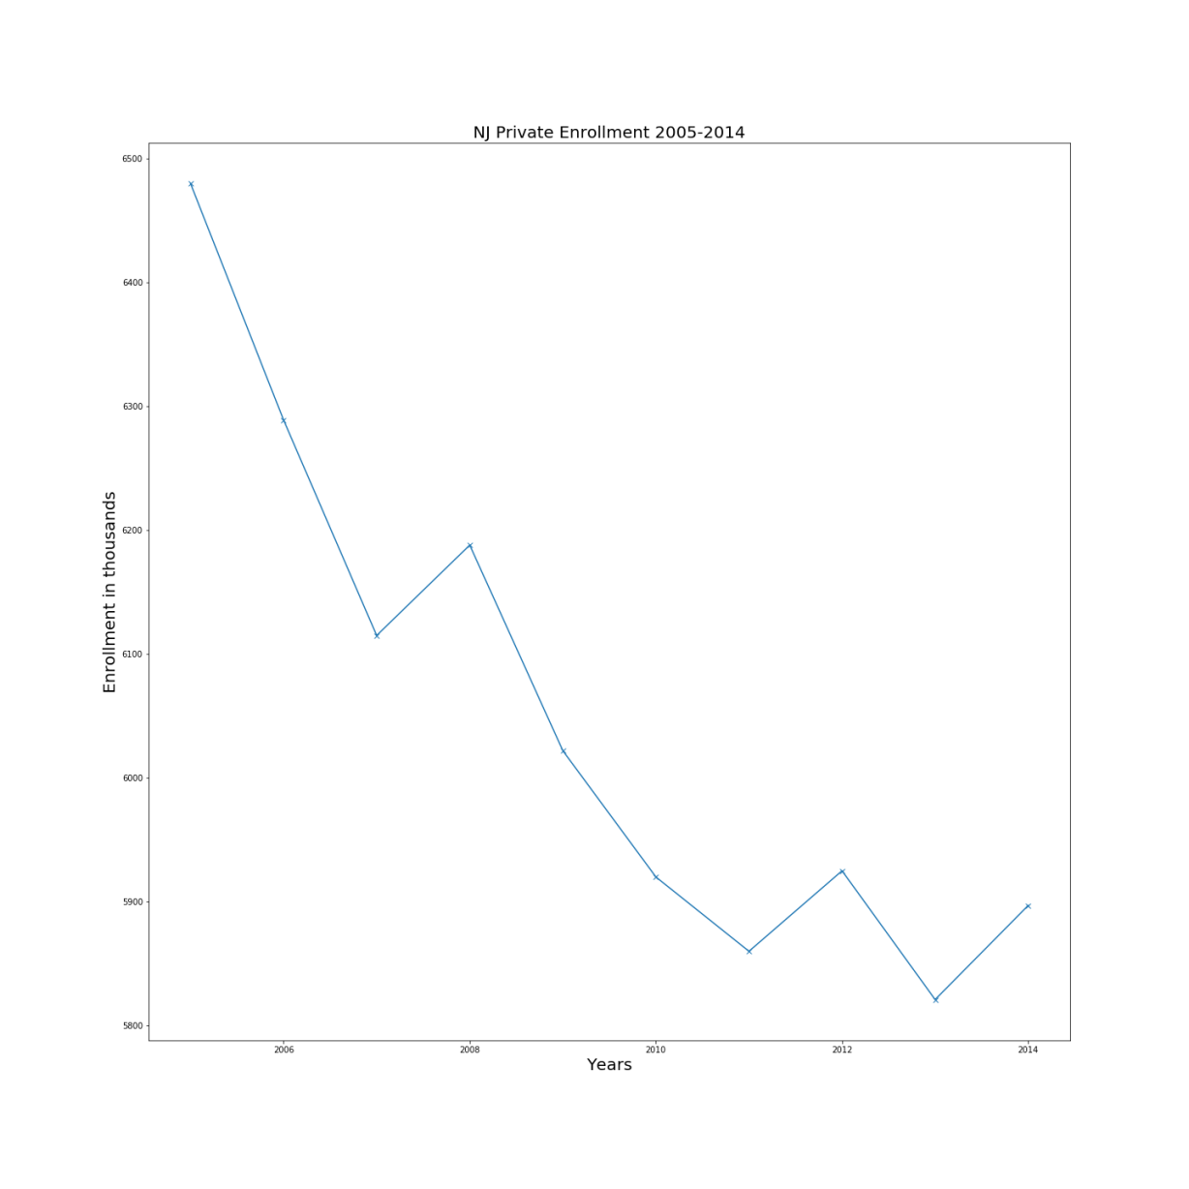
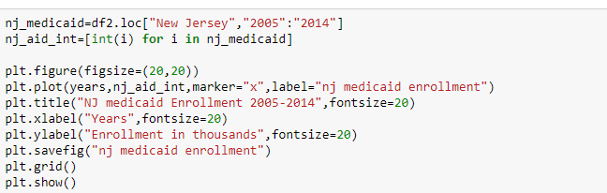
New Jersey Private Enrollment

Slide 18

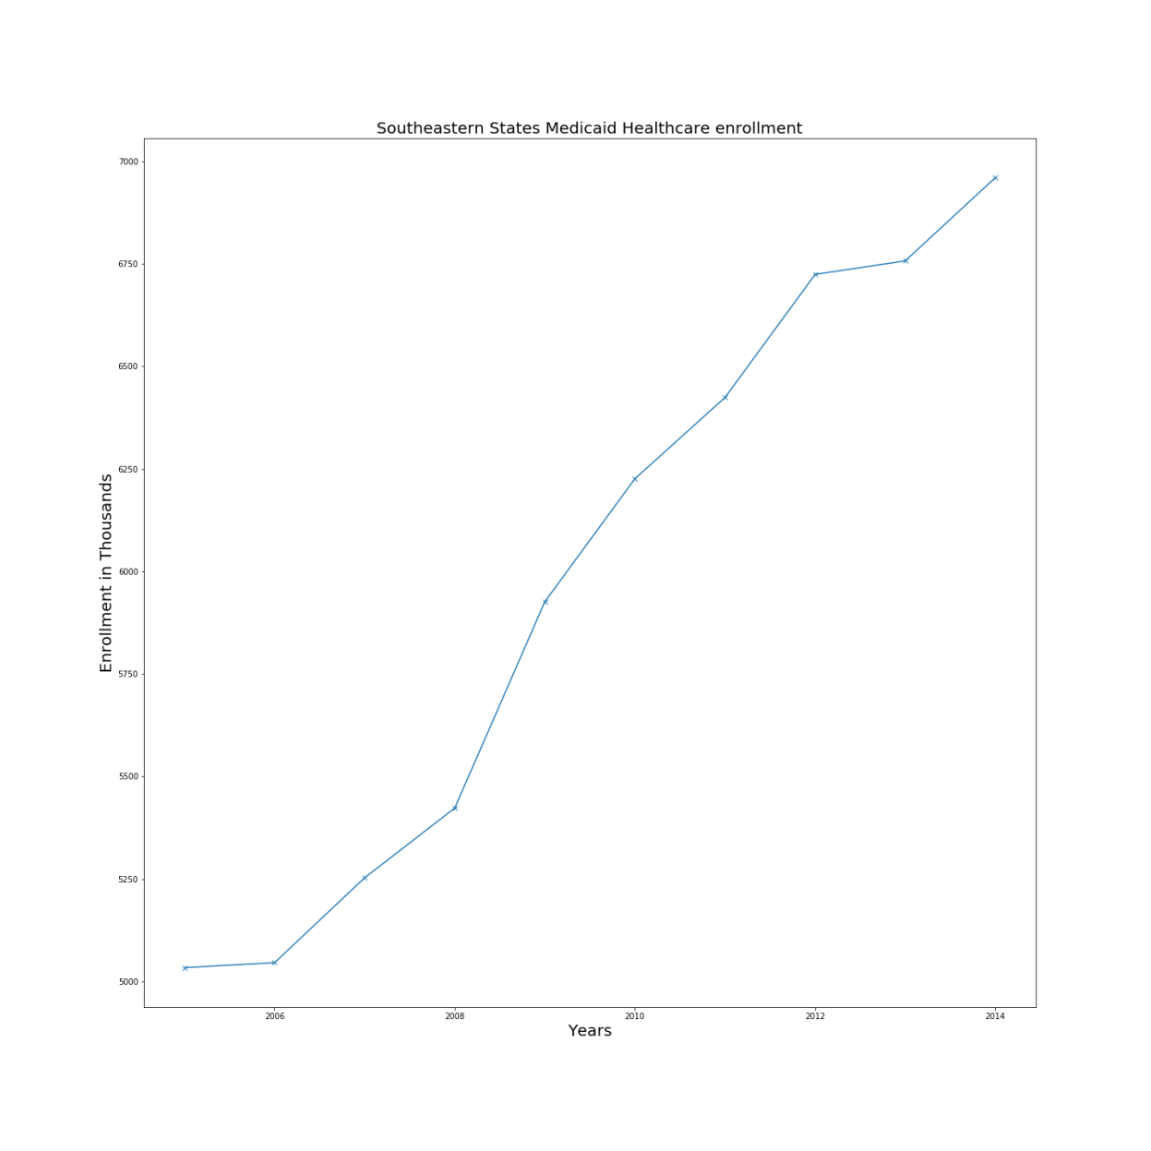
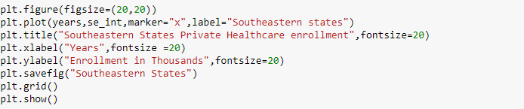
Southeastern States Medicaid Enrollment

Slide 19

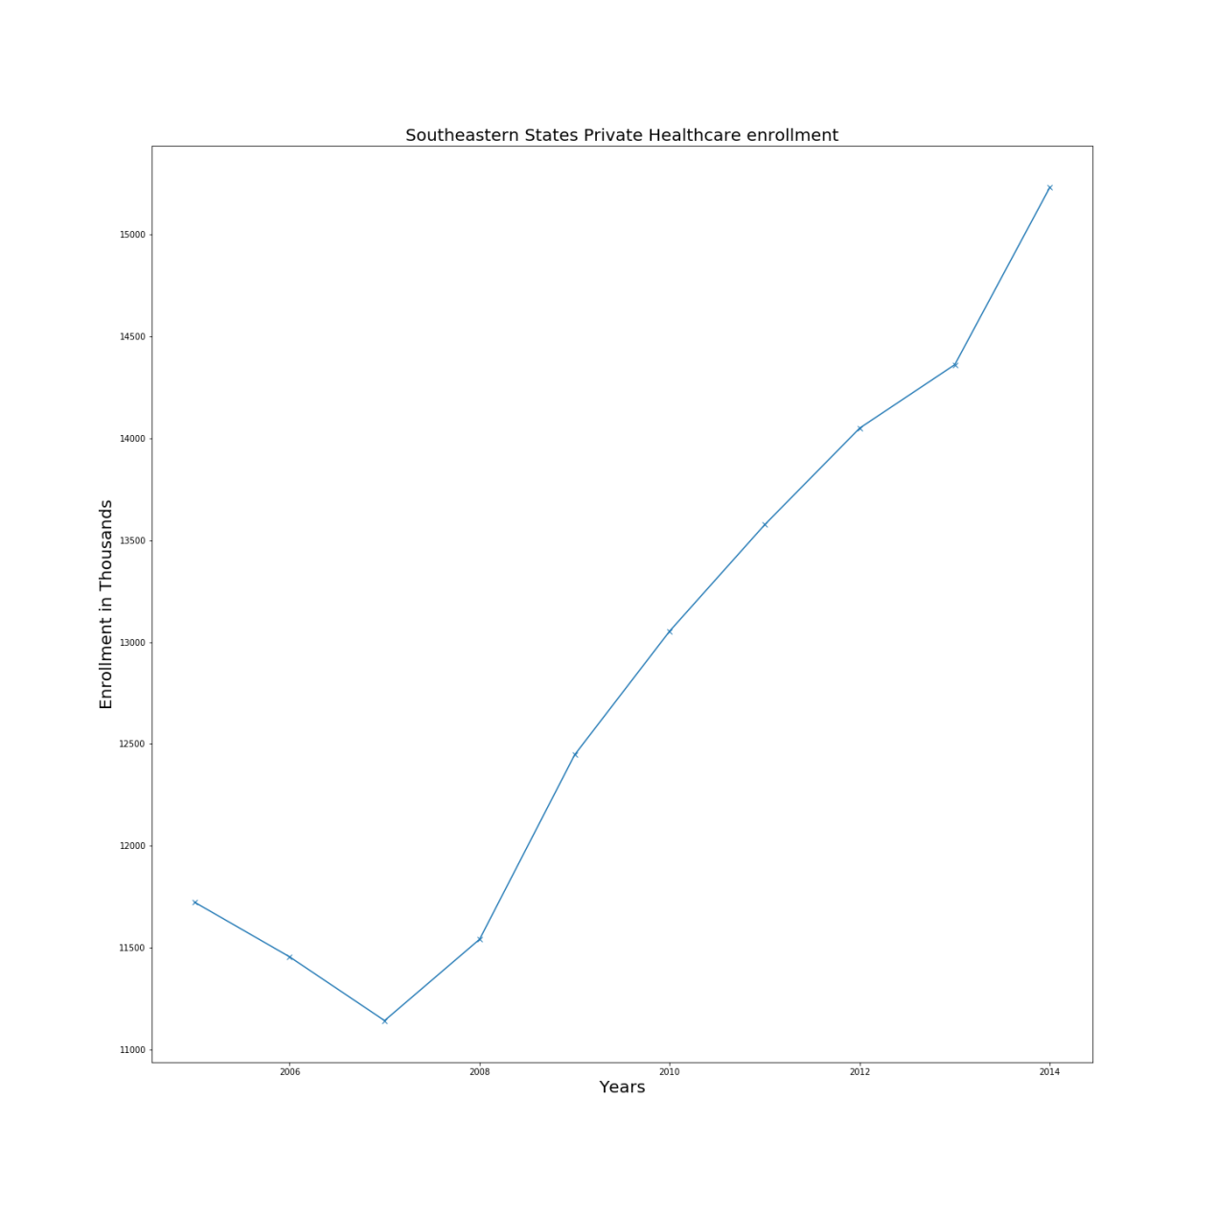
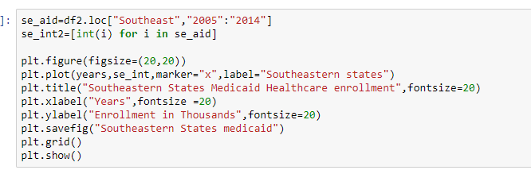
Southeastern States Private Enrollment

Slide 20


Challenges:
The biggest challenge was to find the right data sets.
Not all the data received was in the correct format to create charts.
Initially it was hard to visualize how we would use the acquired data. Working together we were able to decide which methods could best capture our data.
Our datasets were a great limitation as we had a relatively small window to analyze. It would have been much better if we could view through 2018, but such data is unavailable.

Slide 21
Conclusion:
The Americans are spending a lot on the healthcare premiums regardless of their salaries.
Some states spend a little less on these premiums compared to the per capita incomes.
The healthcare costs have risen substantially over the course of time.
Medicaid enrollment has increased even with the introduction of the affordable care act
Pharmaceutical Brand name Pharmaceutical drug prices continue to rise while generics fall
Total Healthcare spending is made of mostly of private insurace
Although the affordable care act meant well, the data suggests that it had little to no effect on decreasing Medicaid enrollment, reducing health care costs, or reducing drug prices in the US.

Slide 22
Questions?

