Slide 1
Git Workshop How to git your coding projects organized
Stephen TH Sher
ACM Workshop
February 2, 2015
Warning: Lots of puns ahead

Slide 2
Git Overview Why git into Git?
Pun Counter: 2

Slide 3
My Personal Experience with Git
“Oh it’s like a homework submission program, like Blackboard… Wait why don’t we just use Blackboard?”
– Stephen, 2013
(paraphrased)
“Oh you need help with Git? I’ve used Git before!”
– Stephen, 2014
(paraphrased and translated)
“Screw Blackboard, let’s use Git”
– Stephen, 2015
“I love Git”
- Stephen, 2016
Pun Counter: 2
SECTION TITLE | 2

Slide 4
Someone without Git in their life:
Cannot work in teams
Irresponsible programmer
High risk of crying (when progress is lost)
Get weird looks from colleagues
Generally very sad
Pun Counter: 2
SECTION TITLE | 2

Slide 5
Git Review Let’s git started!
Pun Counter: 3

Slide 6
At the very least, git familiar with these commands:
$git clone
Copy server’s repo to your local machine
$git pull
Pull the latest version of the repo to your local machine
$git add <path-to-file/filename>
Add file from local machine to repo
$git commit –m “<message>”
Save a state of your local machine’s repo
$git push
Saves the commits on your local machine to the server
Pun Counter: 4
SECTION TITLE | 2

Slide 7
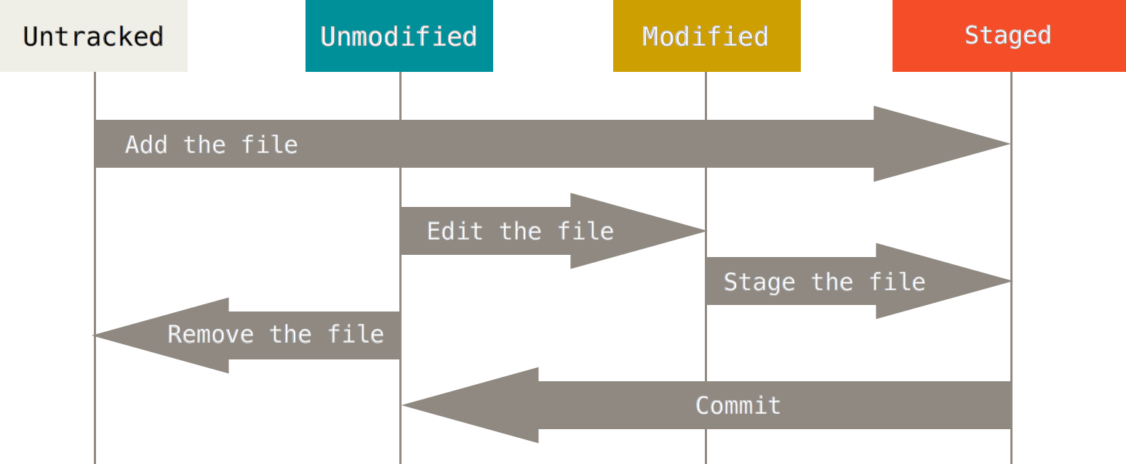
Pun Counter: 4
SECTION TITLE | 2

Slide 8
Git Basics Git new commands!
Pun Counter: 5

Slide 9
If you learn these, you git a power-up:
$git rm <path-to-file/filename>
Tells Git to stop tracking the designated file (also removes it locally)
Tracks the change of removing the file
$git log [--oneline] [-num_of_commits]
Shows commit history
$git checkout <commit_id>
Loads designated commit state to your local machine
$git commit –am “<message>”
Automatically adds modified (not new) files and commits
Pun Counter: 6

Slide 10
Git Advanced Git ready!
Pun Counter: 7

Slide 11
If you learn these, you git to be boss:
$git branch [-a]
Look at the branches you’ve visited [or all branches]
$git branch <branch_name>
Creates a new branch from the current commit version
$git checkout <branch_name>
Switches local repository to the branch repository
$git checkout –b <branch_name>
Creates new branch and checkout to that new branch in one step
$git branch -d <branch_name>
Deletes the designated branch
$git merge <branch_name>
Merges the designated branch INTO your current branch
The branch is not deleted
Pun Counter: 8

Slide 12
These are helpful, but might git you in trouble.
Use with caution!
$git stash
Deletes all your local changes and revert to most recent commit state
$git push -f
Forces Git to push with your changes (I can’t see why you would ever want to do this, unless you want to be mean to your teammates)
To revert back to a previous commit and use that as a the new master
$git checkout <commit_id>
$git checkout –b new_master
$git branch –d master
THIS IS PAST THE POINT OF NO RETURN
$git branch –mv new_mater master
YOU ALSO PROBABLY SCREWED ALL YOUR TEAMMATES UP, HAVE FUN DEBUGGING FOR HOURS UPON HOURS
I DO NOT ENDORSE THIS. DO THIS AT YOUR OWN RISK. I AM NOT RESPNOSIBLE FOR ANY DAMAGES CAUSED BY YOU DINKING AROUND WITH CHANGING YOUR MASTER BRANCH
Pun Counter: 9

Slide 13
Changing Git master branch workaround
Contact all your teammates about reverting master branch to a previous commit, make sure they all agree and save the changes they want to make to their local machine (not in the repo)
Make sure only one person is going to do this process
Checkout the commit you want to revert back to
Copy the contents of the repository to your local machine
Checkout the master branch
Delete all the files in the master branch
Replace all the files in the repository with the contents of the previous commit you saved onto your local machine
Run:
$git add .
$git commit –m “<message>”
$git push (possibly –f)
Once again, DO THIS AT YOUR OWN RISK

Slide 14
Git Demo Git excited!
Pun Counter: 10

Slide 15
Git Healthy Practices
Common procedure: Pull → Write your code -> Add -> Pull -> Resolve any conflicts -> commit -> Push
Never have something broken on the master branch
Work on a branch and only merge if you are sure it’s working (and your teammates know you are merging to master branch)
Git pull before you start your work
Push little commits frequently, instead of large commits infrequently
Pun Counter: 10

