Slide 1
Class 11
Antialiasing
HW6
CS580
(Computer Graphics Rendering)
Ulrich Neumann

Slide 2
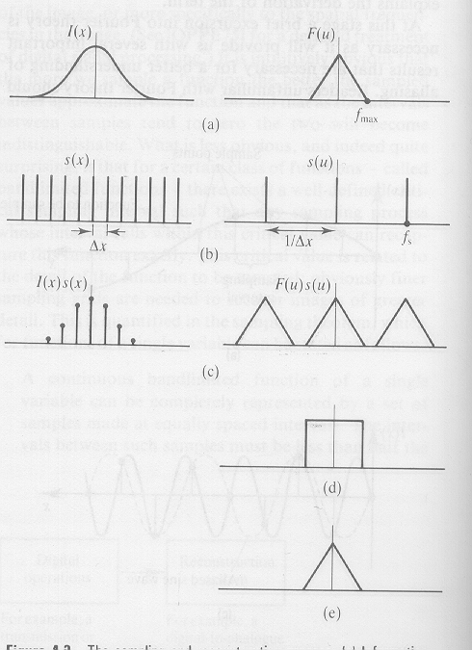

Ideal Rasterization / Sampling
Bandlimited image signal
Bandlimited spectrum of input signal
Sampling function is selected for sufficient rate given Fmax
Transform of comb sampling function is a comb at inverse rate
Sampling function is multiplied by initial signal to produce a sampled version of initial signal
Multiplication in spatial domain is convolution in Fourier
domain, producing multiple copies of initial spectrum

Slide 3
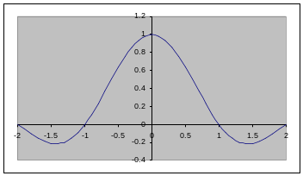
Ideal Reconstruction
Given the sampled function, recover the original continuous function by convolution with sync in spatial domain – or – multiplying the spectrum by a box in the Fourier domain
Multiplication by box in Fourier domain is a convolution with sinc function in time domain
Multiplication by box in Fourier domain
isolates the spectrum of the initial signal
Convolution produces multiple sinc copies,
one on each of sample signal points, to produce exact copy of initial signal
Images courtesy of Watt & Watt, Advanced Animation and Rendering Techniques

Slide 4


Sampling in a Graphics Renderer
Spatial domain
Frequency domain
Triangle representation in the spatial-domain is a Box
A Sinc (in F-domain) has significant amplitude at high-freq’s, so cut-off frequency (the point of negligible amplitude) is very high
Sampling at modest pixel rates leads to overlapping spectra
Reconstruction can not isolate a single spectrum copy of the original signal
Production of overlapping spectra is called
pre-aliasing
Box
Sinc
Multiply
Operation
Convolution
Comb
Comb
Sampled Box
Result
Overlapping Spectra

Slide 5
Sampling Requirements
Ideal sampling has two requirements:
  bandlimit the initial function
  sample at over twice the band-limit rate
Then, copies of the signal spectrum are non-overlapping
and reconstruction can isolate one copy
If you do not bandlimit the initial function, or if sample rate is too low
  reconstruction includes overlapping spectrum copies
  No reconstruction filter can isolate a single copy (pre-aliasing)
0

Slide 6
Fixing Prealiasing
Triangle edges are “box” or “step” signals that transform to sinc functions with wide/infinite extent in freq domain
This means that no reasonable sampling rate is sufficient to eliminate overlap of spectrum copies
Can we fix it after sampling?
  NO – its too late
  No filtering, averaging, or blurring of pixel values can separate the spectrum copies once they mix
The solution is to band limit the input signal before sampling
A low-pass filter can remove or reduce the high-frequencies in box or step signals
Reconstruction is an example of a low-pass filter

Slide 7
Prealiasing Solution
The solution is to filter F(x) before or during sampling
  remove high frequencies (LP filter) to create cutoff frequency ω_{F}
signal spectrum filter function truncated spectrum
Multiply in freq domain or convolve in spatial domain
  Multiply by box function in frequency domain is equivalent to convolution with a sinc function in spatial domain
Rendering algorithms operate in spatial domain
  Convolving with sinc in spatial domain is impractical due to infinite extent of sinc function
  Approximate box/sinc function by another filter with “compactness” in freq and time domain
  A Guassian has the desired compactness properties
      multiply in freq domain to truncate high frequencies
X
=
ω_{F}

Slide 8


Filter Before Sampling
Spatial domain
Frequency domain
Convolving a Box with a Gaussian is a filtering operation in the spatial domain
The F-domain mulitply shows that the higher freq’s are attenuated to reduce the cut-off freq (ω_{F}) of the signal spectrum
The spatial domain result is a smoothed-edge box
The filtered signal can be sampled without creating overlapping spectra
Box
sinc
Convolution
Operation
Multiply
Guassian
Guassian
ω_{F}
Result
Smoothed-edge Box
Truncated Sinc

Slide 9
Filter Before Sampling
Convolve with a finite filter in spatial domain
  Small filter area (extent) is desirable to minimize integration area
  Gaussian has best “compaction” in spatial and frequency domains
    Optimal tradeoff of limited extent in spatial and frequency domain
Convolution evaluation is only needed at pixel centers where samples are computed (fixed shift at pixels)
  Convolve initial signal f(t) by filter function g(t) to get bandlimited f(t)
  Compute convolution integral of filter function aligned at pixel samples
  Evaluate integral of product of triangle-coverage function (box) and filter function over the filter extent
Computation requires a numerical integral approximation
  Numerical integration is done as a sum of small portions of the integral

Slide 10
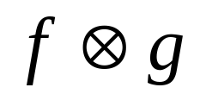



Finite Filter Convolution
f(t)*g(t) = ∫±∞ f(τ) g(t-τ) dτ (evaluate this at t=pixel center)
  Integrate over τ for fixed t=0 offset between functions
  Net effect is that g defines spatial weighting function (filter) of f(t)
f(t) is our triangle coverage function (shifted box function)
g(t) is our LP filter (finite extent Gaussian or triangle function)
Compute convolution value as a sample of a filtered image function (one that has a cut-off frequency)
  Only compute the pixel-values needed by the comb sample process
Red region is non-zero product of functions
Red value is convolution/filter result at a pixel location
=
Dotted line illustrates a complete convolution result – which is not needed or computed
shift of t = pixel spacing to compute convolution/filter value at pixel

Slide 11
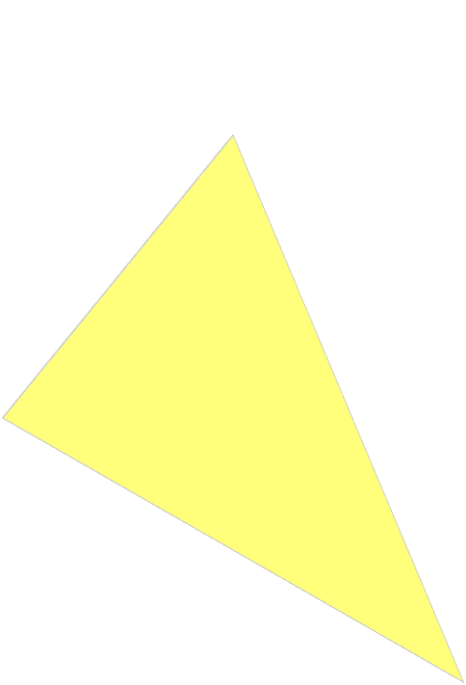
Prefilter Polygons
HW5 point-samples the polygon signal at each pixel…
HW6 Samples the polygon signal convolved with a filter (e.g.,truncated Gaussian)
  Compute the integral of the polygon function weighted by the filter function
  Filter extent is bounded to limit the area to consider around each pixel
1D Example:
Polygon function f(t)
2D Filter function g(t) extent at each pixel of a scan line
Filter function g(t) at each pixel of a scan line
Sample points in FB after filtering
Reconstructed polygon function on display – note smooth edges

Slide 12
Sampled 1D Convolution
Approximate the integral by multiplying sampled edge and filter functions and summing the non-zero samples
  Edge function is binary (1 or 0) so only areas under edge function contribute to final result
Final sum of segments is normalized
as a fraction of complete filter area
(~.4 in this example)
This is the “fractional coverage”
of a pixel by this edge

Slide 13

Sampled 2D Pixel Convolution
Sample the edge and filter functions at various points within the filter extent
Each filter sample corresponds to a fraction of the total filter area to normalize it’s weight. All filter samples sum to 1.0
Approximate the convolution integral by summing sampled filter functions inside the edge function

Slide 14
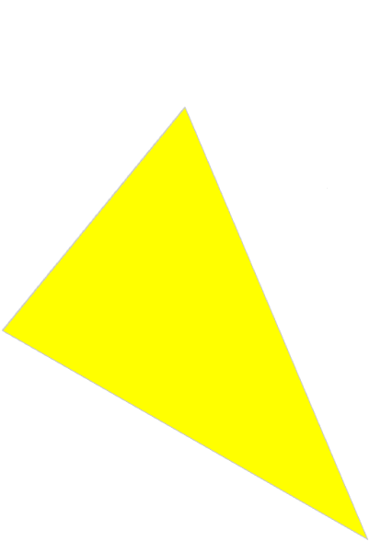

Post Rasterization Filter
If convolution is simply computed for each triangle during rasterization, the filter function produces incorrect results since the final image may have overlapping triangles within a single pixel filter region and the final arrangement is not known until all triangles are rendered
Delay sub-sample summation until
all triangles are processed
Compute sub-samples of filter
regions (star region supersamples)
during rasterization
Each sub-sample has it’s own
Z-value to determine visibility of
its integral portion
Combine sub-samples at the end
of all triangle drawing to produce
filtered pixel samples

Slide 15
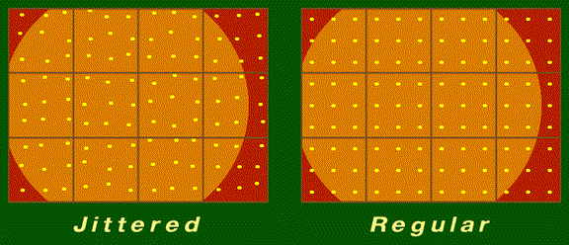
Sub-Sample Options
Sub samples are simply z-buffered rasterizer samples
The filter function determines the weighted summation of the sub-samples to approximate the convolution integral
Filter weights can be applied after all the sub-samples are computed
Any number of sub-samples can be computed per pixel
Sub-samples can be on a regular grid or jittered positions

Slide 16
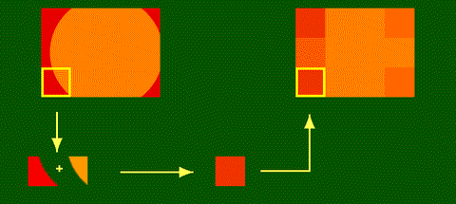
Filter Examples
A box filter g(t) in spatial domain (or sinc in frequency domain) weighs all areas equally within the extent of the box

Slide 17
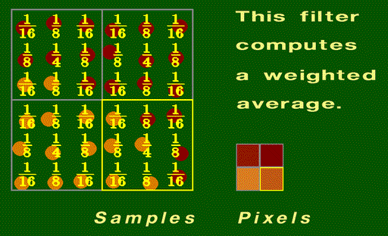
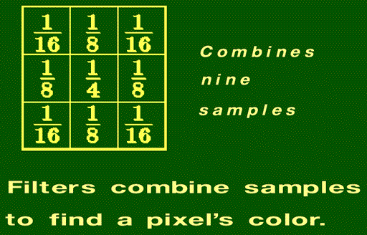
Filters
Filter weights scale each sub-sample
Filter weights sum to 1.0
Filter shapes for triangle (linear) or Gaussian filters are common
Box filter weighs all samples equally
Triangle or pyramid filter weights are shown with 9 sub-samples

Slide 18
Filters and Supersample Rate
The use of sub-samples is often called “Supersampling”
The “Supersample Rate” is defined as how many sub-samples per output pixel (3x3, 4x4, …, etc)
Filter extent after supersamples are computed can be any size
  Filters extents may touch neighbor pixel filters, or overlap each other
  Note sub-samples between pixel positions may be shared by filters
  Smaller extent filters insufficiently filter the input and still show aliasing
  Larger extent filters smooth (blur) image excessively
No agreement on “optimal” number of samples, arrangement of samples, filter shape or extent of filter function
  N ~ 5-15
  Jittered samples preferred over regular grid
  Extent ~ 1.0 – 1.7
  Gaussian filter function preferred over triangle or box

Slide 19
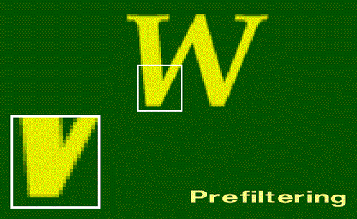
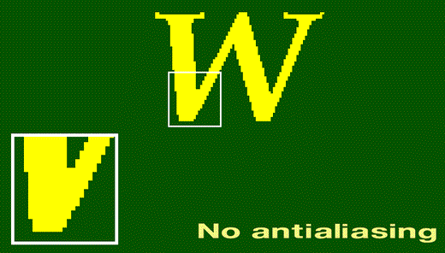
Filtered samples produce smoother edges

Slide 20
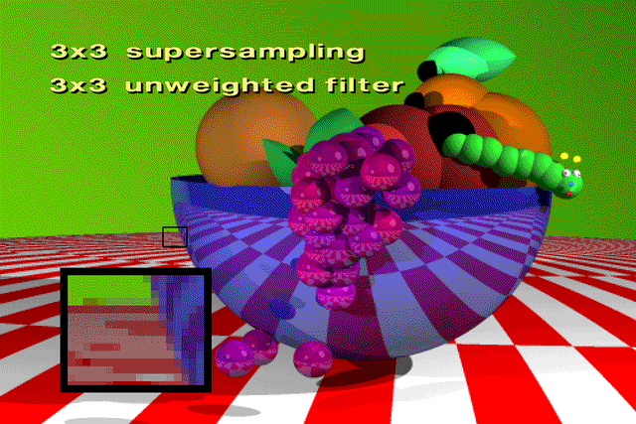
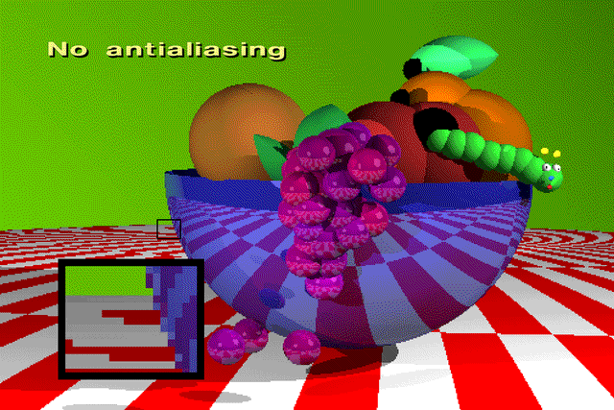
Supersample
Examples
Unweighted filter is a box filter – weight all samples equally

Slide 21


Supersample
Examples (2)
3x3 samples/pixel
5x5 sample filter size
Weighting is linear (triangle filter)
Jittered (above) vs
Regular grid (left)

Slide 22
HW6 - Antialiasing
Use regular-jittered supersampling
  Sub-sample pattern is irregular, but same for each pixel
Aliasing is not a 3D problem – it occurs in 2D (rasterization)
  compute jitter sub-samples in screen space - after transformations
Compute multiple sub-samples per pixel (supersamples) during rasterization
  sample positions are defined by array of x-y offsets from pixel center
Sum weighted supersamples to produce filtered FB pixels after completed rasterization
  what filter shape (2D weight function)?
  what extent?
  what number of samples?
  x-y offsets and weights come from evaluating filter kernel function
Compute offsets and weights as samples of a filter function - then normalize so weights sum to unity (filter gain)

Slide 23
HW6 – Antialiasing by Jittered Supersampling
Samples on a regular grid (offsets) are simply a higher FB resolution
  Could simply increase FB resolution (each pixel also has Z) followed by weighted sum (filter) for computing final output resolution
  This is commonly how supersampling is done since it requires minimal change to a standard rasterizer
  However, regular grid supersamples are sub-optimal in terms of cost/benefit
Irregular offsets pose problems during rasterization
  Difficult during edge/span traversal – DDA spans are on exact lines
  Not too hard for LEE testing – just test supersample X,Y coords
  Need unique Z for each sample - modify FB – how to index?
For HW6 create separate renderer and FB for each offset supersample
  compute separate sub-image with separate z-buffer, color, etc for each offset of a pixel – use the same jittered supersample pattern in each pixel
  filter final images at end - use one filter weight for an entire sub-image
  modify renderer to add screen coord offsets to all transformed verts
  Application uses get-pixel operations from each frame buffer to create final filtered image written into a display and flushed

Slide 24
HW6 Sub-Images from Offsets
For each pixel, compute N offset supersamples
  Each supersample has dx,dy offset wrt to pixel center
Each of the N dx,dy offset supersamples is computed by a separate renderer/FB pair to create an offset-image (N=7 in example above)
Each offset-image can be computed as the pixel-center sample of a simple renderer by shifting the entire image -dx, -dy
dx,dy

Slide 25
HW6 Sub-Images
An offset-image is created by shifting image -dx, -dy and then computing normal samples at the pixel-center
Our renderer already samples the pixel center so we only need to shift the image by –dx, -dy
The shift is easily accomplished by adding –dx, -dy to each vertex in screen space at the end of the transformation (before rasterization)
Compute this offset image based on dx,dy offsets for this supersample.
Offset the polygon vertices by -dx,-dy and sample at pixel centers.

Slide 26
HW 6 - Approach
You will make changes to the HW5 application and renderer to perform multipass supersample antialiasing.
The algorithm computes multiple super samples around each display pixel and weights (filters) these into a final value.
A screen space offset is added to the transformed vertex coordinates of each triangle to produce the sample distribution.
The offset is specified by two new Renderer parameters (GZ_AASHIFTX, GZ_AASHIFTY).
The default offsets = zero --– which makes the renderer work as in prior HWs.
A table specifies the filter offsets and weights in the application. Feel free to build and test your own filters. Offsets are sub-sample shifts and the sum of all their weights = 1.0.
Note that we define the number of samples, the offsets, and the weights at compile time.
#define AAKERNEL_SIZE 6
float AAFilter[AAKERNEL_SIZE][3] /* each sample is defined by Xshift, Yshift, weight*/
{ -0.52, 0.38, 0.128, 0.41, 0.56, 0.119, 0.27, 0.08, 0.294,
-0.17, -0.29, 0.249, 0.58, -0.55, 0.104, -0.31, -0.71, 0.106 };

Slide 27
HW 6 - Filtering Subimages
Modify the application (for HW 5) to set up multiple Renderers and Frame Buffers -- one pair for each supersample defined in the table.
The new application initializes each Renderer with a different offset.
Each Renderer has it’s own frame buffer to write into. All frame buffers are the same resolution.
All triangles are sent to all renderers.
After rendering all the triangles, the application must read back and combine all the offset subimages by weighting their pixel values.
The filtered (result) image is stored (written back) into one of the frame buffers (or a new one) and then flushed to disk (and/or the Win FB).
Your renderer array should support both texture and non-texture output.

Slide 28
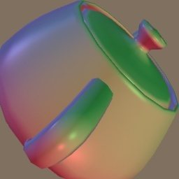


HW 6 result
HW4 result

Slide 29
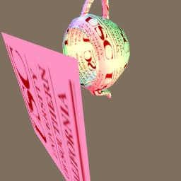
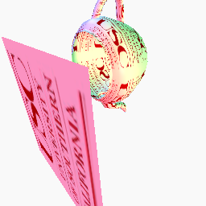
HW 6 result –
-- HW5 result

Slide 30
Reconstruction and Post Aliasing
Reconstruction is needed to fill the screen image
  Usually done by display system (e.g., LCD optics) or D/A conversion system (analog video)
After sampling – points are in FB – these need to be reconstructed into continuous function (see slide 21)
Sampling Theorem says reconstruct by convolution with Sinc function
  Sinc in spatial domain is a box filter in freq domain
    multiplication in frequency domain removes all side-spectrum copies, but leaves center spectrum
    Infinite extent in spatial domain – computation cost too high
If reconstruction filter has too small a footprint in spatial domain
  A series of gaps occur on screen - convolution of filter with FB samples produces regions of zero between pixel samples – poor reconstruction
  Fourier domain signal spectrum will be a wide function causing leakage from side copies of F(ω) spectra
  This leakage and gaps are due to postaliasing - aliasing due to poor reconstruction
If reconstruction filter is too large in spatial domain
  High calculation burden due to large filter area
  Narrow filter in Freq domain narrows spectrum of output signal – blurred image
Consider reconstruction by
  Gaussian – most compact extent in both domains
  Triangle function – linear interpolation ---> sinc² ripples fall off rapidly in freq domain
  Box function – no interpolation ---> sinc ripples extend relatively far in freq domain
  CRT/plasma have Gaussian-like reconstruction, LCDs have a box-like reconstruction

Slide 31
Aliasing is not completely solvable
All image processing is an “art” of best compromise between computing time and quality
  Perfect (infinite) filters can’t be computed
  Perceptual issues are important
  All forms of aliasing are not equally objectionable or noticeable
Some aliasing signals are less-noticeable
Stochastic samples (jittered) make aliasing effects less correlated with image, more like “snow” in image
  Often less objectionable/noticeable to human perception

Slide 32
END OF ALL HW MATERIAL
Second exam covers
Shading (HW4) up to this point

