Slide 1
Class 12
Texture Antialiasing
CS580
(Computer Graphics Rendering)
Ulrich Neumann

Slide 2
Filtering Textures
We now know about aliasing and how it arises from sampling geometry edge functions
How do we address the problem of aliasing texture “edges” that appear on triangle surfaces?

Slide 3
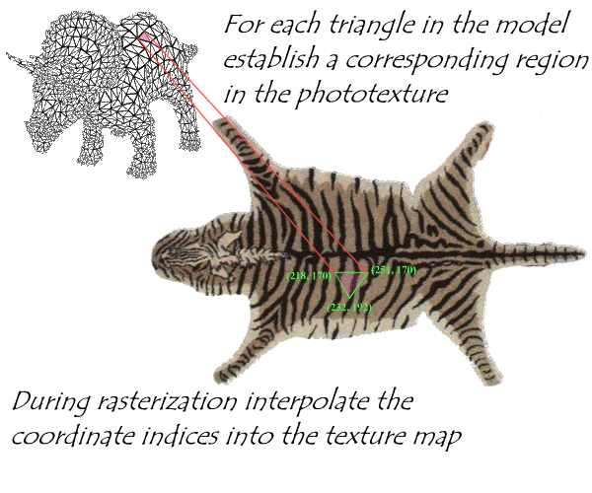
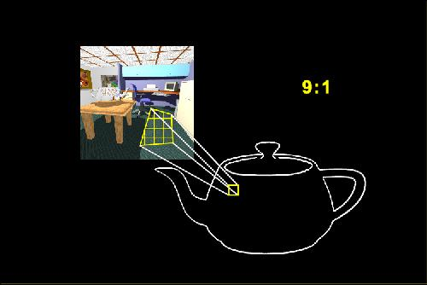
Sample Rate Mismatch
Rendering samples scene geometry and textured surfaces
  Texture has its pixels (texels) resampled onto rendered image pixels
  Texture (texel) sampling rate generally does not match screen pixel sample rate (Texel:Pixel ratio)

Slide 4
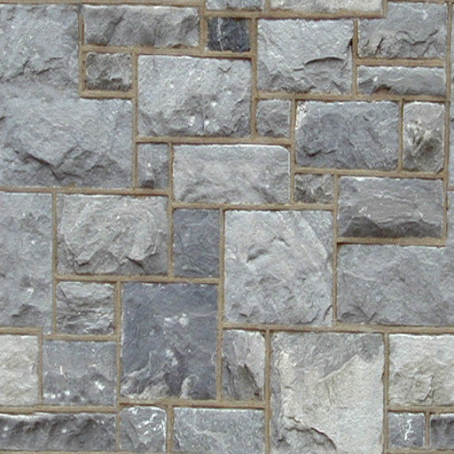
Magnifying Image Textures
Projected texture in screen image should sample near same rate: 1:1, to optimally reproduce texture map
If we zoom in… texture image blurs
  1 Texel : many Pixels
  No aliasing problem here - just no data
  Fix by using higher resolution textures - nothing else we can do - can't invent data for image textures
  Procedural textures have an advantage since many can provide detail over a range of scale-levels (fractals)

Slide 5
Magnifying Image Textures
Zooming into a small
region of texture
leads to a blurred
image

Slide 6
Minifying Image Textures
Texture image aliases when we zoom out – sample rate violates Nyquist rate
  Multiple texels fall in one screen pixel (Many Texels : Pixel)
  We can't easily increase or control scene sample rate
    Camera and FB resolution determine screen sample rate of scene
  Filter texture (reduce F_{max}) so screen sample rate is twice highest freq in texture (like pre-filtering triangle edges)
    Match the texel resolution (rate) and screen resolution (rate)
  Filter can be applied to whole texture image as a pre-process, or on the fly for each pixel’s u,v sample point
  in the texture map

Slide 7
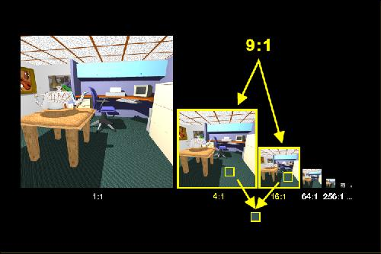
MIP Maps: Precomputed Filtering
Pyramidal Parametrics - Lance Williams [SIG 83]
Precompute filtered versions of texture image at octave scale/size intervals
  Create images with half-size in X and Y per pyramid step
  Top of pyramid is single pixel with "average" color of whole image texture
Filter high
resolution image
to produce
a half-size image
Use filter kernel
  Bilinear
  Cubic
  Gaussian

Slide 8
Storage of MIP maps
R
G
Space cost is 33% increase over texture image itself
R
G
B
R
G
B
R
G
B
B
Trivia: MIP = Multum In Parvo (many things in a small place)

Slide 9
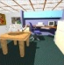
MIP Map Scale
Define a “scale" parameter for each level of the texture-map pyramid based on du/dx and dv/dy (change in u or v per texel)
  Low scale values for hi-res images at base of pyramid
  e.g., for 256x256 image level, scale = du/dx = dv/dy = 1/256 (below)
  Scale increases as we move to the top of the pyramid where
  du/dx = dv/dy = 1/1 and a single pixel represents the whole texture
    For square textures, both scale ratios are equal (du/dx = dv/dy) so only one number is needed to represent scale at each level of the pyramid
u,v = 0,0
1,0
x-axis is also u-axis
y-axis is also v-axis
Scale = 1/1
. . .
. . .
Scale = 1/16
Scale = 1/256
Scale = 1/128
0,1

Slide 10
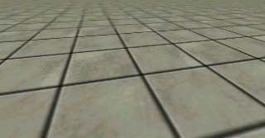
MIP Maps: matching scale
Pixel scale during rendering is more complex since it is projection-dependent, non-axis-aligned, and it varies over the face of a polygon due to perspective
  pixel scale = du/dx, du/dy, dv/dx, dv/dy (4-tuple)
Pixel scale values are projection-dependent texture sampling rates at each image pixel and these four scale components (derivatives) are generally unequal at each pixel and vary
from pixel to pixel
x
y
v
u

Slide 11
Estimating Pixel Scale
In rendering, we interpolate perspective-space U,V
We compute dU/dy, dV/dy along edges, and dU/dx, dV/dx along spans, but we need affine scale ratios to select pyramid level
  Prior-pixel and prior-scanline u,v values can be used to estimate a local scale per pixel based on neighbor differences
Simpler choice is to approximate derivatives from vertex u,v
  Use affine u,v values before perspective warp
  Estimate derivatives using screen vertex positions
  Select a constant scale for whole poly based on average (or peak) du/dx, du/dy and dv/dx, dv/dy values computed along edges
    Reasonable approximation for small triangles
    Use of peak scale values produces over-filtering (blur)
    Blur is often preferred over aliasing (under-filtering)

Slide 12
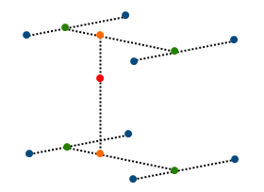
3D Interpolation
4:1 scale level
9:1 scale
interpolation
16:1 scale level
Given continuous texture scale values we can
  sample between levels (3D filter) as Heckbert describes, or
  resample in nearest pyramid plane using 2D filter
  Nearest-level rounding or truncation is faster (2D rather than 3D), but causes visible jumps as scale level switches occur
Most hardware now offers full mipmaps with trilinear (3D) interpolation

Slide 13
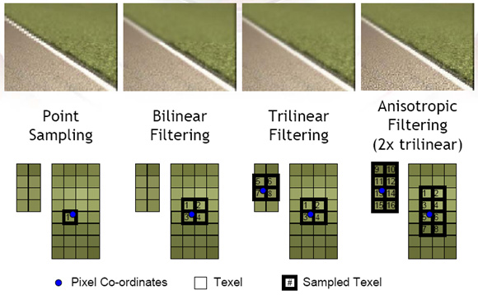
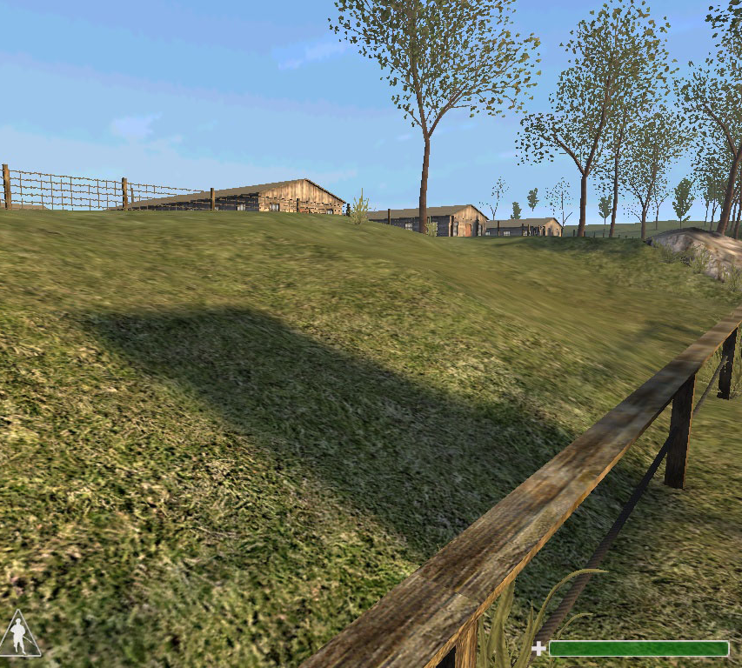

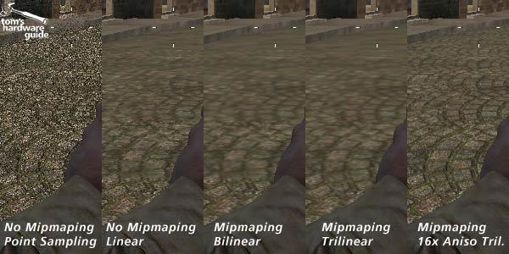
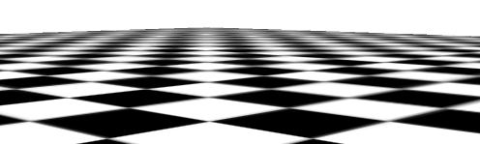
2D vs 3D MIP Map Examples

Slide 14
MIP-Map Weakness
v
u
Weakness of MIP maps is isotropic (same) scale filtering for both u and v
The problem is acute in perspective planes
  Ground plane textures are a common problem case
Texture scale is greater in one screen axis than the other
  d*/dy is typically greater than d*/dx along horizon in ground plane
To keep one dimension from aliasing, the other must be excessively blurred
  Solution is to filter anisotropically (asymmetrically)
  Where an anisotropic filter is needed, a lower resolution mipmap scale is used, and several texels are sampled and merged along the direction of needed additional filtering (approx ellipsoidal filter)

Slide 15
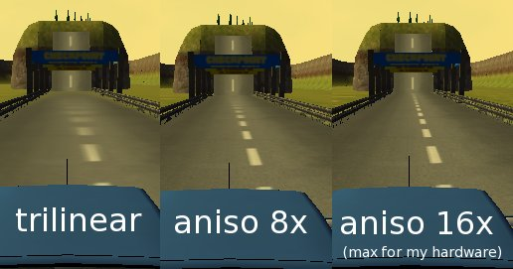
Anisotropic MIP Map Filters
Combine more than 4 texels per MM level to approximate elliptical filter extent
Ellipse shape and orientation is determined by max and min scale values

Slide 16
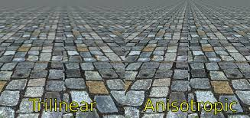

Slide 17
Summed-Area Tables
[Frank Crow SIG 84]
Initialize a texture table so that each pixel has sum of all pixels below and to left (pre-process computed off-line)
Sum of values of any rectangle region of arbitrary width-height ratio can be computed from 4-corner positions
  Sum of all colors in a region = T(UR) – T(LR) – T(UL) + T(LL)
Divide the sum by the number of pixels in the region to obtain average color of region
  Computes a Box Filter of the rectangle region
  Do separate calculations for R,G, and B
All lookups at all scales are constant time!!!
Arbitrary aspects are possible by multiple rectangle approximations
  Do “best-fit” of multiple regions to ideal elliptical filter extent (like MMs)
  Weighted combination of multiple regions - U. Tubingen, Prof. Strasser
UL UR
LL LR

