Slide 1
Hidden Surfaces and Introduction to Transforms, Frustums, and Projections
HW3
CS580
(Computer Graphics Rendering)
Ulrich Neumann

Slide 2
Hidden Line Removal (HLR)
Edge or line drawing also requires visibility methods
wireframe lines are hard to deal with
  simple z-buffer does not work when the renderer only draws lines (outlines of polygons)
  edge-crossing and object sorting methods
no line hiding means no depth sense
hidden line drawing provides depth sense

Slide 3
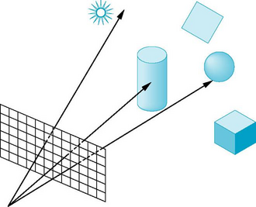
Raycasting
For every ray through a pixel,
  Perform a ray-intersection with every object
  Keep the closest intersection
Image plane
View point
or focal point

Slide 4
Painter’s Algorithm (1)
Just render in order -- front to back or back to front
  view-dependent ordering needs to be computed very frame
Simple cases allow sorting by a simple “per polygon” test : (not pixel test)
  Z of all verts of one poly are < or > than all verts of another
View (Z) direction
top
view
All B vertex Z-values are less than
all R vertex Z-values
front
view

Slide 5
Painter’s Algorithm (2)
Failure cases:
Vertex Z-sort is ambiguous when all verts test fails
  Can’t tell if B in front of R or not (in examples below)
  Vert sort of B-R and G-R produce same order
- Cannot resolve cycles or overlapping surfaces
View (Z) direction
top
view
front
view

Slide 6
Warnock algorithm
Overcomes problem of view dependent ordering and intersecting geometry by divide and conquer strategy
  Subdivide screen until a leaf region has a simple front/back relationship
  Leaf regions have one or zero surfaces visible, and smallest region is usually a pixel
  Usually use quad tree subdivision
Useful for curved surfaces and antialiasing where the subdivision is done to sub-pixel levels
Efficient and focuses work where needed adaptively
  a common theme in graphics
Think of z-buffer as a fixed subdivision to pixel regions

Slide 7
Area Subdivision (Warnock)
Initialize the area to be the image plane
Four cases:
  No polygons in area: done
  One polygon in area: draw it
  Pixel sized area: draw closest polygon
  Front polygon covers area: draw it
Otherwise, subdivide and recurse

Slide 8
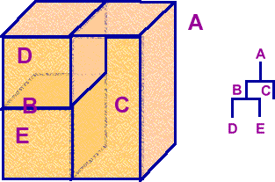
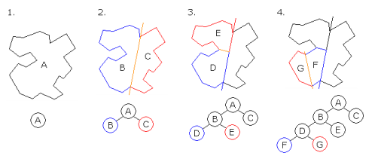
BSP-Tree
A view-independent binary tree structure that allows a view-dependent front-to-back or back-to-front traversal of surfaces
  use Painter’s Algorithm with back-to-front traversal
  useful for transparency – full depth-sort of all surfaces
  fast – no Z-calculation or testing per pixel
  more detail in later class

Slide 9
Z-buffer
Compare each new surface pixel’s depth to current frame-buffer pixel value
Compare FB-Z with new triangle pixel-Z
Lowest Z-value (front-most) wins and becomes the new FB pixel
Most common today due to cheap/fast memory
Advantages
simple
reasonably efficient
Disadvantages
increased memory & bandwidth
z-quantization/accuracy limits
over-rendering
no support for transparency

Slide 10
Culling: Eliminating Triangles
Culling methods reduce the number of triangles
that need to be rasterized for a scene image
  Portals – precompute visible (or invisible) sets
  of triangles for view-point regions (precompute once)
  Frustum cull – skip triangles that fall completely
  off screen (check every triangle every frame)
  Backface cull – skip triangles for closed objects that are facing away from the camera
  (check every triangle every frame)

Slide 11
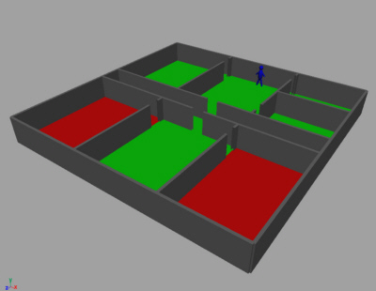
Culling With Portals
Useful concept for buildings and other static scenes
Represent the environment as a graph of Nodes which are bounded areas of visible triangles
Graphs are precomputed for view positions (optionally also directions)
Edges are portals through which Nodes are visible
All potentially-visible triangles are included in a graph
Each room triangle set is a Node
Construct a graph of all visible Nodes from any view point in each room
When rendering: use the graph to determine all Nodes visible from current position and render only those Node triangle sets

Slide 12
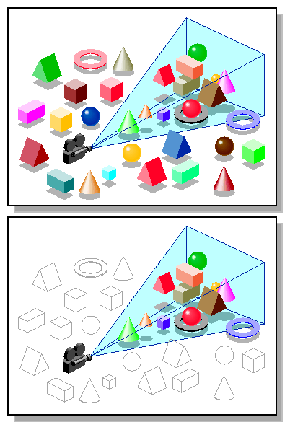
Culling by View Frustum
Check if entire object lies outside the frustum created by extending the four screen edges into the viewing volume
Simplest test is to skip a triangle
iff all its vertices are beyond
the same screen edge
(e.g., to the right of the screen)
image
image
verts are all
off-screen, but
not off same
edge, so don’t skip
skip, this
meets the
cull test
criteria

Slide 13
Backface Culling (1)
For closed (water-tight) objects, surfaces with oriented-normals facing away from the camera (called back-facing) are never visible
  The inner surfaces of closed objects are never seen
  Oriented-normals (N) face outward from the outer surface side
  Below, the red surfaces have normals that face the viewpoint P so they are rendered. The blue surface normals face away so they can be skipped since the front (red) surfaces will always occlude the rear (blue) ones.
If triangle models include an oriented surface-normal vector N, then we can find and skip backfacing triangles:
If (View • N) > 0, then skip the triangle
  View is a vector from the view-point P
  to any point (or vertex) on the surface
Note: our teapot model does not have
oriented-normal vectors
N
View
P

Slide 14
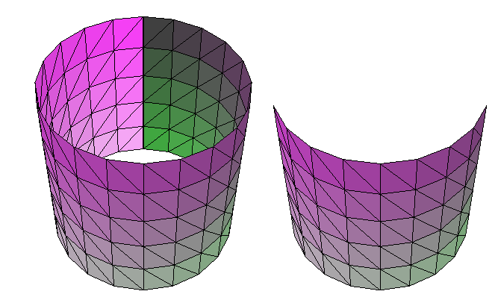
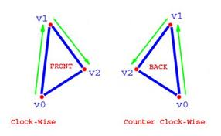
Backface Culling (2)
Alternatively, rather than adding a surface-normal to a triangle data structure, the triangle vertex sequence can encode face orientation
  When viewed from front face, the vertex sequence V0,V1,V2 appears in clock-wise order
  When viewed from the back face, the same vertex sequence appears counter clock-wise
  Example (right image) shows RGB dots to illustrate vertex sequence for front and back facing triangles
With BF-culling, all the back-face triangles are skipped

Slide 15
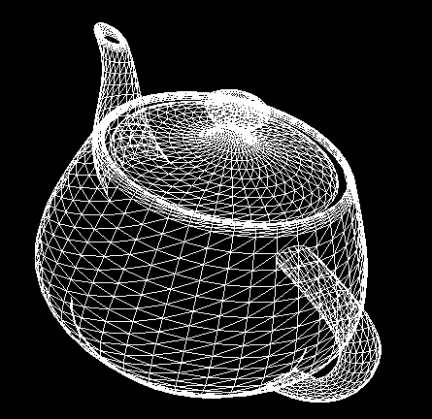
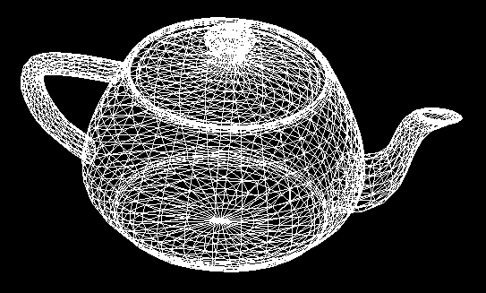
Backface Cull
Wireframe rendering with BF-cull shows missing surfaces at top of spout and crack around lid (left image)
  Such problems occur when models are not “closed” or “watertight”
No BF-cull
BF-cull

Slide 16
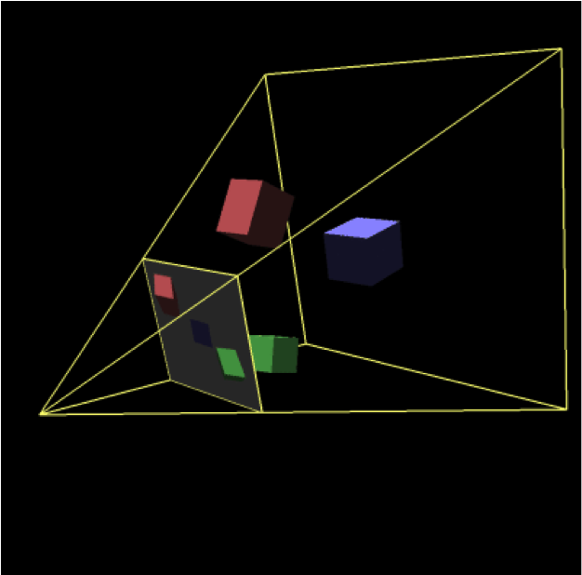
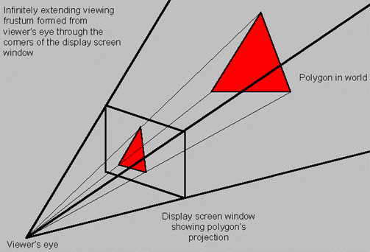
Frustums
The view frustum is formed by a view point, a view direction, and a view plane
  The field of view (FOV) is the angle that fits the view plane (or image plane) into the frustum (horizontal and vertical FOV)
  The image is created by projecting objects in the frustum to the focal point – the projections pass through the image plane (more about this later)
  Frame buffer pixels are sample points on the view (or image) plane
Horizontal FOV
Vertical FOV

Slide 17
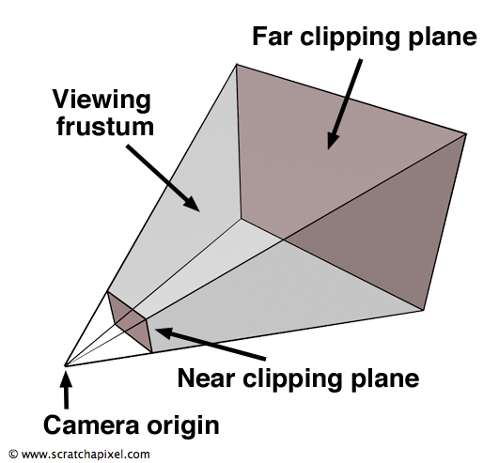
Frustums and Clipping
Clipping to the view frustum ensures that only visible triangles (or fragments) are drawn into the frame buffer
  Trivial clipping to frustum sides is done in the HW1 display by checking for valid pixel addresses
  A far clip plane can be useful, but we
  don’t need or use one in our HWs
  A near clip plane is needed to eliminate
  objects behind the image plane
  in HW3 (details
  coming later)
  Our near clip plane
  is the image
  plane at Z = 0
  (screen space)

Slide 18
Transformations
Linear transformations (Xforms) define a mapping of coordinates (coords) in one coordinate frame to another
  the mappings are 1:1 and invertible
V_{b} = X_{ba} V_{a}
  homogeneous vectors (V) are 4x1 columns (x,y,z,w)^{T}
  homogeneous transforms (X) are 4x4 matricies
  Projection of 4D points onto a subspace (w = 1) yields Euclidean 3-space values (examples shown later)
General Xforms can be decomposed into scale, translate, rotate, shear, reflection, …
View Xforms in graphics are a subset based on S T R
  Scale, Translate, Rotate
    we do not allow shears and other
    non-shape-preserving transforms

Slide 19
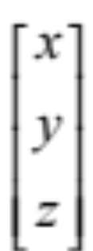
Basic Types
Scalars: s
3D Points:
3D Direction vectors:

Slide 20
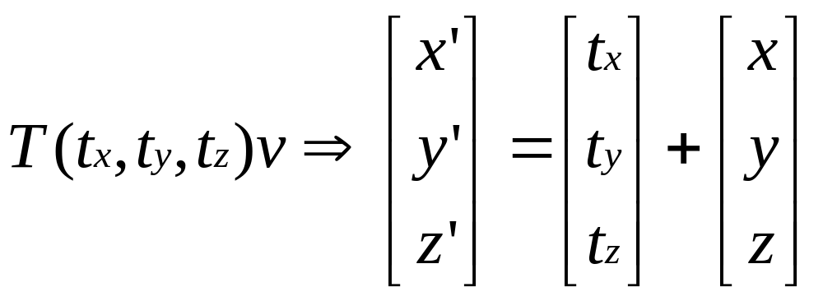
3D Translations
Translations occur along the axes of the space
Axis directions are preserved, but origin changes
Translation is vector addition

Slide 21





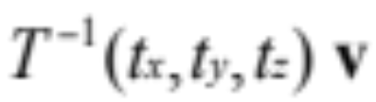

Properties of Translations
=
=
=
=

Slide 22


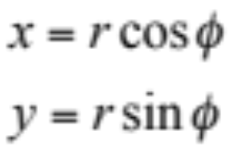

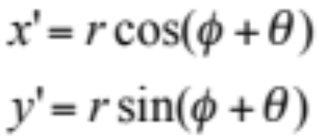



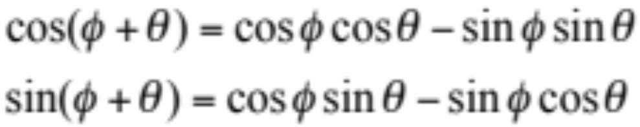
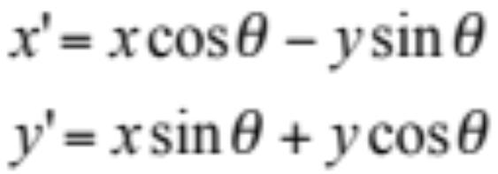
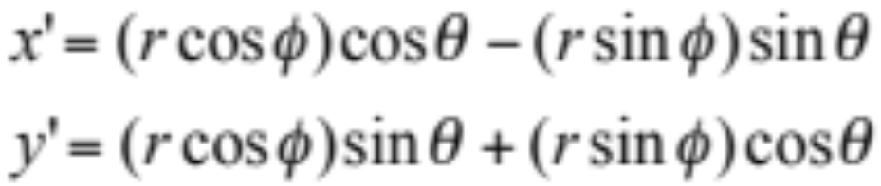
Rotations (2D)
x
y
rotation of point about origin
by angle theta

Slide 23
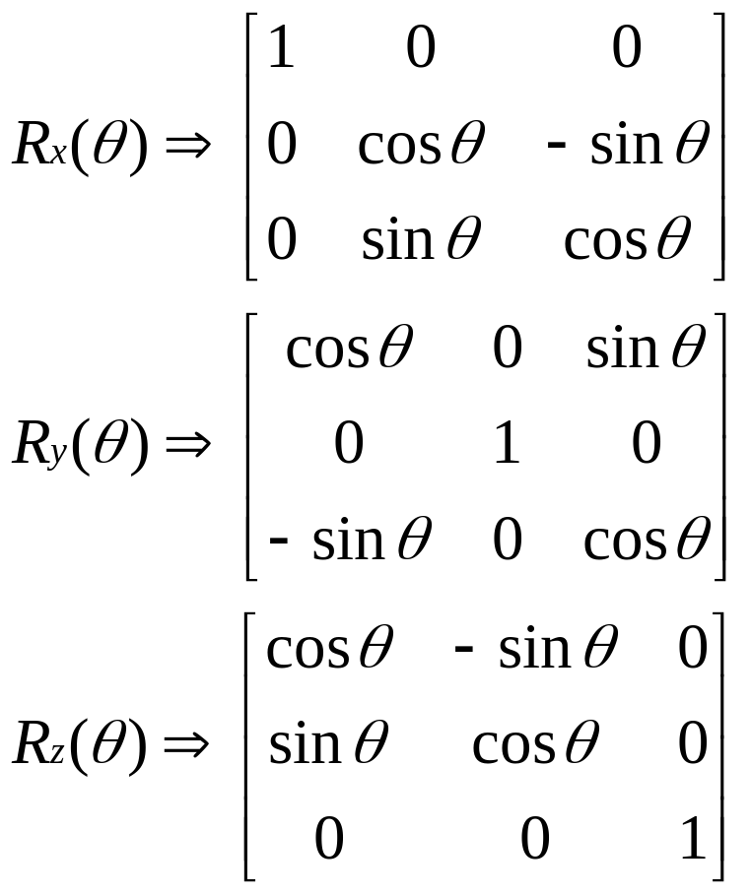
3D Rotations about Axes
Rotations occur about the origin of the space
The origin does not change (fixed-point), but the axis directions do
The input axes prior to rotation (e.g., (1,0,0) … ) become non-axis vectors (x,y,z) in the output coord system

Slide 24
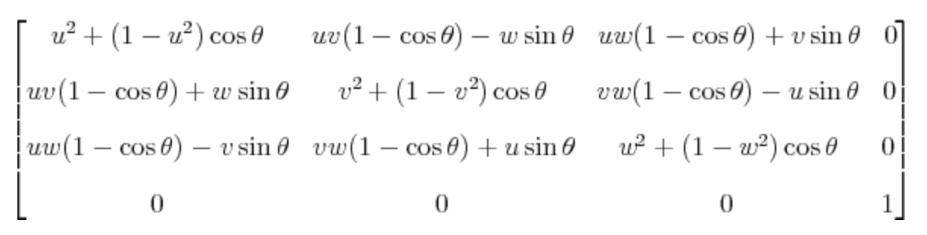
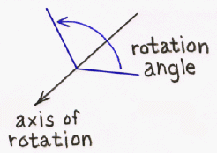
3D General Rotation
This matrix rotates the point (x,y,z) about the vector ⟨u,v,w⟩ by the angle θ, under the assumption that ⟨u,v,w⟩ is a unit vector; i.e., that u² + v² + w² = 1
http://inside.mines.edu/~gmurray/ArbitraryAxisRotation/

Slide 25
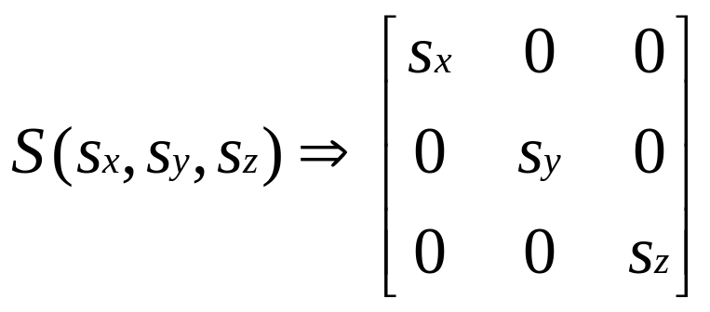
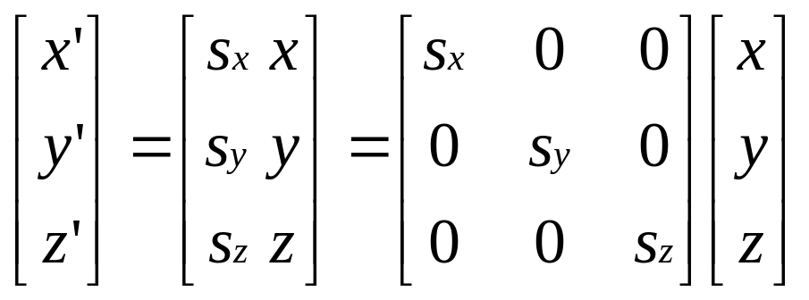

3D Scaling
Scaling occurs about the origin of the space
The origin does not change (fixed-point)
The axis directions do not change (preserves axes)
Distances between points change
Uniform scaling iff

Slide 26
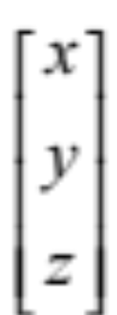
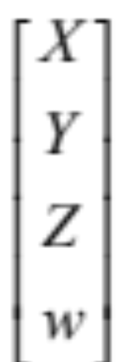
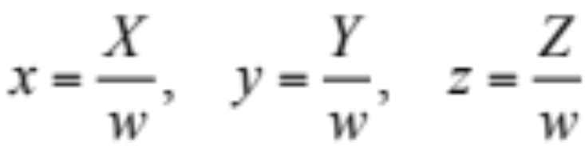
4D Homogeneous Coordinates
can be represented as
where
A 3D coord (x,y,z) is represented by an infinite locus of 4D coords of varying w
The projection of 4D coords to manifold w=1 is the 3D coord system
Projection of 4D coord is done by scaling about the origin (0,0,0,0) with a divide by w
(x,y,z) <==> (x,y,z,1) <==> (X/w, Y/w, Z/w, w/w) <==> (X, Y, Z, w)

Slide 27
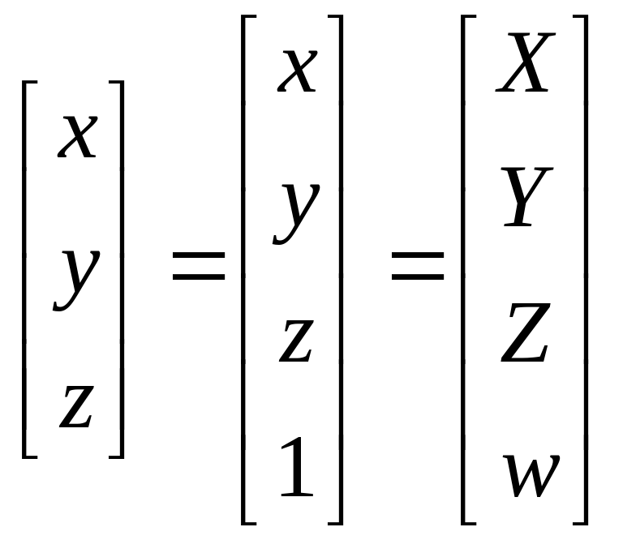
4D to 3D Conversions
Convert 3D to 4D by adding a w=1 term
Convert 4D to 3D by dividing all terms by w

Slide 28
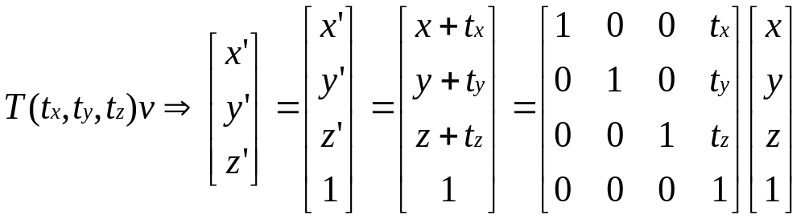
4D Translation homogeneous transformation

Slide 29
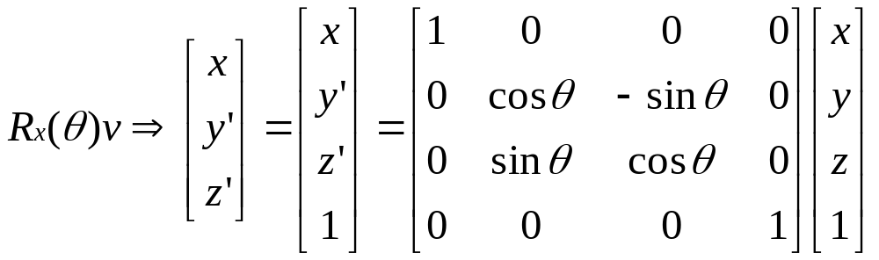
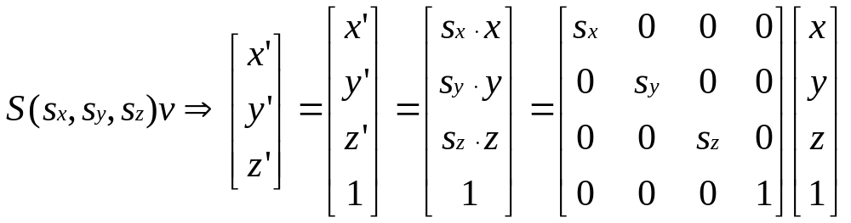
4D Rotation & Scaling homogeneous transformation
The term along the axes of rotation is unchanged (x in this case)
We will always assume Sx = Sy = Sz uniform scaling,
unless clearly noted otherwise

Slide 30
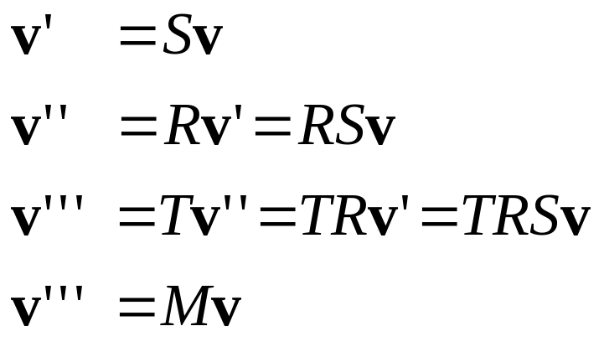

Combining Transformations
where
The result of a sequence of transformations [T] [R] [S] v
is the same as the result of a single transformation [M] v
where M is the concatenated (or combined) transform M = [T] [R] [S]

Slide 31
Scale and Rotation Combined
Xad = Xab Xbc Xcd
  chain any S,R,T matrices to arbitrary length
  fully associative (combine any adjacent xforms)
X = S R = R S (commutative property is for S,R only)
  rotation and scaling commute - neither change origin
    assume uniform scaling in all dimensions
  translations do not commute with R or S
    due to change of origin (fixed-point)
Start with v…
apply SR or RS
to arrive at the
same result
v
R
Origin
RSv = SRv
S

Slide 32
Translation
Translations do not commute with R or S
TR ≠ RT TS ≠ ST
TRv
RTv
TSv
v
STv
v
Origin
Origin

Slide 33
Rotation and Translation Combined
A 4x4 matrix combining rotation and translation X_{ab} = T R
  Rotation about origin in space-b occurs first
  Then, translation using axis of space-a is applied
X_{ab} = =
A different transformation (and matrix) is obtained if we reorder the operations as: X_{ab} = R T
  The translation occurs first, shifting the origin along the axes in space-b
  The rotation follows about the new origin and axes of space-b
(Note that R can also contain a scale xform S, but RS=SR so they commute)
cos ø 0 sin ø xt
0 1 0 yt
-sin ø 0 cos ø zt
0 0 0 1
1 0 0 xt
0 1 0 yt
0 0 1 zt
0 0 0 1
cos ø 0 sin ø 0
0 1 0 0
-sin ø 0 cos ø 0
0 0 0 1

Slide 34
Decomposing Transformations
Given a 4x4 view/projection matrix - we can decompose it into T R S or T S R (assume S is uniform scaling)
  T is upper three elements of right column
  M is 3x3 in upper left corner and M = R S or S R
    R is normalized M so all ||columns|| and ||rows|| = 1
    S is built from the scale factor used for normalization
M=RS
T
a b c xt
d e f yt
g h i zt
0 0 0 1

Slide 35
Normalizing R
R is normalized M so all ||columns|| and ||rows|| = 1
S is built from scale factor used for normalization
Compute any row or col magnitude of M as scale factor
K = ||M_{row}|| = (a² + b² + c²)^{1/2} (a,b,c, are top row of M, for example)
divide all elements of 3x3 M by K : R = (M)/K
R is a normalized (unitary or “pure”) 3x3 rotation matrix
S is a 3x3 diagonal matrix with elements = K : the scale factor extracted from M
a b c xt
d e f yt
g h i zt
0 0 0 1
M=RS

Slide 36
Inverse Transformations
Given [Rac], its inverse [Rca] = [Rac]⁻¹ = [Rac] ^{t}
  transpose = inverse for unitary (pure) rotation
  transpose 3x3 elements of rotation matrix
    row and col vectors are orthogonal (row•col = 0)
    ||row|| = ||col|| = 1
Given [Tac], its inverse [Tca] = [Tac]⁻¹ = [-Tac]
  negate 3 elements of translation matrix
Given [Sac], its inverse [Sca] = [Sac]⁻¹ = [1/Sac]
  replace 3 diagonal elements with their reciprocals
Given [Xac] = T S R
  build the inverse : [Xac]⁻¹ = R⁻¹ S⁻¹ T⁻¹
  it must be the inverse because:
    I = [Xac]⁻¹ [Xac] = [R⁻¹ S⁻¹ T⁻¹] [T S R]

Slide 37
Perspective Projection
Perspective projection of (0,Y,Z) onto the Z=0 plane occurs at point a=(0,y,0)
Camera focal point is at z = -d (0,0,-d)
Use similar triangles ratio to compute y-coord at point a
y/d = Y/(Z+d)
y = Yd/(Z+d) = Y/[(Z/d)+1]
Do the same for X and Y coords to find a projected point (x,y,0) on the image plane x=X/[(Z/d)+1] y=Y/[(Z/d)+1]
y-axis within Z=0 plane
0,Y,Z
a
z= -d
z-axis

Slide 38
Projection Transformation
X, Y, and Z are projected by a 4D transformation
[ X, Y, Z, (Z/d)+1 ] =
Divide by w = (Z/d)+1 to
get projected point [x, y, z] =
  Note : screen-space 3D coords require divide after perspective transformation (divide by w = (Z/d)+1)
  Note: other projection formulations are also used
    e.g., view point is z=0, and image plane at z=d
    Geometry and results are the same for any coordinate system
1 0 0 0
0 1 0 0
0 0 1 0
0 0 1/d 1
X
Y
Z
1
X
(Z/d)+1
Y
(Z/d)+1
Z
(Z/d)+1
, ,

Slide 39
Interpolating Z-Projections
Z= 0
Point B is the mid-point between edge points A and C
  The projection b is not at the mid-point of projected points a and c on the image plane (Z=0)
  Linear interpolation of Z values from a (Z=21) to c (Z=1) would produce Z=11 at point b, not at point b
  Interpolated point b would have Z>11, which is incorrect for a z buffer test at that pixel (e.g., the small square vertex)
For interpolation of Z during rasterization, we must do the perspective transformation of Z onto the Z = 0 plane and interpolate the transformed z-values z = Z/[(Z/d)+1]
a
bc
Z= -d
Z=1 Z=11 Z=21
C B A

Slide 40
Examine projected value of z = Z/(Z/d+1)
For Z=0, X=x, Y=y, z=0
  Points in view plane (Z=0) project to themselves
For Z=-d, z = -∞
  FP exceptions (singularity) occur with Z = -d !
  Implement a clip (cull) plane at Z < 0 to discard any tri with a negative Z value at any vertex --- test Z before divide by w
For large Z (∞ distance), perspective z --> d
  Asymptotic curve of Z vs. z approaches d and causes resolution problems for points at high values of Z
  different Z values map to the same z
See Graphics Hardware Workshop
1998 - 2002 for
"Optimal Depth Buffer” or
“Low-Cost Graphics Hardware"
papers
z
d
Z

