Slide 1
Git Workshop How to git your coding projects organized
Stephen TH Sher
ACM Workshop
February 2, 2015
Warning: Lots of puns ahead

Slide 2
Git Overview Why git into Git?
Pun Counter: 2

Slide 3
My Personal Experience with Git
“Oh it’s like a homework submission program, like Blackboard… Wait why don’t we just use Blackboard?”
– Stephen, 2013
(paraphrased)
“Oh you need help with Git? I’ve used Git before!”
– Stephen, 2014
(paraphrased and translated)
“Let’s use Git”
– Stephen, 2015
“I love Git”
- Stephen, 2016
Pun Counter: 2
SECTION TITLE | 2

Slide 4
Someone without Git in their life:
Cannot work in teams
Irresponsible programmer
High risk of crying (when progress is lost)
Get weird looks from colleagues
Generally very sad
Pun Counter: 2
SECTION TITLE | 2

Slide 5
Git Review Let’s git started!
Pun Counter: 3

Slide 6
At the very least, git familiar with these commands:
$git clone
Copy server’s repo to your local machine
$git pull
Pull the latest version of the repo to your local machine
$git add <path-to-file/filename>
Add file from local machine to repo
$git commit –m “<message>”
Save a state of your local machine’s repo
$git push
Saves the commits on your local machine to the server
Pun Counter: 4
SECTION TITLE | 2

Slide 7
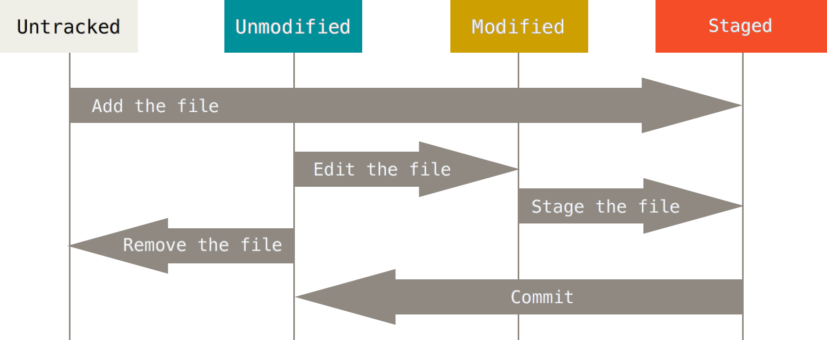
Pun Counter: 4
SECTION TITLE | 2

Slide 8
Git Basics Git new commands!
Pun Counter: 5

Slide 9
If you learn these, you git a power-up:
$git rm <path-to-file/filename>
Tells Git to stop tracking the designated file (also removes it locally)
Tracks the change of removing the file
$git log [--oneline] [-num_of_commits]
Shows commit history
$git checkout <commit_id>
Add file from local machine to repo
$git commit –am “<message>”
Automatically adds modified (not new) files and commits
Pun Counter: 6

Slide 10
Git Advanced Git ready!
Pun Counter: 7

Slide 11
If you learn these, you git to be boss:
$git branch [-a]
Look at the branches you’ve visited
$git branch <branch_name>
Creates a new branch from the current commit version
$git checkout <branch_name>
Switches local repository to the branch repository
$git checkout –b <branch_name>
Creates new branch and checkout to that new branch in one step
$git branch -d <branch_name>
Deletes the designated branch
$git merge <branch_name>
Merges the designated branch INTO your current branch
The branch is not deleted
Pun Counter: 8

Slide 12
These are helpful, but might git you in trouble.
Use with caution!
$git stash
Deletes all your local changes
$git push -f
Forces Git to push with your changes (I can’t see why you would ever want to do this)
To revert back to a previous commit and use that as a the new master
$git checkout <commit_id>
$git checkout –b new_master
$git branch –d master
THIS IS PAST THE POINT OF NO RETURN
$git branch –mv new_mater master
YOU ALSO PROBABLY SCREWED ALL YOUR TEAMMATES UP, HAVE FUN DEBUGGING FOR HOURS UPON HOURS
I DO NOT ENDORSE THIS. DO THIS AT YOUR OWN RISK. I AM NOT RESPNOSIBLE FOR ANY DAMAGES CAUSED OF YOU DINKING AROUND WITH CHANGING YOUR MASTER BRANCH
Pun Counter: 9

Slide 13
Git Demo Git excited!
Pun Counter: 10

