Slide 1
Class 6. Lighting and Shading HW4
CS580
(Computer Graphics Rendering)
Ulrich Neumann

Slide 2
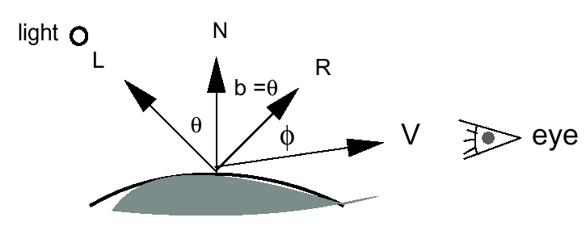
Review: the shading Eq
E
C = (Ks Σ_{L} [Ie (R•E)^{s}] )
+ (Kd Σ_{L} [Ie (N•L)])
+ (Ka Ia)

Slide 3
Examine the Vectors
E
L is the direction to an infinitely-far point-light source
  constant in whole scene and specified by the application
E is constant and set by camera view direction
  Z-axis of camera is a known direction in image space (0,0,-1)
    also known in world space (camera position and look-at point)
  Constant E approximates far away camera with narrow FOV
  A camera close to the scene requires E computed for each model vertex or pixel shading calculation (not for HW)
N is specified at triangle vertices - given in model space
R must be computed for each lighting calculation (at a point)
  R = 2(N•L)N - L (next slide)
L, E, N, R must be transformed to the same space for shading Eq evaluation: model, world, or image space
  assume any of these spaces for now…

Slide 4
Compute Reflection Ray
R = 2(N•L)N – L (L,N,R are unit-length)
2(N•L)N
-L
N
L
R
(N•L)N
θ
θ

Slide 5
Choosing a Shading Space
Cosines and dot products must be computed in an affine space – perspective warps geometry
  We need to have all the (L, E, R, N) vectors in some affine (pre-perspective) space
Any affine space will do, and there are a few sensible/intuitive options:
Image space is "close" to screen space and it's convenient to think about the light being attached to the camera
  everything has to get to image space eventually, on the way to perspective and screen space – suggest you use image space for HW4
World space allows light to be specified in relation to the world
  useful for modeling a room with lights or sunlight
Model space is also a reasonable choice since Normal vectors are already in that space
  This is most efficient, but it requires we have inverse transformations for bringing L, E into each model’s space – must be redone anytime there is push/pop of model transforms.

Slide 6
Image Space Lighting (ISL)
Shading computed with vectors in image space
Specify lights in image space (attached to camera)
E the eye-vector is known in image space (0,0,-1)
Normals are always given in model space
Norms are transformed by a stack Xn that includes all the model to world and world to image transformations → Xn = X_{im}
Recall the geometry stack in HW3 (Xg) goes all the way from model to screen space → Xg = X_{sm}

Slide 7
Two possibilities for ISL
1) Transform N to screen using Xg and then back to image space
  messy since we have screen scale, d, and Zmax scaling and translations to undo
2) Transform norms to image space with separate stack
  Xn used only for N
  A simple & clear calculation – no inverses
  No scaling or translations allowed in Xn
    Make sure Xn is a unitary rotation matrix so the resulting N remains normalized

Slide 8
Translations of Vectors
Direction vector (Normal) is represented by head coord of vector whose tail is implicitly at the origin
Translate V by T =
Translating V alters the direction of the vector
  Translation is not a proper operation on a direction vector
  Do not allow translations in Xn
Strip translations from all matrices pushed on Xn
  Put zeros in 3 upper elements of right column prior to any matrix push
V = x,y,z
V
V’
0,0,0
0,0,0

Slide 9
Unitary Rotations for Normals
To ensure Xn is a unitary rotation, pre-process each matrix before it is pushed onto Xn
  Use knowledge of unitary R matrix properties
  Length of any row/col vector must = 1
Compute a scale factor and apply to all elements in the matrix
  use any row/col and compute scale factor
    K = (a² + b² + c²)^{1/2}
  divide all elements of 3x3 R : R' = R/K
  R' is normalized (unitary) rotation matrix
Push R' onto Xn

Slide 10
Xn Transform Stack for ISL
Xn is the same structure as used for Xg
Do all push/pop operations on both stacks
  Except: push Xsp and Xpi as identity [I] or skip them for Xn
  Xn must only contain pure rotations (unitary)
  no translation and no scale
Normals passed through Xn will remain unit length for dot products calculated in shading equation
  Xn contains only unitary Rotations so the transformed N-vectors remain normalized
    recommended for HW4

Slide 11
Cases that come up in shading (1)
You need to deal with these in the HW
Test the illumination and the viewing direction relative to the normal of a surface
  Sign of N•L and N•E
    Both positive : compute lighting model
    Both negative : flip normal and compute
    lighting model on backside of surface
    Each has different sign : light and eye
    are on opposite sides of the surface
    so the light contributes zero – skip it
E
N
L
E
Flipped N
L
N
L
N
E

Slide 12
Cases that come up in shading (2)
R•E calculations must be clamped to zero to maintain [0, 1] bounded range
  R•E may be negative for front or back surface illuminations
Check for color overflow from multiple lights
  Overflow causes black holes
  Occurs when converting float values >1.0 to 12-bit GzIntensity values written to the frame buffer
E
N
L
R

Slide 13
Shading Calculation Logistics
Application specifies lights (Ie and Ia) and material properties (Ka, Kd, Ks, s) before sending any triangles for rasterization
  Renderer uses these values until they are overwritten
The geometry (vectors) and material properties are all the elements needed to compute the shading equation
  however - we only know all this information
  at the model vertices where N is specified

Slide 14
Vertex and Face Normals
What are the “normals” to the surface?
Each polygonal face has a normal
  N = (b - a) x (c - b)
Polygon mesh only approximates the curved surfaces we are trying to model
  use the actual surface normals
  sample surface normal at vertices
  assume smooth variation of normal
  over mesh faces between vertices
c
N
a
b

Slide 15
Vertex Normals
Vertex normals are specified at each vertex – even when the vertex position is shared by adjacent triangles
Two options when adjacent-faces share the same vertex
  Same normal at adjacent-face vertex for smooth shading
  Unique normal at adjacent-face vertex for sharp edges
Unique normals at verts mean sharp transition between shading on faces
Shared normals at verts means smooth face-shading transitions
Shared normals at verts mean seamless shading transition between faces

Slide 16
All pixels need color
All terms of shading eq are known (and fixed) for the entire triangle, except for Normals
  Norms are specified per-vertex – allow them to vary within the triangle to approximate curvature of smooth surface
The shading mode flag describes how to compute the color of pixels inside the triangle based on the known vertex Normals
  The flag selects interpolation of vertex color or normals
The shading mode determines where in the image or on the model we compute the lighting equation
  per face – flat shading (HW2 and HW3)
  per vertex – interpolate vertex colors (Gouraud Shading)
  per pixel – interpolate normals (Phong Shading)

Slide 17
Shading Modes
Shading Mode = NONE (Flat shading – per face)
  used in HW2,3 to specify flat (constant) shading with color given by application
Shading Mode = Color interpolation (Gouraud – per vertex)
  Shading equation is evaluated only at verts
  Color of shaded verts is interpolated to each tri surface pixel
  Fast, but specular highlights are undersampled – aliasing
Shading Mode = Normal interpolation (Phong – per pixel)
  Interpolate and normalize N at each pixel and compute full shading equation at each pixel
  Expensive computation, but better sampling - eliminates aliasing
  Highlights are more accurate and consistent under motion or view changes

Slide 18
Gouraud Interpolation Problems
Misses some highlights
Stretches (blurs) highlights
Shading is not a linear function…
eye
light
N
N
a worst case…
Shading of yellow surface
will be constant!
Highlight should be in the middle – but isn’t computed
The same color is computed at each vertex and interpolated as constant across entire face

Slide 19
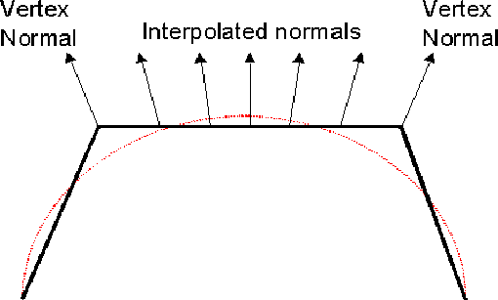
Phong Interpolation
Interpolate the Normals, then compute colors
  Interpolation is by x,y,z components of vector
  Note: length of interpolated N vector is reduced
    It needs to be normalized and this requires square-root calculation
eye
light
Highlight occurs in the center of the face where specular reflection reaches the eye

Slide 20
HW 4 Interpolation Modes
App sets GZ_INTERPOLATE flag
  GZ_FLAT : flat shading (default -- so HW3 should still work)
  GZ_COLOR : vertex shading and color interpolation (Gouraud)
  GZ_NORMALS : normal interpolation and pixel shading (Phong)
App sends triangle
  If GZ_FLAT :
    shade like HW3 – Rasterize while using GZ_RGB_COLOR value
  Else :
    Transform norms with Xn
    If GZ_COLOR :
      compute color at verts, rasterize while interpolating RGB vertex colors
    If GZ_NORMALS :
      rasterize while interpolating Normals and compute color at each pixel
      NOTE: MAKE SURE YOU “NORMALIZE” THE LENGTH OF THE INTERPOLATED NORMAL VECTOR AT EACH PIXEL BEFORE YOU EVALUATE THE SHADING EQUATION

Slide 21
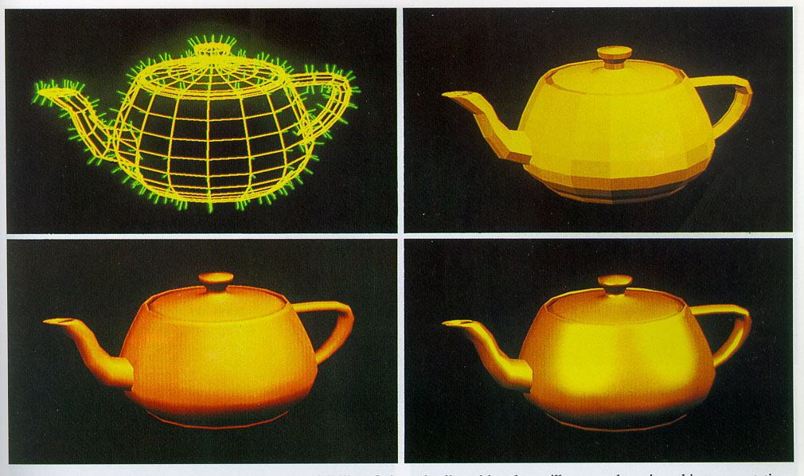
Interpolation Examples
Image courtesy of Watt & Watt, Advanced Animation and Rendering Techniques

Slide 22
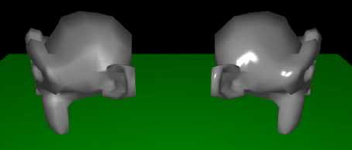
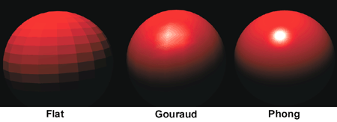
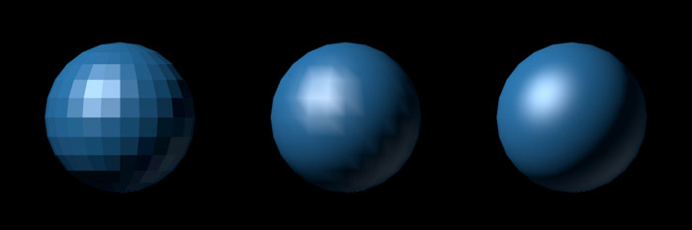
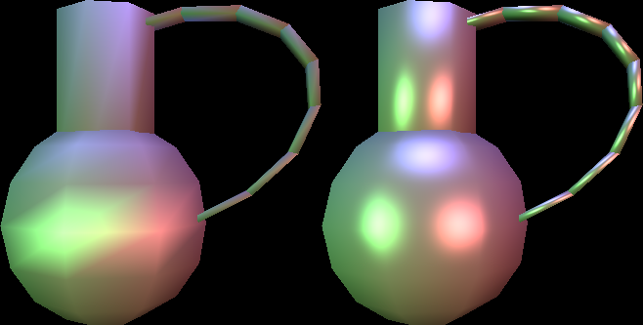
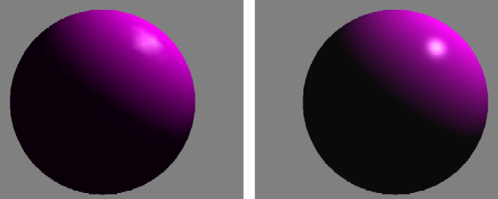
More Interpolation Examples

Slide 23
HW4 Details
Add a shader to your Gz rendering library to support flat-shading (like in HW2/HW3), Gouraud shading, and Phong shading
The shading mode is set by selected an interpolation mode
The GZ_INTERPOLATE flag selects between flat shading (no interpolation), vertex color interpolation, and normal interpolation.
You will support two light types GZ_AMBIENT_LIGHT and a directional light specified by GZ_DIRECTIONAL_LIGHT
  Both are of type GzLight (in Gz.h)
  The direction vector is only valid for directional lights and it is the vector from the scene to the light in image-space
  Ambient light direction has no meaning - so it is ignored

Slide 24
HW4 Details (2)
Only one ambient light is supported, but multiple directional lights are possible (up to 10)
Lights are specified by a call to GzPutAttribute()
GzPutAttribute() must accept the following tokens/values:
GZ_RGB_COLOR GzColor default flat-shade color
GZ_INTERPOLATE int shader interpolation mode
GZ_DIRECTIONAL_LIGHT GzLight
GZ_AMBIENT_LIGHT GzLight (ignore direction)
GZ_AMBIENT_COEFFICIENT GzColor Ka reflectance
GZ_DIFFUSE_COEFFICIENT GzColor Kd reflectance
GZ_SPECULAR_COEFFICIENT GzColor Ks coef's
GZ_DISTRIBUTION_COEFFICIENT float spec power

Slide 25
HW4 Details (3)
Values for GZ_INTERPOLATE
GZ_FLAT 0 /* flat shading with GZ_RBG_COLOR */
GZ_COLOR 1 /* interpolate vertex color */
GZ_NORMALS 2 /* interpolate normals */
Gz.h defines a GzLight type since the application has to set up lights
*** Note that you can use your existing LEE or DDA interpolation methods for color or normal interpolation
  No need to invent a new method

Slide 26
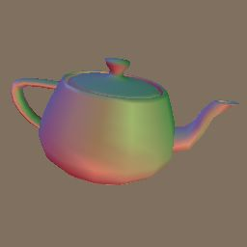
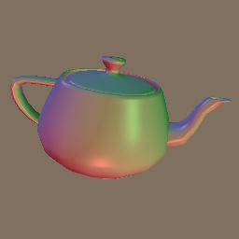
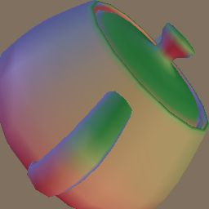
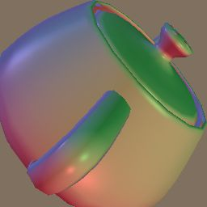
HW4 Shading
Camera set
Color interpolation
Normal interpolation
Default camera

Slide 27
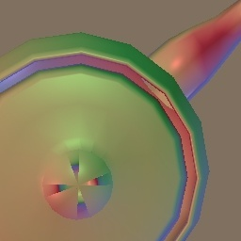
HW4 teapot
Modeling errors in the teapot normals
  Normals have inconsistent signs
line 2593
triangle
0.000281 3.000000 0.000844
0.000000 1.000000 0.000000
0.250000 0.000000
0.000750 3.000000 0.000750
0.000000 -1.000000 0.000000
0.500000 0.000000
0.242477 2.950782 0.242477
0.423818 0.800473 0.423818
0.500000 0.250000
similar issues at lines 2625, 2629,
2721, 2753, 2849, 2881, 2977, 3009

Slide 28
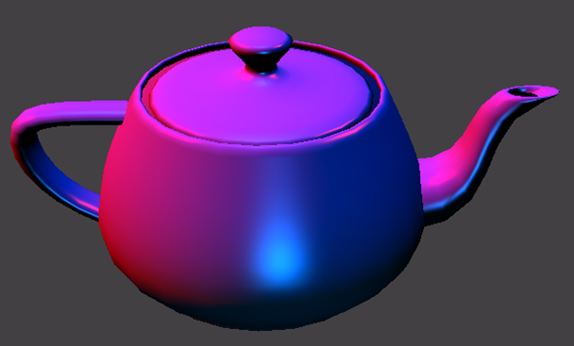

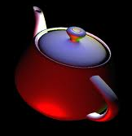
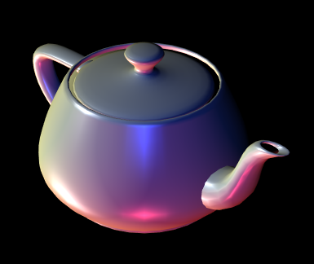
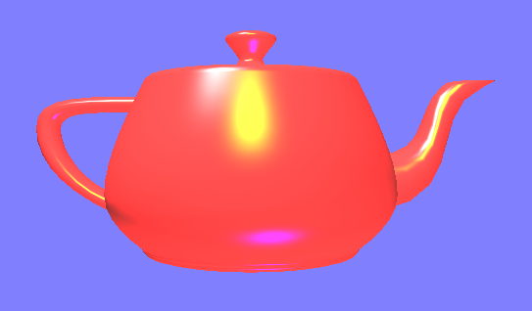
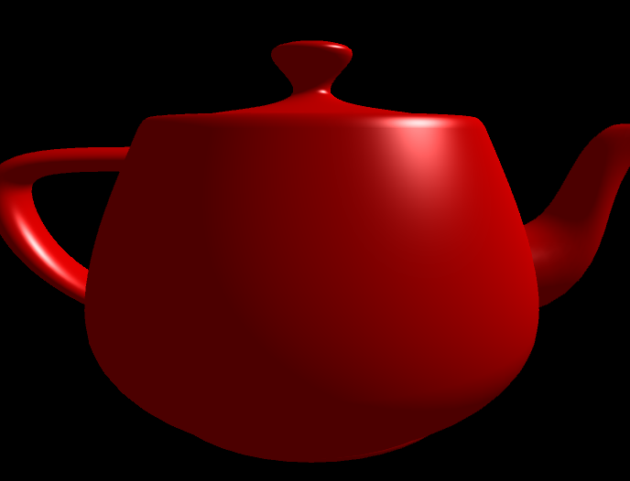
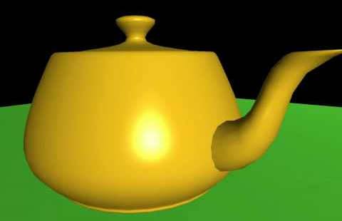

More teapots

Slide 29
Observations
Highlights usually affect only a small portion of model surface
  Classic problem for adaptive methods
    Cho'94 580 project
  For mobile platforms, web graphics, or games the specular term is disabled for efficiency and to hide coarse model tessellation
  A subset of Gouraud (color interpolation) shading that only computes ambient and diffuse terms – a subset of the shading equation

Slide 30
Non-Uniform Scaling
All transforms for our HW contain only R, T, S – where S is a uniform scale applied equally to all dimensions
If we allow non-uniform scale factors, we have to solve a problem that arises with the scaling of Normals
For example – consider a non-uniform scale of 0.5 in X :
………
A non-uniform scaling alters the relationship between the surface orientation and the Normal vector
This occurs if we use the same matrix M for transforming the Normals that is used for transforming the vertex coordinates
We can fix this by using a different transformation Q = f(M) for transforming the Normals
N
N’
X - axis
0,0,0
0,0,0

Slide 31
Q for Non-Uniform Scaling
N
Take any point P in a plane and the plane norm N
  <N•P> = 0 (P plane includes the origin)
N and P written as column vectors
  N = (A, B, C)^{T}, P = (x, y, z)^{T}
N^{T} P = 0 is the matrix-product form of the dot product above
If we transform the point P by M (any rotation or scaling transform), then we need to find Q so that (QN)^{T} (MP) = 0
  N^{T} Q^{T} M P = 0, since (AB)^{T} = B^{T} A^{T}
  If Q^{T} M = K I, the above eq is satisfied (K can be any constant)
  Let's pick K = 1, then Q^{T} = M⁻¹ or Q = (M⁻¹)^{T}
Transform Norms by: Q = transposed-inverse of Xim = (Xim⁻¹)^{T}
  Build the transformation stack so that: Xn = (Xim⁻¹)^{T}
  For HW4, Xim has uniform scaling, so after removing translation:
  Xim = Q = (Xim⁻¹)^{T}
  If Xim has non-uniform scaling, we must compute Q on Xn stack
  If we compute Q = (M⁻¹)^{T} for each M pushed on the Xim transform stack, the resulting Xn stack has Q and therefore allows non-uniform scaling
P
0,0,0

Slide 32
Concatenated Xn Transformation
So, the transposed-inverse of the Xim transformation will produce the correct transformation of the normal
However, we should verify:
  If we push multiple transposed-inverse transformations Q on Xn do we get the correct transposed-inverse on the stack?
First we push A, then we push B:
  ((A B) ⁻¹) ^{T} = ((B⁻¹ A⁻¹)^{T} = (A⁻¹)^{T} (B⁻¹)^{T}
So, yes, if we push the transposed-inverse of A and B, we get the transposed-inverse of AB (concatenated)
*** Reminder: For a unitary rotation matrix, the inverse transpose is itself. There is no need or point in computing Q for HW4 since we limit Xim to uniform scaling. Translation and Scale are removed to leave only pure rotations for Xn.

Slide 33
Option: Model Space lighting (MSL)
In this case, we need to transform L and E back to model space using inverse transforms
Since lights could be in world or image space, we may need two inverses
For HW4 we have image-space lights so we can build and use Xn, but we need to invert it
If we ensure Xn is pure rotation R, the inverse is simply R⁻¹ = R^{T} and vector lengths are not affected by transform
Transform all image-space L vectors into model space each time the Xn matrix is changed so when triangles are passed into renderer, shading can be done in model space
Eye/camera direction is known in image space (0,0,-1), it also must also be transformed into model space each time the Xn matrix is changed

Slide 34
Orthonormal Rotation Matrix
Matrix Normalization is needed to keep scaling uniform and remove shears during sequence of incremental rotations from GUI manipulations or animation script
  not a HW issue – but needed when 100’s of sequential transformations are done (interactive apps)
Gram–Schmidt Orthogonalization process uses matrix rows r1, r2, r3, (or cols) to form orthogonal basis R1, R2, R3. Normalize R1, R2, R3 to yield an orthonormal or pure rotation transformation.
  R1 = r1
  R2 = r2 - R1 (r2•R1)/(R1•R1)
  R3 = r3 - R2 (r3•R2)/(R2•R2) - R1 (r3•R1)/(R1•R1)

Slide 35
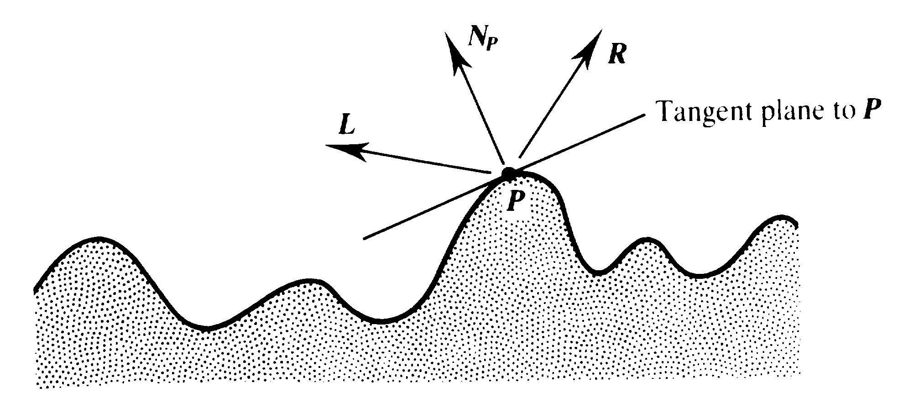
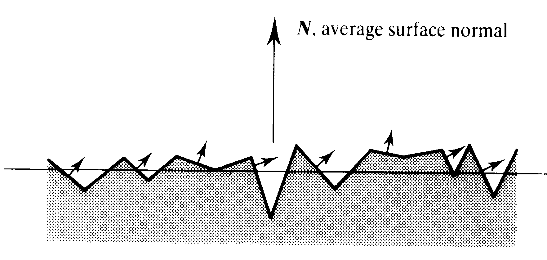
Shading Physics
Many materials are not really smooth or uniform at microscopic scale
  Small-scale N variations are averaged over macro-scale area
The surface structure impacts light reflection in ways that are not captured in our simple reflectance function
  Specular intensity changes with incident angle
  Highlight color changes with incident angle due to diffraction effects at varied wavelengths

Slide 36
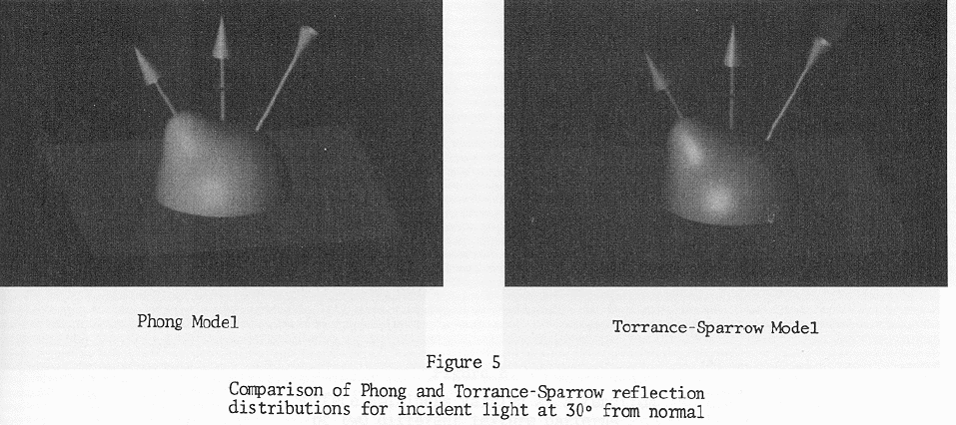
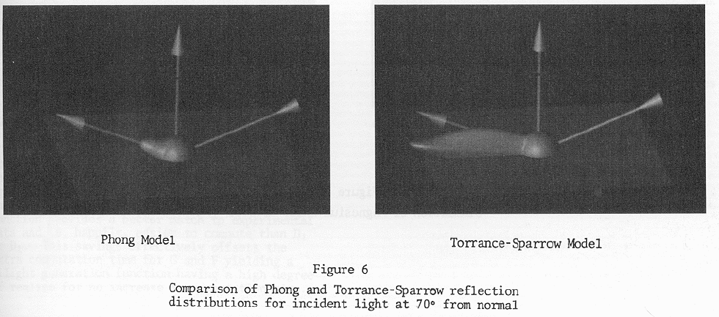
Other Shading Models
There are other models of illumination that approximate various reflectance effects
Torrance Sparrow (1966) model
  based on microfacet distribution
  (FvD chapt. 16)
  Increased specular reflectance at grazing angles

Slide 37
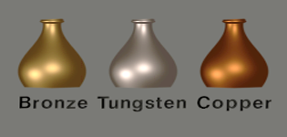
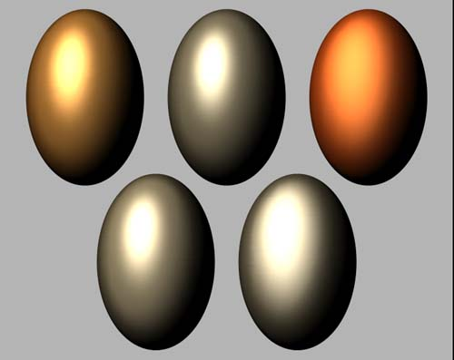
Other Shading Models (2)
Cook Torrance (~1978) models
  Color shift of specular reflections at gazing angles (see yellow outlined areas)
  Color at grazing angles becomes light source color
  Metals (and most natural materials) show similar diffuse and specular color (Kd, Ks) at nominal angles
  Plastics have different Kd, Ks at nominal angles (Ks is often just white)

Slide 38
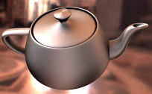
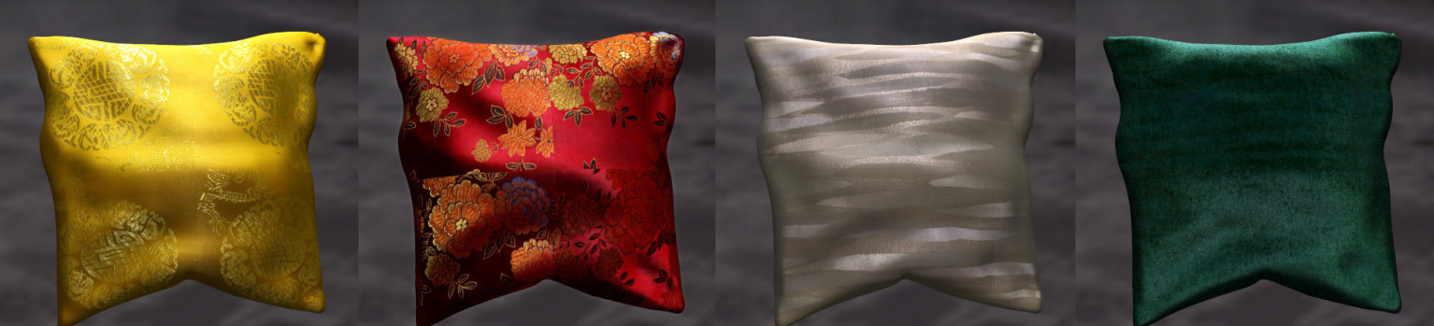
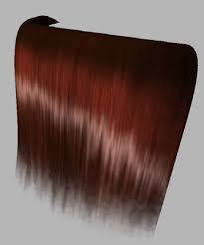
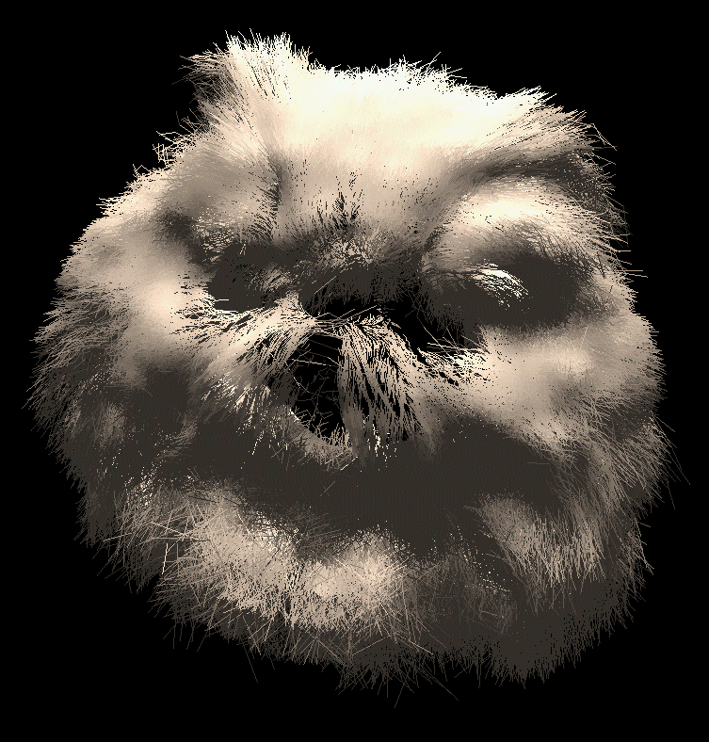
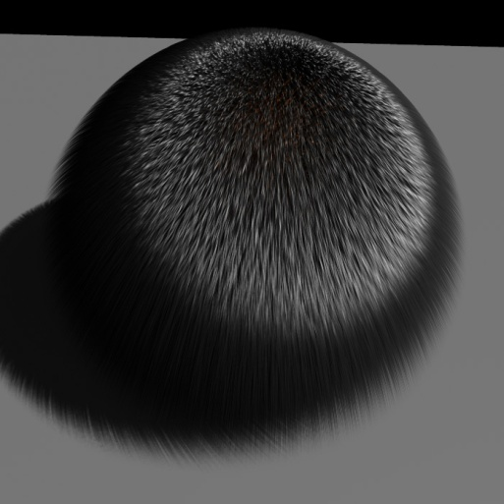

Other Shading Models (3)
Kajiya (1985) modeled anisotropic shading based on Cook Torrance model
  Reflectivity (K) is not symmetric about the surface normal
  Directional shading is needed for brushed metal, cloth, hair, etc.
  Surface normal and tangent define surface orientation (grain-direction)
  Cross product produces "binormal" to create local coordinate frame at all surface points

Slide 39
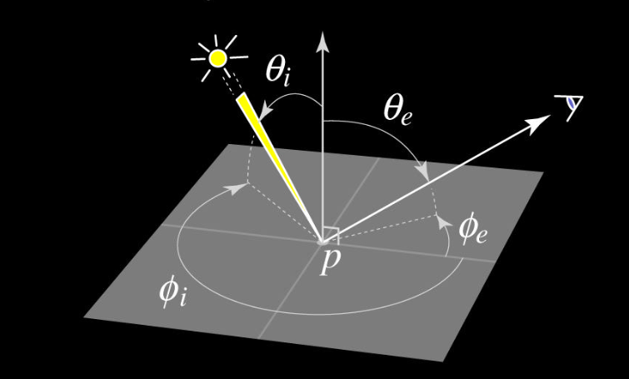
BRDF Definition
General case of reflectance ratio ρ at a point p is defined by:
Bi-direction Reflectance Distribution Function (BRDF)
ρ(p) = f(λ, φ_{i}, θ _{i}, φ _{e}, θ _{e})
5D function of:
  Wavelength λ and Light and Eye directions (each 2D angles)

Slide 40
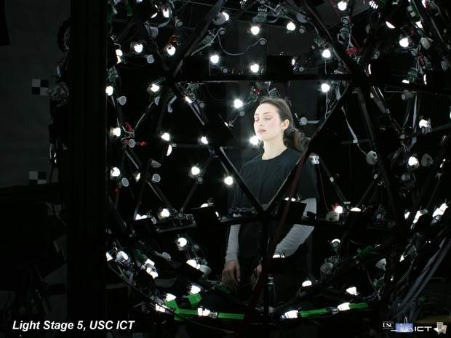
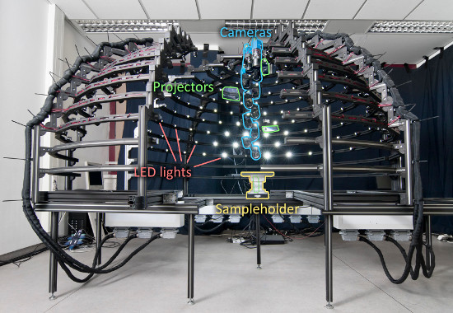
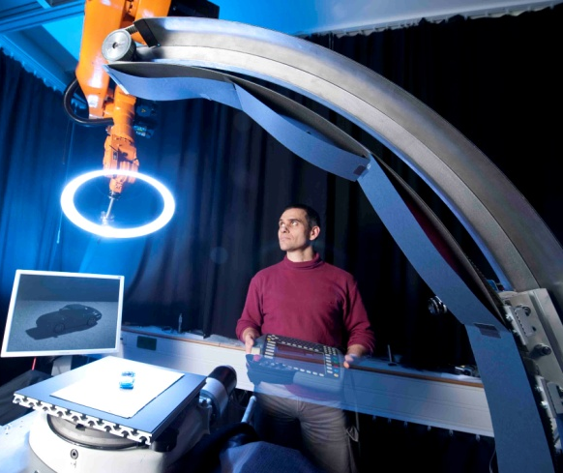
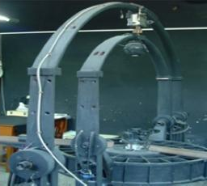
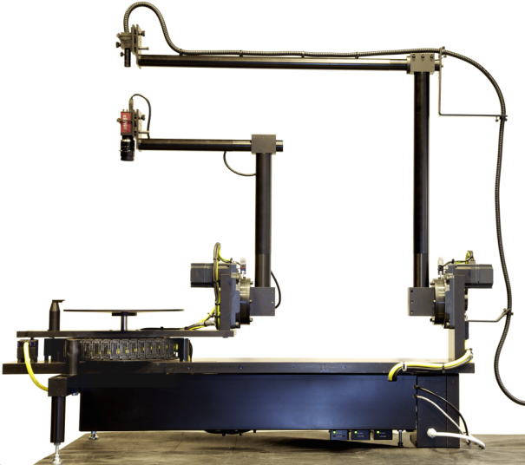
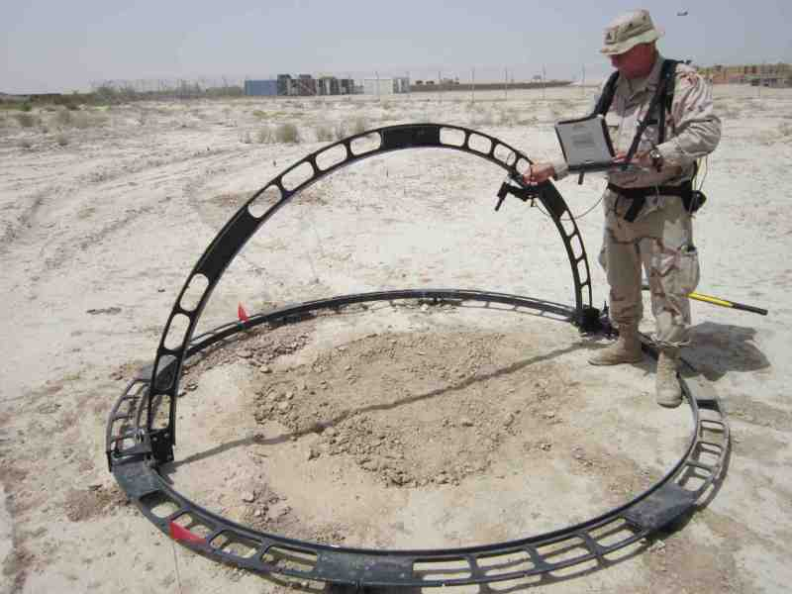
BRDF Measures
5D reflectance function is measured with special instruments called a goniometer, or a light stage, or similar …

Slide 41
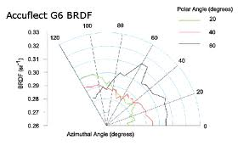
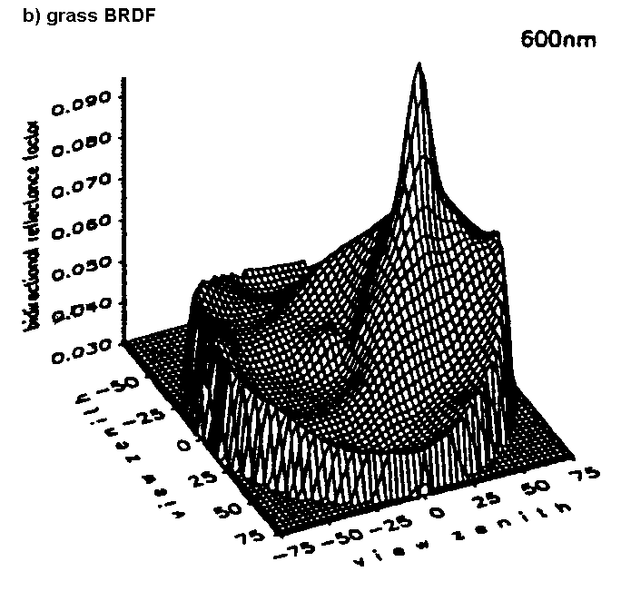
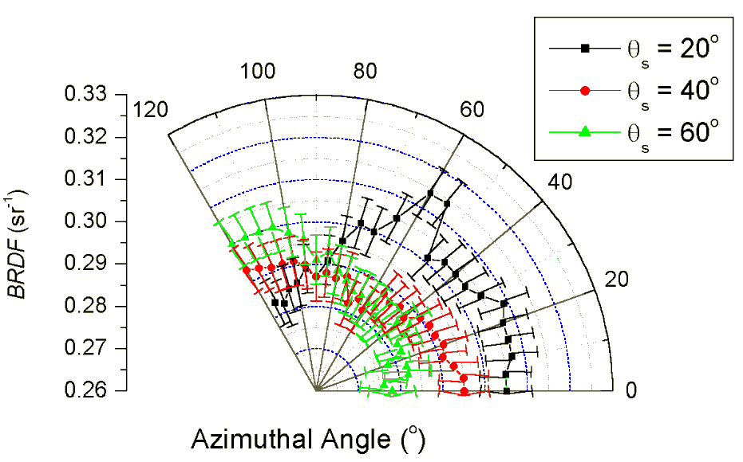
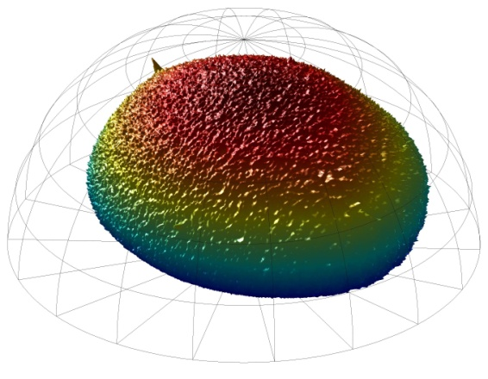
BRDF Representations
Approximate BRDFs with coefficients of basis functions
(spherical harmonics) or look up tables (LUTs)
Note: texture-maps are LUTs
structured for fast calculations
during the shading process

Slide 42
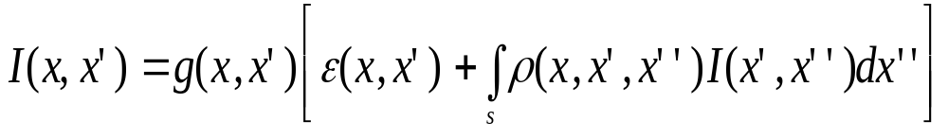
The General Rendering Equation
A generalization is presented as a "rendering equation" by Kajiya (1986)
x, x', x'' are points in environment (set x as camera focal point, for example)
I(x,x') is radiance of all light reflected from x' to x.
g(x,x') is geometry term that models occlusion between x' and x (0 or 1/r²)
ε(x,x') is radiance of light emitted from x' to x (light sourced at x')
Integral is taken over all environment points x'' of light heading to point x' and reflecting to x.
I(x',x'') is radiance of light from x'' to x'.
ρ(x, x', x'') is surface reflectivity function (BRDF) of surface point x', given x and x'' – also has to include light transmission if x' is translucent material.
Solving this for any case depends on what we set constant, what we ignore, and what functions we use to model/approximate real physical behaviors.

