Slide 1
Class 7
Screen-Space Interpolation with Perspective Correction
CS580
(Computer Graphics Rendering)
Ulrich Neumann

Slide 2
Problem
We employ simple linear interpolation of vertex shading parameters for HW4
  accurate interpolation of RGB color or Normal vectors should take perspective into account
  we need the equivalent of “perspective-z” for accurate parameter interpolation

Slide 3
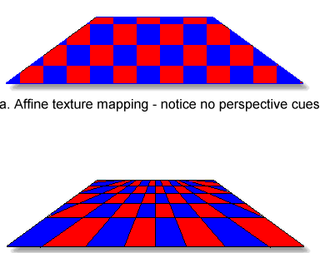
Checkerboard Example
Checkerboard defined as integer grid derived from vertex parameters
  red over odd/odd (o, o) and even/even (e, e) intervals
  black over odd/even intervals (e, o), (o, e)
Image midpoint is not actual midpoint of checkerboard
  Straight line along diagonal remains straight under perspective
0,2
1,2
2,2
0,1
2,1
0,0
2,0
1,0
Linear Interpolation
Perspective Interpolation
Mid-image checkerboard
interpolation
point is not mid-object
Correct mid-checkerboard
interpolation to mid-object

Slide 4
Parameter Interpolation
Similarly, linear interpolation of affine (image space) parameters like Z give wrong results at pixels
Interpolation of perspective-z is correct (all HW so far)
  we can recover image space result if we transform perspective-z back to image (affine) space after interpolation
Effect is modest for scene like teapot where Z range is small, or with narrow FOV cameras
  Roads to horizon, grazing angles on curved surface like a car hood, and wide FOV cameras produce a more dramatic impact
Perspective-correct interpolation of u,v texture coords is needed in HW5 – e.g., checkerboard texture
Z= 0
a
bc
Z= -d
Z=1 Z = 11 Z = 21

Slide 5
Color and Normal Interpolation
Color or Normal interpolation (Gouraud/Phong) is actually wrong (in HW 4) since parameters are interpolated as affine-space values
  Colors and Norms are not transformed to perspective-space where depth is taken into account
Ignore error in color interpolation – it’s an approximation
  Visual system is sensitive to intensity and color discontinuities
  Interpolation errors impact the rate of changes
  Human visual perception is not sensitive to rate of color change
  Often triangle vertices only differ by a small color change
Ignore error in normal interpolation – it’s an approximation
  Diffuse variations are not important for reasons already stated above
  Specular errors are minor and only shift the highlights slightly
  Much larger highlight errors can result from approximations of L and E as constant over the scene – and these are not noticeable either

Slide 6
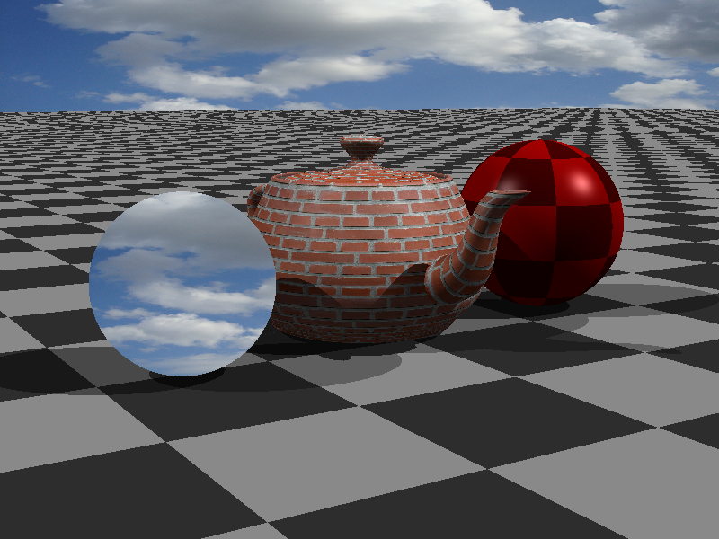
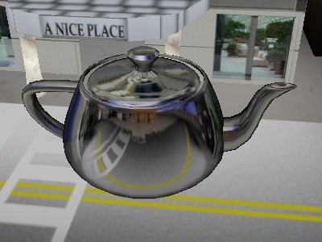
Perspective-Correct Parameters
Perspective-correct interpolation is needed when interpolated parameters produce edges or discontinuities in shading or geometry
  E.g., texture edges (in checkerboard) or use of normals for reflective or mirror surfaces

Slide 7
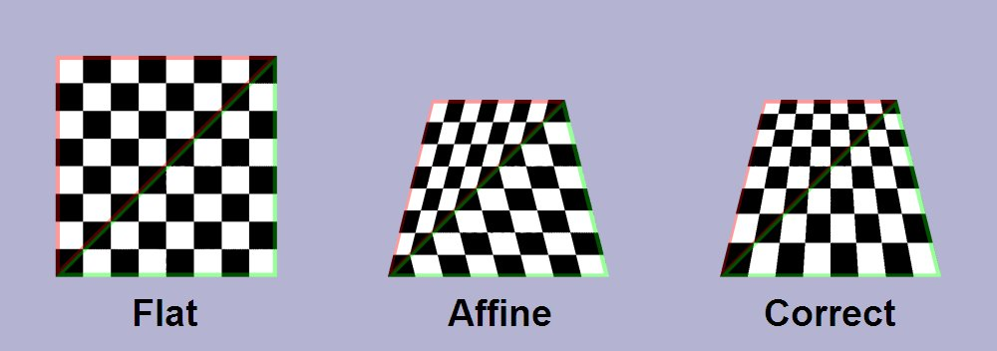
Perspective-Correct Parameters
Our z-interpolation is perspective-correct
Screen-space and NDC space only differ by scale (MAXINT)
  Perspective-correction is not impacted by scaling
We need a similar perspective transformation to allow interpolation of other shading parameters (e.g., texture u,v coordinates)

Slide 8
Any parameter P can be properly interpolated by…
Transform (warp) vertex parameter P to perspective space P^{s} vertex value
Interpolate perspective P^{s} vertex values to new sample points (P^{s} values at pixels)
Transform (unwarp) interpolated P^{s} pixel values back to original space to produce interpolated P values for use in shading (or other processes)

Slide 9
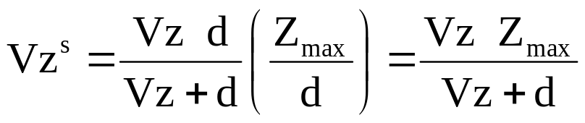
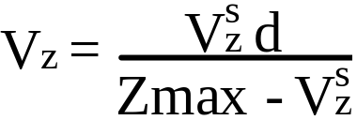
What happens to Z ? study Z as an example of perspective interpolation
V = [Vx,Vy,Vz] an image-space point, V^{s} is its perspective coordinate
Writing the transformation as an equation:
(1)
= V^{s} (2)
We scaled Xpi to scale Vz^{s} ∈ [0, Zmax] to bound it for Z-buffer range
Scaling by Zmax/d doesn’t alter perspective characteristic that arise from divide by (Vz+d)
Z-buffer doesn’t require inverting the transformation of z to get Vz at each pixel – but we could do it
(3)
Invert the relation to find Vz (image space)
(4)

Slide 10
Interpolating Parameter P
Use the unscaled Xpi matrix (Eq 2) for any parameter P
(in image-space) that we wish to transform to P^{s} for correct interpolation in screen space
(5)
After interpolation of P^{s} parameter values to a pixel, the pixel-value can be transformed back to image space
(6)
Note that d plays a role in the transformations and that we need V_{z} values at each vertex (for Eq5) and pixel (for Eq 6)
We don’t have V_{z}, but we do have V_{z}^{s} the screen space z-values at the vertices and at each pixel (for z-buffer)
P^{s} = P d / (V_{z} + d)
P = P^{s} (V_{z} + d) / d

Slide 11
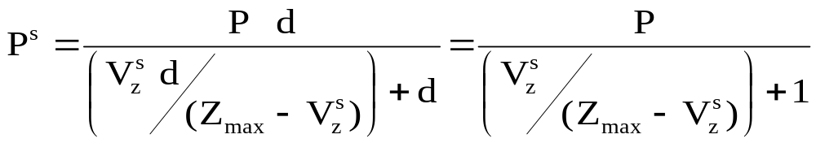
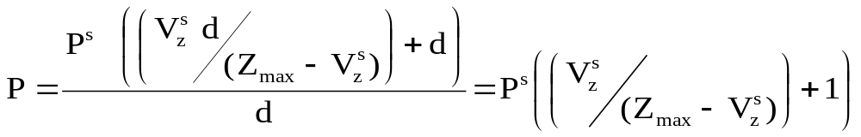
Interpolation Using Screen Z
If we plug in Eq. 4 for Vz in equation 5, we get
(7)
and (6) becomes
(8)
In both cases the d’s cancel so in fact, d is not needed
Note that Zmax is needed, but it is constant and known
We use (7) and (8) as transformations between image and screen space to interpolate any parameter P to any pixel using screen-space z-values, which we know everywhere

Slide 12
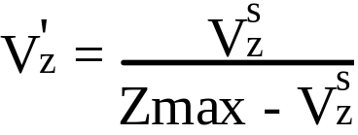
P Interpolation Simplified
Create a new term V′z based on screen space Z interpolated during rendering for z-buffer use
(9)
Then we use (9) in (7) to transform parameter into perspective space before interpolation
(10)
and in (8) to transform interpolated parameters back to affine space after interpolation
(11)
P^{s} = P / (V'_{z} + 1)
P = P^{s} (V'_{z} + 1)

Slide 13
Summary
By using (9), (10), and (11) we perform perspective-corrected interpolation for any affine-space parameter
  without dealing with d and only using screen-z values already computed for z-buffer use
Note that V_{z}^{s} , (screen space Z) is needed (in 9) at each point where transformations are done in or out of perspective space
  We know it at vertices and we compute
  interpolated V_{z}^{s} (screen-space z values)
  at each pixel for z-buffer tests

Slide 14

HW5 texture procedure
The procedure for texture u,v coordinate interpolation needed for HW5 is :
  1. Use (9) and (10) for each vertex u,v to transform them to perspective space U,V (use V_{z}^{s} at each vertex)
  2. Interpolate transformed U,V components (like Z)
  3. At each visible pixel in triangle (after Z-buffer test) use interpolated V_{z}^{s} in (9) and (11) to transform interpolated U,V back to affine space u,v values
  4. Compute texture color = f(u,v) and evaluate shading equation
1
u,v → U,V
3
U,V → u,v
Texture and shading
4
2
U,V
1
u,v → U,V
1
u,v → U,V

