Slide 1
Retail Reapers Stephanie Thurstone & Tanya Adams Project IV

Slide 2

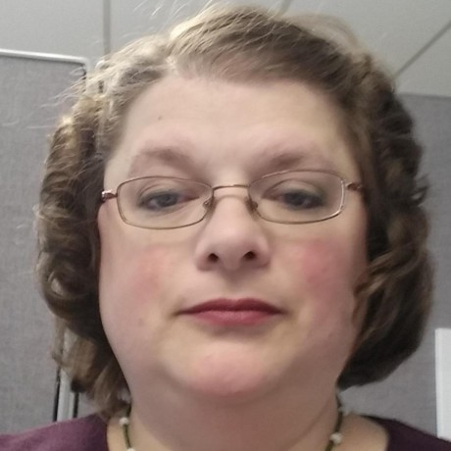
Team Presentation
Stephanie Thurstone
Tanya Adams

Slide 3

Table of Contents
Motivation & Summary
Introduction to Dashboard & ML Models
Demonstration
Discussion
Post Mortem

Slide 4

Motivation & Summary
In-person shopping has taken a back seat to Ecommerce sales in recent years which leads many to wonder, is Brick and Mortar a dying breed? Will all shopping eventually be Ecommerce or automated, self-serve stores? Tracking sales trends of one of the largest corporations in America, Walmart, will help us in determining our theory.

Slide 5
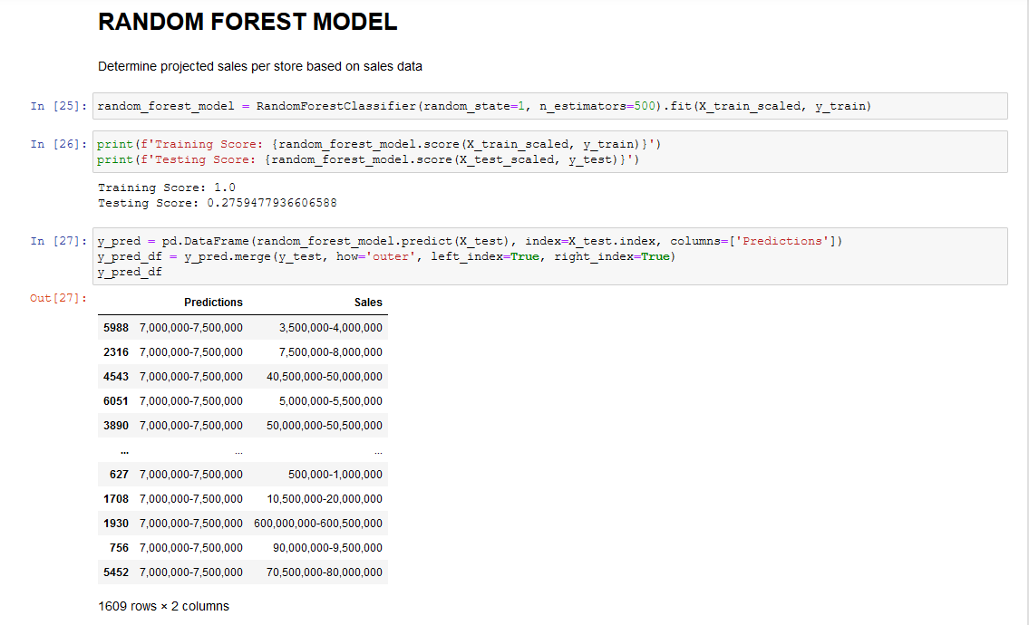
Machine Learning Models
In 2021, Walmart U.S. had eCommerce sales amounting to 43 billion U.S. dollars, an increase of over 70 percent in comparison to 2020's figure according to Statista which is only about 10-15% of their net sales of $393.25 billion.
Public data for Big Box stores is extremely hard to get – so the data we obtained for Walmart is demonstrating sales from 2010-2012 however, you can see in the model the predictions are all significantly increasing the sales income.

Slide 6
Machine Learning Continued
Random Forest
Logistic Regression
Linear Regression
Training Score: 1.0
Testing Score: 0.2759477936606588
This is not a great model – not enough data to be very accurate.
Training Data Score: 0.6469125569830088 Testing Data Score: 0.6712243629583592
This is more accurate than Random Forest Model but still in need of more/better data.
Mean squared error (MSE): 11.933040779746149
R-squared (R2 ): 0.903603363418708
Model Score: 0.903603363418708
This probably would have been the most accurate model to have further investigated.

Slide 7
Post Mortem
Machine Learning is not for the faint of heart it is HARD – we did not come to conclusion to our hypothesis from ML however, based on research outside of Machine Learning I was able to determine that Walmart seems to do better
Think small before you go big
Big companies don’t want competition accessing their data

Slide 8
Goodbye, Class of March 2022
Thank you to Ashish & Hector for going above and beyond to teach us so much in such a short amount of time. It has truly been a pleasure.
Questions? ……

