Slide 1
Hermes github.com/sti-uff
Daniel Castellani

Slide 2
Agenda
Architecture
Frameworks
How it Works
Testing and Continuous Integration

Slide 3
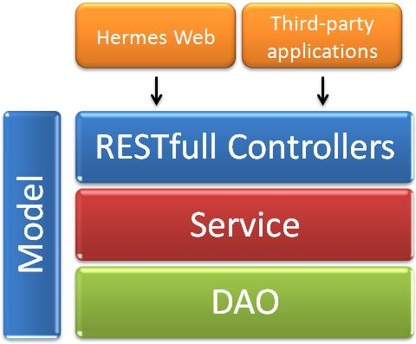

Architecture
Design Patterns
MVC
Service Layer :Business Rules
DAO
RESTfull Controllers
Service
DAO
Jobs
Model

Slide 4
Frameworks - App
Java :Main Programming Language
Maven :Build Management System
JavaMail :Mail Sending
Spring :IOC, Datasource
JAX-RS – Jersey :Provide API Web Services
Flyway :Database Migration
Quartz :Schedulled Tasks
Log4j :Logging
JDBC :Access Database
Swagger :API Documentation
MySQL :Database
Jetty, Tomcat :Web Servers
Client Side
HTML + CSS + JQuery
AngularJS :MVVM Framework

Slide 5
Frameworks - Testing
JUnit :XUnit Tests
Mockito :Test Double
Selenium :User Tests
RestAssured :Test APIs, HTTP
Flyway-test :Test Database preparation
Jetty :Web Server
MySQL :Database

Slide 6
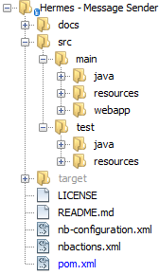
Structure
Maven
Documentation :this file
Source Code
App Sources
Test Sources
Main File

Slide 7
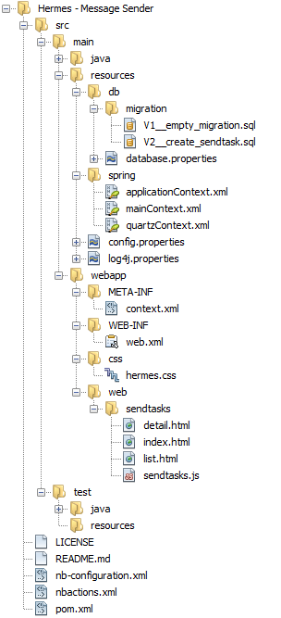
Structure
Java Classes
App resources
Maven
Java Test Classes
Test resources
Project Configuration

Slide 8
Structure
Java Classes
App resources
Flyway Configuration
Flyway Migrations
Maven
Flyway
Flyway Database Configuration
Java Test Classes
Test resources
Project Configuration

Slide 9
Structure
Java Classes
App resources
Flyway Configuration
Flyway Migrations
Maven
Flyway
Spring
Flyway Database Configuration
Spring Configuration
Spring Context Configuration
Java Test Classes
Test resources
Project Configuration

Slide 10
Structure
Java Classes
App resources
Flyway Configuration
Flyway Migrations
Maven
Flyway
Spring
Quartz
Flyway Database Configuration
Spring Configuration
Spring Context Configuration
Quartz + Spring Configuration
Java Test Classes
Test resources
Project Configuration

Slide 11
Structure
Java Classes
App resources
Flyway Configuration
Flyway Migrations
Maven
Flyway
Spring
Quartz
Log4j
Flyway Database Configuration
Spring Configuration
Spring Context Configuration
Quartz + Spring Configuration
Log4j Configuration
Java Test Classes
Test resources
Project Configuration

Slide 12
Structure
Java Classes
App resources
Flyway Configuration
Flyway Migrations
Maven
Flyway
Spring
Quartz
Log4j
Hermes
Config
Flyway Database Configuration
Spring Configuration
Spring Context Configuration
Quartz + Spring Configuration
Hermes Configuration
Log4j Configuration
Java Test Classes
Test resources
Project Configuration

Slide 13
Structure
Java Classes
App resources
Flyway Configuration
Flyway Migrations
Maven
Flyway
Spring
Quartz
Log4j
Hermes
Config
Web App Files
Flyway Database Configuration
Spring Configuration
Spring Context Configuration
Quartz + Spring Configuration
Hermes Configuration
Log4j Configuration
Hermes Web
Web App Configuration
Client Side: HTML + JS :Angular
Java Test Classes
Test resources
Project Configuration

Slide 14
Structure
Java Classes
App Resources
Flyway
Flyway Migrations
Maven
Flyway
Spring
Quartz
Log4j
Hermes
Config
Web App Files
Flyway Database
Spring Context
Quartz + Spring
Hermes Configuration
Log4j
Hermes Web
WAR Configuration
Client Side: HTML + JS :Angular
Test Classes
Test resources
License Information
Github welcome file
Netbeans
Maven Configuration

Slide 15
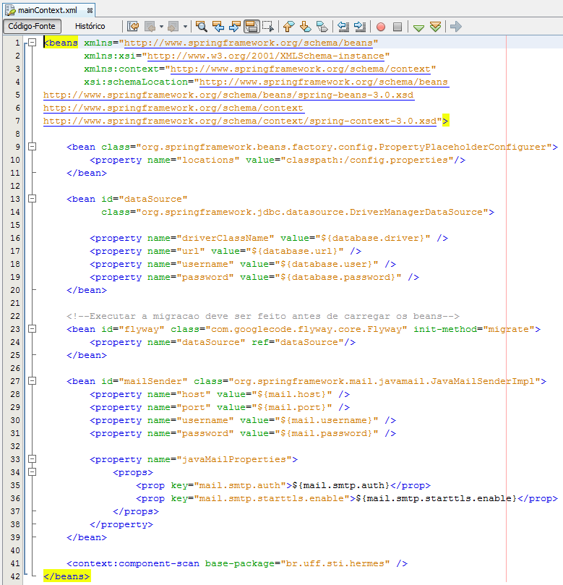

Hermes Configuration - Spring
config.properties
All Hermes Configuration
datasource
Flyway + Spring Integration
Run Flyway Automatically
JavaMail Configuration

Slide 16
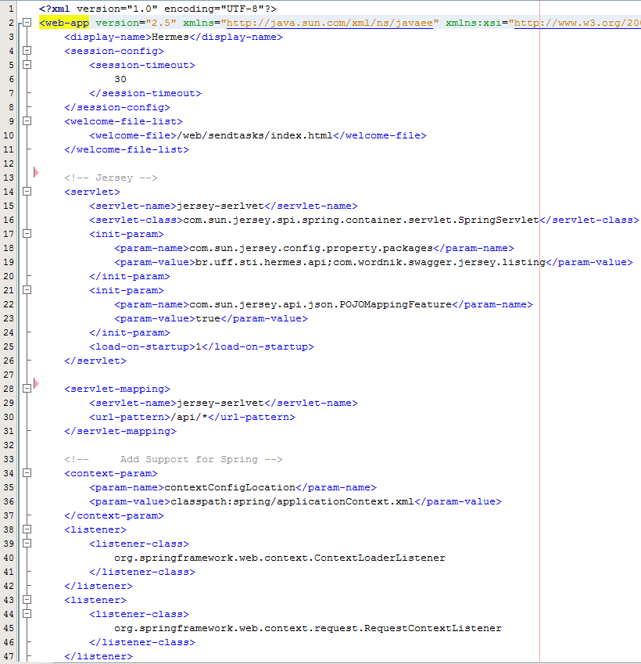
Hermes Configuration – web.xml
Welcome file
Jersey Servlet
Jersey + Spring Integration
Hermes API + Swagger
Jackson (JSON convertion)
Jersey Servlet maps to /api/*
Spring Context Configuration

Slide 17
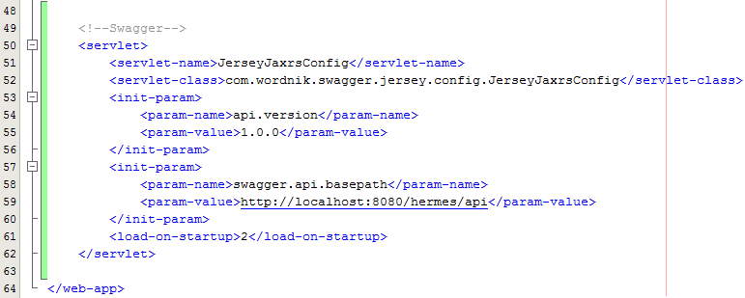
Hermes Configuration – web.xml (2)
Swagger Configuration

