Slide 1

One Prediction, Three Voices
Designing AI That Explains Itself Differently to Different People
Maitreya Sapariya • COG1, JYU Summer School • Aug 2026

Slide 2
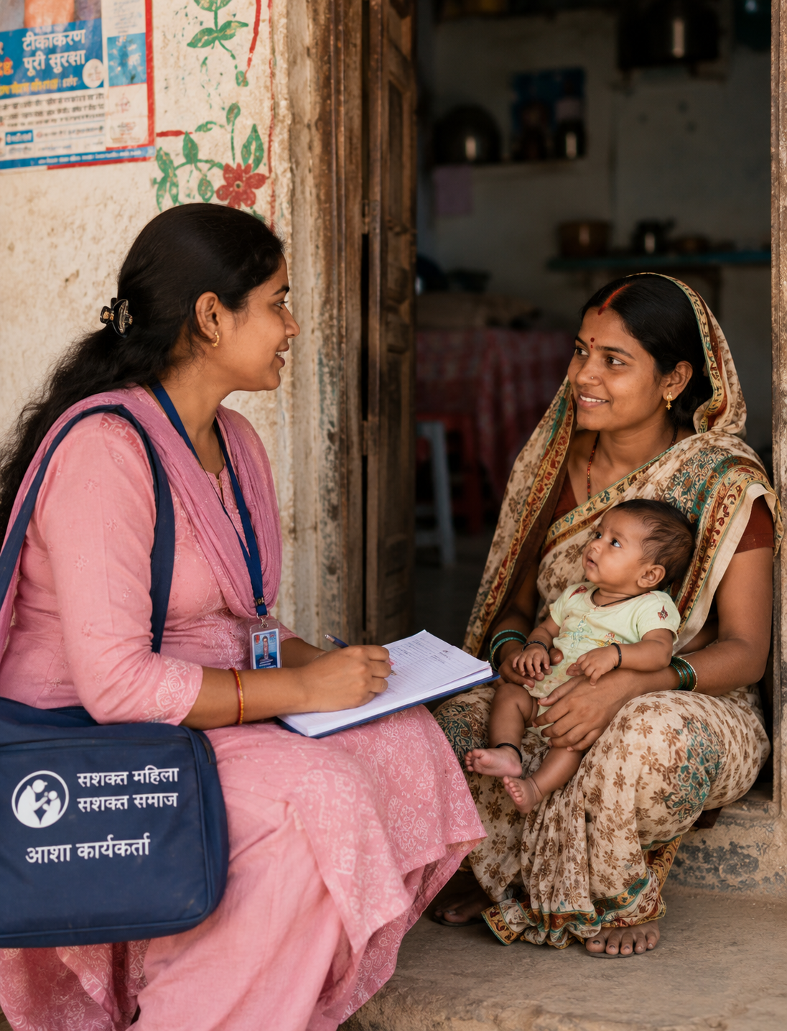
Every day, a health worker walks
into a home she already knows.
[ Photo: an ASHA worker visiting a home in rural India, warm and candid, not staged ]
Full-bleed right panel
5.73in W x 7.50in H
Long before any algorithm enters the picture, trust already has.

Slide 3

260,000
~2 min
women die from pregnancy-related causes worldwide, every year.
roughly the gap between each of these deaths, somewhere in the world
Source: WHO / UN Maternal Mortality Estimation Inter-Agency Group, 2025 (reference year 2023)

Slide 4
Maternal deaths per 100,000 births
Global average
197
97
India
97
maternal deaths per 100,000 births in India, the country's own official figure.
And a real share of these deaths trace back to one cause we can catch early: high blood pressure during pregnancy.
Source: Registrar General of India, SRS Special Bulletin on Maternal Mortality, 2022 (reference period 2018–20)

Slide 5

1.05 million
~1 per 1,000
ASHA community health workers stand between rural India and its public health system.
people, the average reach of a single ASHA worker
They counsel mothers-to-be, escort them to care, and are usually the very first person to notice something is wrong.
Source: National Health Mission Management Information System, as on 30 September 2024

Slide 6
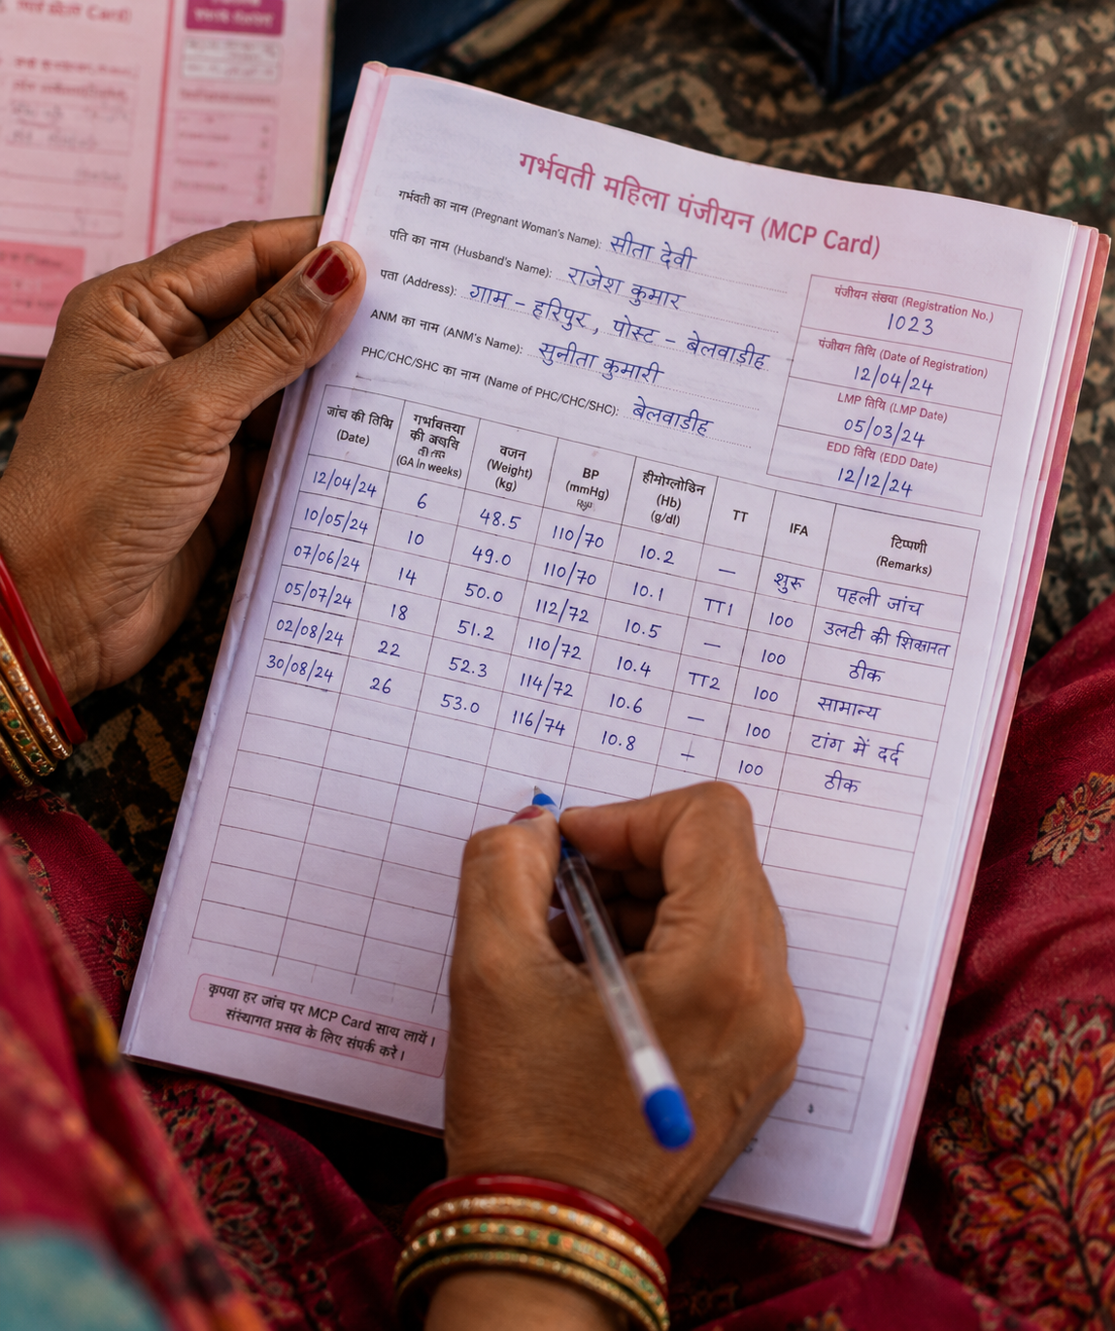
Her workload, before any
new technology arrives
30–40
home visits, every single day
[ Photo: close-up of a hand-written health register / MCP card ]
4.43in W x 5.30in H
25–30
paper and digital registers, filled by hand
Source: Pandey & Zheng, Information Systems Journal, 2023

Slide 7

A smarter model, dropped onto an already overloaded system, doesn't help anyone.
It has to work for the person actually carrying it.

Slide 8


One Prediction. Three Voices.
Doctor
full detail
ASHA Worker
lighter load
AI Risk
Prediction
Mother-to-be
Solve for one, extend to many: the same design idea behind curb cuts and captions.
spoken, in her language

Slide 9
For the doctor: every detail that matters
Doctor
full detail
ASHA Worker
lighter load
AI Risk
Prediction
Full clinical detail, presented the way a medical decision actually needs it.
Mother-to-be
spoken, in her language
Notes:
If running short on time, this slide and the next two can be compressed into a single spoken pass over the flow diagram from the previous slide.

Slide 10
For the ASHA worker: something that helps, not adds
Doctor
full detail
ASHA Worker
lighter load
AI Risk
Prediction
Designed to lighten her documentation load, not become one more register to fill.
Mother-to-be
spoken, in her language

Slide 11
For the mother-to-be: spoken, not written
Doctor
full detail
ASHA Worker
lighter load
AI Risk
Prediction
A voice she can understand immediately, when reading isn't the easiest way in.
Mother-to-be
spoken, in her language

Slide 12
Why Three Voices?
Three different affordances, matched to three different needs.
Doctor
ASHA Worker
Mother-to-be
needs precision
needs speed
needs understanding
↓
↓
↓
Dashboard
Simplified workflow
Voice
Inclusive design means adapting the explanation to the person, not expecting the person to adapt to the explanation.

Slide 13

It isn't about her eyes, or her ears.
It's about confidence with technology itself.
Accessibility isn't always sensory. Sometimes the biggest barrier is digital literacy.
Source: National Statistical Office, India. Basic digital literacy: around 20% nationally, near 40% even among 15-29 year olds.

Slide 14

One sense can carry what
another usually shows.
That is the affordance behind the voice layer: sound standing in for sight.
A real research question: when an AI converts a complex visual explanation into spoken guidance, is it performing sensory substitution, cognitive accessibility, or both?

Slide 15
Where this actually stands today
The design is set.
The testing comes next.
Design
Testing
This talk is the first step. The written report goes further.
And it points to something bigger: AI that decides not just what to say, but how to say it, depending on who's listening.

Slide 16
What informed this design?
Gaver, “Technology Affordances,” CHI ’91
the theory that lets voice carry what sight normally shows
WHO World Reports on Vision (2019) and Hearing (2021)
the real scale of accessibility need this design has to hold
Scott et al., BMJ Open, 2022
the ASHA workflow lesson that shaped the ASHA tier
Kilkari trial, BMJ Global Health, 2022
the reminder that voice alone isn't automatically enough

Slide 17
One prediction. Three voices.
One chance to get it right.
Thank you.
Prepared By: Maitreya Sapariya
Email: maitreyasapariya@gmail.com

