Slide 1
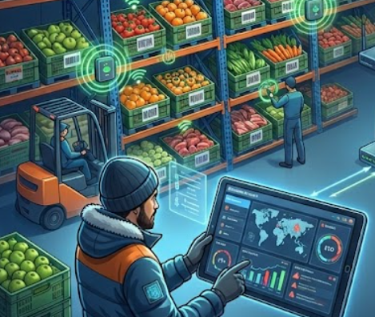
SMART COLD STORAGE MONITORING AND SPOILAGE PREDICTION
TEAM 9
Members:
Rahul S 2362355
Elna Benny 2360366
Stia Rose 2362370
Shyam Suresh 2362338

Slide 2
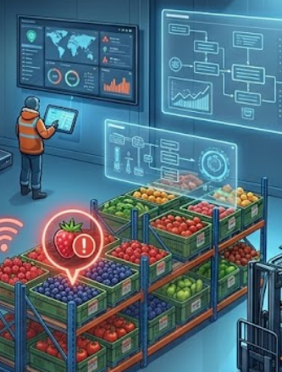
PROBLEM STATEMENT
Cold storage systems often face fluctuations in temperature, humidity, and gas levels due to environmental changes and operational factors, leading to unnoticed spoilage of perishable goods. Traditional monitoring methods lack real-time tracking, gas detection, and predictive capabilities.
There is a need for a smart IoT and AI-based system that uses temperature, humidity, and gas sensors to continuously monitor conditions, detect early signs of spoilage, and provide real-time alerts to reduce losses and ensure product quality.

Slide 3

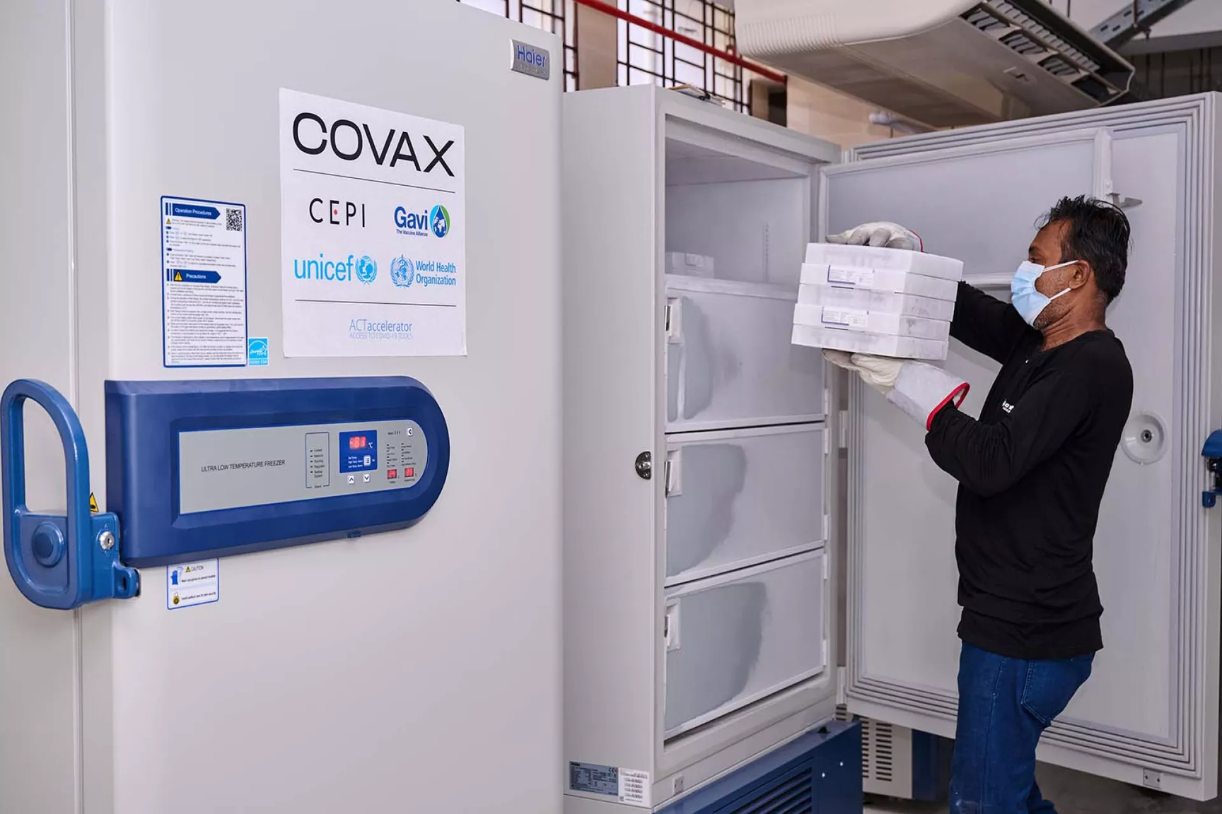
VACCINE STORAGE DURING COVID - 19 IN INDIA

Slide 4
LITERATURE REVIEW
“Remote Monitoring System for Cold Storage using IoT” (2020)
This paper proposes an IoT-based system using temperature and humidity sensors to monitor cold storage conditions in real time. It reduces manual effort and improves storage efficiency through continuous monitoring.
“Food Spoilage Detection Monitoring and Alerting System” (2024)
This study integrates gas sensors along with temperature and humidity sensors to detect early spoilage conditions. It emphasizes that gas emission is a key indicator of food degradation and enables early alerts.
“IoT-Enabled Electronic Nose System for Food Quality Monitoring”
This research uses multiple gas sensors (such as ammonia and CO₂) to detect spoilage. The system shows that combining gas data with environmental factors improves accuracy in identifying food quality changes.
“IntelliStore: IoT and AI-based Intelligent Storage Monitoring System”
This paper combines IoT sensors with machine learning algorithms to predict spoilage risk. It highlights the importance of predictive analytics and real-time dashboards for better decision-making.
“Real-Time Anomaly Detection in Cold Chain Systems”
This study focuses on identifying abnormal conditions like sudden temperature rise and triggering alerts. It shows that early detection can significantly reduce food losses during storage and transportation.

Slide 5
OBJECTIVES
01
Monitor temperature, humidity, gas levels, and door status in cold storage
02
Analyze environmental trends over time
03
Predict spoilage risk using data insights
04
Generate alerts for unsafe conditions (temperature rise, gas leak, door open)
05
Improve decision-making and reduce losses
06
Develop an interactive dashboard using Microsoft Power BI

Slide 6
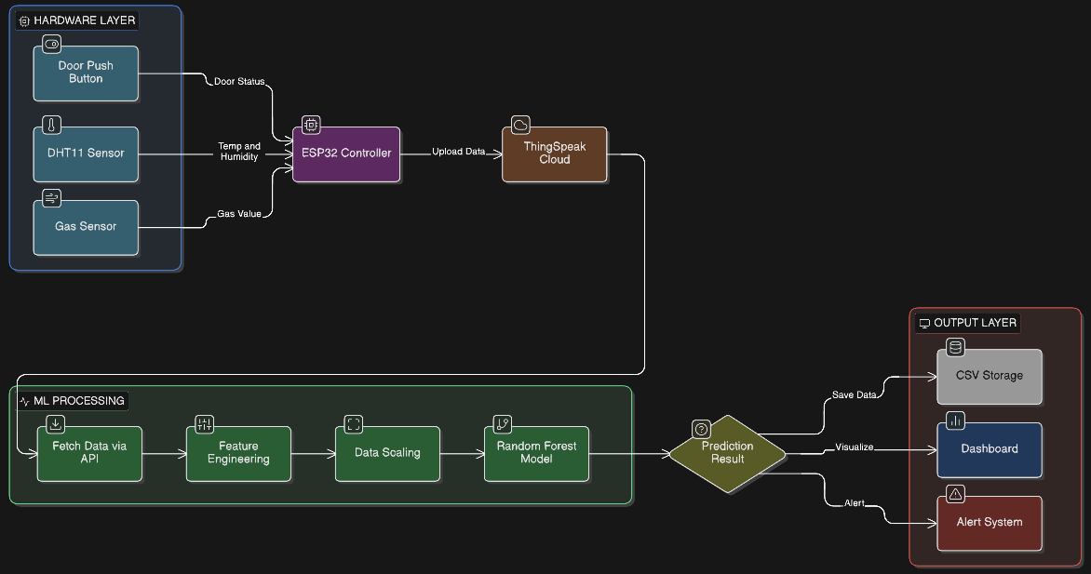
SYSTEM ARCHITECTURE DESIGN

Slide 7
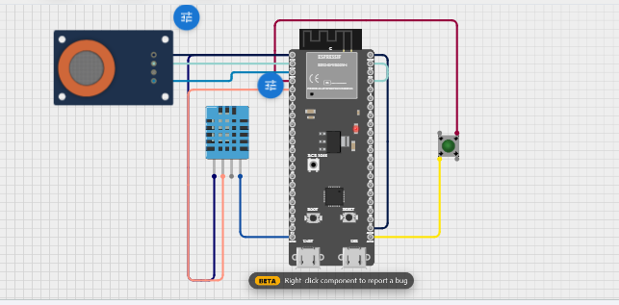
ARCHITECTURE SYSTEM

Slide 8
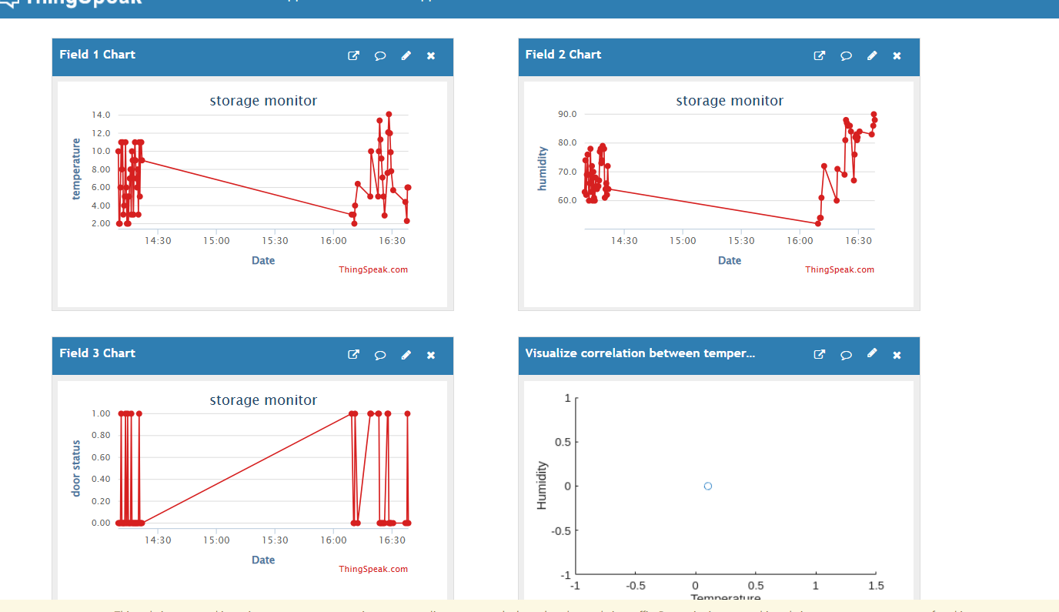
LIVE CLOUD DATA

Slide 9
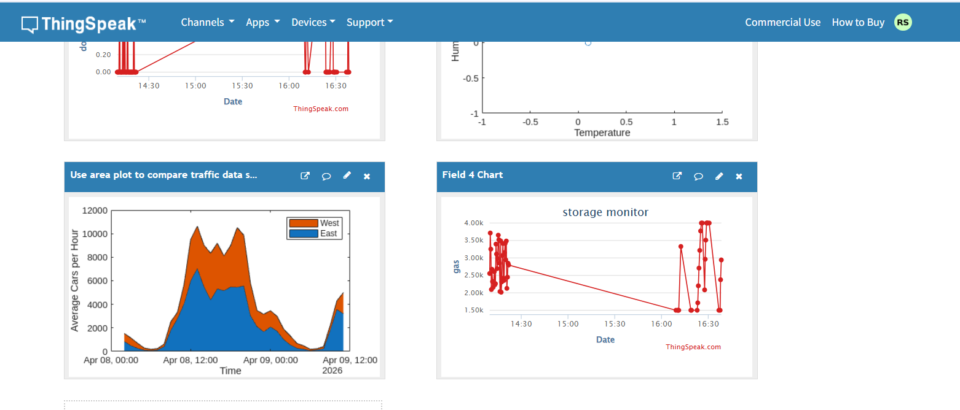
LIVE CLOUD DATA

Slide 10
COMPONENTS
Controls and processes all sensor data
Measures temperature and humidity
Detects harmful gases
DHT11 Sensor
Gas Sensor (MQ series)
ESP32 Microcontroller
Represents door open/close status
Enable communication between components
Push Button
Connecting Wires

Slide 11
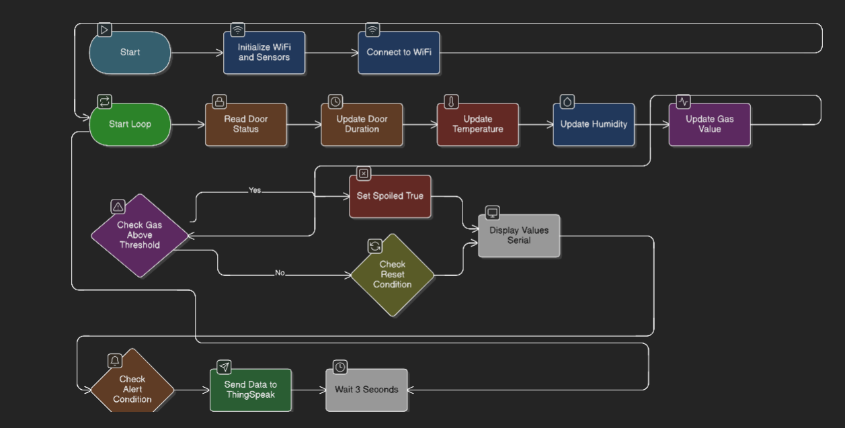
FLOW DIAGRAM

Slide 12
The dataset contains 10 key features representing cold storage conditions:
DATASET GENERATION AND ML MODEL
Timestamp – Date & time of observation
Temperature – Internal temperature (°C)
Humidity – Relative humidity (%)
Door – Open (1) / Closed (0)
Door_Duration – Time the door remains open
Cooling_Status – Cooling ON (1) / OFF (0)
Outside_Temperature – External temperature
Temp_Trend – Increasing / Decreasing / Stable
Load_Level – Storage load (Low/Medium/High)
Risk (Target) – 0: No Spoilage, 1: Spoilage

Slide 13
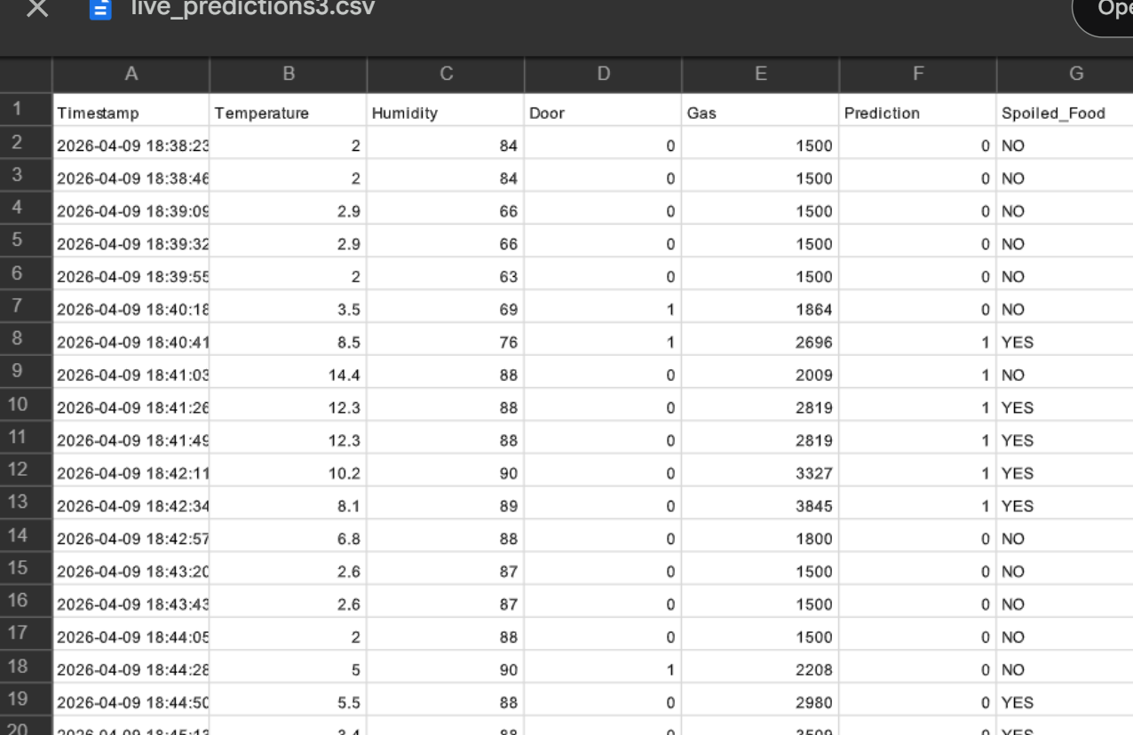
DATASET

Slide 14
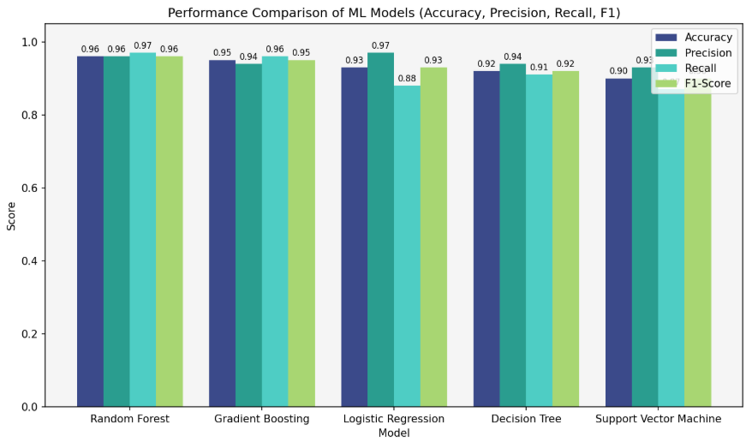
ML MODELS

Slide 15
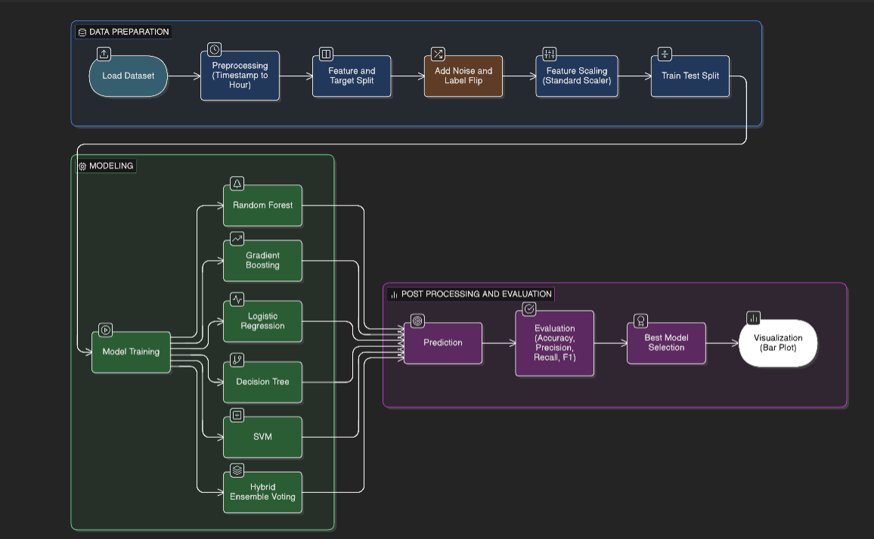
FLOW DIAGRAM

Slide 16
LIVE DATASET GENERATION
Dataset Details
Total Records: 101 entries
Total Columns: 7 parameters
Data Type: Time-series (live streaming data)
Attributes
Timestamp - Date and time when data is recorded
Temperature - Measures temperature values (°C)
Humidity - Measures moisture level in the environment (%)
Door - Indicates door status (Open/Closed or 0/1)
Gas - Gas sensor reading (used for leakage detection)
Prediction - Output from the model (0 or 1) , 0 = Normal , 1 = Alert condition
Spoiled_Food - Final status , YES = Food spoiled , NO = Safe

Slide 17
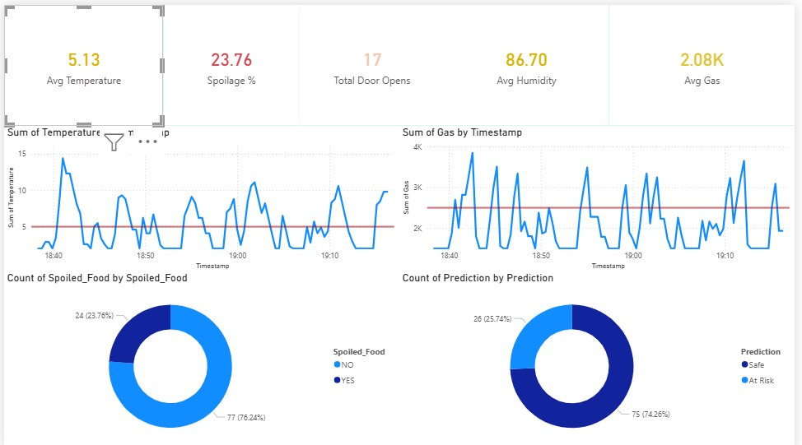
POWERBI DASHBOARD

Slide 18
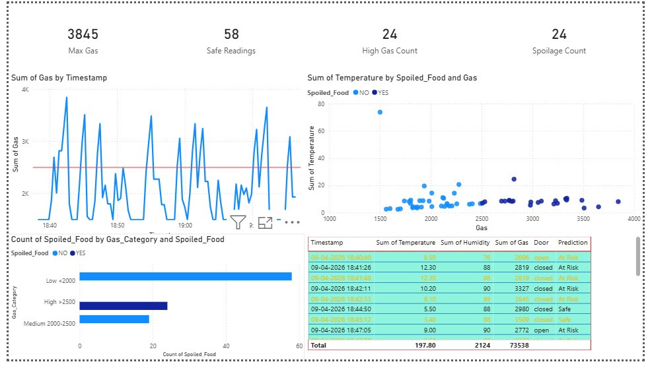
POWERBI DASHBOARD

Slide 19
POWERBI DASHBOARD
1
Tracks gas, temperature, humidity, and door activity in real time
2
Highlights high gas levels and potential spoilage risks
3
Shows trends to identify unusual spikes and unsafe conditions
4
23.76% spoilage rate with most readings still marked safe
5
Uses predictions (Safe / At Risk) to support early action

Slide 20
THANK YOU

