Slide 1


On the Care and Feeding of Codebases: BrainGrid past, present, and future
University of Washington, Bothell
CSS 497
Ethan Crawford
June 4, 2010

Slide 2

BrainGrid
Simulation of ex-vivo cortical tissue
Formal spiking neuron model (Leaky Integrate and Fire) used to model neuron behavior
Regular 10x10 neuron arrangement
Runs at 100x “real-world” speed
Models neuron growth and spiking
Notes:
Real-world experiments demonstrate pathological bursting

Slide 3
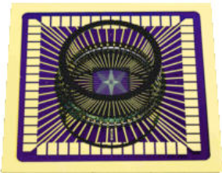
Ex-vivo Cortical Tissue
Cultures of rat embryo cortical neurons grown on multi-electrode arrays

Slide 4
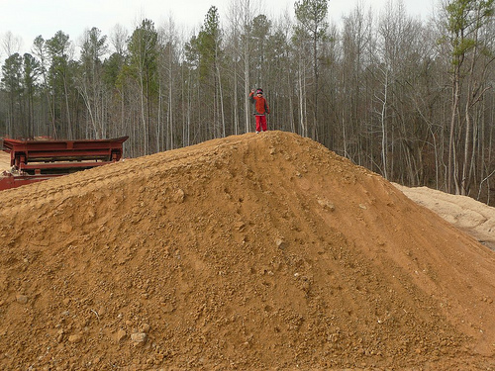
Limitations
10x10 grid takes 6-8 hours for 300 cycle simulation on a single CPU
100x100 grid could take more than a month of continuous processing
New approaches needed

Slide 5

History
4 versions
CSIM, hybrid, rewrite, refactored
3 approaches
Single-threaded
OpenMP multi-threaded
UWAgent distributed
2 separate codebases
1 new opportunity
NVIDIA GPGPU (Tesla C1060)
Notes:
The original version was based on a multi-purpose simulator (CSIM), customized for specific neuron types and included C functions that re-implemented Matlab functionality. Later versions removed dependencies on CSIM, re-wrote random number generation to retrieve a more normalized set of values, and added multi-threaded features for parallelizable blocks.
In the beginning, a single thread was used to run the entire simulator. Later, the OpenMP threading library was used to parallelize portions of the simulation. In 2008, some investigation was done towards a distributed version using UWAgent service host technology.
Between 2008 and 2009, CSIM library functions were removed and replaced with native C++ functions. The behavior of the simulator changed slightly during the rewrite.
Recently, the UWB acquired an NVIDIA Tesla C1060 GPGPU (general-purpose GPU). This multiprocessor allows up to 30,000 simultaneous threads to perform floating point operations. This new opportunity should enable the simulation to resolve the single-threaded performance bottleneck.

Slide 6

Philosophy
Software is a research tool
Focus on results, not absolute code quality
Research is long-term, student contributions are short-term; smooth hand-offs are important for efficiency
Code must be flexible enough to survive technology changes

Slide 7

Maintainability
Multiple simultaneous contributions should be possible
Learning the code should be easy
Changing approaches should be simple
Failure diagnosis should be straightforward

Slide 8
Previous design
Notes:
In the beginning, and elegant and sufficient design
Later, maintainability became difficult. The Network class grew in size.
Added code lumped together implementation-specific code with implementation-agnostic simulation steps.
Lots of duplicate code with only minor changes, requiring all bug fixes to be made in multiple places.
Parameters were passed individually, requiring one change per implementation-specific prototype when adding functionality.
Harder for multiple people to work on separate features with all code in the same file.
Network would only grow more unwieldy with future features.
Another layer of abstraction was needed.

Slide 9
Refactored design
Notes:
Move parameter list into SimulationInfo struct
Create ISimulation interface (abstract class) to hold implementation specifics
Create classes that implement ISimulation in their own way
Use polymorphism to run-time instantiate correct implementation
Hide implementation-specific structs
Hides implementation, enables multi-user contributions, and eases future feature additions

Slide 10
Interfaces
Many different implementations
Isolate immutable logic from implementation specifics
Supported in C++ with pure virtual methods ( = 0;)
#include "SimulationInfo.h"
class ISimulation
{
public:
virtual ~ISimulation() {}
virtual void advanceUntilGrowth(SimulationInfo* psi) = 0;
};

Slide 11

Revision Control
A
Enlist, make changes, check in
Multiple users can work in the same file and merge changes at check-in time
Server-side repository containing full change history – changes can be tracked and backed out
Linux, Mac, and Windows clients
Maintained on University biocomp research server

Slide 12
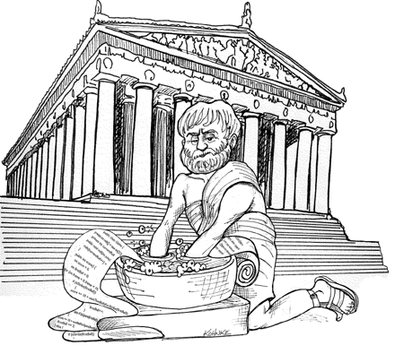
Clean code
Informative comments
Semantic consistency
Stylistic consistency
m_ prefix for class members
g_ prefix for globals
‘p’ prefix for pointers
Parameter passing
Use struct containers when many parameters are needed

Slide 13

Validate functionality
Enhance reproducibility
Add fixed layout support
Increase maintainability
Improve documentation
Evaluate single vs. double-precision

Slide 14

Comparing Versions
Input file format is identical, so side-by-side comparisons are possible
600 growth cycles
Only 2% inhibitory neurons (bursting expected)
4 versions analyzed (2007, 2008, 2009, 2010)
Interesting differences from identical inputs

Slide 15
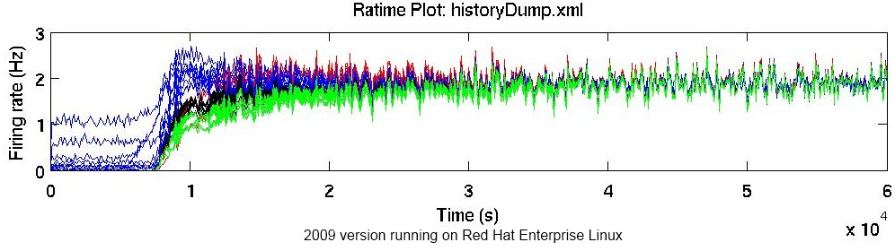
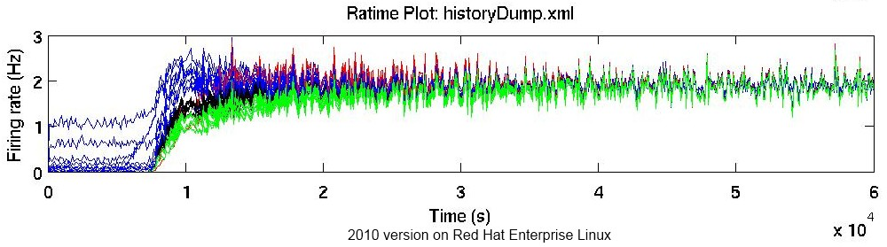
Refactoring Goal: First, Do No Harm
Notes:
We don’t yet know the reasons for the functionality differences between 2008 and 2009, but we have at least confirmed that no substantial behavioral differences were introduced in the process of code cleanup

Slide 16

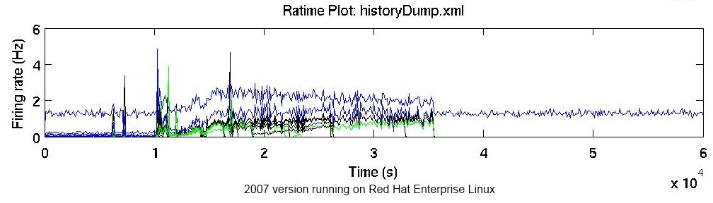
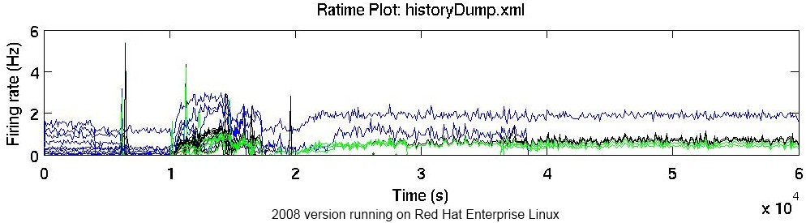
Red Hat Enterprise Linux
Notes:
These charts represent the firing rates of individual neurons over time. Large spikes of many numbers of neurons represent pathological bursting or “epileptic” behavior.
Different behavior for identical parameters over the years
Biggest differences seen between 2008 and 2009 versions, during the rewrite

Slide 17

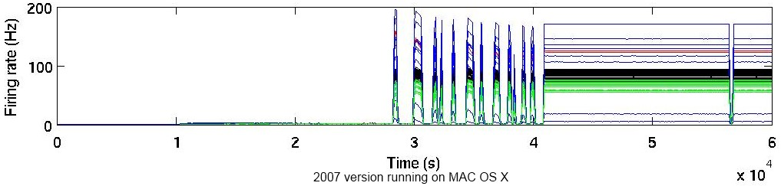
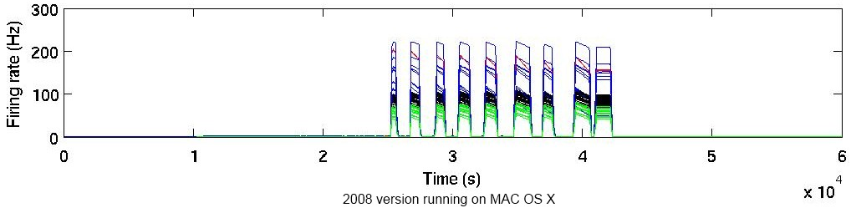
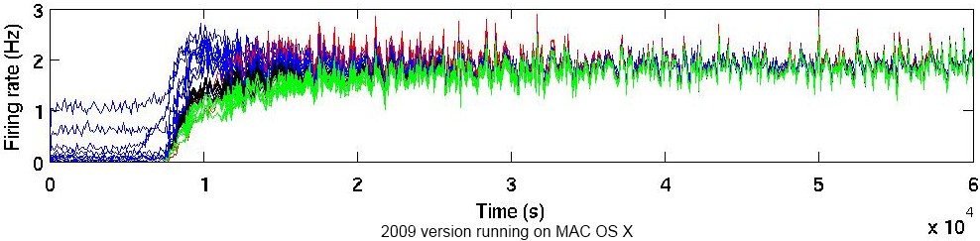
Mac OS X
Notes:
Results on Mac OS more closely resemble expected simulation results with CSIM-related code versions
After 2008 (clean rewrite), OS differences disappear, but so do the expected simulation results.
The reason for such dramatic behavioral differences between operating systems is not currently known.

Slide 18
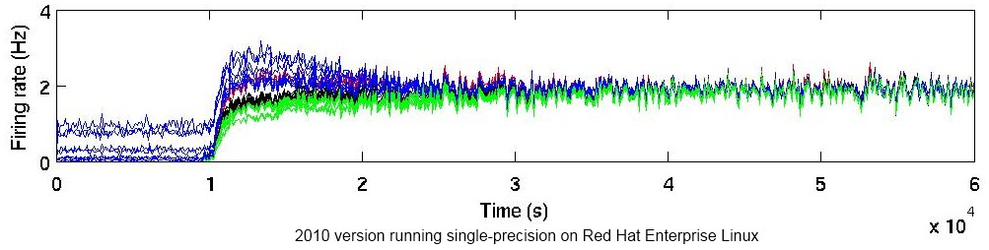
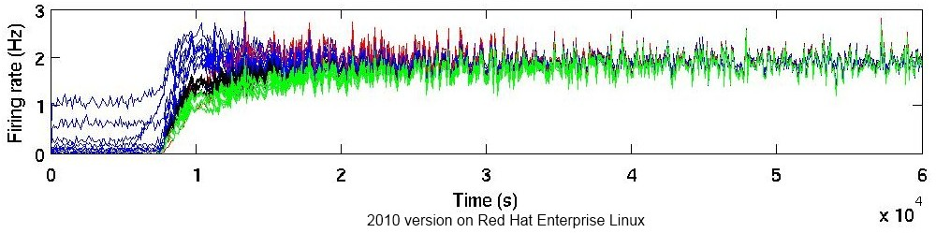
Float vs. Double
Single-precision (float)
Double-precision (double)
Notes:
Single-precision shows slightly different behavior. The firing rate plots move within similar ranges

Slide 19

The Future
Full validation of behavioral correctness
Platform differences
Comparing real-world data to simulation results
Continued features to enhance reproducibility
Random number seeding
Performance
GPGPU with 30,000 simultaneous threads

