Slide 1

Geologically-Weighted Regression for House Price Prediction
Yong Zhao, PhD
Data Analytics Consultant
FI Consulting, INC
04-18-2018

Slide 2
Presentation Outline
Introduction
Methodology
Analysis and Modeling
Model Integration
Summary

Slide 3
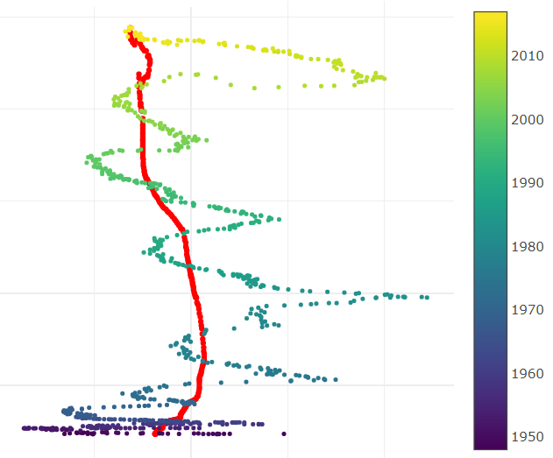
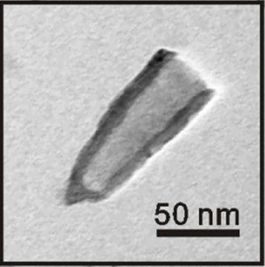




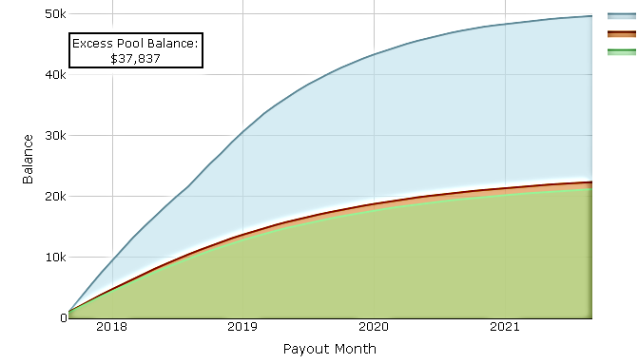
Personal Background
BS, Chemical Physics, University of Science and Technology of China
PhD, Analytical Chemistry, University of Pittsburgh
Associate Scientist, Covestro LLC
Data Analytics Consultant, FI Consulting
Analytics
Statistics
Research
Programming
Statistical analysis
Financial modeling

Slide 4




Why Modeler?
Professional experiences with statistical analysis
Strong background in math and programming
Continuous interest in finance and modeling
Research
Programming
Math/Statistics
Data Analysis
Fast Learning

Slide 5
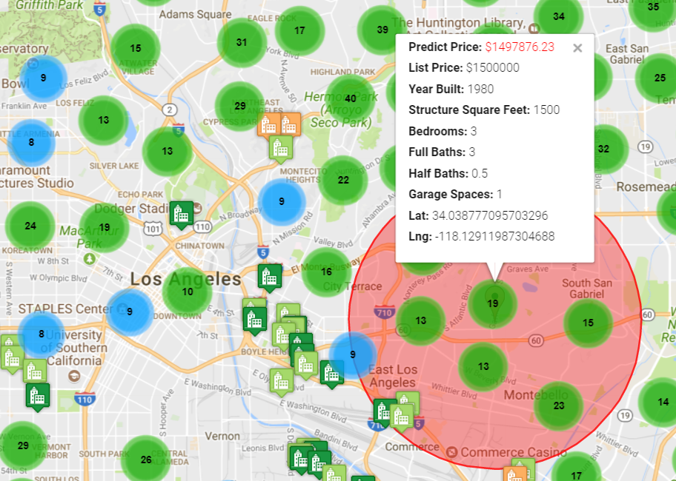

Project Introduction
Goal: Predict House Price on a Interactive Web App
Geographical Information System (GIS) Platform
Geo-coding – Google Map API Services
Geologically Weighted Regression (GWR)
Interactive Web Application
In collaboration with:

Slide 6
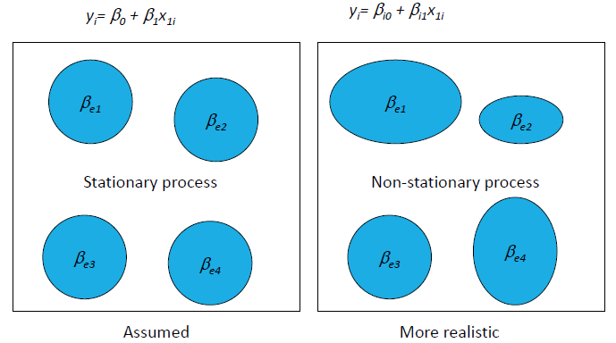
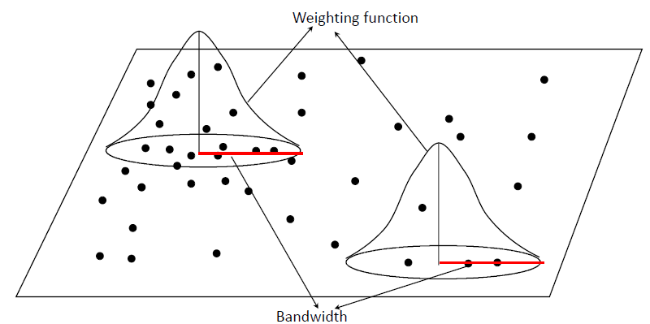
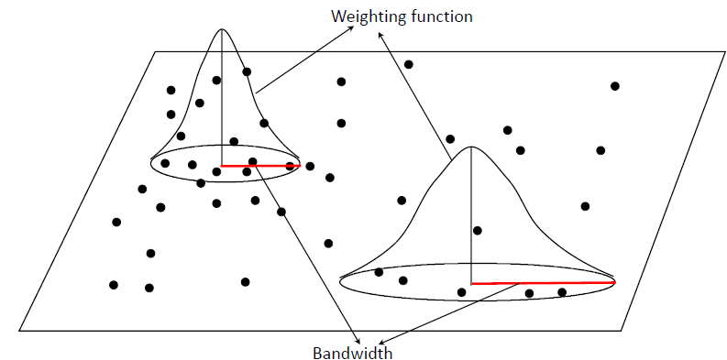
Background – GWR
Fixed Bandwidth
Spatial Stationary
Adaptive Bandwidth
Spatial Nonstationary

Slide 7



Business Objectives
Key Info: MLS/Geo-coding
Building predictive model
Interactive web interface

Slide 8

Data Source
Multiple Listing Service Data
For South California:
20000+ Housing Data, 103 Variables
Google Map API Services
- Geo-coding
- Web-interaction

Slide 9

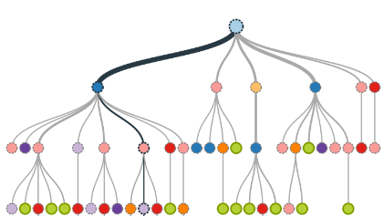





Approach
Data Exploration/
Data Preprocessing
Model Building/
Optimization
Web App Integration/
Product Development
Visualization
Data cleaning
GWR
NearestNeighbor
Cross-validation
Flask framework
Model embedding
Web application

Slide 10
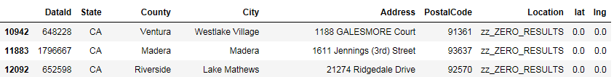
Geo-Coding using Google API
1188 Galesmore Court
(34.149500, -118.83997272)
Package: urllib
serviceurl = 'https://maps.googleapis.com/maps/api/geocode/json?’
url = serviceurl + urllib.parse.urlencode({"address": query, "key": API_key})
uh = urllib.request.urlopen(url, context=scontext)
entry = uh.read()​
js=json.loads(entry)

Slide 11
Exploratory Data Analysis
Extract Regression Features:
Important features are selected for model and app inputs.
Grouped by discrete or continuous variables
(Total 14 independent variables):
Discrete:
'Bedrooms', 'BathsFull', 'BathsHalf', 'GarageSpaces', 'ParkingSpaces', 'NumberUnits', 'StoriesTotal’
Continuous:
'HOAFee', 'StructureSqFt’, 'DOM’, 'YearBuilt’, 'LotSqFt',
'ListPrice’, 'CDOM’, 'SalePrice’
Target: “SalePrice”

Slide 12
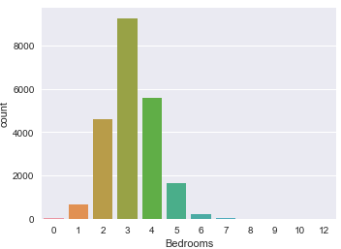
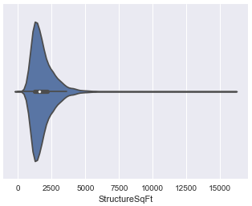
Exploratory Data Analysis
Variable Data Distribution
Remove extreme variables. (0.5% quantiles)
Remove abnormal entries (YearBuilt = 0, GarageSpace = 10000…)

Slide 13
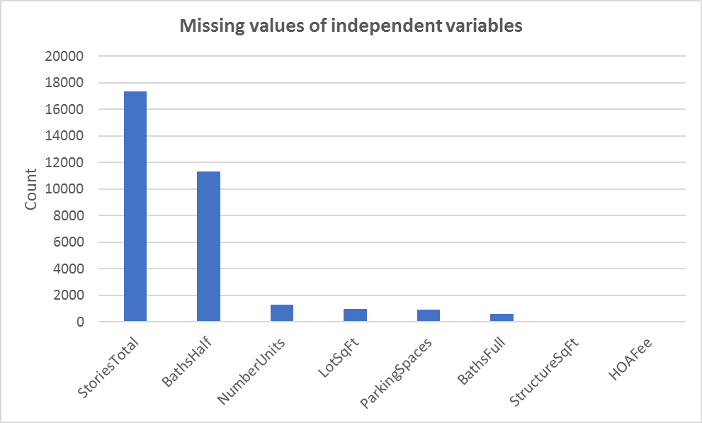
Exploratory Data Analysis
Missing Value Treatment
Independent variables: Mean imputation for missing values.
Dependent variable: Drop missings.
Original Dataset:
22079 × 103
After Data Processing
21825 × 18

Slide 14
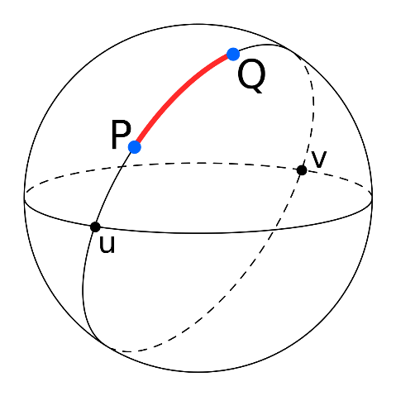

Model Building
Defining of Bandwidth:
k nearest neighbors
Adaptive bandwidth
Calculate distance between two coordinates (Haversine formula)
Find the nearest k points
Determine the bandwidth (h): (distance to the furthest neighbor)
Assign a bisquare weighting function:

Slide 15
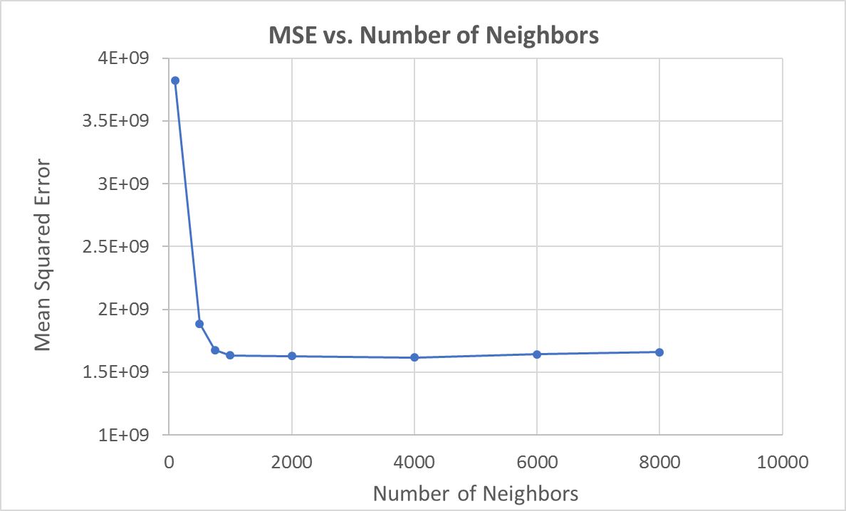
Model Building
Number of Neighbors:
Leave-one-out Cross-validation
Minimizing Mean Squared Errors (MSE)
Find out the optimal number of neighbors
n = 1000, MSE = 1.6 × 10⁹

Slide 16
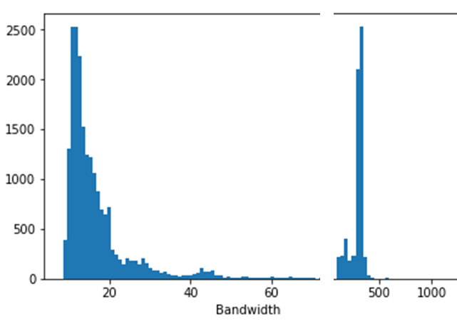
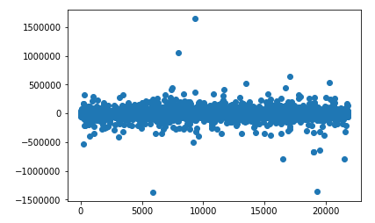
Model Testing
Number of Neighbors: 1000
Leave-one-out Cross-validation MSE: 1.6 × 10⁹
Global Model MSE: 1.7 × 10⁹
Bandwidth
Residual Plot

Slide 17


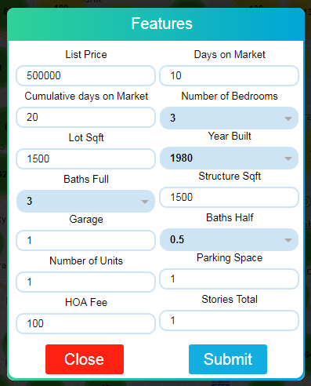
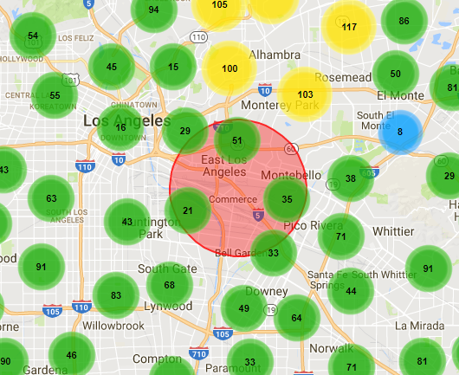
Model Integration

Slide 18
Summary
Global vs Local Models
Model Development
Real-time Web-app Implement
Model Optimization

Slide 19
Thank you!
Yong Zhao
04/18/2018

