Slide 1



Intelligent Personal Investment Consultant For Lending Club
Yong Zhao, PhD

Slide 2
Presentation Outline
Introduction
Data Exploration
Modeling and Analysis
Results
Summary

Slide 3
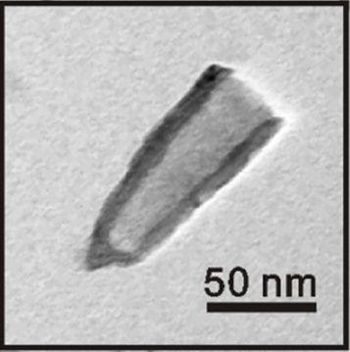






Personal Background
BS, Chemical Physics, University of Science and Technology of China
PhD, Analytical Chemistry, University of Pittsburgh
Associate Scientist, Regional Technical Services, Covestro LLC
Design of experiments
Data processing
Statistical analysis
Analytics
Development
Research

Slide 4




Why Data Science?
Professional experiences with scientific analysis
Interest in statistics and programming
More career opportunities in DC Metro Area
Scientific Research
Programming
Math/Statistics
Data Analysis
Fast Learning

Slide 5
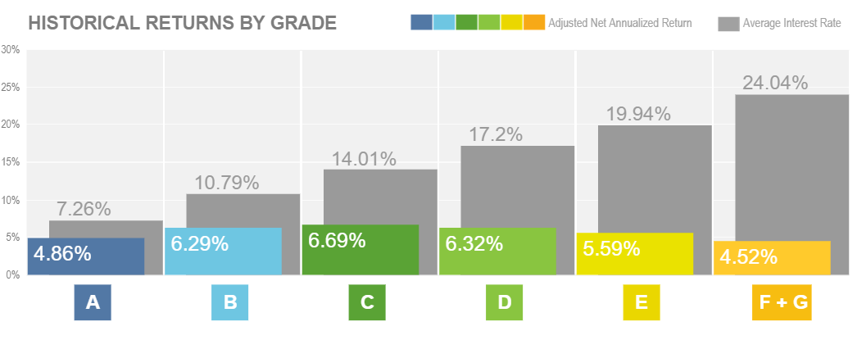
Project Introduction
Lending Club is an on-line P2P lending platform.
Investors benefit from interest payments of loans.
However, loans have risk of default.
Goal: Predict default rate based on loan information

Slide 6



Business Objectives
Key factors leading to default
Building predictive model
Interactive web interface

Slide 7

Data Source
Historical loans (training set)
Source: Loan Data, Year 2014
Rows: 235629, Columns: 128
Target feature: “loan status”
Current loans
Source: real-time API service request
Rows: vary, Columns: 103
r = requests.get(url, headers = headers)
data = r.json()

Slide 8

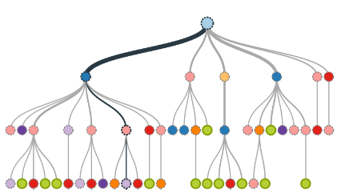





Approach
Data Exploration/
Data Preprocessing
Model Building/
Model Tuning
Web App Integration/
Product Development
Visualization
Data cleaning
Feature engineering
XGBoost
Cross-validation
Auto-tuning
Flask framework
Model embedding
Web application

Slide 9
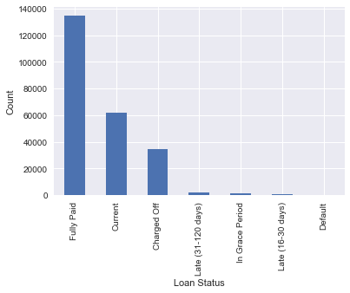
Exploratory Data Analysis
Target feature – Loan Status:
Average Default rate: 20.5%
Fully paid: 0, Charged-off: 1, discard others
Determined

Slide 10
Exploratory Data Analysis
Extract Common Features:
Find the common features in historic and current loans
Process feature names to match between datasets.
Drop null columns in training set.
 | Feat. # | Feat. Name | All Null Cols
Historic | 128 | “loan_amnt” | 31
Current | 103 | “LoanAmount” | 2
Uniformed | 74 | “loanamount” | 0
74 Common features:
16 Categorical,
58 Numerical.

Slide 11
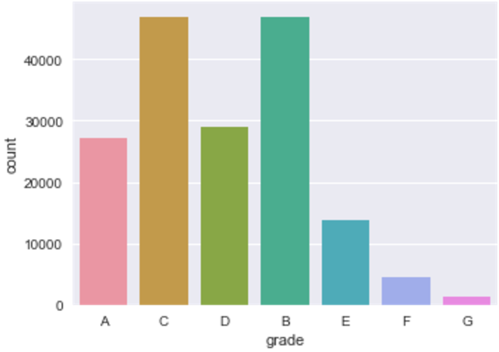
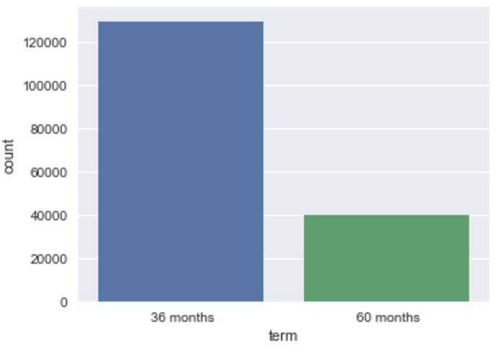
Exploratory Data Analysis
16 Categorical Features:
['addrstate', 'addrzip', 'applicationtype', 'desc', 'earliestcrline’, 'emplength', 'emptitle', 'grade', 'homeownership', 'initialliststatus’, 'intrate', 'isincv’, 'purpose', 'revolutil’, 'subgrade', 'term’]
Grade
Term of Loans

Slide 12
Categorical Features
Type | Name | Definition | Solution
Intrinsically numerical | intrate | Interest rate | Convert to numerical
 | revolutil | Credit line utilization
 | term | Term of loan (36/60)
Date-time | earliestcrline | Date first credit line | Extract new feature: credit history
High cardinality | emptitle | Employment title | NLP and extract new features
 | desc | User comments
 | addrzip | Zipcode | Encoding by frequency rate
 | addrstate | State
Ordinal | grade | Loan risk grade | Label encoding
 | subgrade | Loan risk subgrade
 | emplength | Months employed
Other | applicationtype | Application type | Only one type. Drop the feature.
 | homeownership | Home ownership | One-hot encoding (OHE)
 | initialliststatus | Initial list status
 | purpose | Purpose of loan
 | Isincv | Is income verified?

Slide 13
Exploratory Data Analysis
Feature “desc”:
“I want to borrow…”
“Debt consolidation…”
“I need money for…”
N/A
Solution:
Create “desc_islong”
0 for NA,
1 for short desc,
2 for long desc.
Feature “emptitle”:
“Truck Driver”
“Sales”
“assistant manager”
N/A
Solution:
Create “emptype”
0 for nonmanagerial,
1 for managerial.
-999 for NA

Slide 14
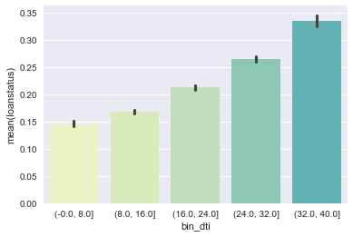
Feature Responses
Debt to Income Ratio
Debt to Income Ratio vs. Default Rate

Slide 15
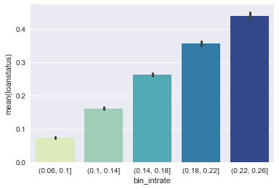
Feature Responses
Interest Rate
Interest Rate vs. Default Rate

Slide 16
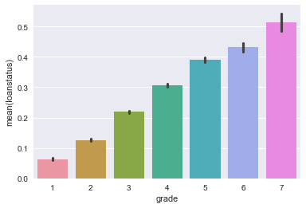
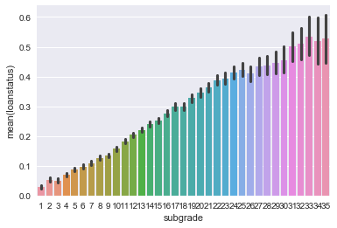
Feature Responses
Grade/Subgrade
Grade vs. Default Rate
Subgrade vs. Default Rate

Slide 17
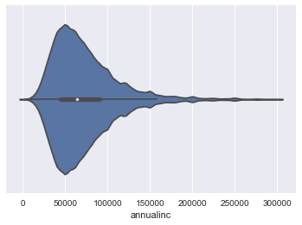
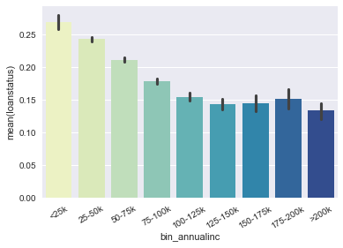
Feature Responses
Annual Income
Annual Income Distribution
Annual Income vs. Default Rate

Slide 18
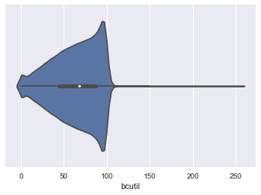
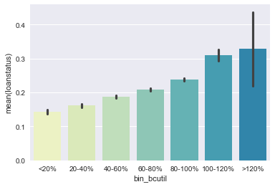
Feature Responses
Portion of Balance to Total Credit Limit
Distribution
vs. Default Rate

Slide 19
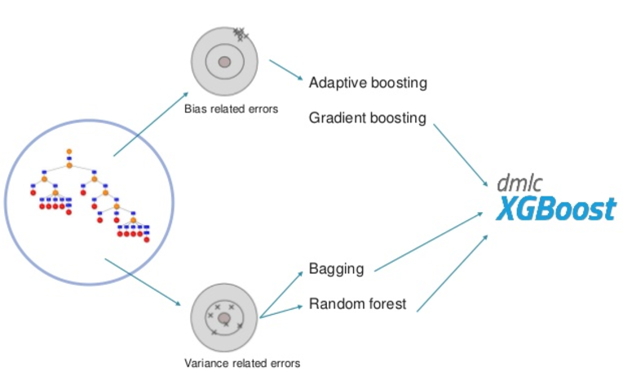
Model Building
Model Algorithm: XGBoost

Slide 20
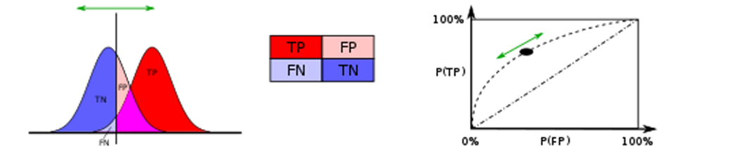
Model Building
Metrics:
Receiver Operating Characteristic (ROC)
Area Under Curve (AUC)
Training set: 2014 Loan Data: Jan. – Sep.
Testing set: 2014 Loan Data: Oct. – Dec.
Target:
Find the highest AUC score from testing set via Cross-Validation

Slide 21
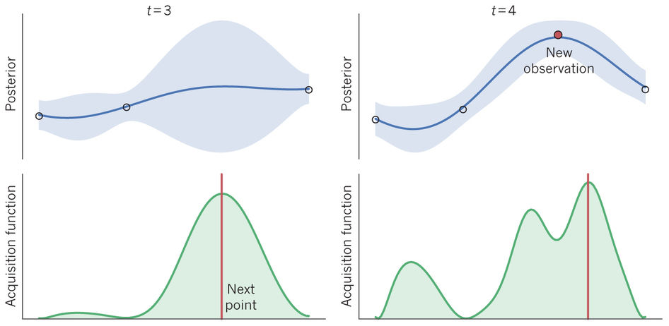
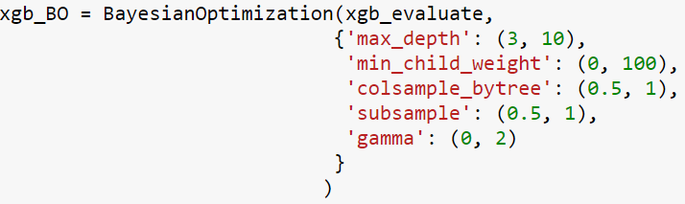
Model TUNING
Bayesian Optimization:
Parameters | Value
colsample_bytree | 0.585
gamma | 0.685
max_depth | 3
min_child_weight | 99
subsample | 0.968
best score | 0.733

Slide 22
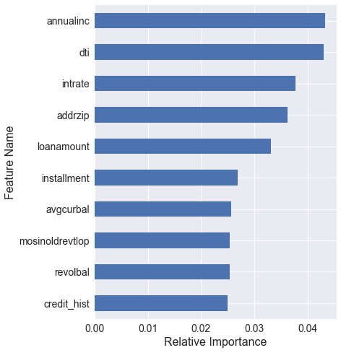
Feature Importance
This features (except addrzip) are used as customizable features in the web app.

Slide 23
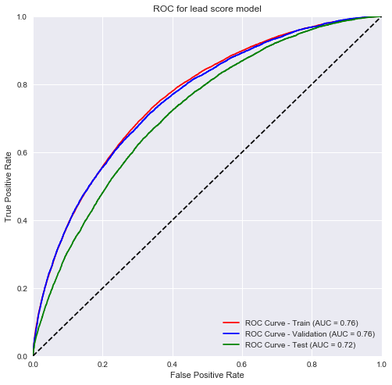
Model Performance
Results on test sets:
Test AUC = 0.73,
Predicted Default Rate:
Min: 0.0058 – Non-default
Max: 0.872 – Default
Mean: 0.215
Average Real Default Rate: 20.5%

Slide 24
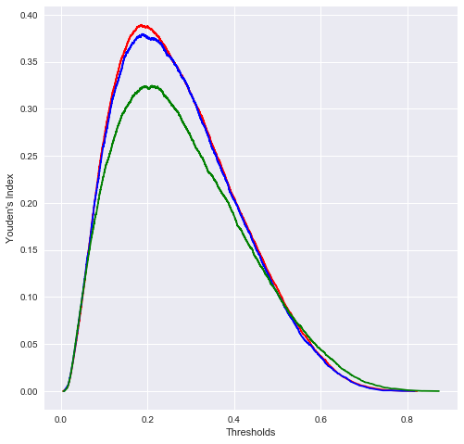
Thresholds Selection
Youden's index:
= sensitivity + specific – 1
= TPR – FPR
Best Threshold: ~ 0.2
Precision: 0.38
Recall: 0.69
F1-score: 0.49

Slide 25
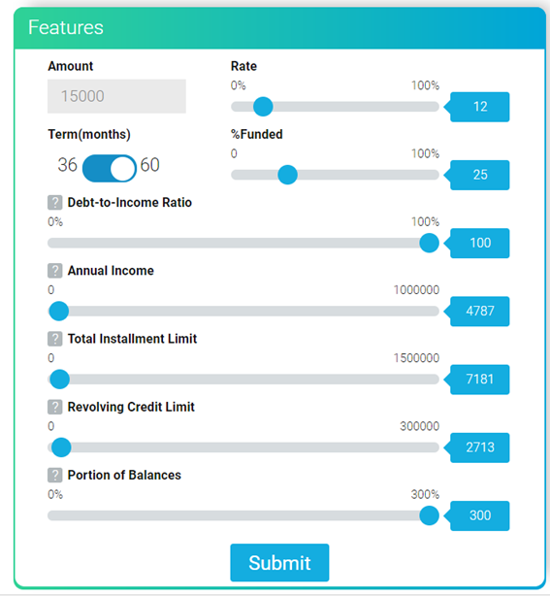
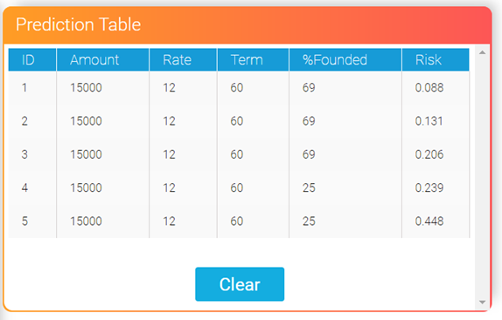
Web Application Development
Flask Framework + Pickle.
http://127.0.0.1:8080/fintech/

Slide 26
Future Work
More feature engineering
Predict time-evolving loan status
Real-time analysis web-app
Return of Investment

Slide 27
Summary
Key factors leading to loan default:
Debt-to-Income Ratio
Annual Income
Installment
Interest Rate
Portion of Balance
Data Analysis/Processing
Model Building
Web Application

Slide 28
Thank you!
Yong Zhao
08/15/2017

