Slide 1
Experimental Setup

Slide 2
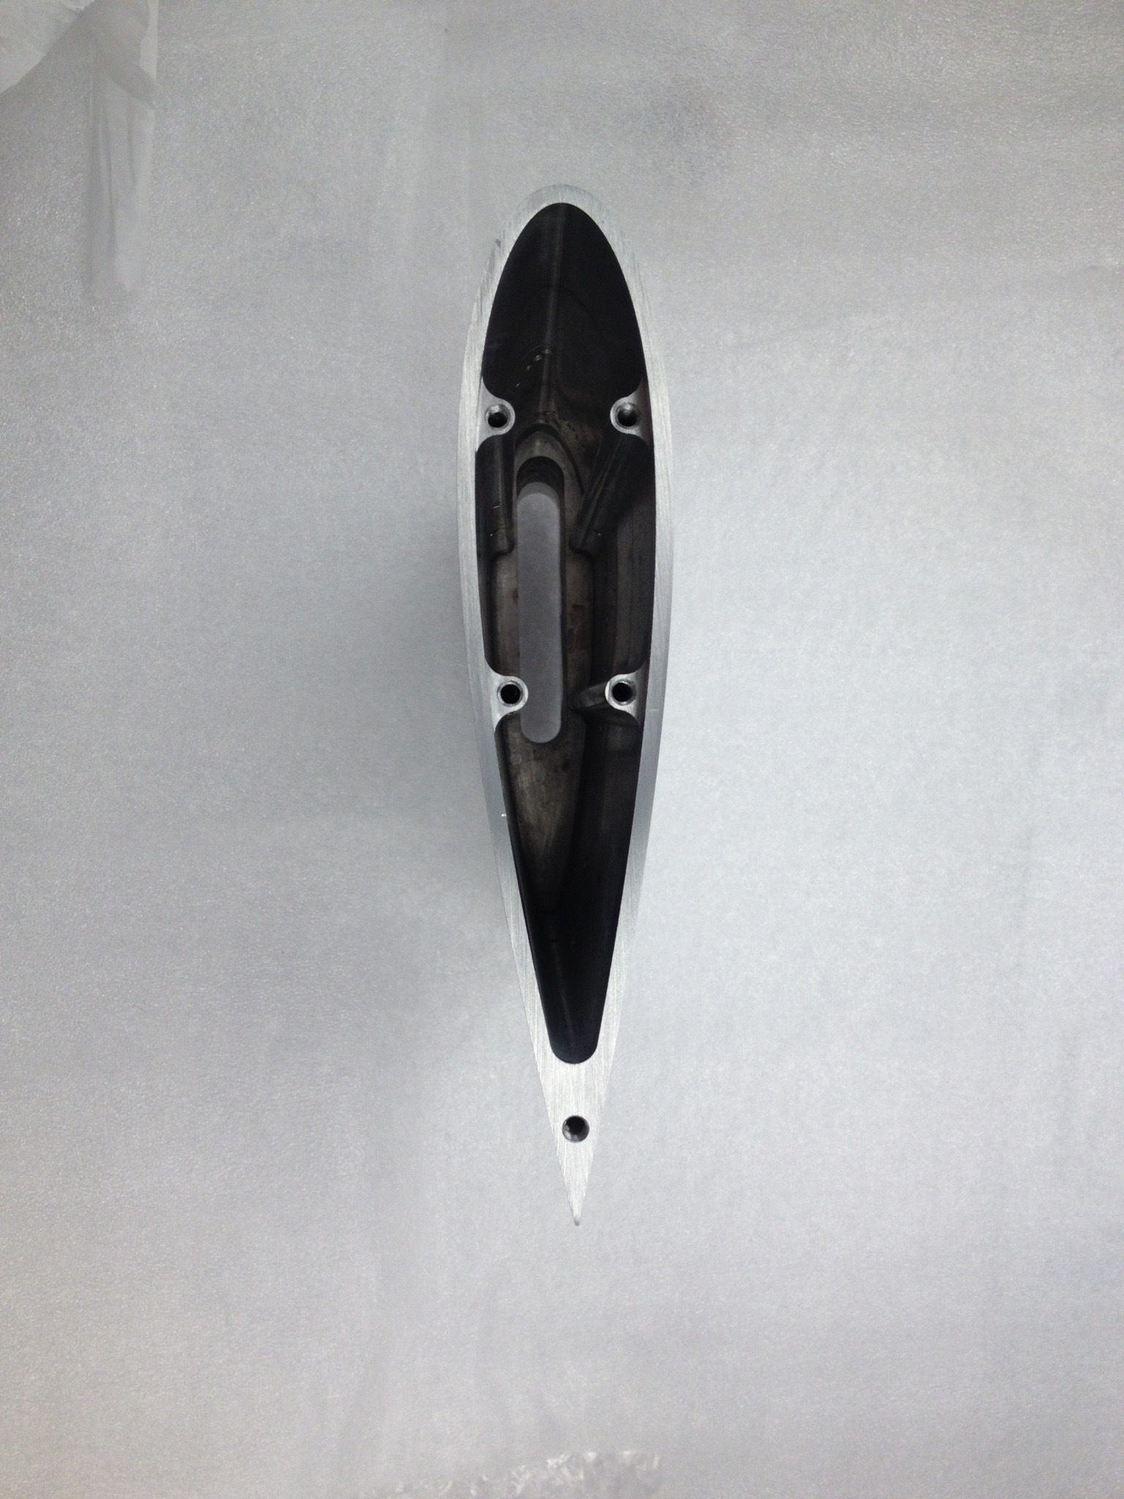
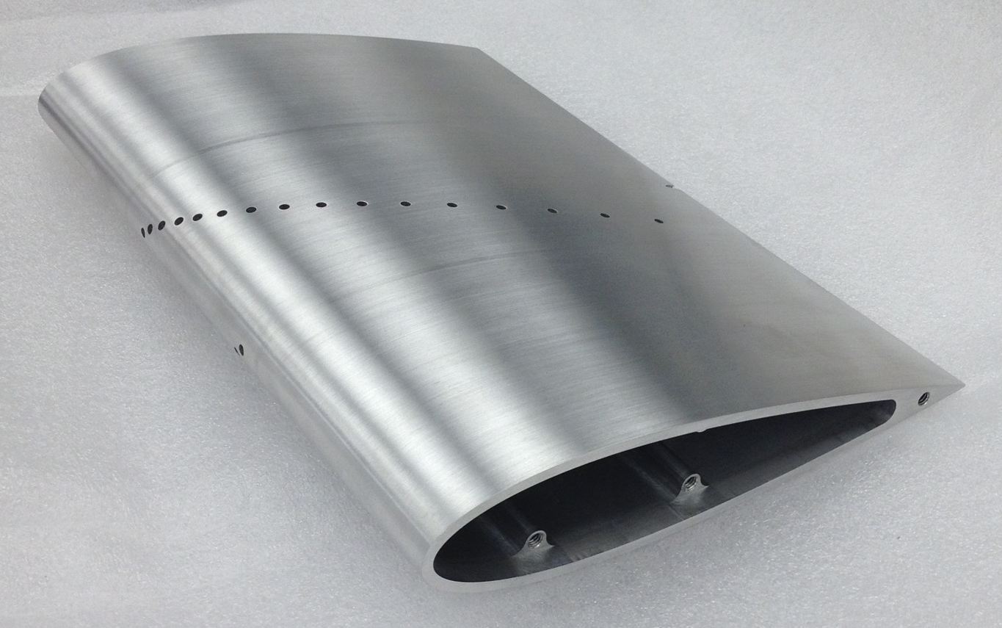
Airfoil Design
pressure taps
c = 17 cm
s = 25.5 cm
Notes:
As I said earlier, the airfoil that was used in this experiment is a NACA 0021, which means that it is symmetric and has a thickness of 21% of its chord length
The chord length is 17 cm, and the span is 25.5 cm.
The airfoil has 32 pressure taps in its surface. You can see them as little dots in the picture in the top right. Each of those holes has a tube leading to a pressure transducer similar to the ones you’ve used in your other labs.
In the bottom left photo you can see that the airfoil is hollow on the inside. During the experiment, a circuit board with 32 pressure transducers sits inside the airfoil and measures the pressures at all the pressure taps.
Since the pressure taps are flush with the airfoil surface, they measure the static pressure, not the total pressure.

Slide 3
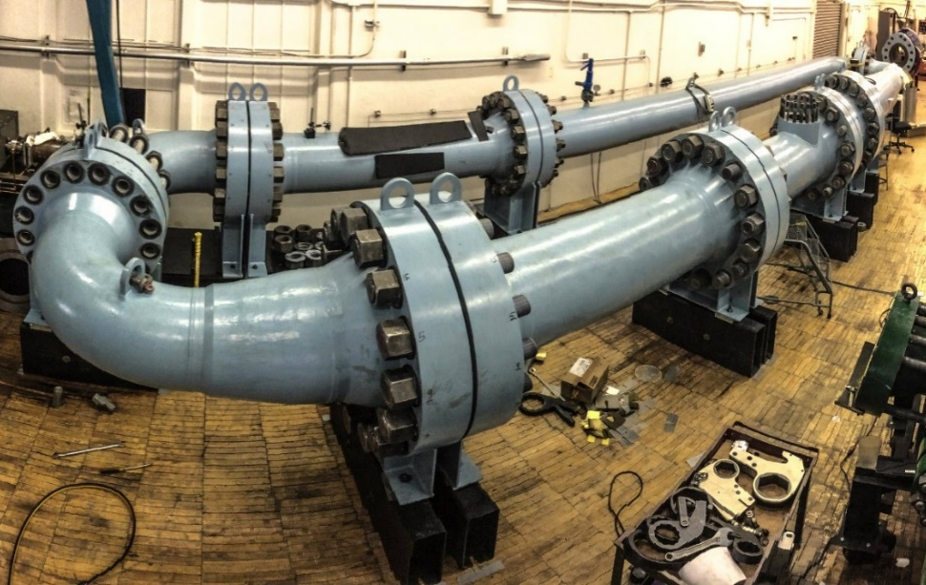
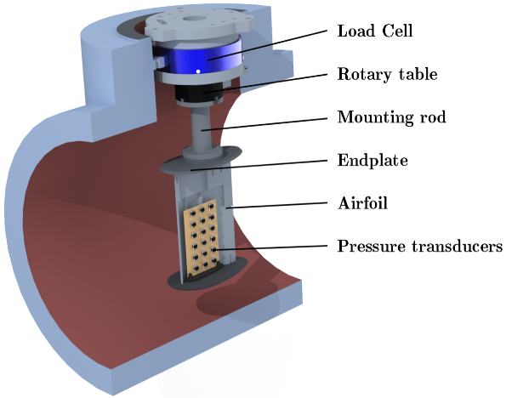
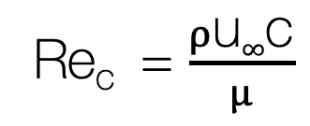
Using Pressure to Achieve High Reynolds Numbers
Re_{c} = $\frac{ρ\text{u}∞\text{c}}{μ}$
230 atm → 200 times higher Re
Notes:
The next thing we do is put this airfoil into a wind tunnel.
As I mentioned earlier, the data I’ll be giving you is data that I took for my phd thesis, and the main difference between this data and the data you would have otherwise used is that I used this special wind tunnel to get really high Reynolds numbers.
The way we do that is by pressurizing the air up to around 230 atmospheres.
So if we assume that we have the blade on a real-life wind turbine or airplane, it’s Reynolds number is roughly between 1 million and 10 million.
Now if we want to study it, we can either build a massive wind tunnel that the entire wing fits into, which is really hard to do, or you can study a small-scale model.
The problem is that if you decrease the chord length, you decrease the Reynolds number.
So if you want the Reynolds number to stay the same, you need to adjust the other parameters.
If you increase the velocity, you increase the Mach number, and so at some point your flow is no longer incompressible.
So instead, in this wind tunnel we increase the density by pressurizing the air inside it.
It’s a closed-loop, so we have huge compressors that pump air into the tunnel for several hours and then we close the valve, so the air stays inside. We then use a pump to make the air go around the loop.
The consistency of the air inside is quite hard to imagine, but its so dense that the pump we use is actually intended for water, not for air. The walls of the tunnel are 2-3 in thick.
That allows us to increase the Reynolds number 200 times, so essentially we can study a model of a wind turbine, or an airfoil that’s 200 times smaller than a real one, and still have the exact same Reynolds number.

Slide 4
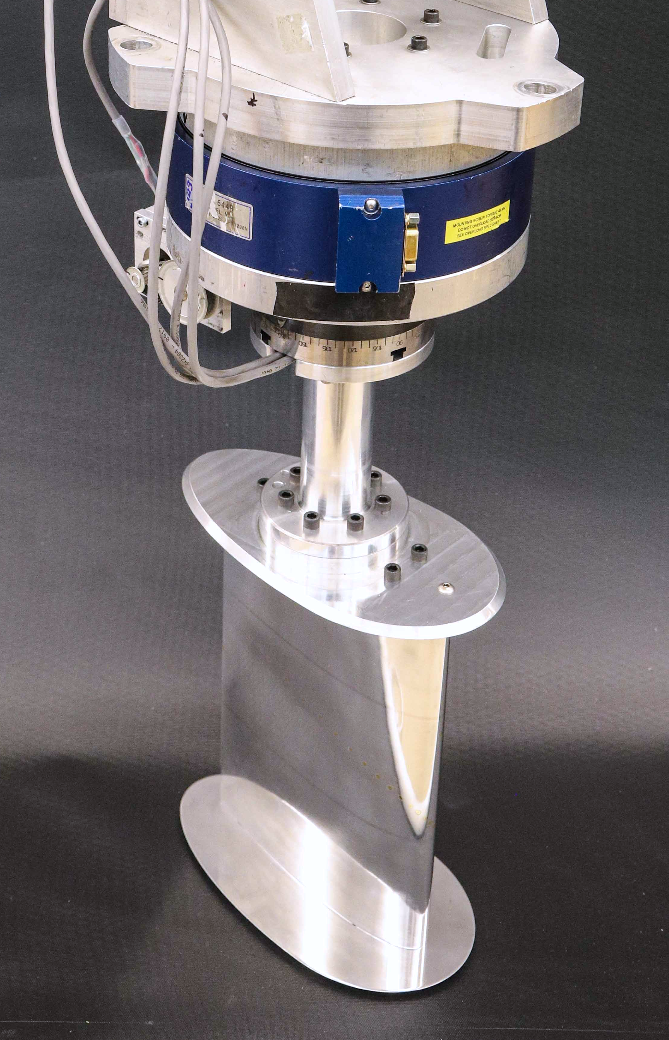
force sensor
stepper motor
mounting rod
endplate
airfoil
endplate
Notes:
So this is what the experimental setup looks like.
The force sensor is mounted at the top of the wind tunnel, and the airfoil hangs underneath it, so the only thing it’s connected to is the force sensor.
Underneath the force sensor is a motor that changes the angle of attack.
Then comes a mounting rod and then the endplates.
The endplates try to reduce downwash by preventing flow from coming up from the sides of the airfoil. They have the same effect as the winglets on an airplane.
The force sensor record the entire lift force and drag force acting on everything below the force sensor
This is important for your data analysis, so I’m going to repeat it. The force sensor is recording lift and drag on the entire contraption that is hanging underneath it, including the endplates and the mounting rod.
The force sensor can measure up to 200 N and its accuracy is +- 2.5 N.

Slide 5
Data Analysis
Three data sets, each at a different Reynolds number. Calculate the Reynolds number of each dataset!
Choose one Reynolds number and plot the pressure distribution of the top surface and the bottom surface at zero angle of attack. Is this what you would expect?
Choose one Reynolds number and plot the pressure distribution on the top of the airfoil at the angle right before stall, and the angle right after stall. Compare them.

Slide 6
Calculating lift and drag
From force sensor:
it directly measures lift and drag on the contraption below.
b) From pressure sensors:
integrate pressure over the entire surface → resultant force on airfoil
find components normal (lift) and parallel (drag) to the flow
c) Compare! Do you expect them to be the same? Are they measuring
the exact same things?

Slide 7
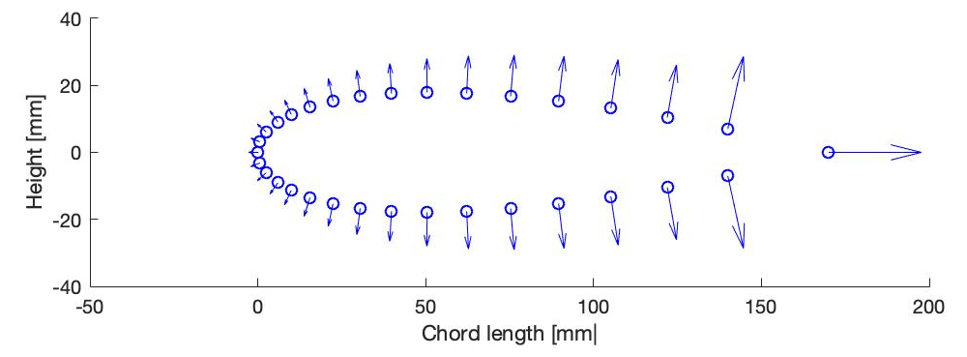
Integrating pressure
[xn, yn, u, v] = airfoil_normal(angle);
u
v
pressure tap
area dA
Notes:
There is a matlab function that you need to download from blackboard which will help with the integration.
Don’t use the one from github, it won’t compile with the data sets you’ll be using.
The function will create plots like this one for every angle of attack, that’s just for you to verify that it’s doing what you expect it to do. You don’t need to use these plots in any way.
Each of the circles in the plot is a pressure tap. These are the only locations where we know the pressure. So when we say we want to integrate the pressure along the surface, really that means adding up the pressures at these individual taps.
Each arrow is a vector normal to the surface of the airfoil at that point, which tells us which direction the force due to this pressure is acting in. Because pressure itself doesn’t have a direction, but once it’s acting on a surface, the force due to pressure is normal to the surface.
The lengths of the arrows are inversely related to their density.
Around the leading edge, there are way more pressure taps than near the trailing edge, but when we integrate the pressure around the surface, we want all areas to be weighted equally, so we look at the area dA that each pressure tap corresponds to, and multiply it with a unit normal vector, which gives us these different lengths.
You don’t need to do any of this, the function returns the locations and lengths of these vectors, but you need to think about how to use them to find the resultant lift and drag forces.

Slide 8
Data Analysis
For each Reynolds number, plot the lift and drag curves based on the force sensor data and based on the pressure sensor data. Compare them.
Make one plot that shows the lift and drag curves of the pressure sensors for all three Reynolds numbers. Compare them.

