Slide 1

Loan Approval Rates
Project 4: Gurjap Singh, Aditya Saini, Garrett Stiehl

Slide 2

Project Introduction
The project on loan approval rates across the United States aims to perform an in depth data analysis to explore various outcomes of loan approvals.
We will be exploring a public dataset, employing data training models to create a program that can predict loan approval rates for various individuals and test the accuracy of these algorithms.
The desire and motivation for this project stems from the curiosity of knowing what key factors play the biggest role in getting approved for any type of loan.

Slide 3

Popular Research Questions
What is the most important factor when it comes to predicting if a loan is paid in full or charged off?
What factors are most predictive of loan approval status?
This involves building a classification model to predict Loan_Status based on other features.
How does credit history (if available as a variable) correlate with loan approval?
This involves examining the relationship between Credit_History and Loan_Status.
How do applicant and co-applicant incomes affect the likelihood of loan approval?
How does the number of dependents affect the likelihood of loan approval?

Slide 4

Data Source
For this project we sourced a csv file from Kaggle to help train our models to give us answers to these common questions.
https://www.kaggle.com/datasets/mirzahasnine/loan-data-set

Slide 5
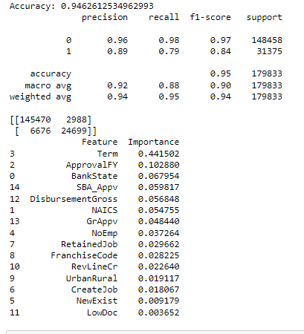
Evaluation MEtrics
We used several different models:
Logisitic regression, decision tree classifier, and random forest classifier
Random forest Classifier had the best results for the data we used

Slide 6
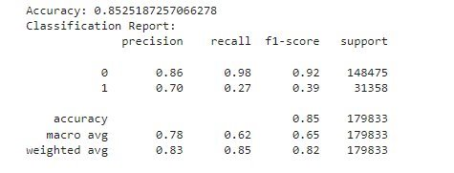
Logistic Regression
Applied logistic regression on preprocessed data, achieving 85.3% accuracy, highlighting moderate predictive effectiveness.
Showed a recall of only 27% for the minority class, underlining its inadequacy in correctly identifying rarer events in an imbalanced dataset.

Slide 7

Why Random Forest Was Better
Random Forest had a much higher accuracy (94.6%) than Logistic Regression (85.3%).
It was more effective in identifying the minority class, indicating its strength in handling imbalanced datasets.
Logistic Regression had a low recall for the minority class, showing difficulty in identifying less frequent outcomes.

Slide 8

Results
According to our model the most important factor for any type of loan approval was the term factor.
The ‘term’ is the amount of time it takes to completely pay off your loan.

