Slide 1
Identity Based Encryption for Online Social Networks
Bringing privacy control to Facebook users

Slide 2
Presentation Outline

Slide 3
Current Situation
The world as it is today

Slide 4
The world as it is today

Slide 5
Issues with this situation
Facebook stores all data
User has to rely on Facebook’s privacy policy
Subject to changes
Average user does not read this
Facebook is a company

Slide 6
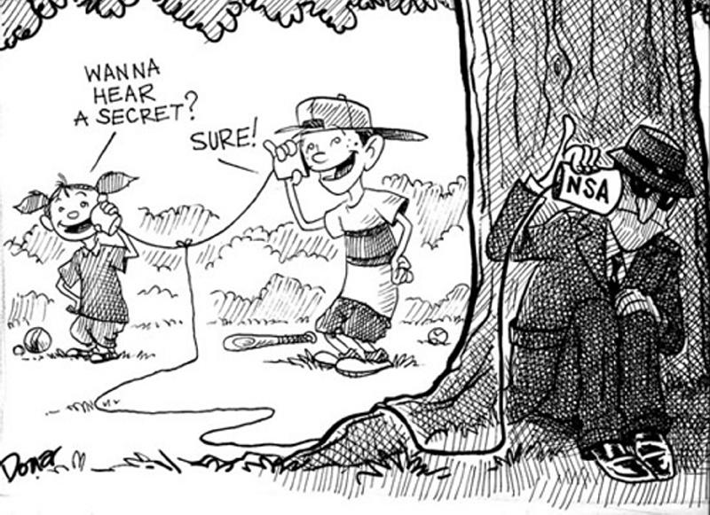

Slide 7
Utopic Situation
The world as it should be

Slide 8
Security Model

Slide 9
Security Goals
User should determine who reads his messages
= The recipients
Third parties should not know who the recipients are
= Everyone that is not in the recipient set
Third parties should not see the difference between

