Slide 1
Forecasting case
Predicting sales
Gábor Stikkel

Slide 2
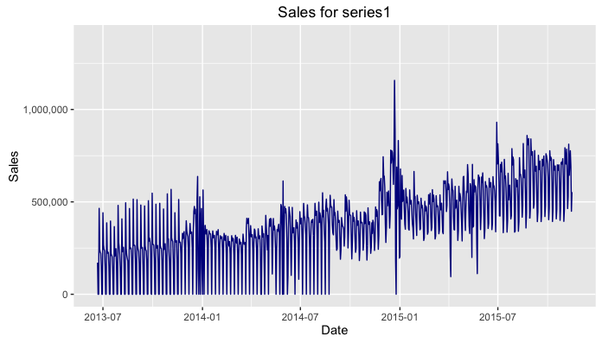
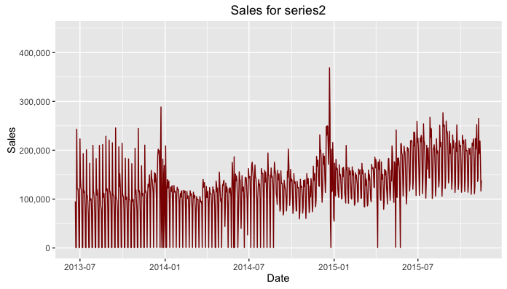
Exploratory analysis
Sales of series1 shows an increasing trend with weekly cycles
In the first weeks zero sales were reported during the weekends
Later only on Sundays until 2014-08-23, finally on Christmas day of 2014
Dickey – Fuller test suggest stationarity:
  Dickey-Fuller = -6.038, Lag order = 9, p-value = 0.01
Similar weekly cycles for series2
No zero sales but same minimal values in the first weeks
Both series peak at 2014-12-22, i.e. just before Christmas
Dickey – Fuller test suggest stationarity:
  Dickey-Fuller = -5.1919, Lag order = 9, p-value = 0.01
Check SwExploration.R for details

Slide 3
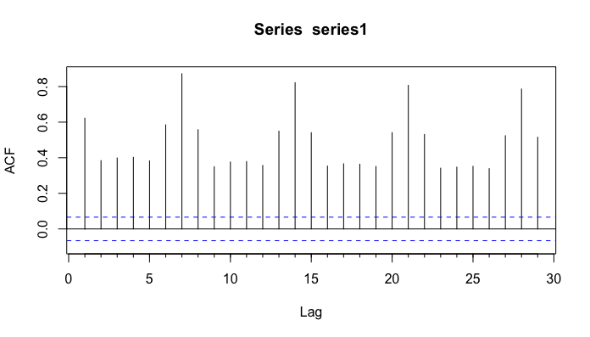
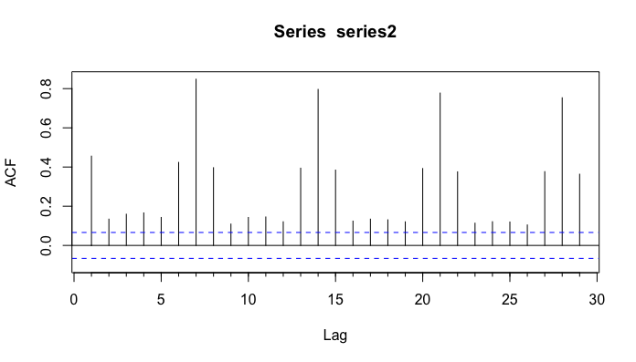
Exploratory analysis - autocorrelation
Strong weekly correlation (lag = 7, 14, 21, 28)

Slide 4
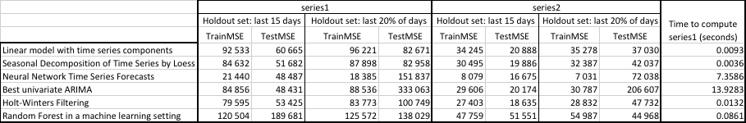
Forecast modelling
The following table shows RMSE for training and hold out sets for both series and time to compute forecasting models for a few modelling techniques:
Neural network is providing the best training performance, however, it is overfitting and the high time to compute the models are not convincing to use them in production environment.
Seasonal decomposition’s performance is quite close to the best models and takes the least time
to compute hence that’s the one to to recommend for forecasting large number of SKUs.
(Check SwModelling.R for details)

Slide 5
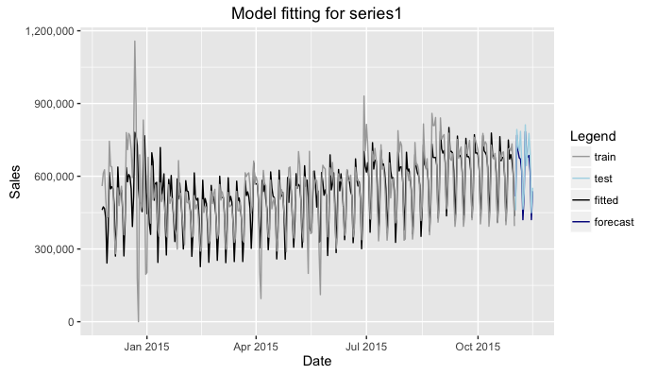
Model fitting with seasonal decomposition by Loess
This graph shows how the seasonal decomposition by Loess model fits to the training and holdout sets (last 15 days) for series1
Not all data points are shown due to the visibility of the plot

Slide 6
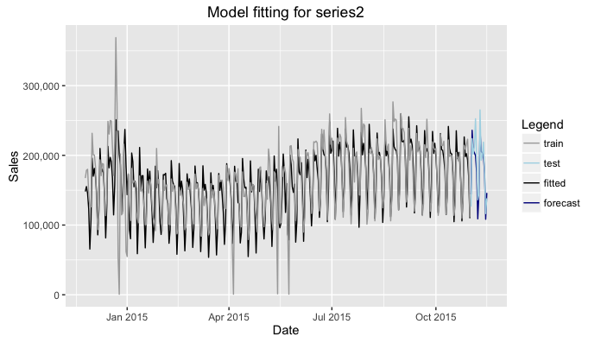
Model fitting with seasonal decomposition by Loess
This graph shows how the seasonal decomposition by Loess model fits to the training and holdout sets (last 15 days) for series2
Not all data points are shown due to the visibility of the plot

Slide 7
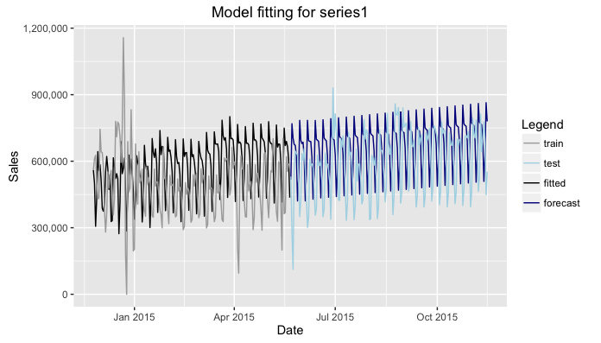
Model fitting with seasonal decomposition by Loess
This graph shows how the seasonal decomposition by Loess model fits to the training and holdout sets (last ~20% of the days) for series1
Not all data points are shown due to the visibility of the plot

Slide 8
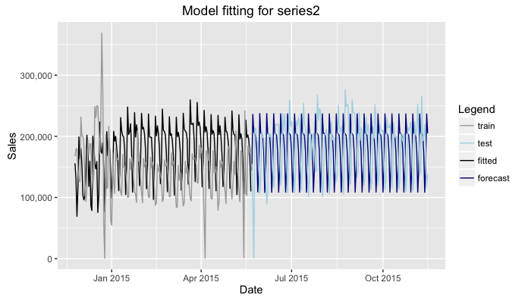
Model fitting with seasonal decomposition by Loess
This graph shows how the seasonal decomposition by Loess model fits to the training and holdout sets (last ~20% of the days) for series2
Not all data points are shown due to the visibility of the plot

Slide 9
Forecasting for 2015/11/16 - 2015/11/30
SwForecaster.R handles the forecasting task
Configurable parameters:
  forecastW: number of days to forecast
  partitionByDate: logical, determines if the out shall be sorted/partitioned on Date
  nSKUs: number of products to forecast (training.csv must contain data on all SKUs)
It uses the doMC package to speed up forecasting by parallel execution
  partitionByDate is recommended to be False if sales on large number of SKUs to be forecasted
  Execution time for 55 000 SKUs:
    > s <- Sys.time()
    > outDF <- foreach(i = 1:nSKUs, .combine=rbind) %dopar% + forecaster(paste("series", as.character(i), sep=""), forecastW)
    > e <- Sys.time()
    > print(e-s) Time difference of 5.786039 hours

