Slide 1
LIB2024 Final Assignment

Slide 2
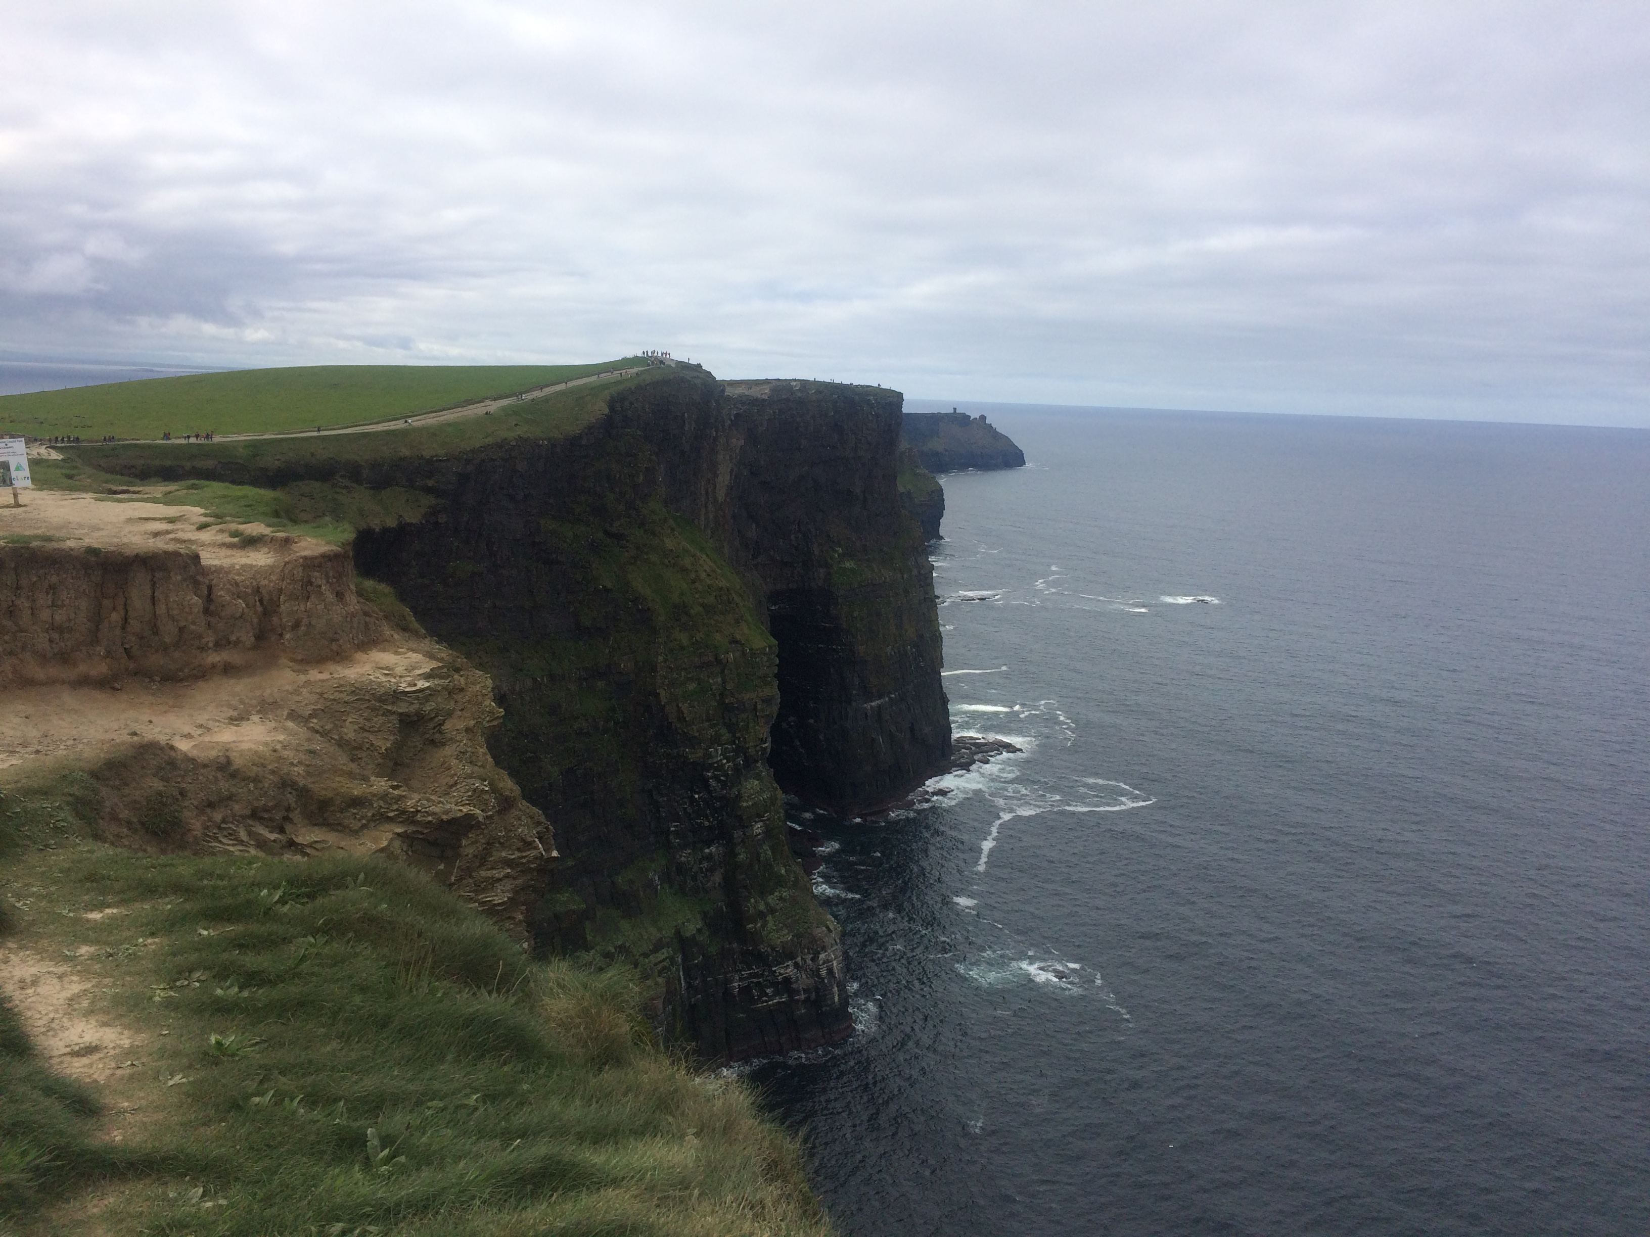
B I R D I E L A N D

Slide 3
Vision
Promote travel and tourism
Notes:
Site Purpose-through photos and travel blogs and light paragraphs my client hopes to attract their key demographic: millennials and young travelers.

Slide 4
Structure
Clean lines
Simplistic navigation
Minimalistic
Eye catching
Notes:
Colours are black and white for this purpose. My client wanted colours that would appeal and attract young people.

Slide 5
Persona of Users
Post-secondary, Post-grad
Under 30
Travel and Adventure seekers
Competent web users
Notes:
Before they settle into their full time careers they want to travel abroad. The site shows and describes to them all that they can see and do in Birdieland.
They use the internet everyday for their

Slide 6
https://stil0044.github.io/final/birdielandindex.html

